Slide 1
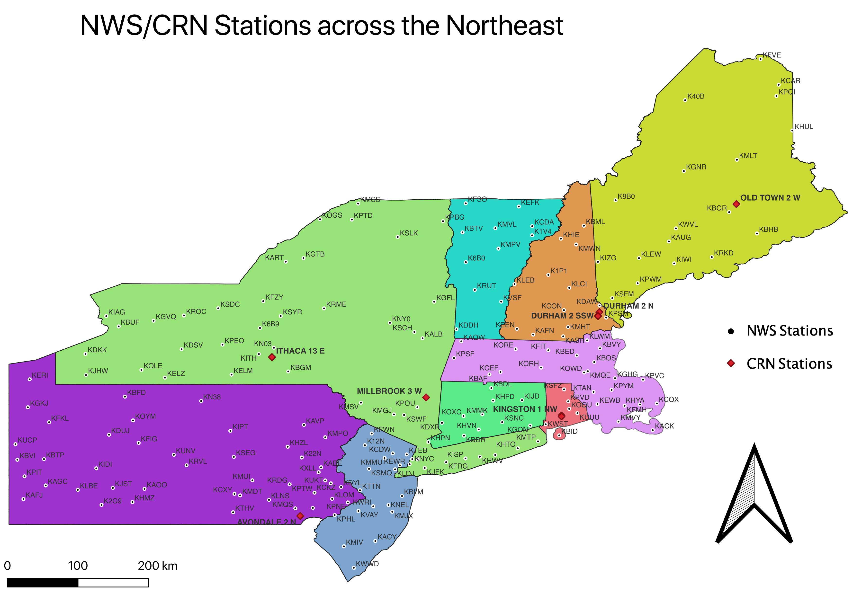
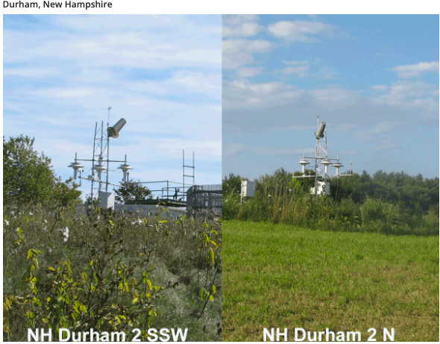
Analysis of Weather Data in the Northeast US Marvin Kuryala Faculty Advisor ~ Matthew J. Davis Department of Environmental Sciences, University of New Hampshire
Introduction
The goal of my experiment is to analyze weather data from National Weather Service stations in the Northeast US. I used python to analyze weather data from the National Weather Station and Climate Reference Network. The main objective is to evaluate the accuracy and completeness of the National Weather Service stations in the Northeast of which there are about 100 stations.
Figure 3: Graphical analysis of KPSM station and CRN station in Durham, NH (2)
Figure 4: Displays the Air Temperature Difference for the KPSM station
Figure 6: GIS map created to display the CRN and NWS stations along the Northeast US
Figure 1: Images of Durham, NH CRN stations 1 (left) and 2 (right)
Results
Methods
The stations observed, KPSM the NWS station in Portsmouth, NH showed to have the lowest Air Temperature Difference after six months as shown in Figures 3 and 4. NSW station KITH located in Ithaca, NY and CRN station in Ithaca, NY showed to have the largest margin of Air Temperature Difference as seen in Figure 5. In Figure 5 we can see the largest difference between both stations is around -14ºC and in Figure 4 the largest difference seen is around 11ºC. Figure 5 also displays the difference in exceedance over around 10ºC about seven times. As for in Figure 4 it exceeds once over a 10ºC difference. Table 1 displays that NWS station KITH and CRN station in Ithaca, NY has the highest standard deviation value indicating a more spread out data.
We started off downloading the CRN data. Then gathered data from the NWS and then created a Python code to analyze/compare results from the NWS and the CRN stations. The process was to use an NWS stations close in proximity to the different CRN stations across the Northeast. To retrieve the data of the NWS stations, each station name was manually entered into the code to get the appropriate data from the online source, which then was compared to the CRN data. After this process the temperature difference, mean, standard deviation, elevations, 5th and 95th quantiles are determined.
Figure 5: Displays the Air Temperature Difference for the KITH station
Discussion
~100 NWS Sites
NWS Current Data
NWS
Data
CRN
Data
CRN Station | NWS Station | Distance (km) | Mean (ºC) | Std. Deviation (ºC) | CRN Elevation (m) | NWS Elevation (m) | 5th Quantile | 95th Quantile
AVONDALE, PA | KMQS | 12.60 | 3.35 | 3.51 | 121 | 200 | -2.3 | 9.2
DURHAM, NH (1) | KPSM | 11.44 | 0.79 | ﻿ 1.88 | 19 | 31 | -2.0 | 4.1
DURHAM, NH (2) | KDAW | 8.69 | ﻿0.38 | ﻿1.74 | 36 | 93 | ﻿-2.1 | ﻿3.4
ITHACA, NY | KITH | 18.38 | ﻿. -0.06 | ﻿ 4.60 | 374 | 334 | -7.2 | 8.1
KINGSTON, RI (1) | KOQU | 17.14 | ﻿. 2.18 | ﻿ 3.34 | 35 | 6 | -4.3 | 6.7
KINGSTON, RI (2) | KUUU | 22.31 | ﻿ 2.18 | ﻿ 3.39 | 32 | 52 | -4.0 | 7.2
MILLBROOK, NY | KPOU | 21.00 | ﻿. 2.39 | ﻿ 2.93 | 125 | 49 | -2.4 | 7.5
OLD TOWN, ME | KBGR | 17.16 | ﻿ -1.48 | ﻿ 2.90 | 38 | 57 | -6.1 | 3.2
Table 1 indicates station KITH in Ithaca, NY and CRN station in Ithaca, NY has the largest elevation when comparing to other stations and a distance of 18.38 km making it more susceptible to difference in temperature fluxes. Stations of that height can have a drastic change in temperature and result in a colder atmosphere. However, in Table 1 we can see that the distance between the KPSM and the Durham, NH (1) stations are closer and have a significantly low elevations as compared to that of stations KITH and Ithaca, NY, the NH stations shows a more similar pattern of weather data captured. A similar relationship can be seen with station KDAW in Rochester, NH and CRN station located in Durham, NH (2). The NWS and CRN stations in closer proximity and low elevations retrieve more similar data which in Table 1 can be seen in the 5th and 95th quantiles.
Temperature error was calculated
Combines both data by common date time index
Algorithm reads downloaded CRN and observed NWS Data
.
Data Sources
Temperature error’s mean is calculated
US Department of Commerce, NOAA. “ZSE Site Information and PIL.” ZSE Site Information and PIL, NOAA's National Weather Service, 31 Mar. 2022.
Service, NOAA's National Weather. “XML Data Feeds - Current Conditions.” NOAA's National Weather Service, 10 Apr. 2003.
National Centers for Environmental Information (NCEI). “U.S. Climate Reference Network.” U.S. Surface Climate Observing Reference Networks, NOAA.
Figure 2: Shows the process of the coding algorithm
Table 1: Represents the outcome of the distance, mean, standard deviation, elevations, and quantiles of the NWS and CRN stations over 6 months

Slide 2
This poster template provided courtesy of
UNH ESRC Poster Printing Services
Trust us to make your poster look GREAT!
Website: http://posters.unh.edu
Poster Guide: http://goo.gl/1E7TJY
DELETE THIS SLIDE BEFORE PRINTING

