Slide 1
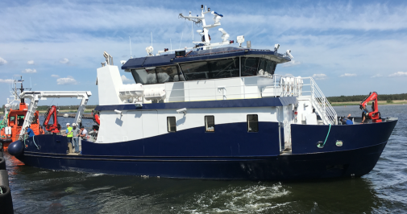
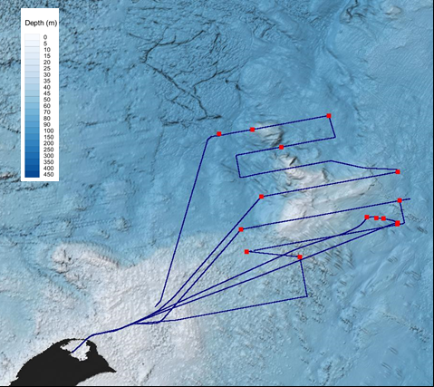
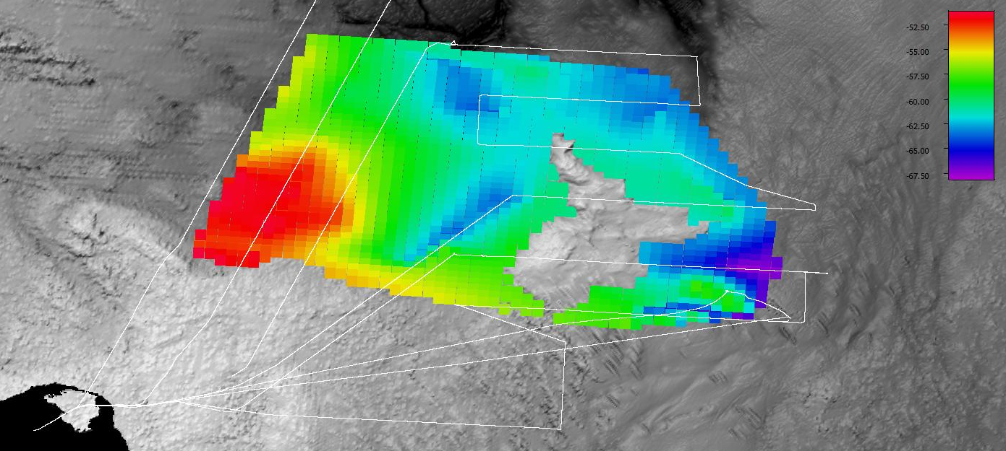
Studying the spatiotemporal variability of the anoxic zone in the Baltic sea using broadband acoustics
Elizabeth Weidner^{1,2,3}, Christian Stranne², Jonas Hentati Sundberg⁴, Thomas C. Weber^{1,5}, Martin Jakobsson², and Larry Mayer^{1,3}
Corresponding author: Elizabeth Weidner, eweidner@ccom.unh.edu
Abstract
Baltic anoxia
Study site
Equipment
Anoxic zones in the Baltic Sea are associated with water column habitat loss, disruption of marine food webs, and altered nutrient cycling. In the Gotland basin, anoxic conditions are constrained to bottom water regions (depth >50 meters) due mainly to salinity-controlled stratification and poor circulation. The interface between the oxygenated surface waters and anoxic bottom waters is characterized by a strong gradient in density. We used a broadband (45-90 kHz) split-beam echosounder and concurrent CTD profiles to show the impedance contrast brought about by the density gradient corresponds to the upper limit of the anoxic zone. This provides the means to observe near-continuous spatial variations of the anoxic zone with horizontal resolution on order of meters to 10’s of meters, much higher than ever reported. Additionally, the nature of the acoustic scattering at the oxic-anoxic interface affords us important quantitative information on the vertical distribution of dissolved oxygen in the water column and the processes that control it.
The survey site was northeast of Öland Island, in the Western Gotland Basin of the Baltic Sea. It covered an area of ~1000 km³. 300 km of acoustic data were recorded and 16 CTD stations were sampled. The Western Gotland Basin is a region known for anoxic bottom waters and a permanent halocline at ~60 meters depth.
Hypoxic extent
Hypoxia is <2 ml/l dissolved oxygen
Anoxic extent
Anoxia is a complete absence of dissolved oxygen
Electra is equipped with two Simrad EK80 wideband transceivers, transmitting broadband signals through a Simrad ES70 (45-90 kHz) and a Simrad ES200 (160-250 kHz) echosounders.
At CTD stations, profiles of physical water column properties were collected with a Seabird SBE 9plus CTD unit, equipped with a full suite of sensors, including a Seabird SBE 43 oxygen sensor for dissolved oxygen profiles.
From Jakobsson et al., 2019
Modified from Carstensen et al., 2014
Linking CTD, acoustic, and oxygen water column profiles
TS (dB)
Compute density (ρ) and sound speed (c) following TEOS-10
Calculate impedance ($η$) using:
$$η\left(z\right)=ρ\left(z\right)c(z)$$
From impedance estimate reflection coefficient profile ($R_{CTD}$):
$$R_{CTD}=\frac{η\left(i\right)−η(i−1)}{η\left(i\right)+η(i−1)}$$
From calibrated, corrected acoustic data estimate reflection coefficient ($R_{EK80}$):
$$R_{EK80}(z)={10}^{{TS\left(z\right)−10\log_{10}{A(z)}}/{20}}$$
Compare $R_{EK80}$ profile to oxygen profile
1-3
4
5
The depth of the acoustically derived peak in reflection coefficient is closely associated with the point of hypoxia (2mL/L) at all CTD stations (N=16). In tracking the peak of $R_{EK80}$ we can track the point of hypoxia within ~1 meter (1.2 meters +/- 0.76 meters standard deviation).
Mapping the extent of anoxia
Spectra of evolving thermohaline staircases
Steps to track the depth of hypoxia across the survey region:
Mask seafloor return based on >-30 dB threshold
Remove scattering from fish aggregations using Coherence Factor Index (Blomberg et al., 2018)
Compute $R_{EK80}$ profile for each acoustic record (ping)
Apply running average filter with filter length of 31 pings along track
Identify the peak in filtered $R_{EK80}$ profile
Extract depth and position at peak $R_{EK80}$ (XYZ)
TS (dB)
In the survey area in the region of the halocline, colder fresher water sits atop salter warmer water. The positive gradient in both temperature and salinity results in mixing driven by double diffusion.
Fully-formed staircases
TS (dB)
Smoother gradients with evolving features
TS (dB)
S
T
Modified from Lavery and Ross, 2007
Future research foci:
Spatial variability of staircase structures
Frequency dependence of spectra
Constraining mixing rates at staircase interfaces
Depth (m)
The depth of hypoxia was interpolated across the survey region using triangulation-based natural neighbor interpolation function onto a grid with 400x400 meters spacing.
The result is a high resolution map of the horizontal and vertical, O(distribution of anoxia the Gotland Basin. This research will better inform the scientific community, governments and the public of the actively changing anoxic conditions in the Baltic Sea
The diffusive interface of fully-formed staircase features have flat spectra (no frequency dependence), as expected for a smooth surface. In areas of relative smooth gradients where staircases appear to be evolving there are regions of volume scattering that have a weakly negative frequency dependence. These preliminary results have identified a measureable difference in the acoustic spectra of fully formed and evolving staircases and offer a potential a path towards estimation of mixing parameters associated with this system.
N
-50
-55
-60
-65
-70
Author affiliations
Acknowledgements
¹Center for Coastal and Ocean Mapping, University of New Hampshire, Durham, NH, USA
²Department of Geological Sciences, Stockholm University, Stockholm, Sweden
³Department of Earth Sciences, University of New Hampshire
⁴Department of Aquatic Resources, Swedish University of Agricultural Sciences
⁵Department of Mechanical Engineering, University of New Hampshire
The captain and crew of RV Electra
The Baltic Sea Centre
Baltic Sea Ecosystem Approach to Management
NOAA grant NA15NOS400002000
Swedish Research Council
0 km
2.5 km
5 km
7.5 km
10 km

