Slide 1


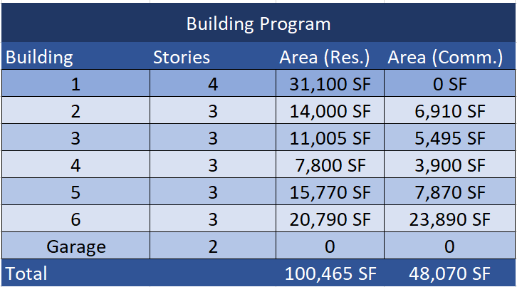
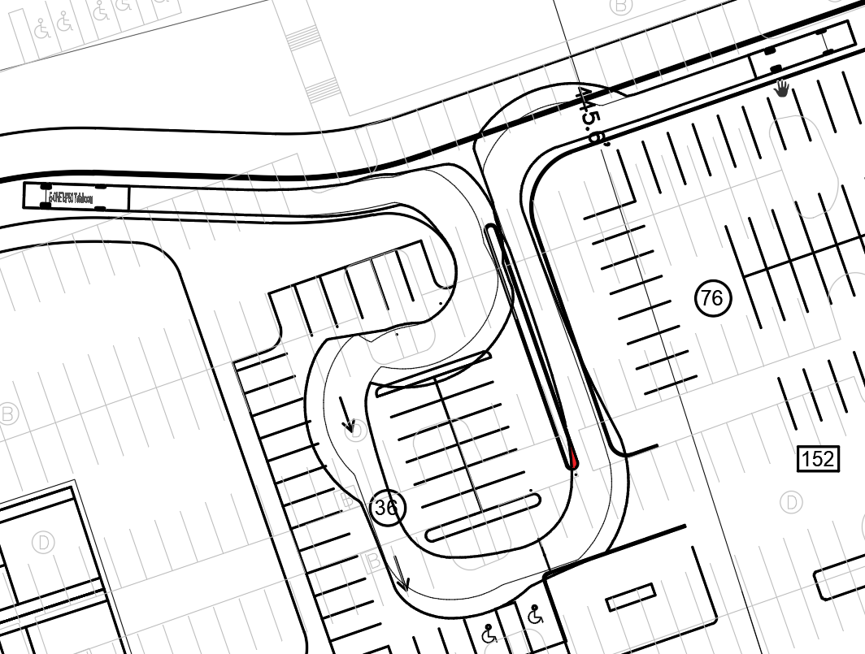
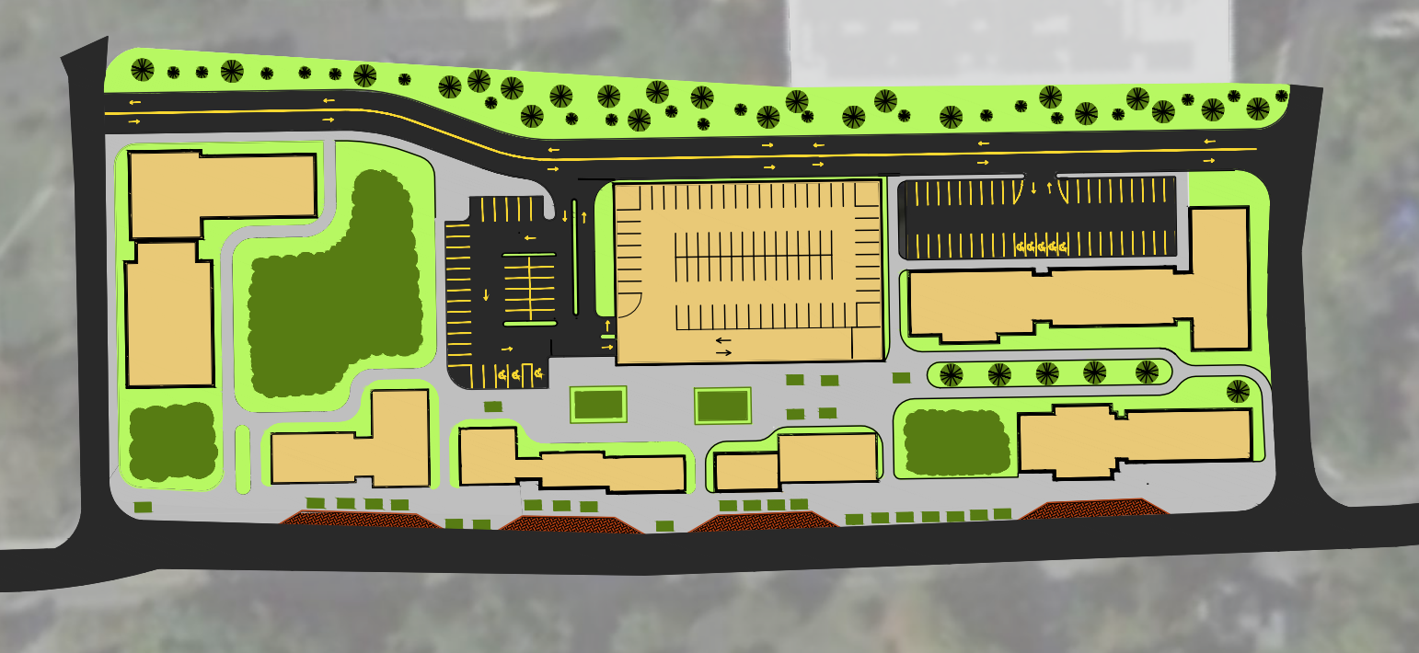
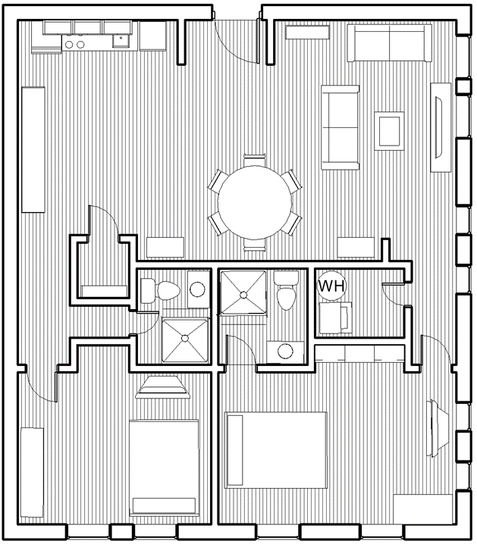
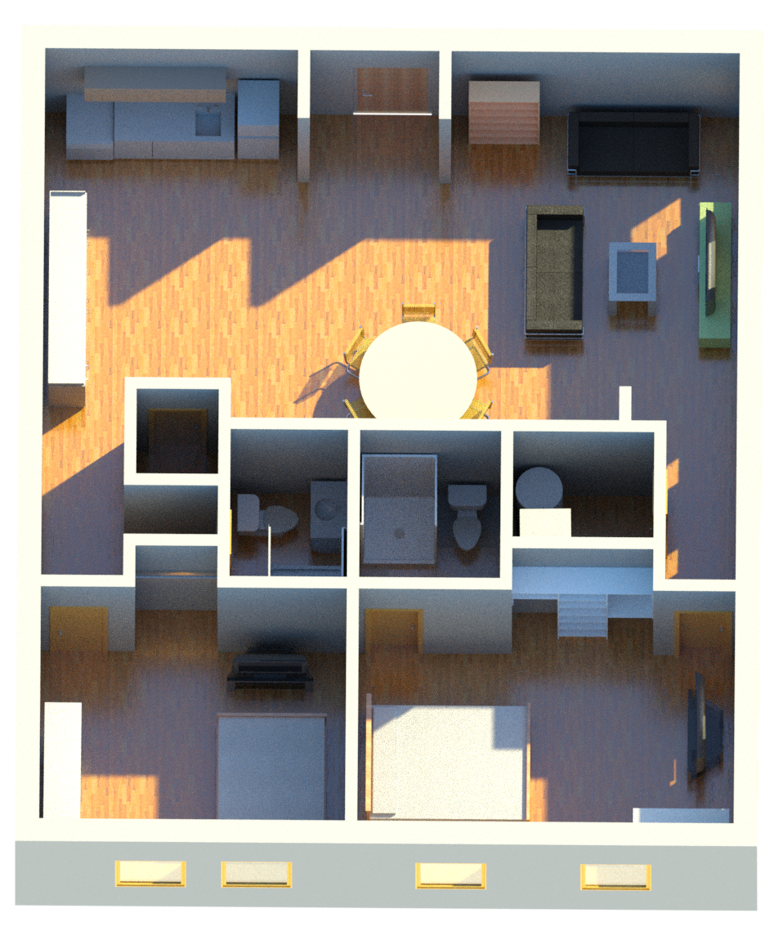
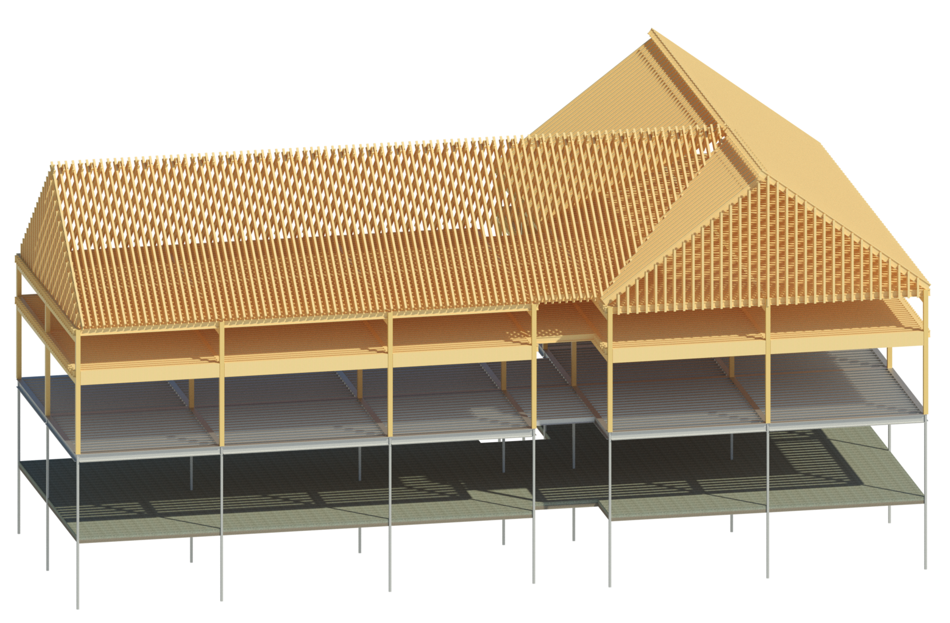
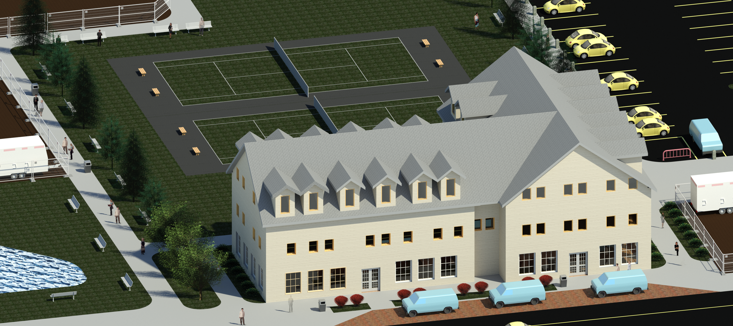
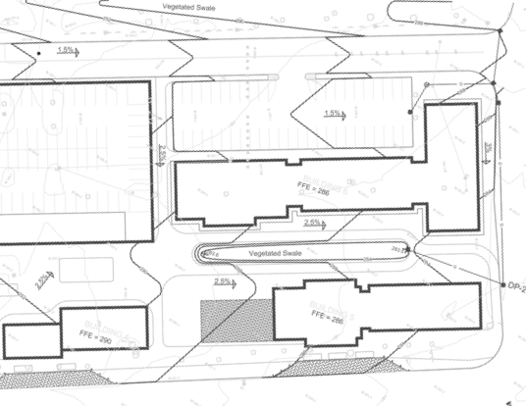
King Street Commons Mixed-Use Development
Tanner Valhouli (Project Manager), Conner Gill, Megan Cramton, Jacob McIntire, Noah Wilcox
Civil & Environmental Engineering, University of New Hampshire, Durham, NH 03824
Project advisors: Chris Raymond (TEC), Brenna Heinley(TEC), Prof. Tony Puntin
Project Summary
Building Program
Vehicle Turning
The Site of Interest is Located at 550 King Street in Littleton, Massachusetts and is currently a 6-acre parking lot for an abandoned IBM office building. The town of Littleton has chosen to develop the unused space into a mixed-use community to revitalize an otherwise unused space. The program provided, shown to the right, dictated the layout of buildings as well as the use allocation within each building. The scope of the project can be divided into two main portions. The site design and the building design, The site design portion of the project consisted of building layout, grading and drainage, and feasibility of design through vehicle turning paths. The building design portion of the project consisted of the architectural and structural design of Building 2 located on the site. This included the selection of members as well as producing a final render of the proposed building.
50,000 Square feet
of commercial
and 100,000
square feet of
residential were
Set as minimums
In this project to
ensure the layout
satisfied the mixed
use need of the site
Using the AutoCAD Vehicle Tracking feature, the turning radius of a 35’ E-one fire truck was used to determine the proper layout of the site
Proposed Site
Structural Design
Apartment Floor plan
Building 2 utilizes steel members for the first floor followed by two stories of timber framing.
Layout of a second-floor 2 bed 2 bath apartment in Building 2 as well as a rendering of the unit. There are 5 950ft² apartments on level 2 and 3.
1
6
2
3
4
5
Architectural Rendering
Grading and Drainage
Proposed elevations are shown as bold and tie into the existing elevations at the edge of the site. Slopes range from 1.5% to 2.7%.
Peak flows post-development are required to be less than the pre-development peak flows for the 2-yr and 10-yr 24-hr storms. Hydrocad was used to analyze these peak flows using the SCS Curve Number Method (Storm Type III). Design point #1, located on the west side of the site did not require stormwater management, while design point #2 on the east side of the site required swales to reduce the peak flow.
This architectural rendering of Building 2 utilizes traditional New England architectural motifs such as the gabled roof with dormers to pay homage to the history and culture of Littleton.
Notes:
Possible layout

