Slide 1

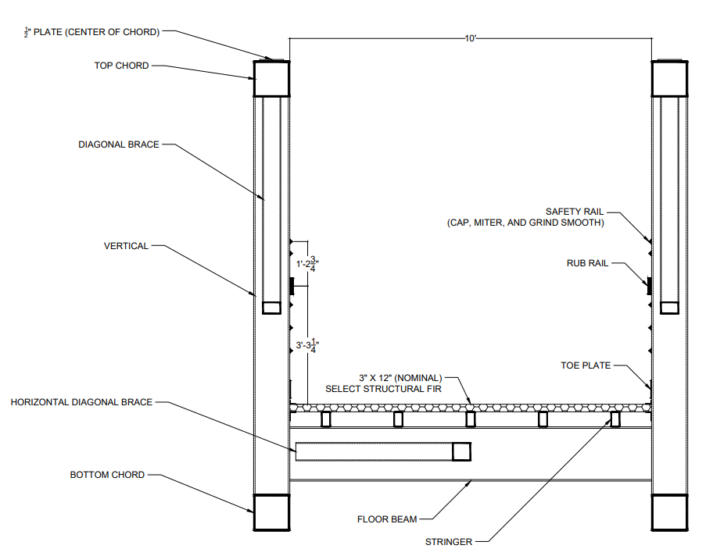
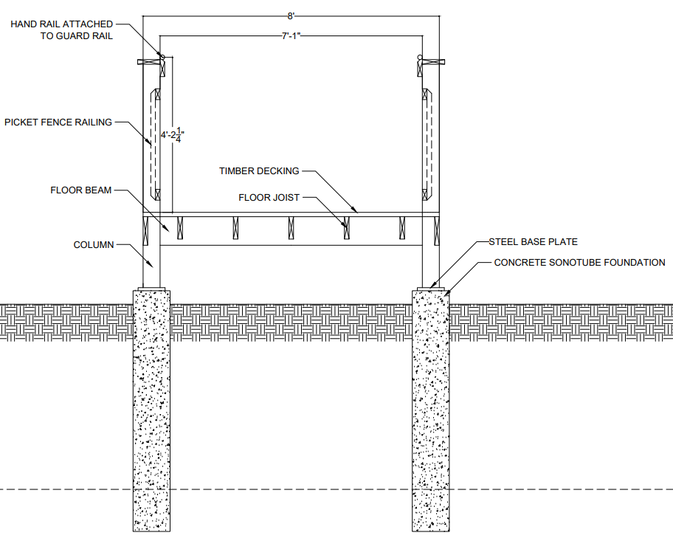
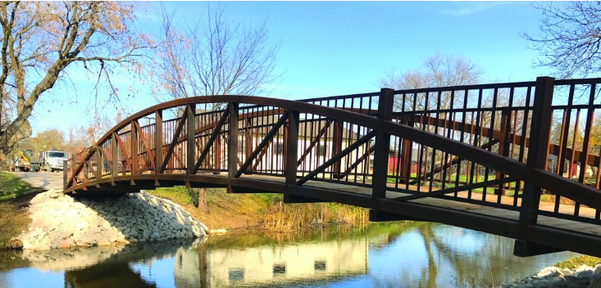
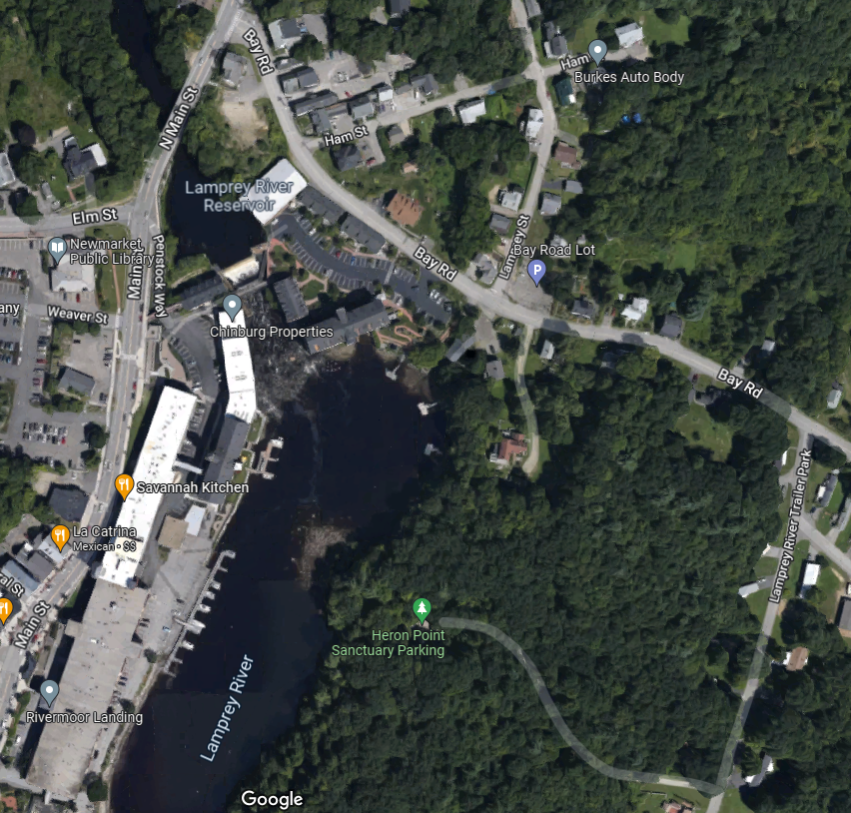
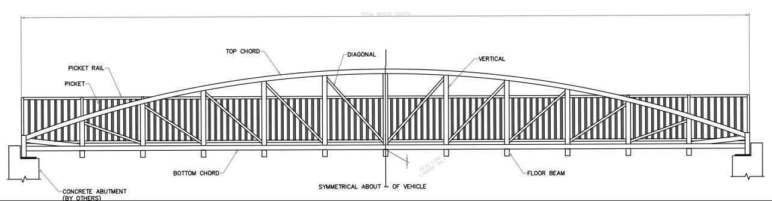
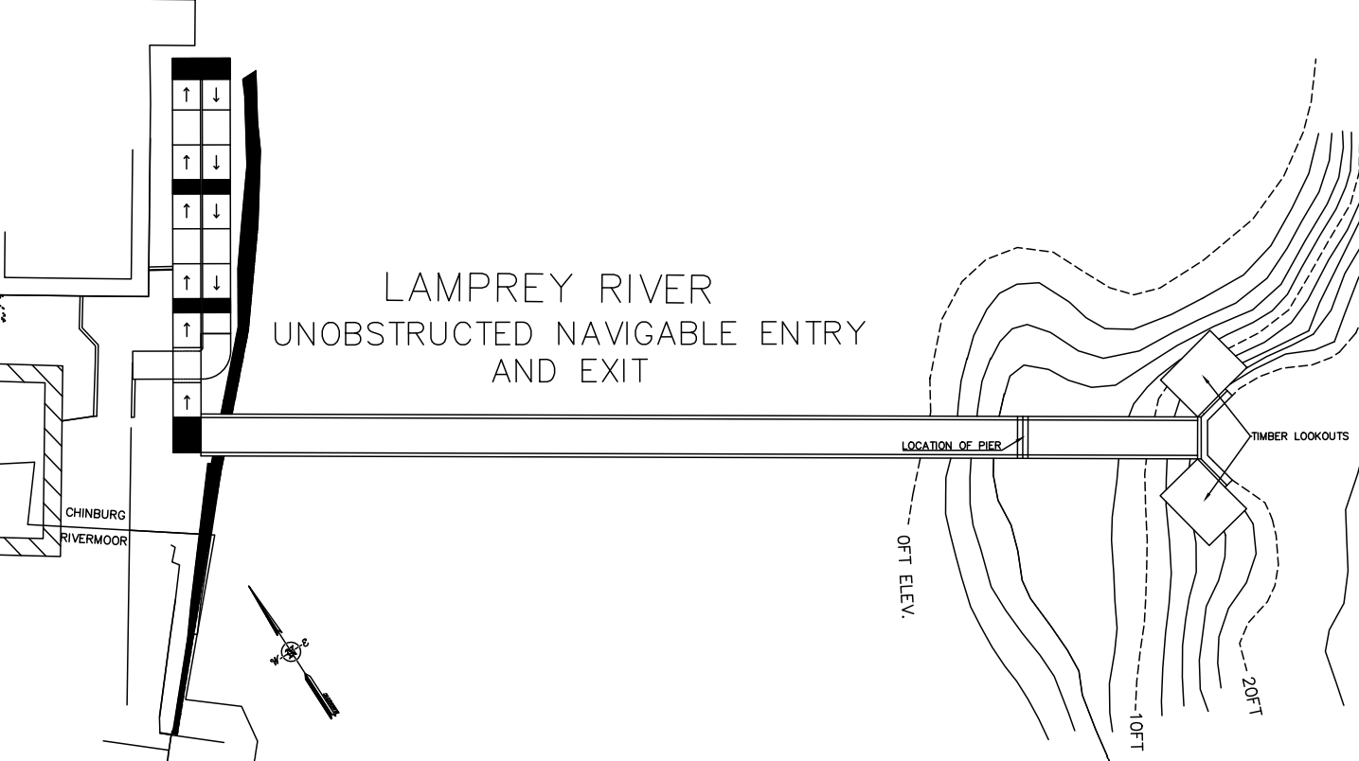
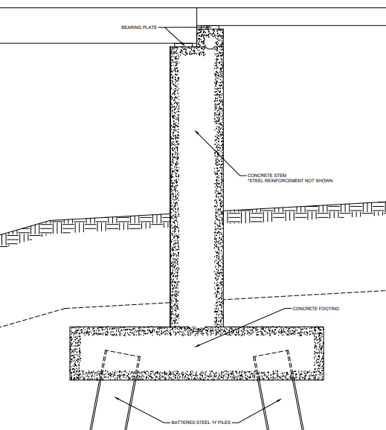
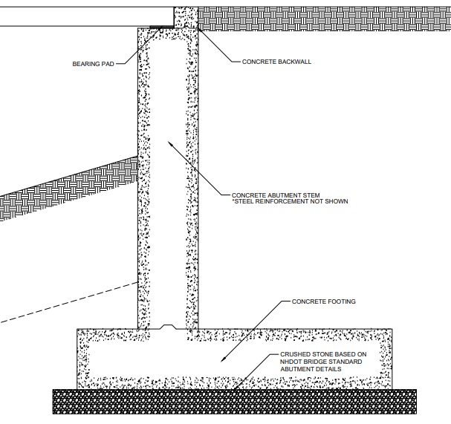
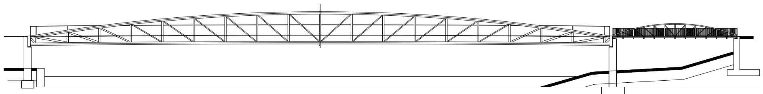
Newmarket Waterfront Improvement Project
Tyren Hartford (Project Manager), Nathan Clegg, Jaime Murphy, Nick Walsh
Faculty Advisor: Matthew Low Project Sponsor: Tyler Renz (Wunderlich-Malec Engineering)
Introduction
Superstructure
Timber Ramp
Wildcat Engineering Services was hired by the Town of Newmarket and Wunderlich-Malec Engineering to provide engineering design services for the development of the Newmarket Waterfront District.
This pedestrian bridge will allow for easier foot travel between the urbanized waterfront area on the west side of the river and the public park on the east side of the river.
Wildcat Engineering has developed a proposed alternative as well as two design alternatives for the project based on:
Geometric requirements (vertical clearance and ADA requirements)
Impacts to properties and navigable waterway
Permitting
Estimated probable costs of construction
The proposed superstructure chosen is a prefabricated truss pedestrian bridge provided by Contech Engineered Solutions.
The Keystone Pedestrian Bridge is the preferred choice and we have chosen a 235ft span and a 50ft span to completely minimize the number of substructure components required and impact to natural resources.
Justin Reardon, a Contech Representative, has provided cost estimates and overall weight estimations that are used in the design of the east abutment.
For the west abutment, the proposed alternative will provide an 8ft wide timber ramp with an ~170ft run. The design consists of a single switchback layout that begins at the road access and runs beneath the upper limits of the ramp with about 10ft of clearance. Attached to concrete sonotube foundations for simple future maintenance.
Overview of Site Location and Site Elevation
https://www.simplifiedbuilding.com/projects/how-to-add-ada-railing-to-a-wooden-access-ramp
Alternative Considerations
Pier
Alternative One was a six-span design, with a timber ramp of just 5ft in width. This was alternative was designed to be as compact as possible to minimize the amount of disturbance to the adjacent properties. Although, this alternative was not chosen due to the significant disruption to natural resources and poses usability concerns for two-way pedestrian traffic.
Alternative Two was a four-span design that implemented an increased boat clearance to allow boat traffic to continue without the possibility of collision until 2100 based on severe sea level rise. This alternative was not chosen because the extended ramp would block numerous parking spaces which are dedicated to the dock owned by Rivermoor Landing.
In this design there will be a single pier supporting two deck spans. The pier will be constructed out of concrete and will be cast in place. Supporting the pier will be driven steel “H” piles and the piles will be battered in order to resist overturning moments that can be induced on the structure due to high winds.
Cantilevered Abutment
The east abutment was designed to support the 50ft span superstructure. The cantilevered abutment was evaluated based on overturning, sliding, and bearing pressure and passes all stability checks. A winged design was implemented to minimize fill area.
Estimate of Probable Cost
Based on a list of items provided by the faculty advisor, the cost of each alternative was determined based on the quantity of structures and volume of construction materials.
Proposed Alternative: $2.2m
Alternative One: $1.6m
Alternative Two: $2.3m
Acknowledgments
Justin Reardon – Contech Engineered Sol. LLC.
Bill Doucet – Doucet Surveying Inc.
Kyle D’Urso – Vanasse Hangen Brustlin, Inc

