Slide 1

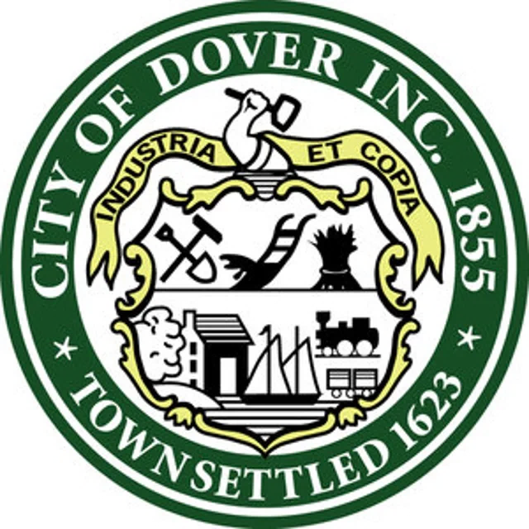
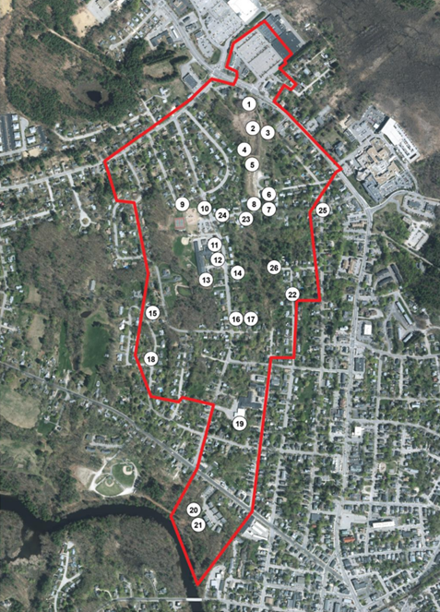
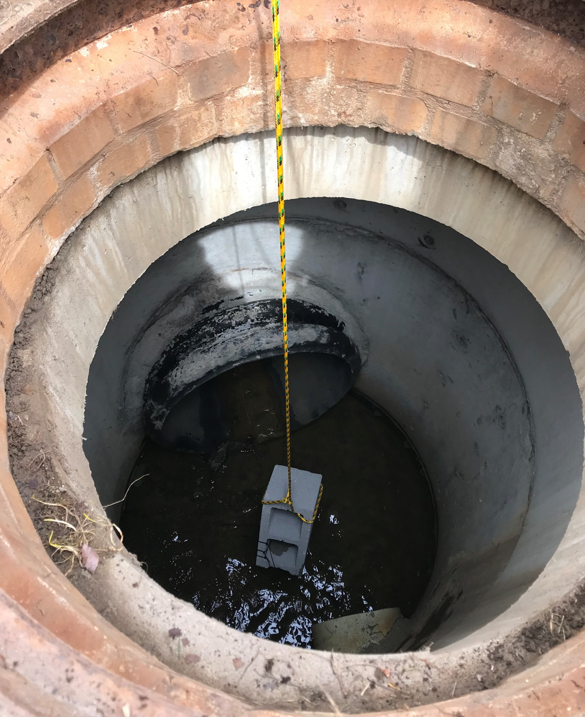
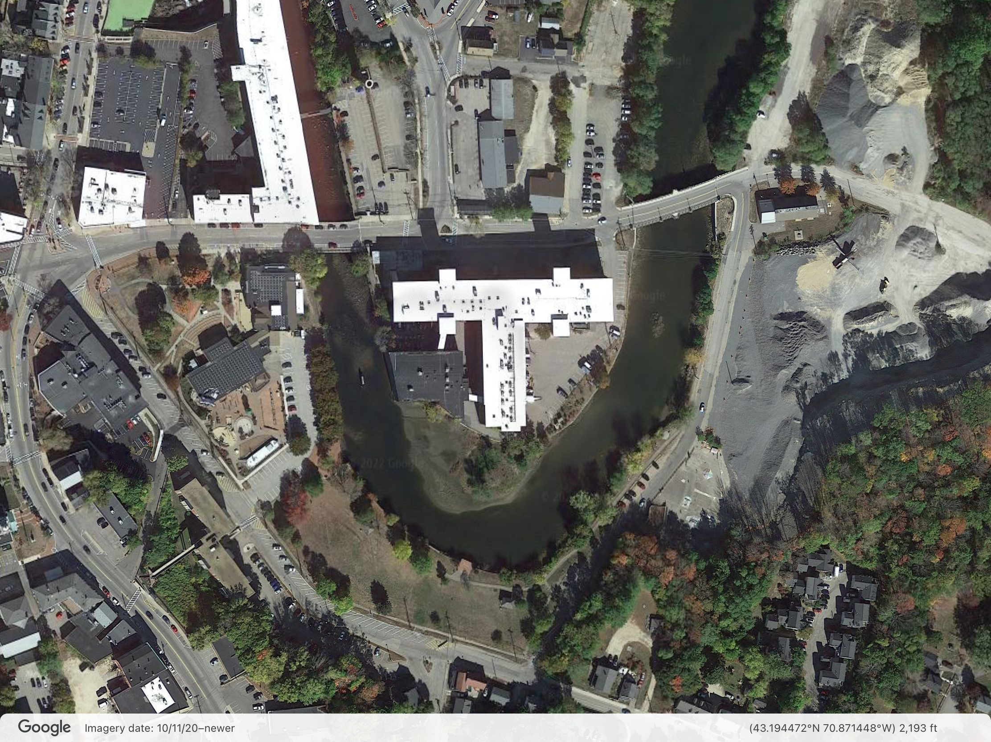
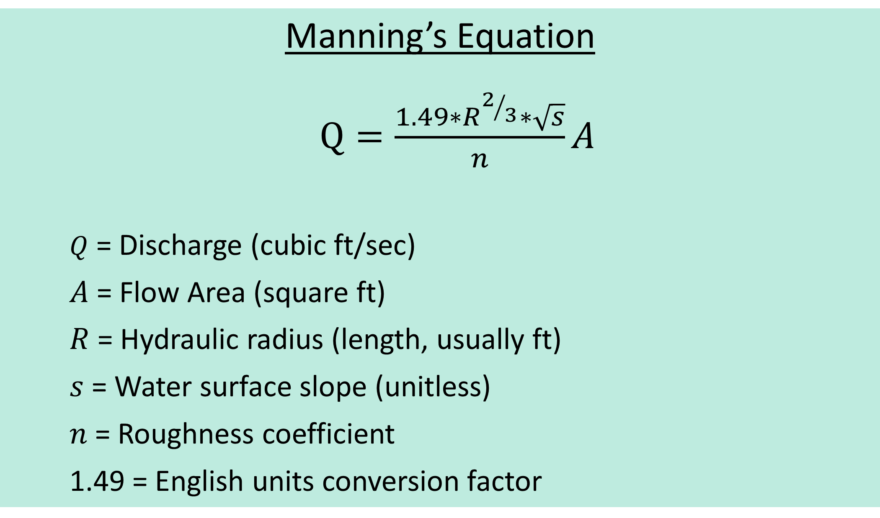
Best Management Practice in Highly Urbanized Henry Law Park
Managing Nitrogen and Adapting for the future
Jasper Anderson, Allison Bickford, Justin Durant, Benjamin Spencer
Dr. James Houle and Gretchen Young, PE
Motivation
Methods and Deployment
Proposed Design and Hydraulic Concepts
Reduce: Total Nitrogen inputs into the Great Bay Estuary
Prepare: For increasing frequency and severity of storm events
Retain: Public value and access to the park
Phase I: Initial Site Assessment
GIS data provided by the City of Dover was used to quantify a 120-acre stormwater watershed and three sub-watersheds surrounding the Henry Law Park and Washington Street
Phase II: Sensor Deployment and Data Collection
Flow meters plan to be installed at the outfall pipe under Washington St. Bridge, Manhole 1 near the intersection of George St. and Henry Law Ave. and Manhole 2 in the East corner of the park. Flow meter data will be collected over the course of 2 weeks for each location between the months of April and May.
Phase IV: BMP Design and Sizing
Once flow data has been calculated and watershed acreage is confirmed, the proposed gravel filter and concrete vault upstream will be sized.
Stage 1: Pretreatment
Existing 48” inlet will be intercepted by a pretreatment concrete sediment chamber where larger debris will be filtered out.
Stage 2: Primary Treatment
Existing 48” line will be replaced with perforated pipe feeding to a Subsurface gravel filter with saturated zone that promotes the removal of nitrogen from the stormwater before it is released into the Cocheco River.
Stage 3: Secondary Flood Storage
Secondary laterals will be vented to surface through grated standpipes to allow for secondary flood storage in the field area to be grassed and gently contoured. This will protect urban infrastructure during storm surges or tidal restrictions on the outfall.
Berry Brook Project
2008 - 2017
Success of Berry Brook BMP project shows proof of concept for new BMP designs and low impact development .
Nov.
2020
Great Bay General Permit
EPA region 1 issues the Great Bay Total Nitrogen General Permit, which becomes effective on February 1, 2021
Phase III: Analyzing and Compiling Field Data
Using collected data from the flow meters and a survey preformed on site, stormwater flow rates will be determined and used to calculate 5, 10, and 25 year storms and peak flow rates. Manning's Equation will be used to determine required pipe size in the BMP and any size of any additional pipe intended for servicing other sub-watersheds. Understanding necessary capacity will determine if existing pipe infrastructure is capable of servicing an expanded watershed.
Mar.
2021
Settlement Agreement between CLF and Great Bay Municipalities
Concrete Sediment Chamber
Primary Inlet
The Cities of Dover, Portsmouth and Rochester reach an agreement with the Conservation Law Foundation, ending a years long battle over nitrogen permitting for the Great Bay
Subsurface Gravel
Apr.
2021
Dover Joins MAAM
Overflow Release Vents
In partnership with other municipalities in the Great Bay Watershed, Dover joins the Municipal Alliance for Adaptive Management, opting into Part 3 of the General Permit
Aug.
2021
MAAM submits Adaptive Management Plan to EPA
Along with the other members, the City of Dover signs and submits the AMP, initiating a years long process of Nitrogen mediation in the region
Location and Site Considerations
Mathematical Modeling
System Outfall
Manning’s Equation
$Q=\frac{1.49∗R^{2/3}∗\sqrt{s}}{n}A$
$Q$ = Discharge (cubic ft/sec)
$A$ = Flow Area (square ft)
$R$ = Hydraulic radius (length, usually ft)
$s$ = Water surface slope (unitless)
$n$ = Roughness coefficient
1.49 = English units conversion factor
Ongoing Work
Washington St. Outfall
A survey of existing conditions on-site will be preformed to gather pipe sizes, water elevations, and pipe slope in the park, necessary for accurate and complete calculations using Mannings Equation.
Tidal characteristics of the Cocheco River requires an investigation into possible hydraulic impacts on the existing stormwater outfall. A survey in combination with analyzing regional tidal charts is expected to give insight into any potential impacts.
Continue to collect and compile data from the flow meters over the coming months. Average and peak flows will be calculated to size pipes and finalize the conceptual design after a survey is preformed for each meter location.
Manhole #2
Approximate Sight for BMP
Manhole #1

