Slide 1



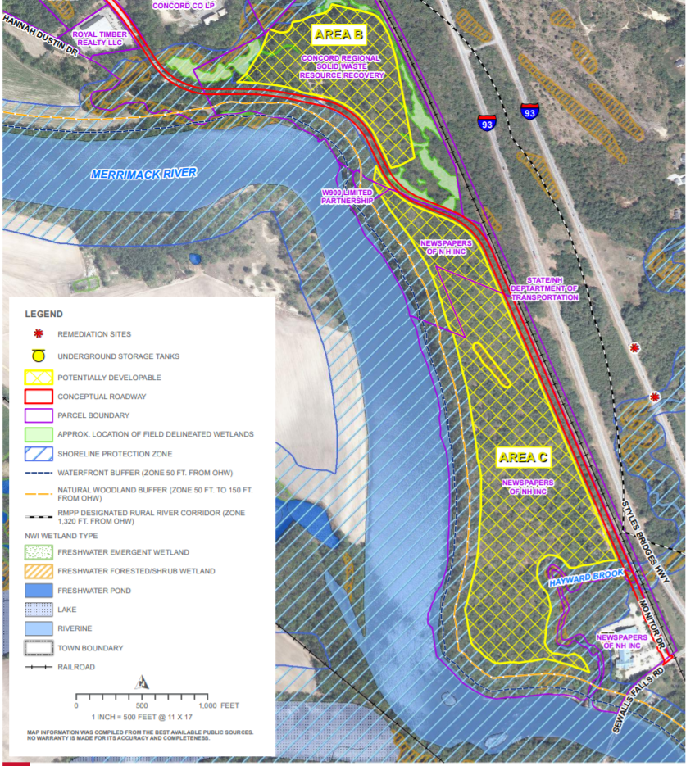
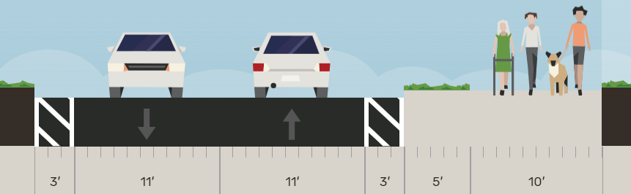
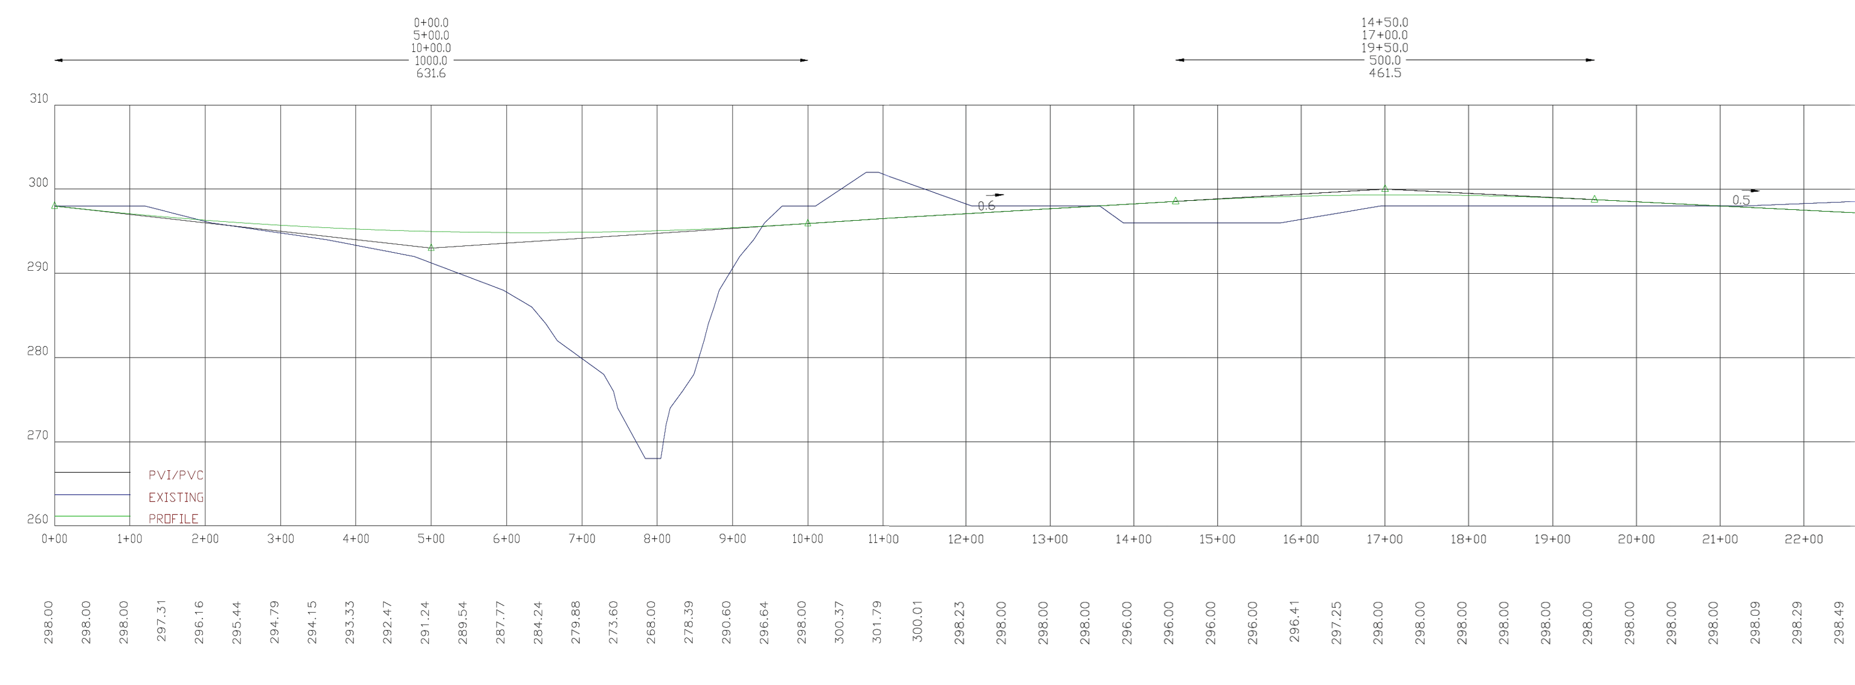
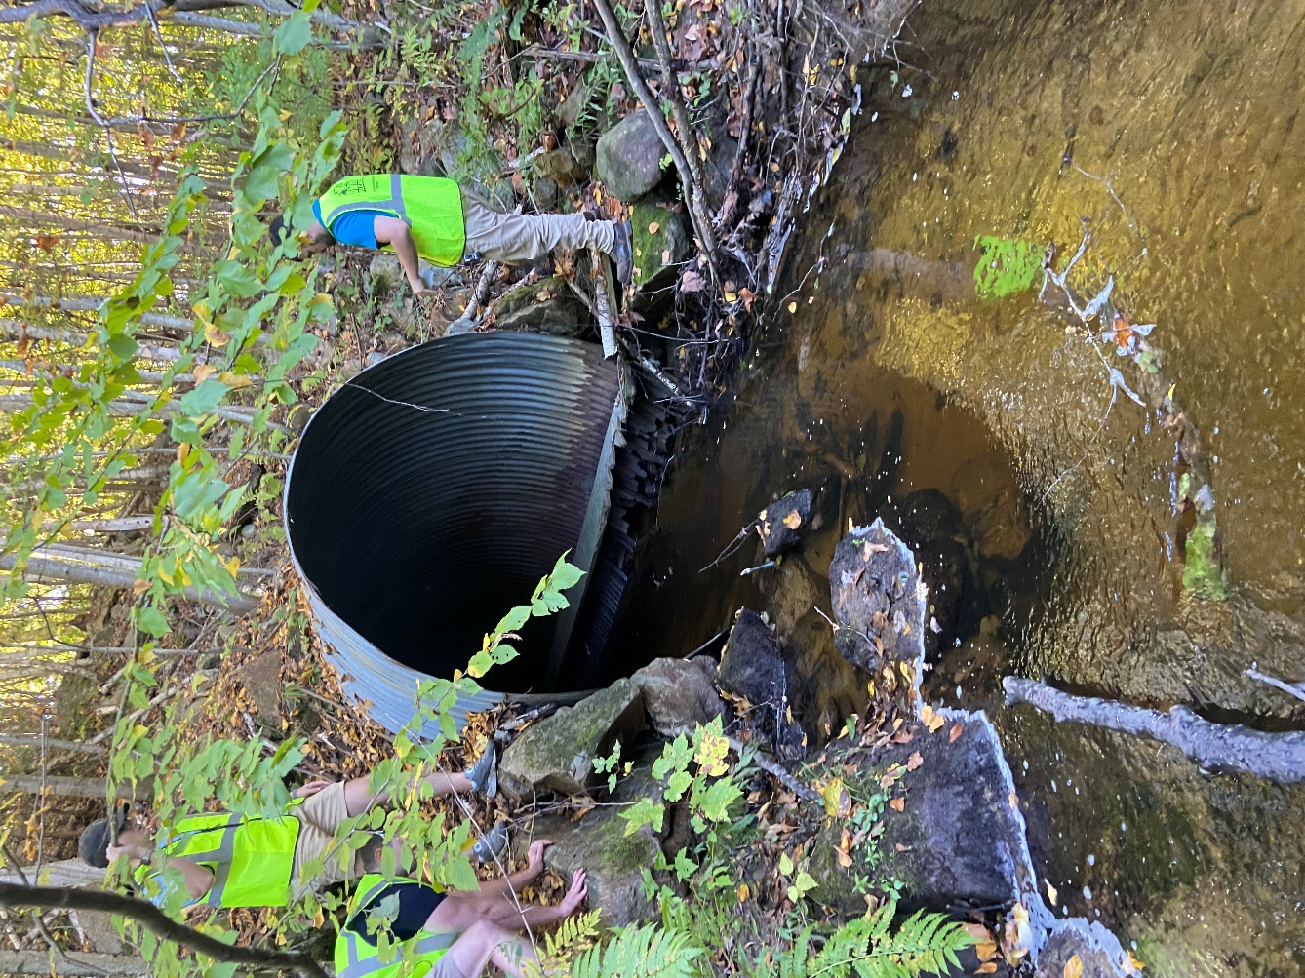
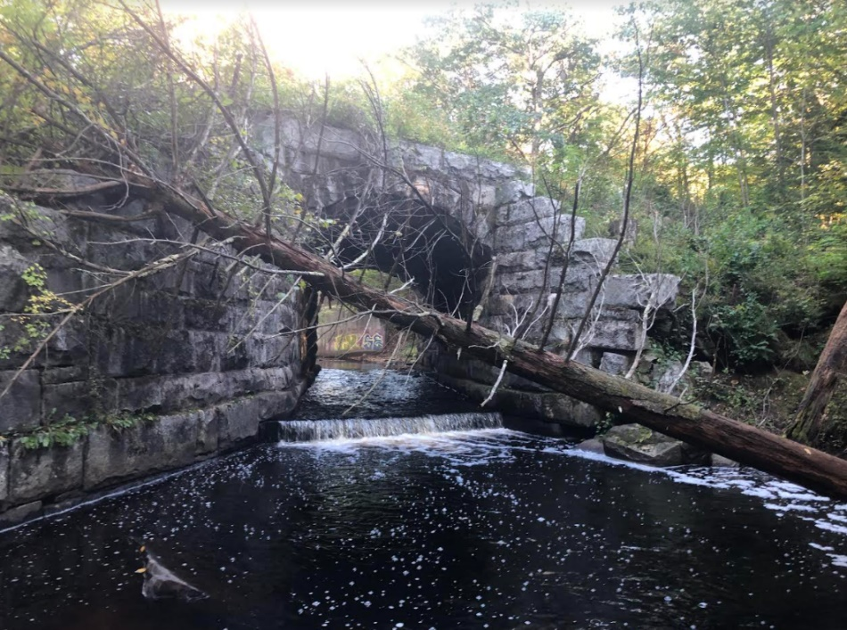
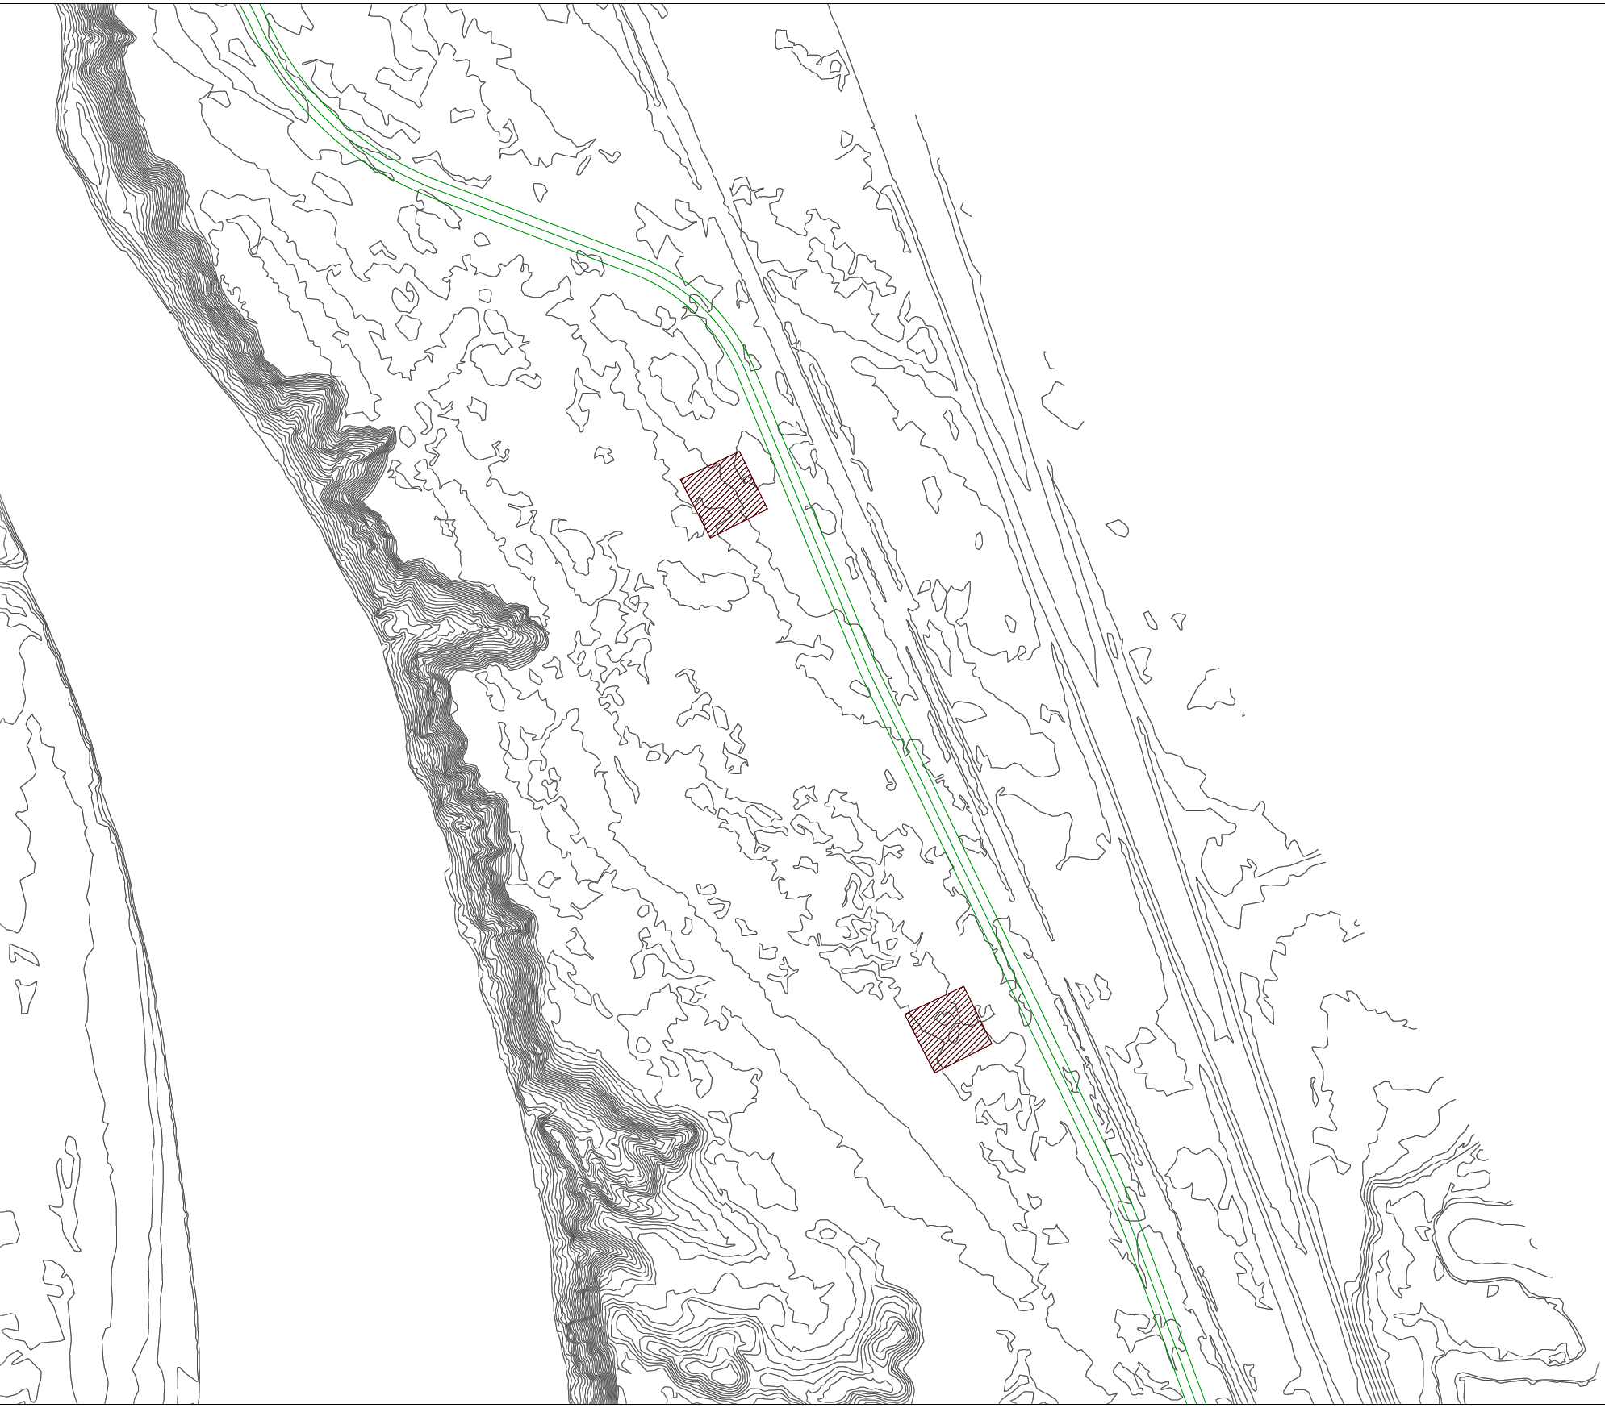
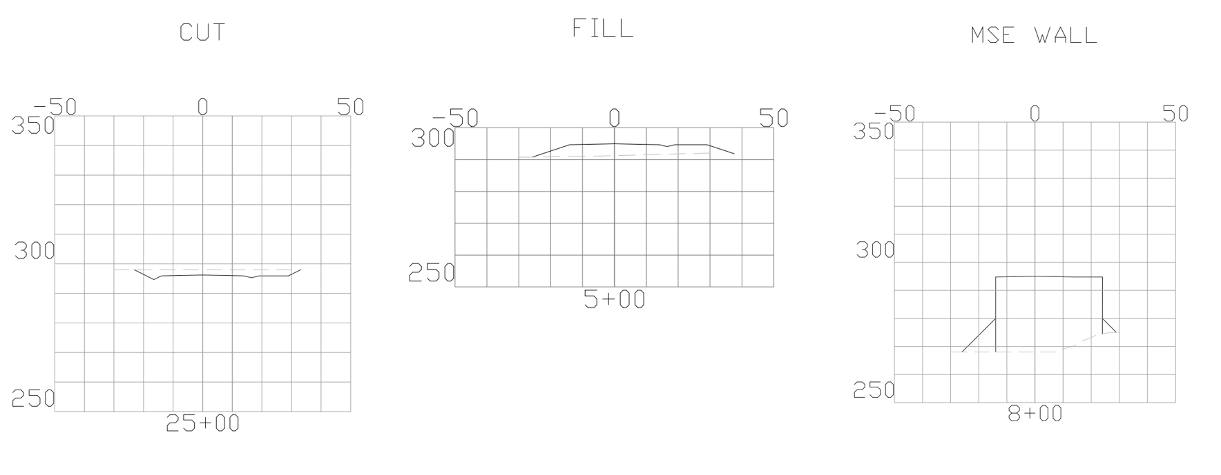
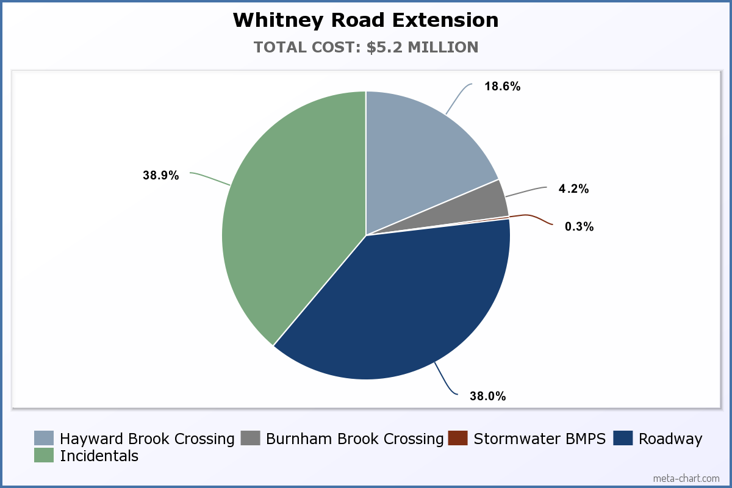
Whitney Road Extension
Logan Stevens (PM) - Joey Rebeiro - Connor Schott - Jake Sullivan-Hasson
Sponsors: Dave Cedarholm, City of Concord – Roch Larochelle, HDR
Faculty Advisor: Tony Puntin
background
Proposed roadway
Stream Crossings
City of Concord and HDR looking to extend Whitney Road, just off Exit 17 on I-93
Will service Interchange Development and allow for future development
Accommodate two stream crossings, pedestrian, and cyclist use
As shown in figure 3 the roadway will accommodate two 11’ travel ways for cars with 3’ shoulders, a 5’ infiltration trench, and a 10’ shared use path on eastern side
Hayward Brook:
Existing
Open 30’ wide brook with railroad bridge upstream on the east side
Proposed
A box culvert with MSE walls
EcoSpan Arch Systems - 36 ft span with 6 ft height
  Provides natural wildlife crossing and sufficient hydraulic opening
Burnham Brook:
Existing
A 7’ diameter 150’ long CMP covered by 30’ of fill
Collapsed and deteriorated
Proposed
8’x7’ three-sided culvert with 2’ wildlife crossing ledge
Figure 1: Locus Map
The road extension will be 6000’ long, connecting Monitor Dr and Whitney Road
Figure 3: Proposed Roadway Render
Stormwater Management
Handles storm runoff, controls drainage, and treats for pollutants
Infiltration basin and gravel wetland located on western side of proposed roadway, seen in figure 2
Infiltration trench running east side of proposed roadway
Figure 6: Hayward Brook Existing
Figure 7: Burnham Brook Existing
Figure 4: Partial Vertical Alignment
Estimate
$967,000
$2,024,000
$218,000
$15,000
$1,976,000
Figure 5: Proposed Roadway Cross Sections
Figure 2: Horizontal Alignment with BMPs
Figure 8: Cost Estimation

