Slide 1



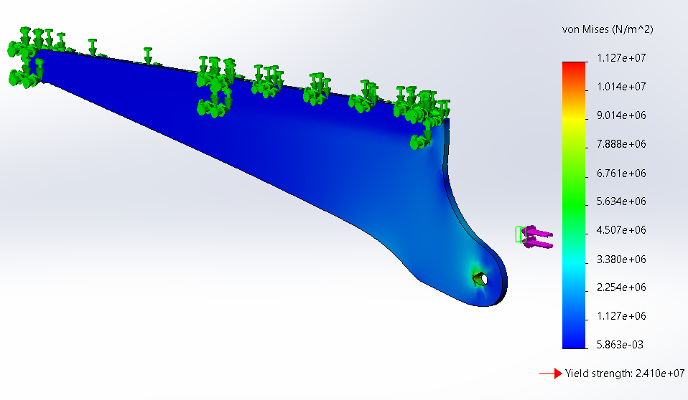
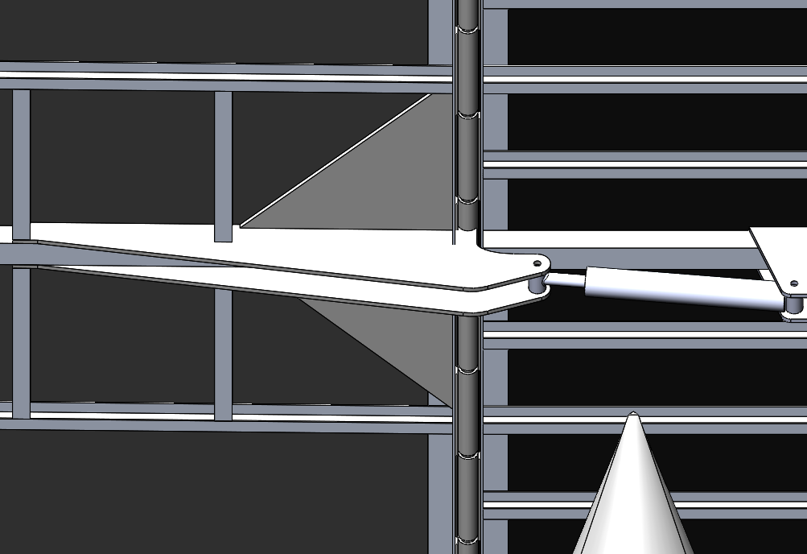
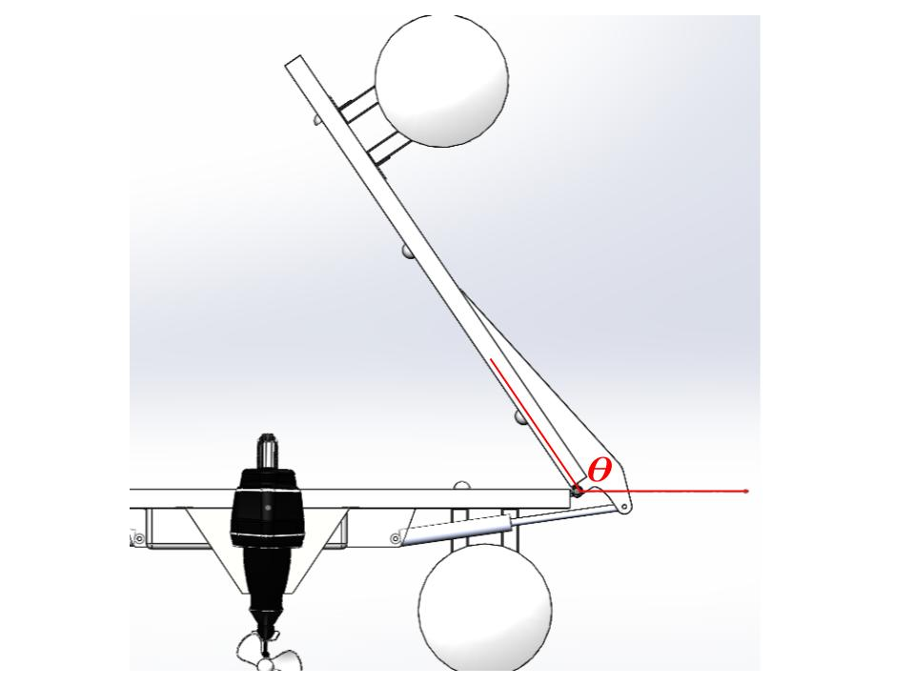
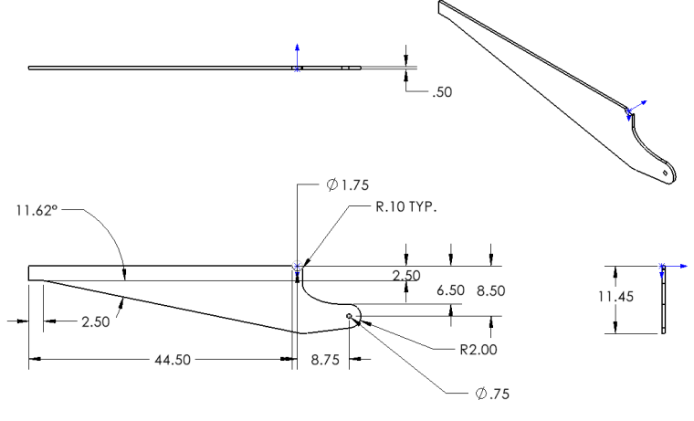
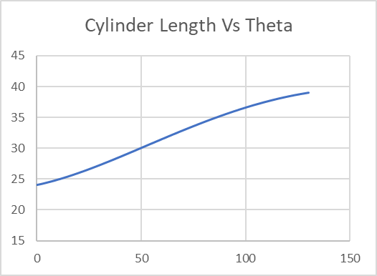
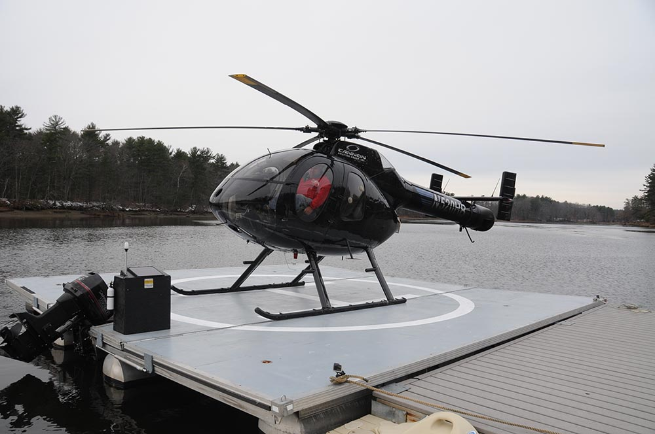
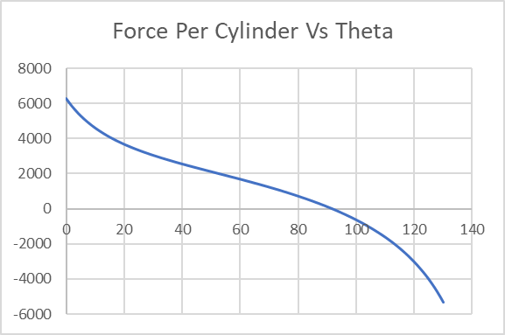
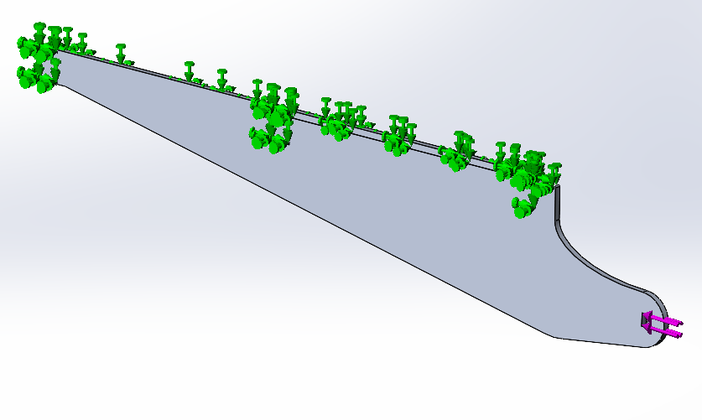
Pontoon Boat Helipad
Members: Justin Berube, David Luby, Mya Levy, Cody Sullivan, and Xin Yang,
Faculty Advisor: Christopher White & Nathan Laxague
Project Sponsors: Karl Leinsing, PD Aviation LLC & ATech Designs, Inc.
Department of Mechanical Engineering, University of New Hampshire
Introduction
Hydraulic Requirements
Bracket Design for Hydraulics
Aluminum lever arm bracket performs well under the yield strength of 24 MPa
Location with most stress is at pin hole as expected
Distributes the force along area of surface of the part as intended
Lever arm bracket successfully passes FEA stress test simulation (Figure 8)
PD Aviation LLC designed and built a fully operational pontoon boat helipad. The pontoon boat helipad was built as a solution to the problem of not being able to land a helicopter on land per Dover, NH ordinances. The current helipad is a 24ft x 24ft, three panel hinged deck (Figure 1). The two outer panels fold up toward the center panel for removal from water and transportation via boat trailer. The sides are folded up using industrial straps and a hand crank mechanism. PD Aviation LLC is looking to design and implement a hydraulic system to facilitate folding of helipad. The new design will be a 42.5 ft x 24.5 ft helipad for full access of helicopter for inspection purposes.
Free body analysis on hydraulic system as a function of folding deck angle “𝛳” (Figure 2)
Hydraulic cylinder must match the push/pull force and stroke calculated in the force calculations that would be able to fit in the overall CAD design
Max./min. hydraulic length and force capacity determined when 𝛳 = 126° and 0° (Figures 3 & 4)
Specs of Hydraulic: Rod diameter: 1.375”, Stroke: 16”, Retracted: Pin to pin 24”, Extended: Pin to pin 40”, Barrel diameter: 3”
F-push = P * (𝝅 * Barrel ⌀^2)/4
F-pull = P * (𝝅 * Barrel ⌀^2 - Rod ⌀^2)/4
The hydraulic cylinders are mounted and fixed onto a bracket underneath the center panel
Two lever arm brackets are welded to aluminum support
Hydraulic cylinder attaches to pin holes in bracket
Two aluminum triangular gussets are welded to outer sides of the lever arm bracket (Figure 5)
Lever arm designed to distribute force along panel and rotate about hinge (Figure 6)
Problem Statement
Figure 8: Stress results of Lever arm bracket
Results
Implement hydraulic system to be able to withstand the forces of each side of the helipad at various angles of rotation, so that the process of folding each side is safer and more efficient.
Figure 5: View of hydraulic mounting underneath helipad
Maximum calculated magnitude of force from deck on hydraulics is about 6300 lbf.
Minimum and maximum calculated hydraulic lengths about 24”- 40” (16” stroke)
Determined aluminum lever arm bracket design safe for expected force to be exerted by the cylinders
Objectives
Figure 2: CAD image of side folding about angle 𝛳
Determine force calculations and hydraulic specifications.
Design mount bracket and lever arm for hydraulic cylinder to avoid interfering with other parts of the platform
FEA testing lever arm and the side as a whole
Next Steps
Figure 6: Drawing of Lever Arm Bracket
FEA Testing and Results
SolidWorks FEA simulation of one aluminum bracket lever arm was performed
Force applied by hydraulic cylinder to pin hole at 𝛳 = 0° was 3,127 lbf
Bracket lever arm was constrained at weld locations (Figure 7)
Fixed hinge constraint applied at the location rotating around hinge
FEA analysis of helipad assembly
Build newly designed helipad
Install hydraulic system
Test hydraulic system and folding of each side
Figure 3: Hydraulic cylinder length vs Theta “𝛳”.
Contacts
Karl R. Leinsing, MSME, PE
President
Email: kleinsing@comcast.net
Office:(603)-926-8216
Web: www.pdaviation.com
Figure 1: 24ft x 24ft Helipad Design in the water
Figure 4: Hydraulic cylinder force per cylinder vs. Theta “𝛳”.
Figure 7: Constraints applied to lever arm bracket

