Slide 1
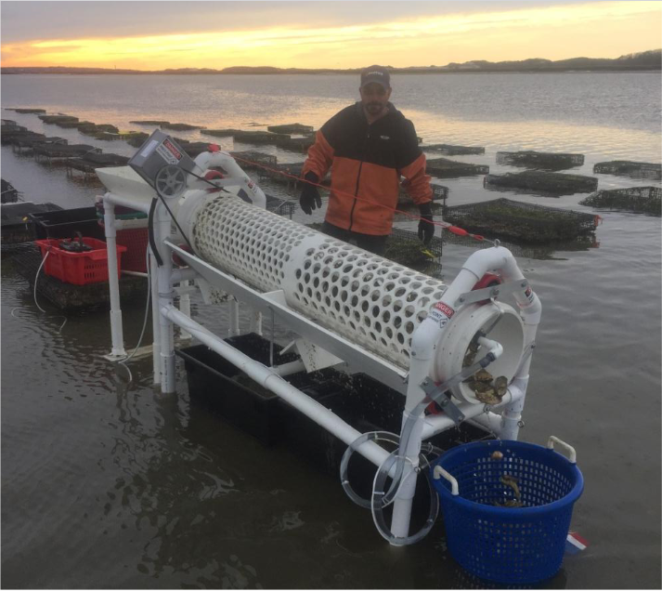
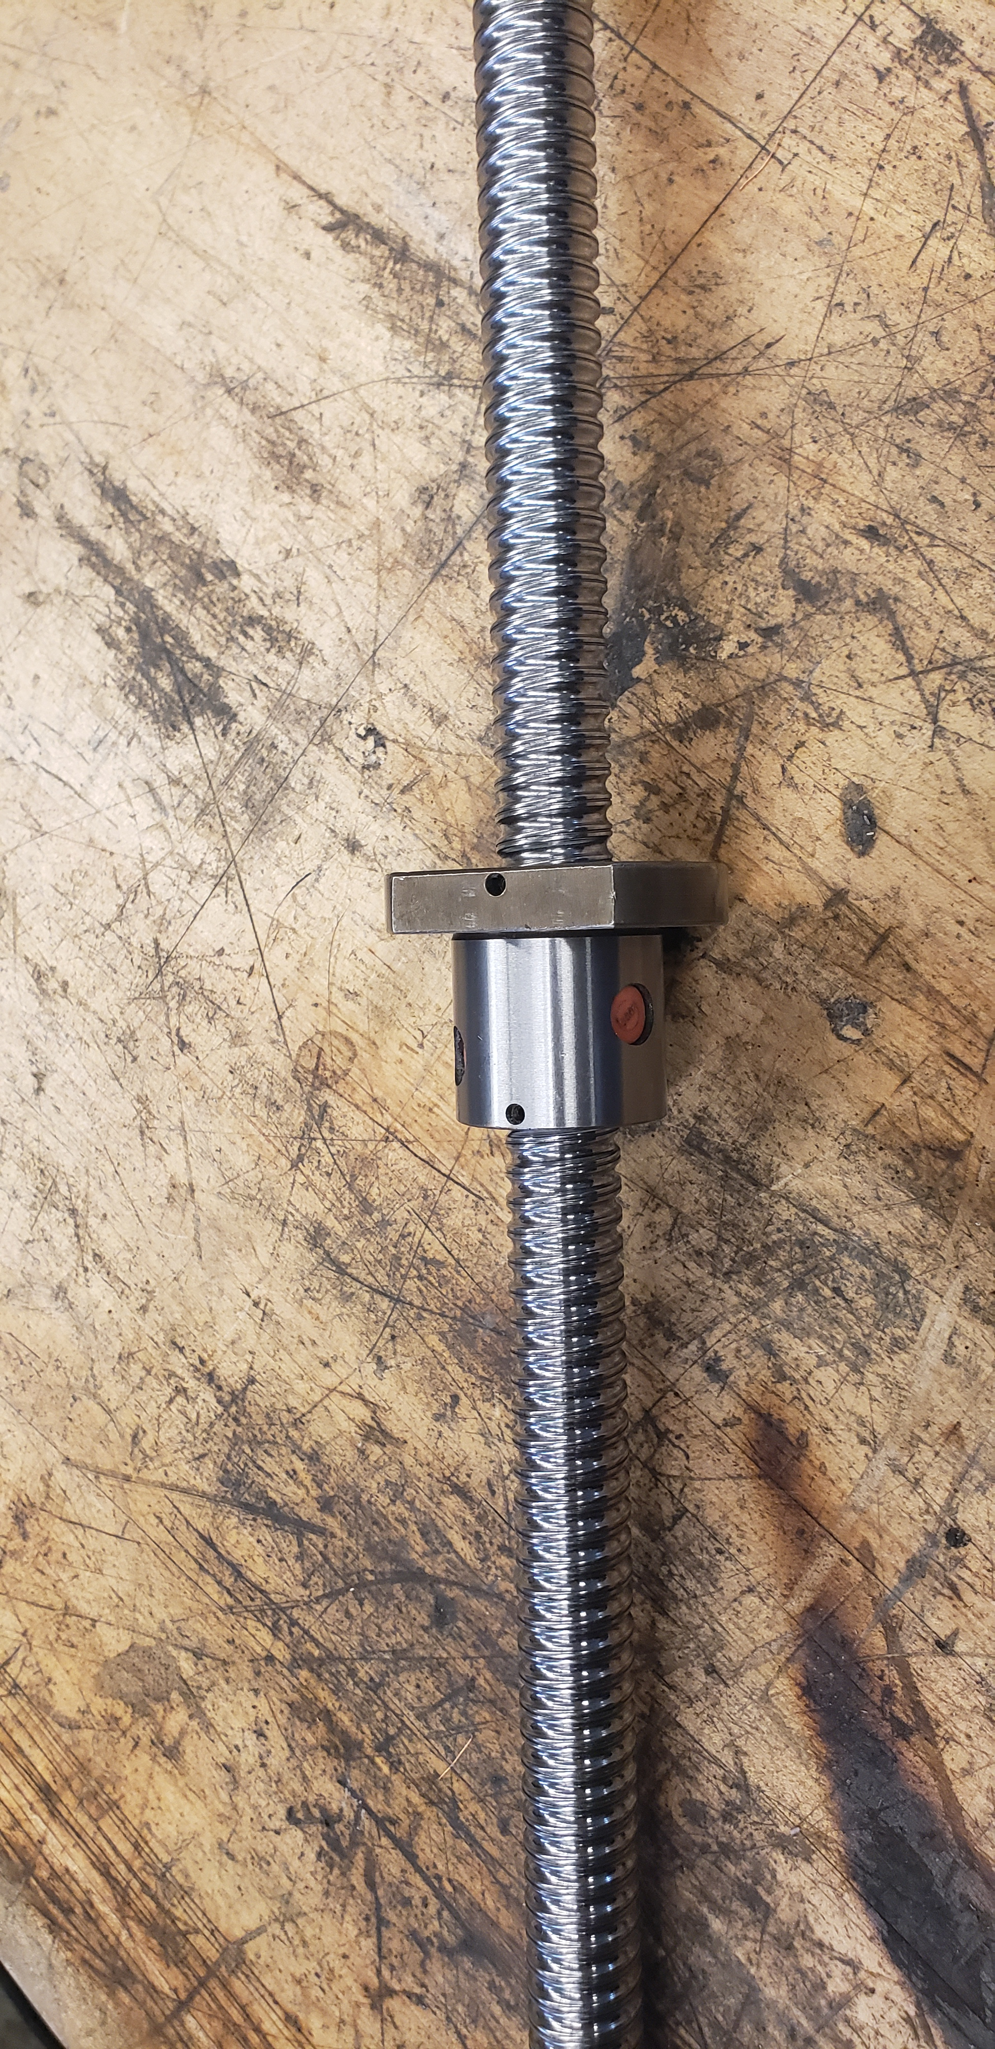
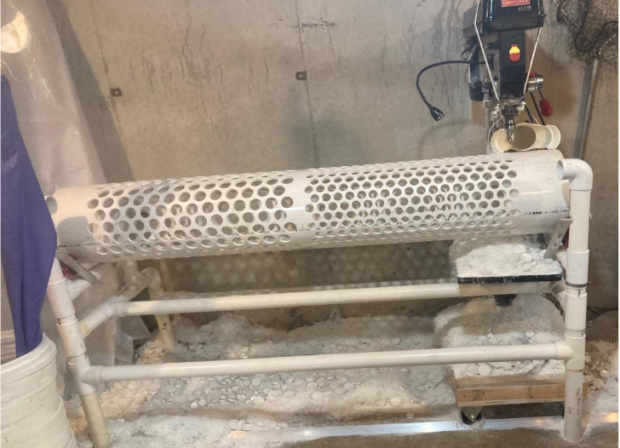
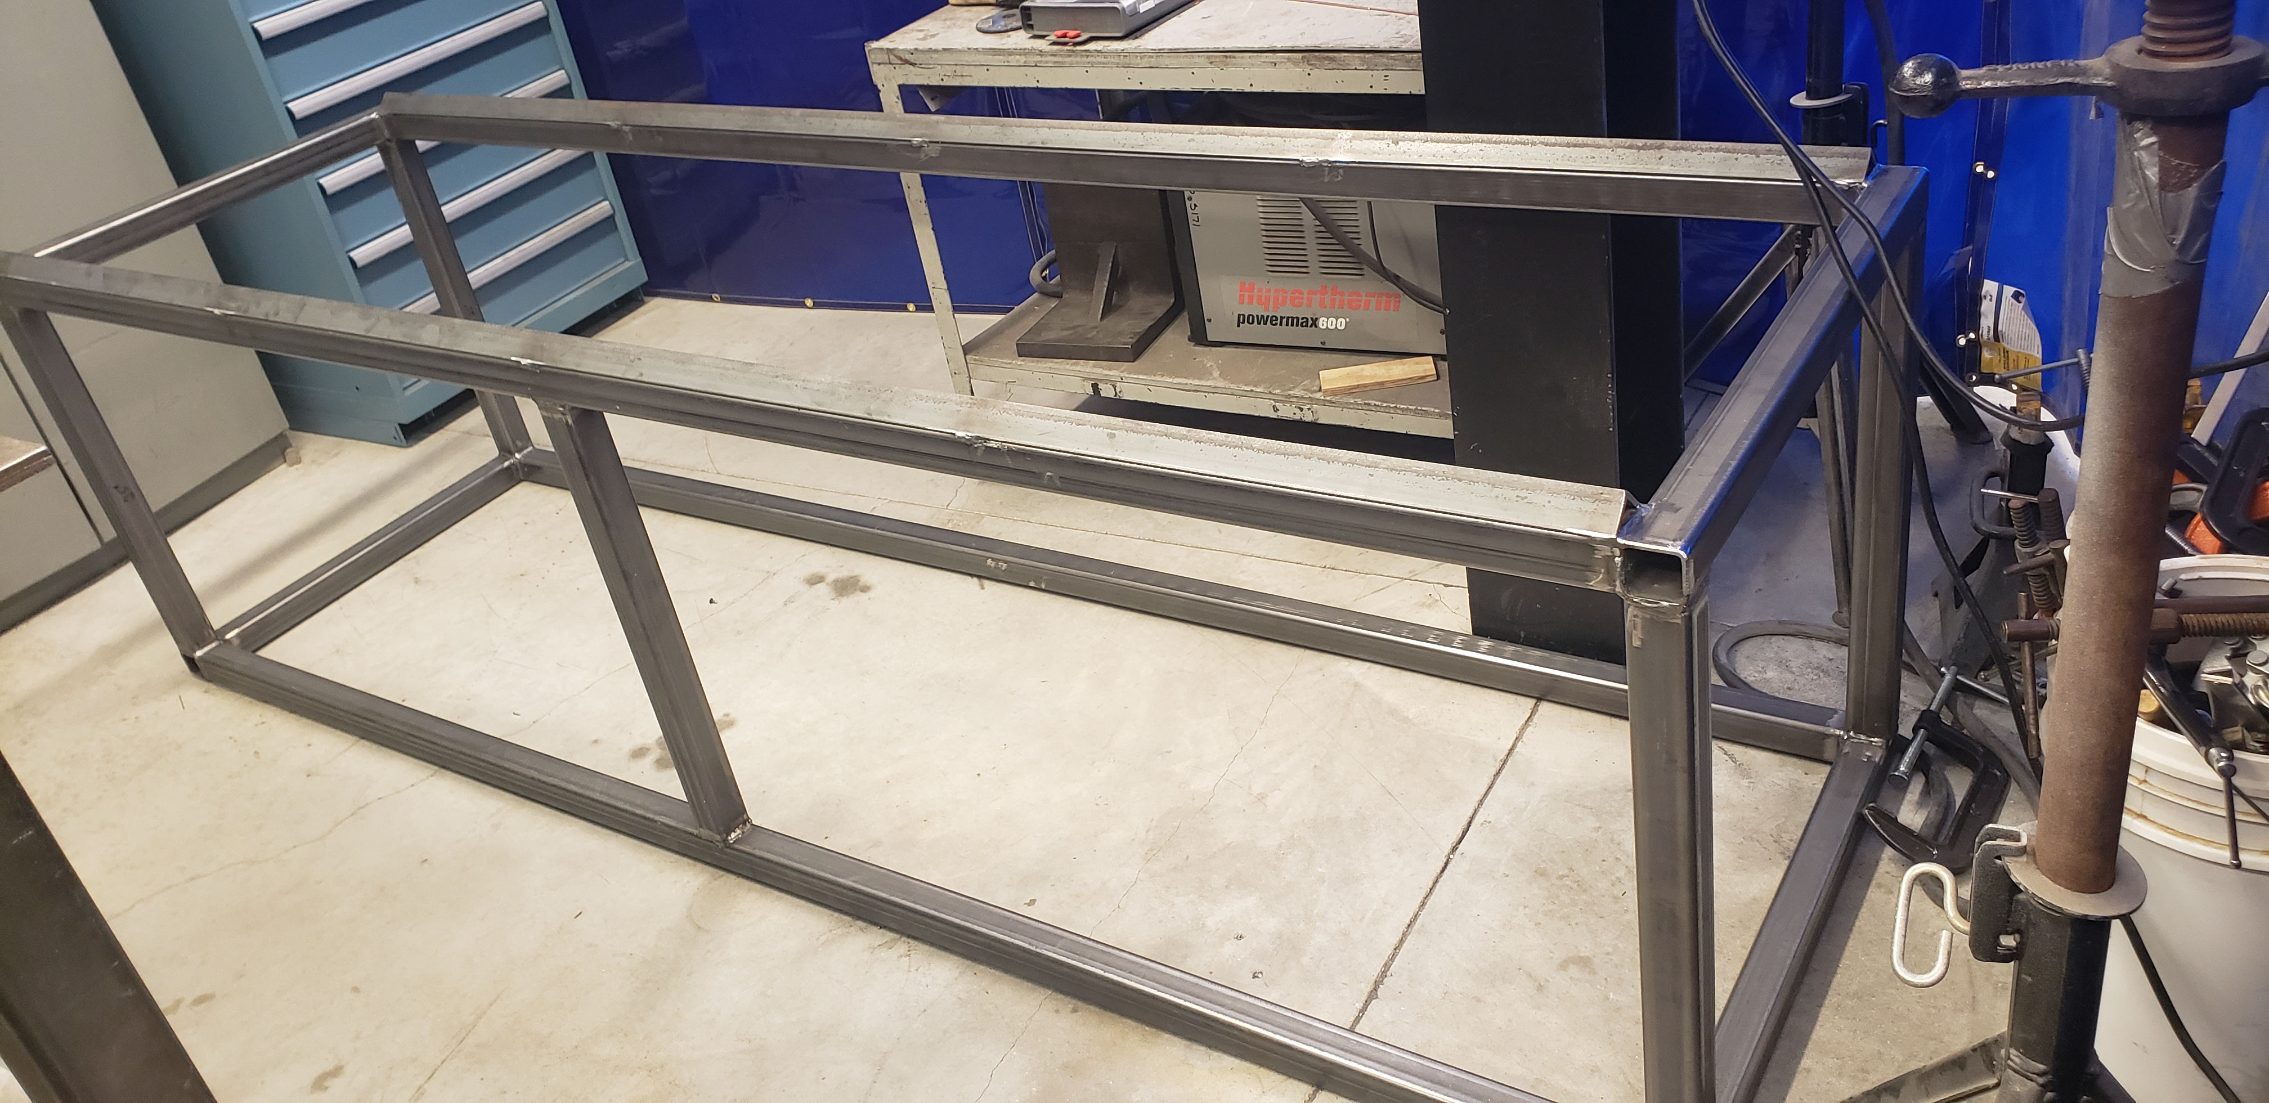
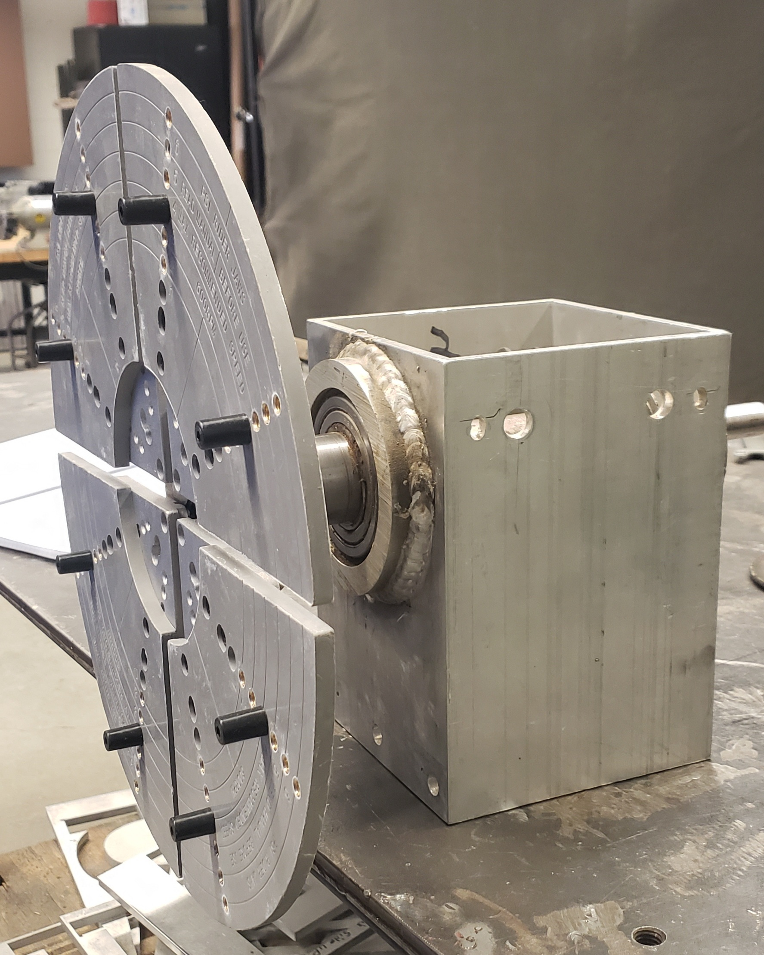
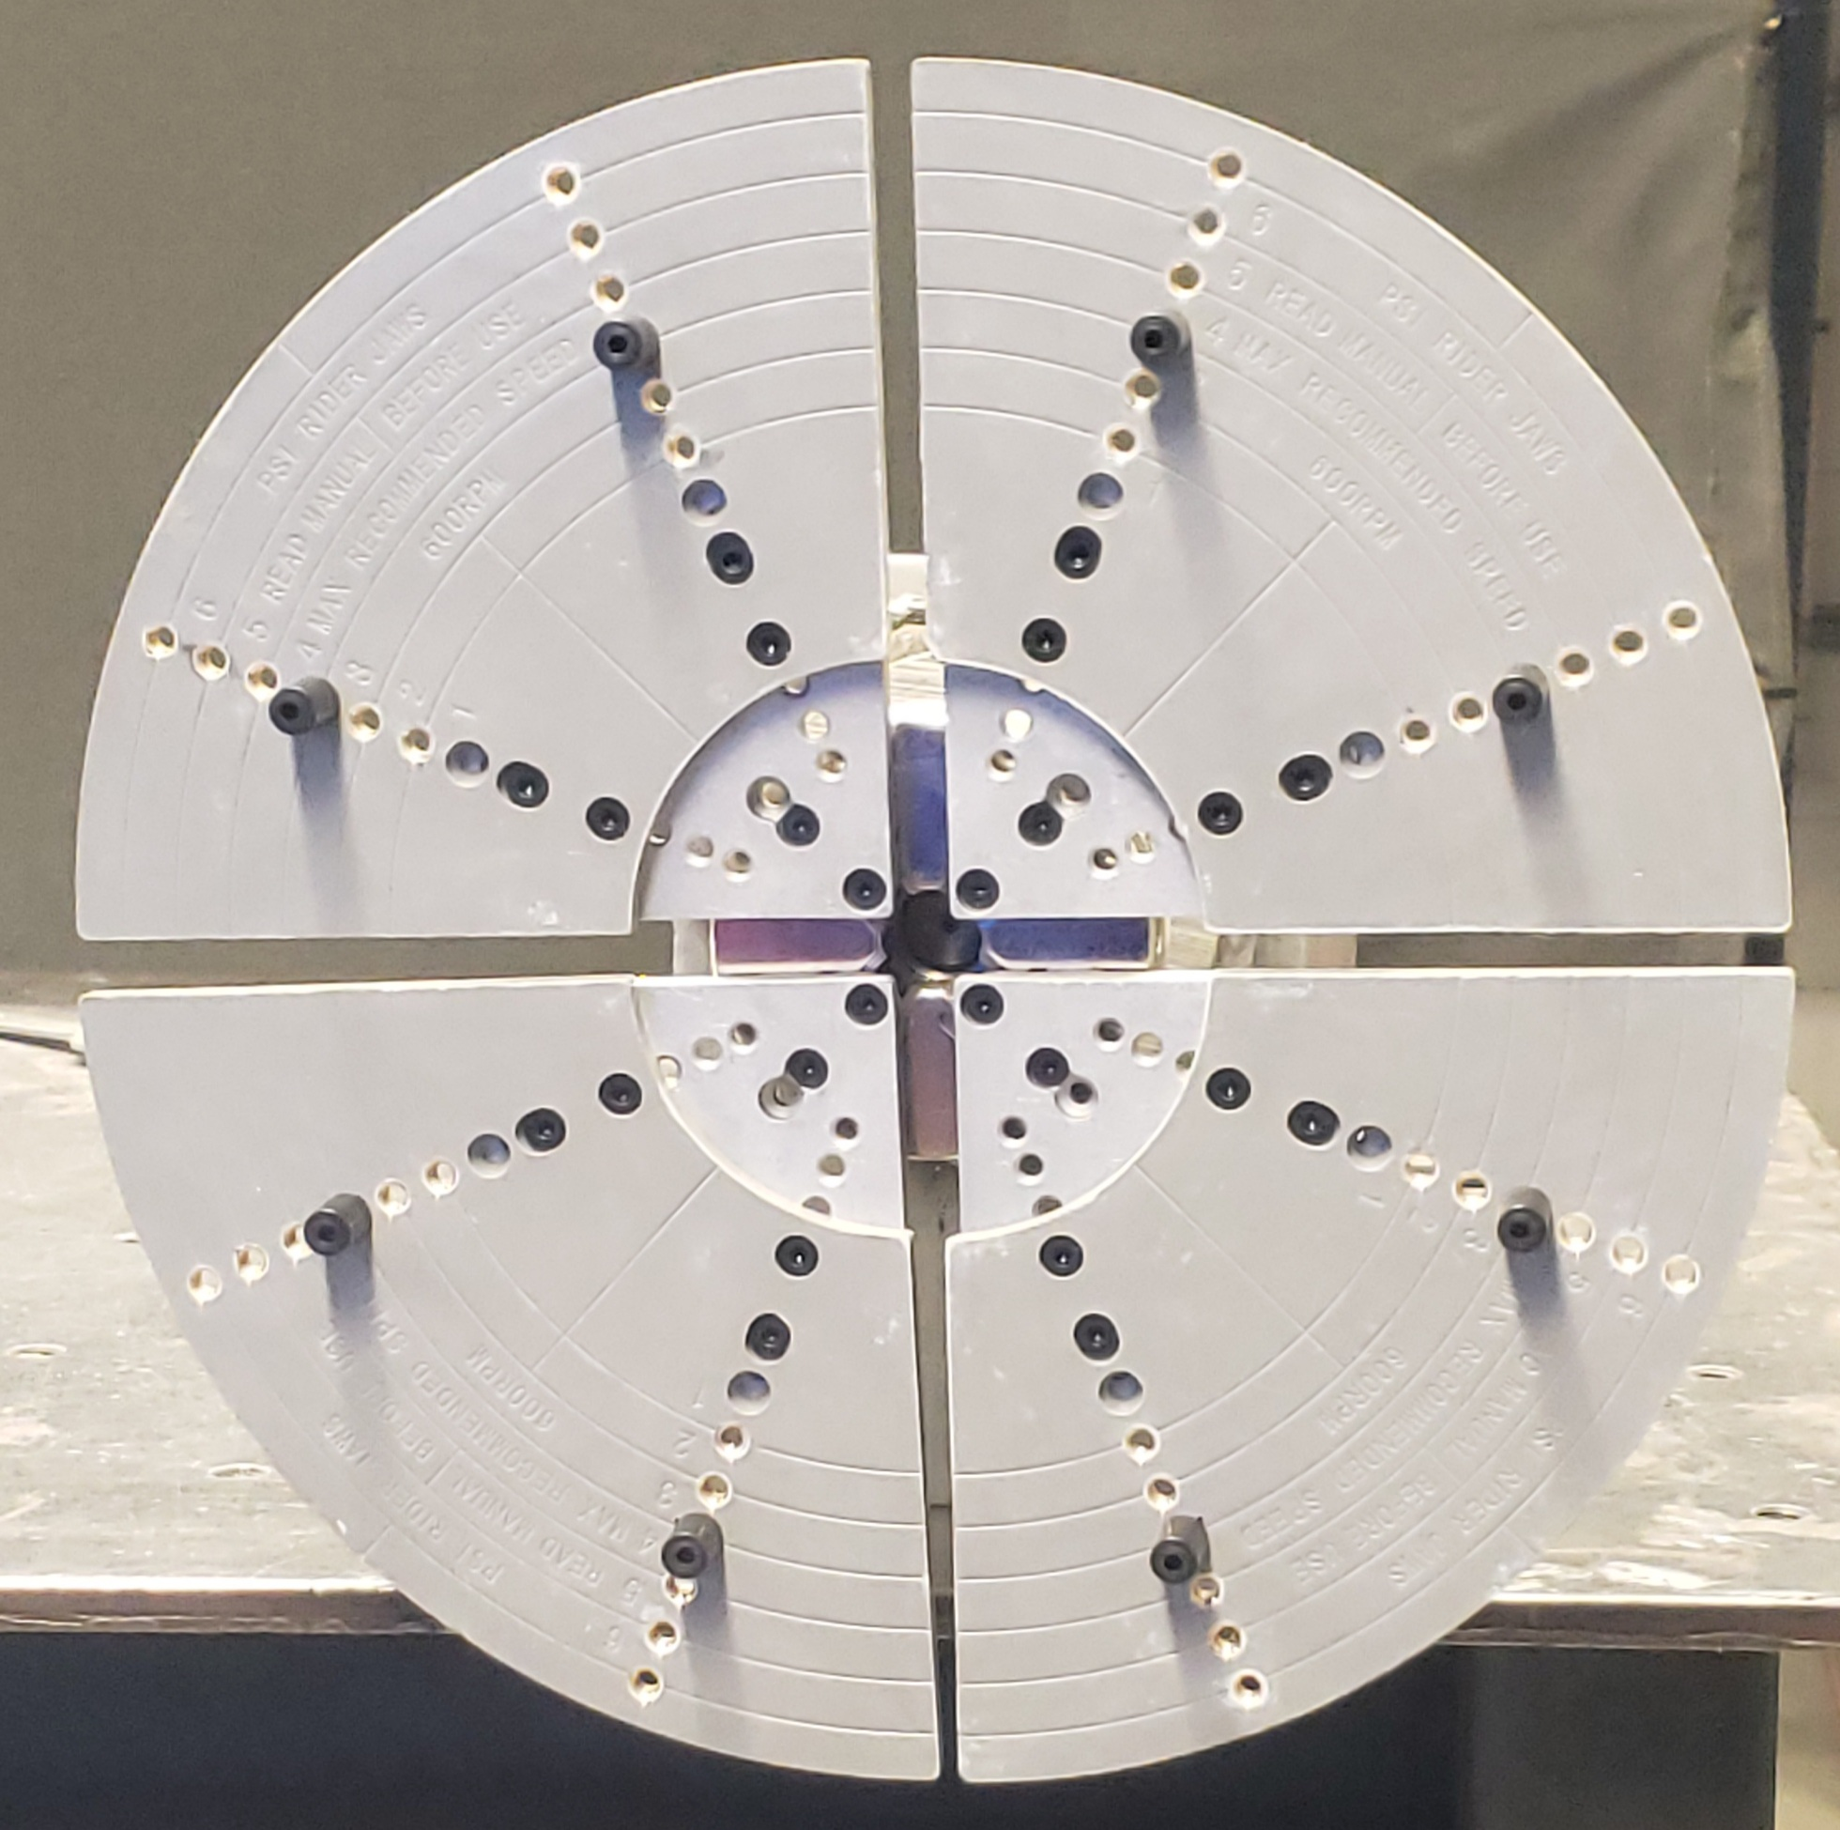
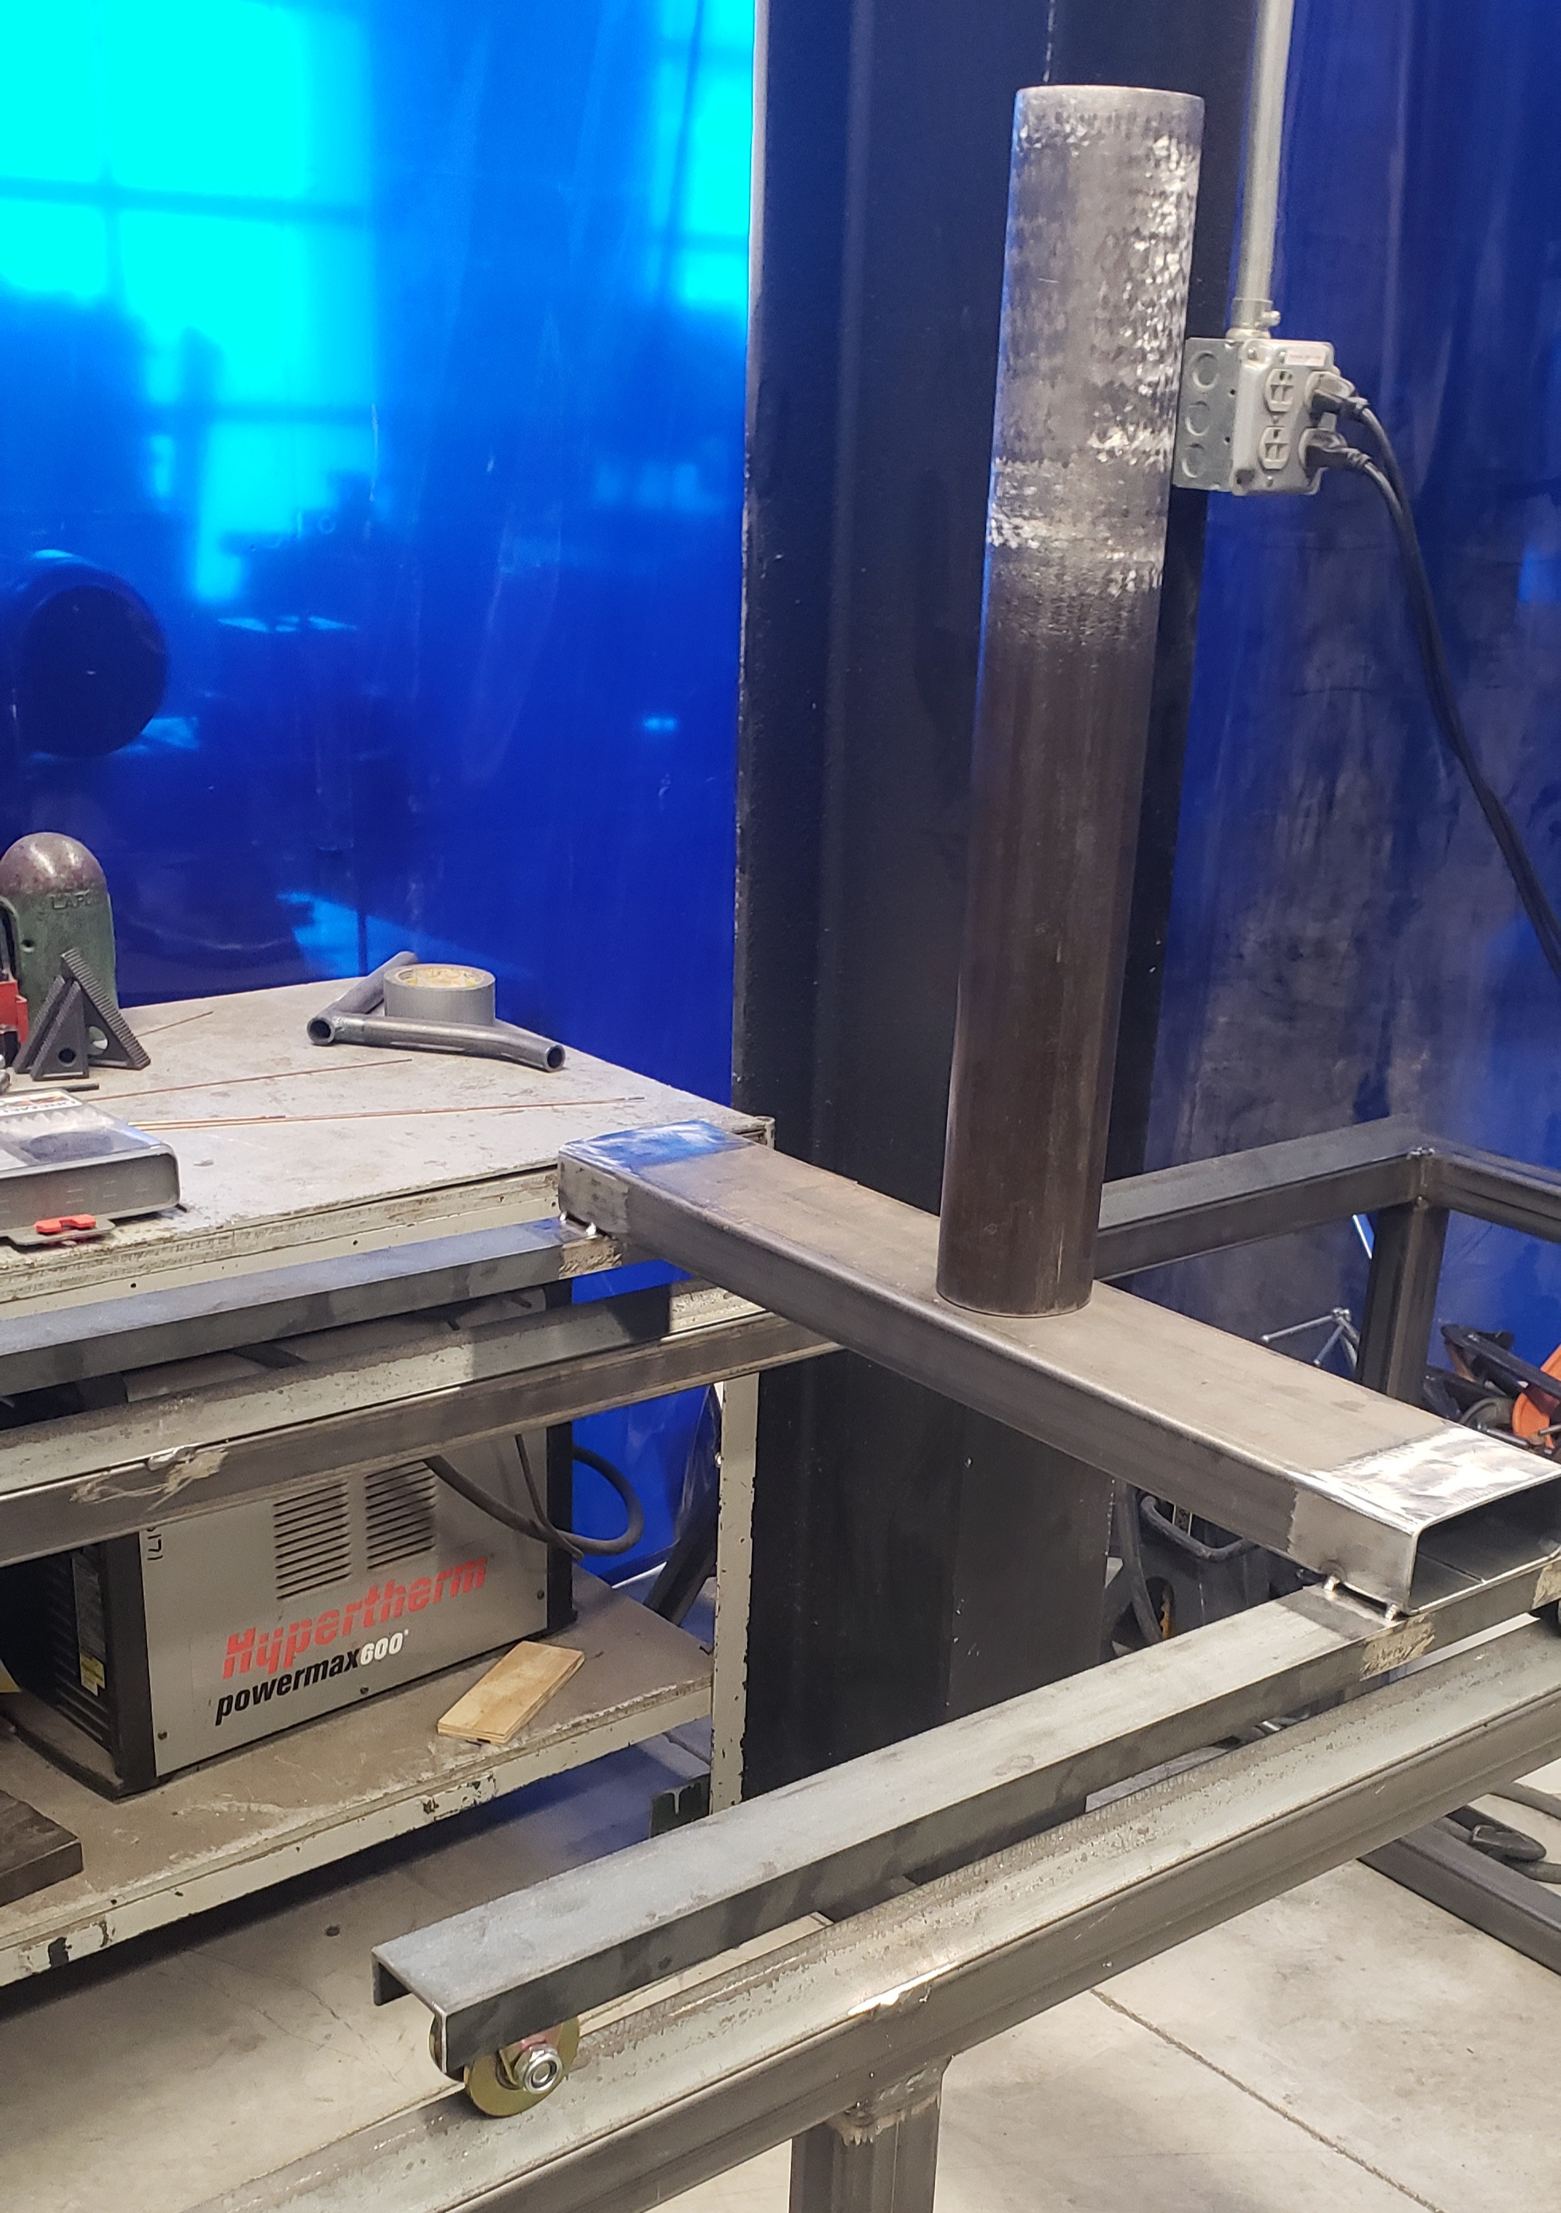
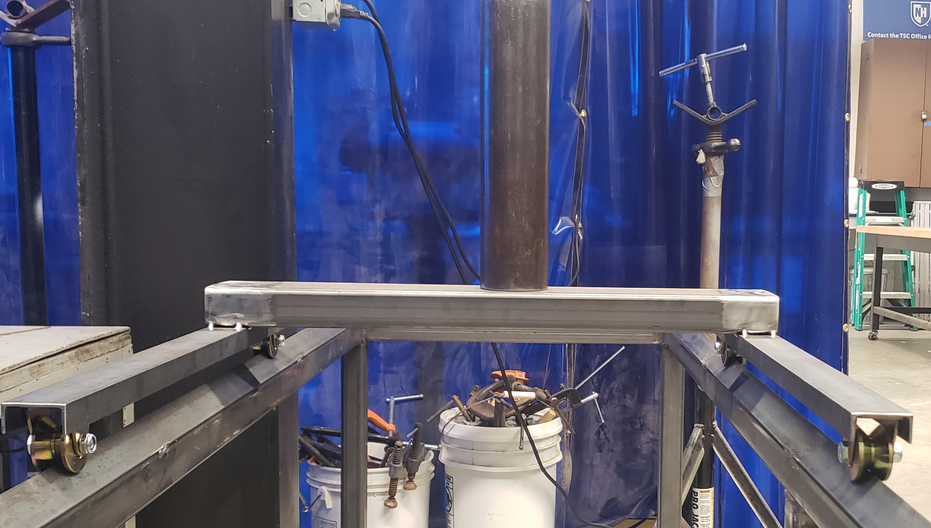
Pipe Drilling Automation for PVC Oyster Sorting Machines
Shea Malloy and Elizabeth Saucier, Mechanical Engineering, University of New Hampshire
Professor John Roth, Faculty Advisor; Brian Gennaco, Project Sponsor
background
Design
Ball Screw
Brian Gennaco, owner of the Virgin Oyster Company, developed a PVC oyster sorting machine that could be made with simple materials and equipment.
Brian Gennaco with
the oyster sorting machine
Each Schedule 40 PVC tube is custom made with between 800 to 2000+ holes ranging in size. The average 6 feet long tube takes 8 to 12 hours to manually drill with a drill press.
Former pipe drilling
setup
The pipe drilling machine is compiled of an 8ft long steel box frame with two v-tracks that a steel drill head carriage rolls on top of.
The drill head carriage rolls laterally down the frame with an 8ft long ball screw mechanism.
The PVC pipe is held horizontally through the middle of the box frame by the rotational clamp and will be rotated as the drill press drills holes down from the carriage.
By having the drill press carriage roll above the PVC pipe, the PVC debris will not pose as much interference
The ball screw will be connected to the cross bar of the carriage and will control its linear motion.
The ball screw will be powered by its own motor and by switching the spin direction, the ball screw will move the carriage and drill back and forth along the top of the box frame with precision and accuracy for small hole spacings.
Ball screw
Steel B0x frame
Rotational System
The welded 25" x 29" x 8' steel box frame is the main housing unit for the PVC tube during the drilling process.
The two angle bars welded across the length of the box provide a v-track for the drill press carriage's v-castor wheels to roll on.
Welded steel
box frame
The rotational system is mounted to the side of the frame and its height is adjustable to accommodate different sizes of PVC tubes.
The head of the rotational system come from the head of a lathe. It grips the PVC tube from the inside and can hold tubes up 18 in. In diameter.
The head is on a shaft that will have its own motor. This will allow the tube to rotate inside the box frame so that holes can be drilled at any spot on the tube.
Rotational system
with pipe clamp
Project Statement
To design, build, and program an automated drill press machine with an automated, laterally moving drill head and automated rotational movement of a large PVC cylinder in the manufacturing of Virgin Oyster Company’s oyster sorting machine.
The original plan for this project was to fully automate the movement of the drill press, the extension of the drill bit, and the rotation of the PVC tube.
Due to complications in the delivery of materials and lack of electrical engineering and programming knowledge, the project was updated to only incorporate the mechanical aspects of the design.
The electrical portion of the project will be continued by a future senior design group.
Steel Carriage
The steel carriage holds the head of the drill press and rolls on top of the steel cage
The steel tube on the carriage is inserted into the head of the drill press, securing it the same way as on a normal drill press.
The ball screw moves the carriage along the top of the box frame using v-tracks and castor wheels.
Steel carriage with drill press pipe on
steel box frame
Future implementations
To automate the drilling machine, three motors to control the linear motion of the carriage (ball screw rotation), the rotation of the PVC tube (rotational system), and the drill bit insertion and extraction from the drill head must be implemented.
An Arduino Mega 2560 Rev3 was initially planned to program and control each motor however, it was found that with the amount of torque needed to be applied, large stepper motors would likely be used which necessitates the use of a motor driver, ultimately complicating the electrical system and programming more than a mechanical engineering disciplined team is familiar with.

