Slide 1
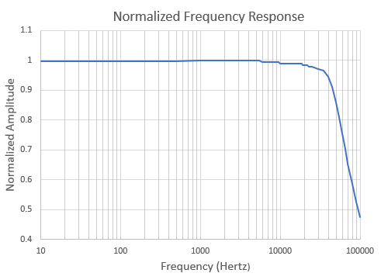
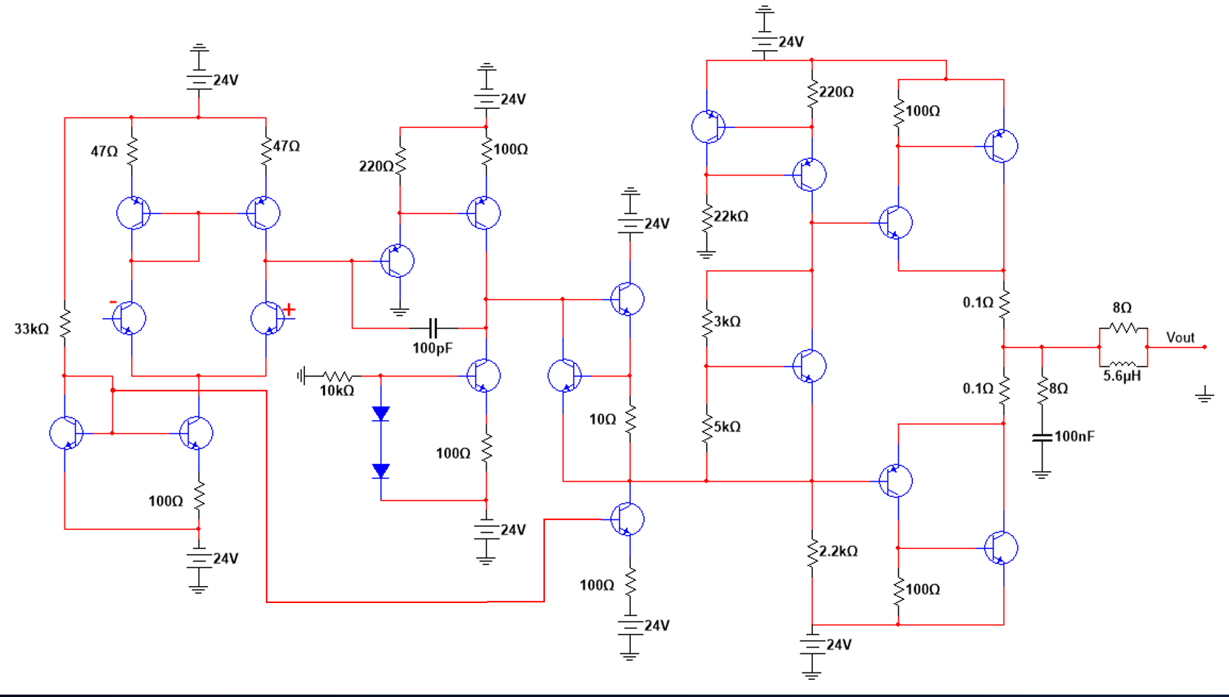
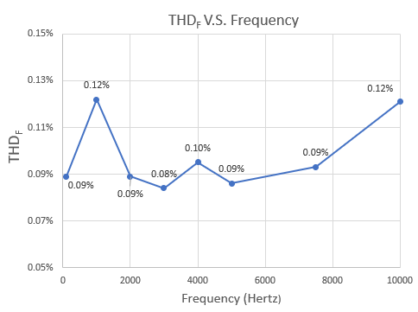
Design of a Discrete Audio Amplifier
Budget Amplifier Achieves Low THD
Marc P. Tausanovitch
Advised by Dr. John LaCourse
Department of Electrical & Computer Engineering University of New Hampshire, Durham, NH 03824
Introduction
Results
Schematic
A 20-Watt, direct-coupled audio amplifier is designed using discrete bipolar junction transistors
Discrete components allow greater design flexibility and specialization compared to monolithic op-amps
Economical design offers significant price advantage over similar products
Left: Normalized frequency response from 10 Hz to 100 kHz
R_{L} = 8 Ω, A_{V} = 30 V/V, P_{out} = 20 W_{RMS}
Methods
Future Work
Based on discrete operational amplifier
Class AB power amplifier provides current gain
Prioritizing flat frequency response, low noise, and low THD over 20 Hz – 20 KHz for transparent amplification
Minimal component count to reduce cost and complexity, enabling serviceability and modification
Small signal analysis and analog design techniques provide foundation for amplifier construction
Dual-rail power supply
Construction of an additional channel
Addition of tone, balance controls
Provide capability for phono inputs
Improve op-amp characteristics & features
Ideal op-amp characteristics
Overvoltage, saturation protection, etc.
More power?
Left: %THD_{F} from 10 Hz to 10 kHz
R_{L} = 8 Ω, A_{V} = 21 V/V, P_{out} = 1 W_{RMS}
First 10 harmonics measured.
Parameter | Condition | Value
P_{out} | R_{L} = 8 Ω | 25 W_{RMS} MAX
DC Offset | R_{L} = 8 Ω, P_{out} = 20 1 W_{RMS} | 100 mV MAX
%THD_{F} | R_{L} = 8 Ω, P_{out} = 1 W_{RMS} A_{V} = 21 V/V | 0.12% MAX
%THD_{R} + N | R_{L} = 8 Ω, P_{out} = 1 W_{RMS} A_{V} = 21 V/V, f_{in} = 2 kHz | 0.13% TYP
f_{-3dB} | R_{L} = 8 Ω, A_{V} = 30 V/V, P_{out} = 20 W_{RMS} | 65 kHz TYP
Bill of Materials
References
Part | Approximate Cost
Transistors | $18.97
Passives | $10.80
Hardware | $10.40
Total | $40.17
Self, D. (2009). Audio Power Amplifier Design Handbook. Focal Press.
Self, D. (2020). Small Signal Audio Design. Routledge.
Huijsing, J. (2011). Operational amplifiers: Theory and design. Springer Netherlands.
Jaeger, R. C., & Blalock, T. N. (2016). Microelectronic Circuit Design. McGraw-Hill Education.
Otala & Lohstroh (1973). An Audio Power Amplifier for Ultimate Quality Requirements. IEEE Trans on Audio and Electroacoustics.
Sato et al (1982). Amplifier Transient Crossover Distortion Resulting from Temperature Change of Output Power Transistors.

