Slide 1
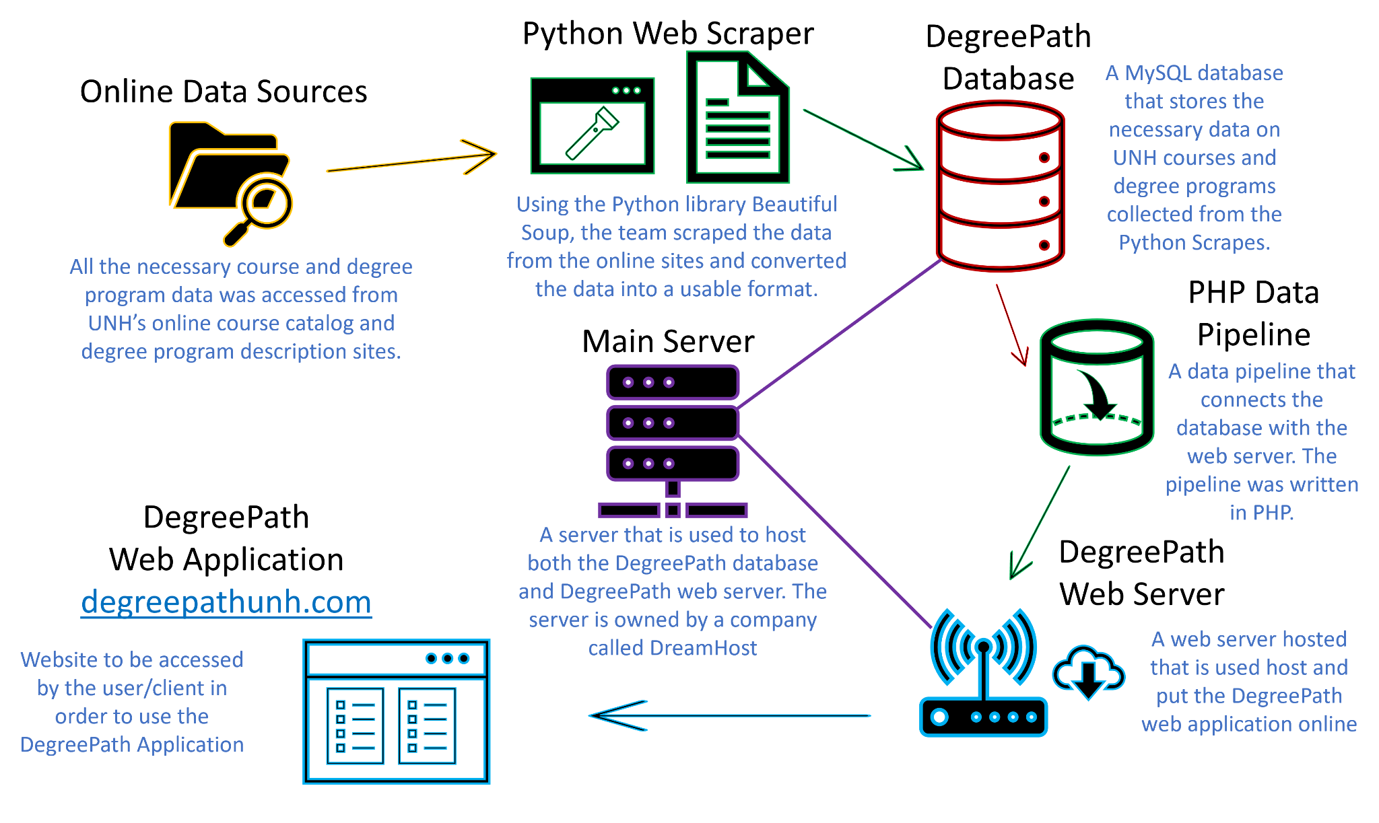
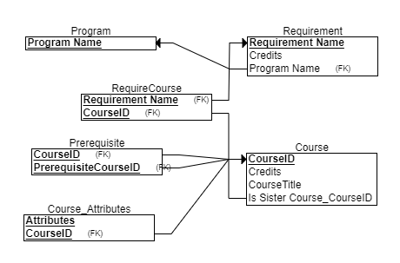
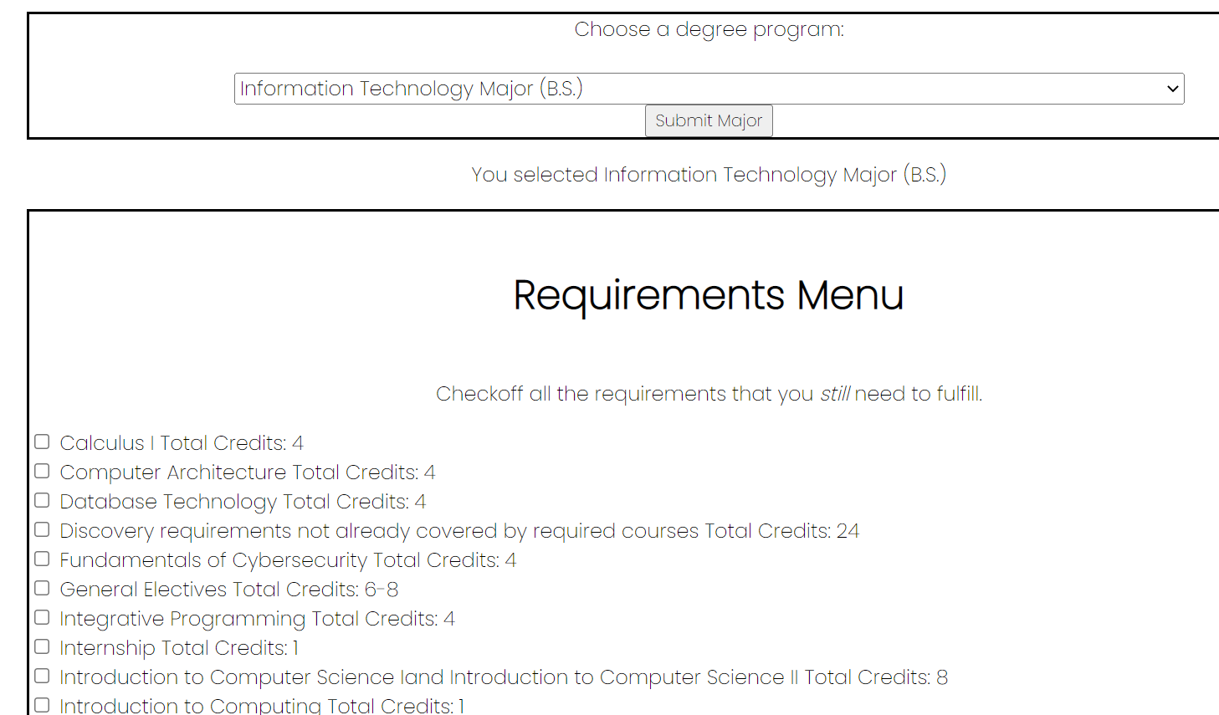
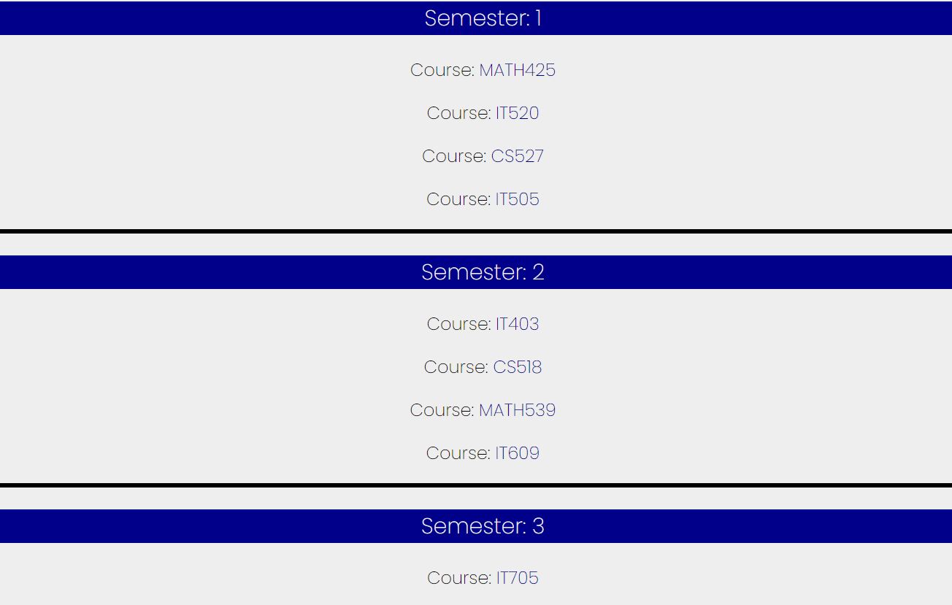
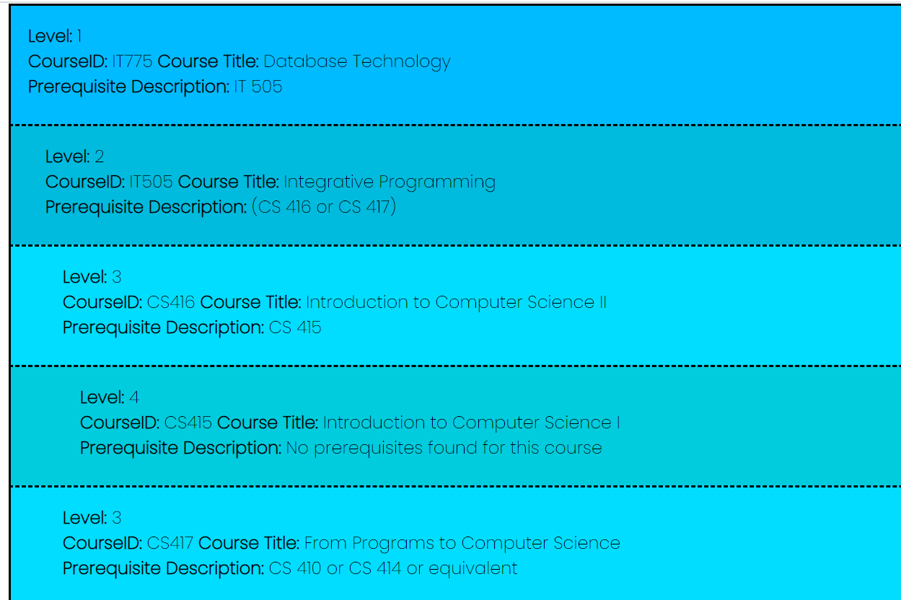
DegreePath Nas Tber, Ryan Foley, Jiacheng Ding University of New Hampshire, Durham, NH 03824
Introduction
System Design, Implementation, and Data Flow
Results
DegreePath is a web application that will allow UNH students to easily view requirements of all UNH degree programs in a centralized area. Additionally, DegreePath will allow UNH students to build and view a future degree path based on the courses and credits they have already received.
Our goal is to create a service in which 90% of UNH students are successfully able to select any degree program and determine a remaining degree path based on the courses they have already taken by the end of the school year.
Overall, the team would deem this project a success. The prerequisite tool generates accurate output, is easy to understand, and works in under a second. Using the tool, students can easily view all the courses they would need to have completed in order to take any UNH course.
The team will acknowledge that there still is a lot of work to do in terms of generating usable schedules based on a student’s prior courses. Currently, the schedule tool is more of a proof of concept in that it can take user input, interact with the database, and generate a feasible schedule based on that user’s input. However, the schedule generator tool still needs to better factor in course prerequisites, general course selection logic, and be more usable across different majors (currently it functions best for the IT major).
In summary, this project certainly adds value for the student as they can look up any course and see a progression of prerequisites for any selected UNH course. While we currently do not have a comprehensive schedule generator, students can still use the application to get an idea of a major’s requirements and a course’s prerequisite path, adding value and making our project a success.
Requirements
Using web scraping tools, scrape and collect data from the UNH course and degree program websites.
Design and implement a mySQL database with the collected UNH course data.
Implement a web server that will host the DegreePath application.
Create a web application using HTML, CSS, JavaScript, and PHP that is able to generate future course schedules and display them back to the user, based on the courses the user has already taken and the degree requirements a user has already satisfied.
The application should allow a user to enter any valid UNH course ID and view all the prerequisites for that course.
The application should allow a user to select any major and then using checkboxes, check all the degree requirements and courses they have already satisfied.
The generated and displayed schedules should generate as many schedules as necessary until the user’s graduation.
The generated schedules should take into account any prerequisites a course may have.
The DegreePath application should also be:
Easy to access webpage/domain that application is able to run on.
Fast and generates a schedule quickly. (Under a few seconds)
Testing / Future Steps & Limitations
Functionality Testing:
Application is free of bugs and errors
Make sure all prerequisites for a course are satisfied before they are taken
Test to make sure the program does not crash
Functionality testing
Program can handle invalid input
Program can handle no input
Program is functionally sound
Current Limitations:
Schedule Tool:
Needs to more accurately factor in prerequisites.
Less effective for all UNH majors (most useful for IT major).
Data across different UNH majors is often organized in slightly different formats. This can sometimes cause inconsistencies in schedule generation.
Future Steps and Future Testing:
Continue schedule tool testing:
Ask advisors of various degree programs if schedules generated make logistical sense.
Usability Testing:
Ask random UNH students to try and use the application.
How long does it take them?
How easy is the program to use?
Implement DegreePath at other Universities
User accounts
Ability to save/store user inputs
Ability to download CSV file of user inputs
Interface with YouScheduler (another UNH based course scheduling application)
Figure 1: DegreePath Data Flow and System Design diagrams.
DegreePath Database Outline
Database Outline:
Table 1: Degree Programs - (ie: Majors)
Purpose: To store the name of the degree program.
Table 2: Requirements
Purpose: This table will store the information regarding the requirements of a selected degree program.
Table 3: Requirements - Course Connector
Purpose: This table simply acts as a connector between the courses and requirements table.
Table 4: Courses
Purpose: To store information regarding all courses that UNH offers.
Table 5: Course Attributes
Purpose: This table stores all the various UNH based attributes/tags a course has.
Table 6: Prerequisites
Purpose: This table stores all of the prerequisites a specific course has.
Figure 2: DegreePath database relational schema.
DegreePath Requirement Input and Generated Schedules
Acknowledgments
Figure 3: DegreePath Application: Course/Requirement Input Menu
Figure 4: DegreePath Application: Generated Schedule (IT Major)
Figure 5: DegreePath Application: Prerequisite Tool Output
Special thanks to our sponsor, Professor Arvind Narayan

