Slide 1
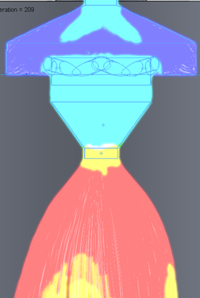
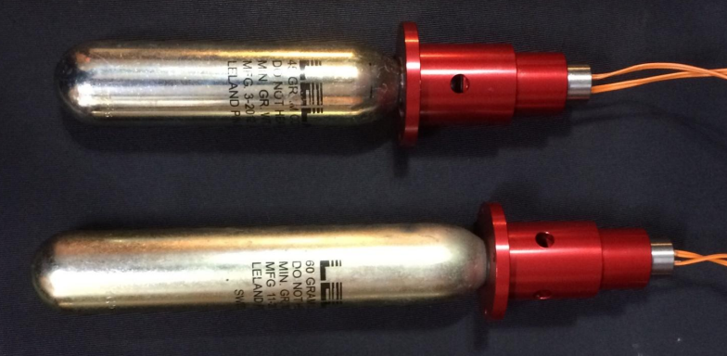
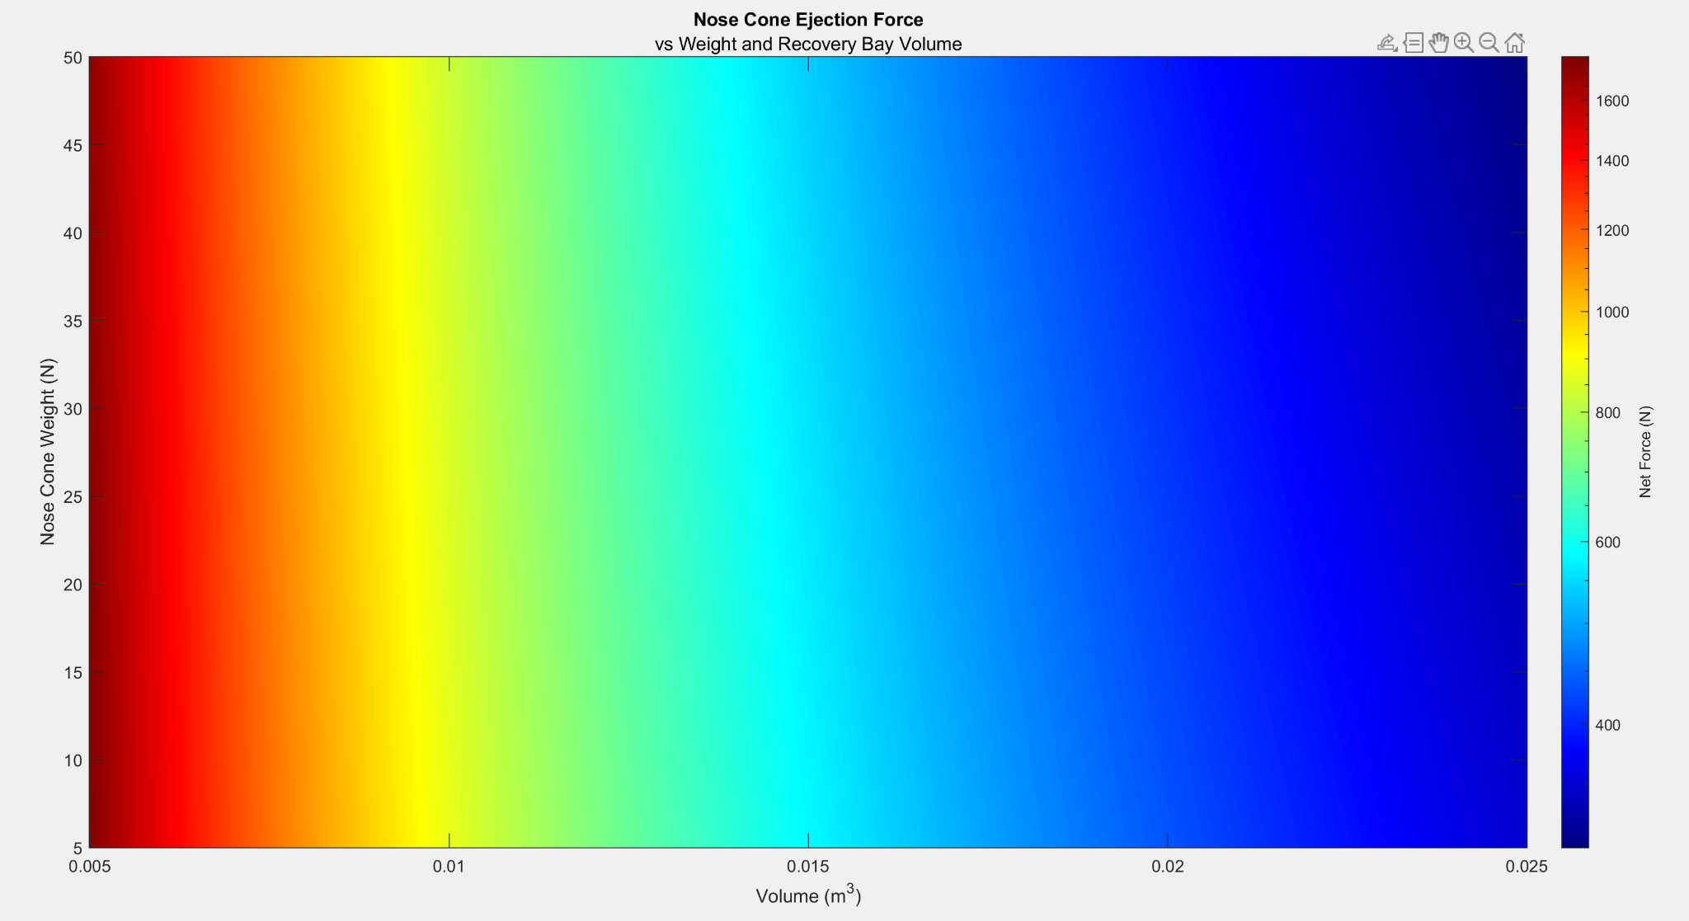
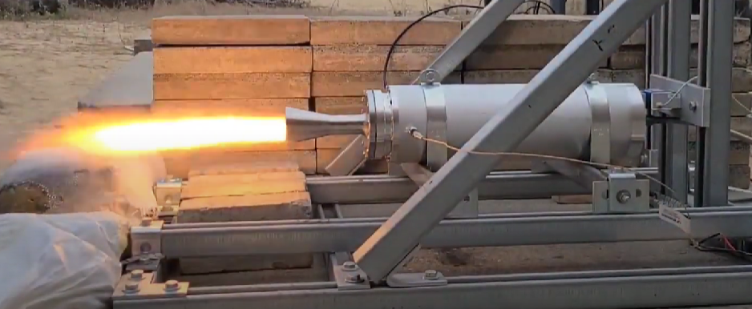
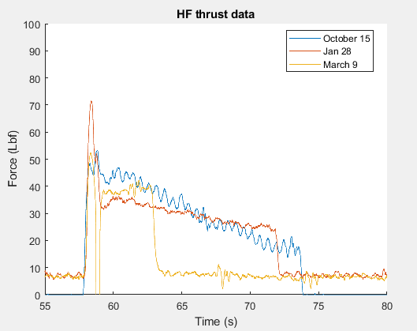
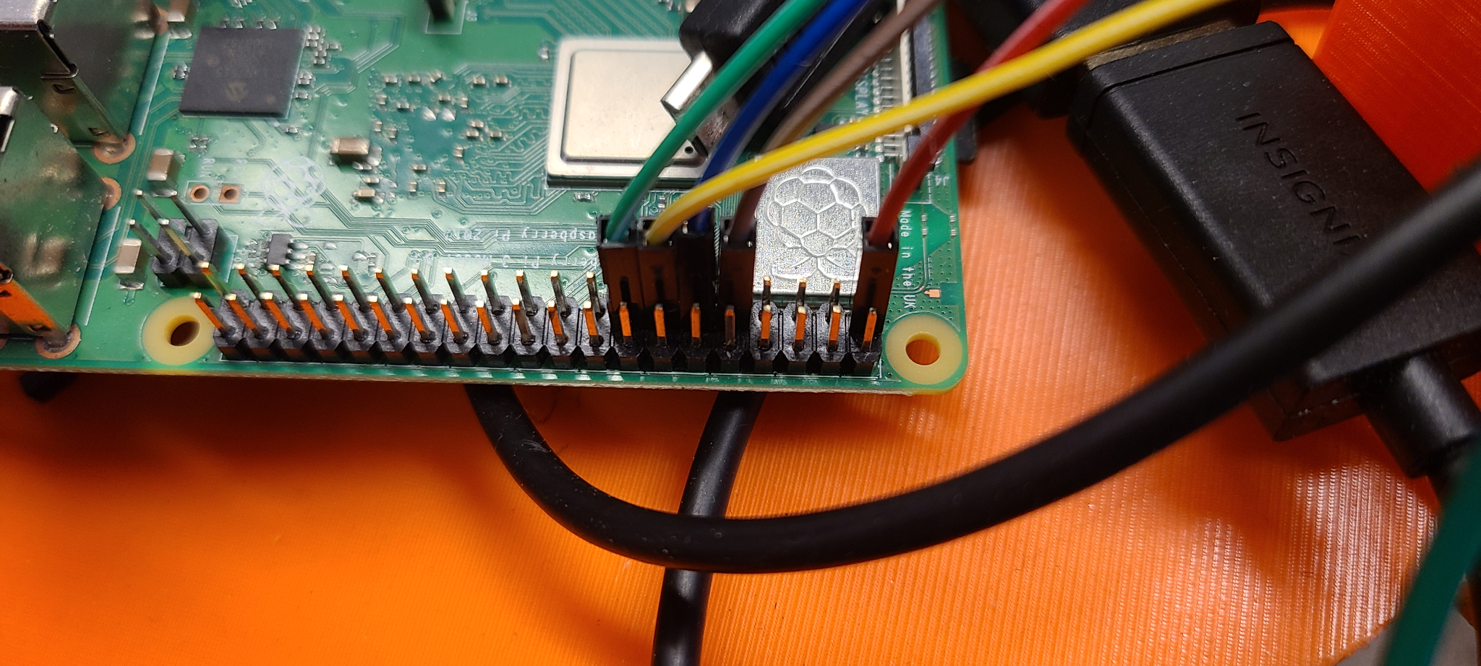
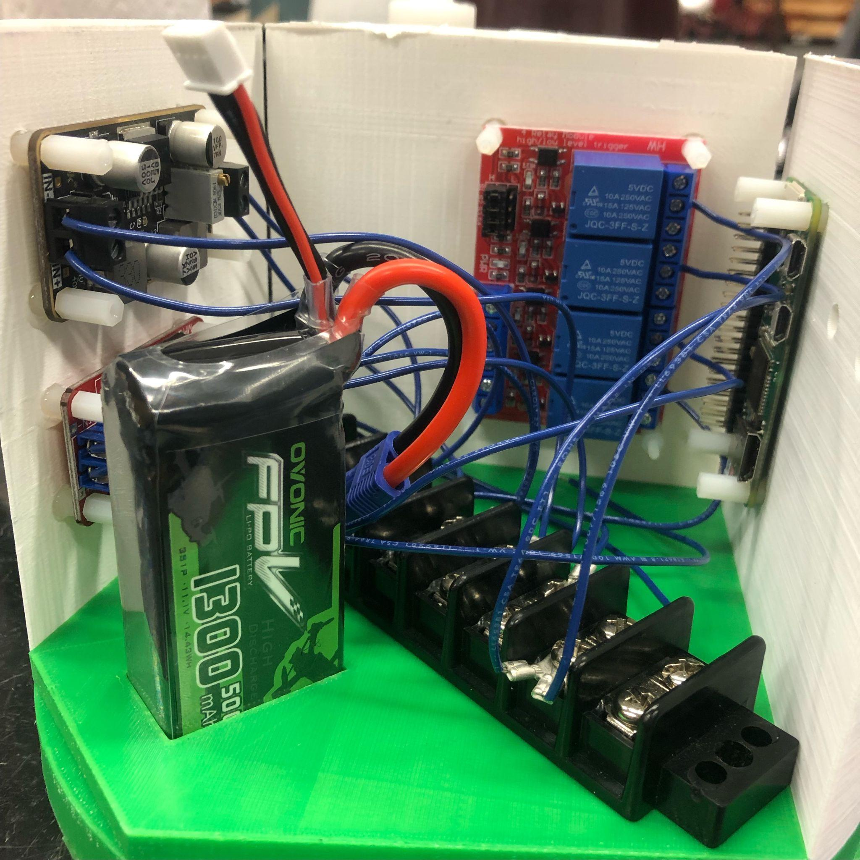
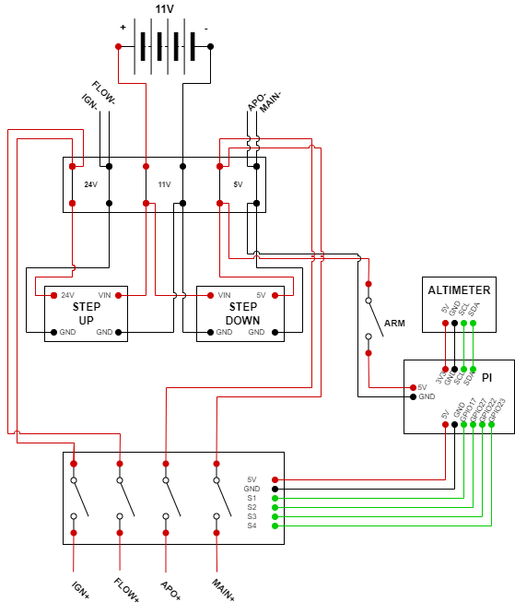
UNH SEDS | Europa Rocket Department of Mechanical Engineering, University of New Hampshire
Authors: Dawson Buchanan, Alex Chesley, Samantha Cuozzo, Tyler Dubien, Jeffrey Grant,
Casimir Guida, Tom Pare, Maddy Pitre, Cornelis Plomp, Alec Ross, Alice Wade
Project Overview
Frame
Propulsion
Design and build a rocket for the Spaceport America Cup
Goals
Build a rocket capable of climbing to 10,000 ft
Carry a 9lb payload
Hybrid Rocket Engine
Constraints
Redundant electronics
High safety and stability requirements
The shell is comprised of 6061 aluminum and Blue Tube, with four sections connected by cylindrical couplers
Cylinders were machined using both waterjet and drill press. Large size made this difficult
Minimizing weight was a high priority
Fins and nose cone optimized for stability
The Banshee Hybrid Engine is what provides thrust to launch the rocket, this engine uses a solid fuel and liquid oxidizer
The propulsion system consists of an oxidizer reservoir, flow regulation system, a swirl injector, combustion chamber, and the nozzle
Many types of fuel can be used in a hybrid engine like PVC or HTPB, but paraffin wax was chosen due to the ease of use and extremely low cost
The fuel is molded directly into the combustion chamber into the shape of a cylinder
The fuel is initial ignited to “pre-heat” the combustion chamber, before the oxidizer is injected to begin the combustion process
Hybrid engines are advantageous because they can be throttled and have low complexity when compared to liquid engines
Nosecone
The nose cone is a 3D printed Von Karman curve with an aluminum tip with a hook on the bottom to connect to the parachutes.
Payload and Recovery
Recovery
The recovery system includes both parachutes along with CO₂ ejection systems.
To recover the rocket a two stage recovery system was used with a drogue parachute to stabilize followed by a main chute to slow the rocket to its final speed
To deploy the parachutes the nose cone is ejected at apogee by a Raptor CO₂ ejection system
An aluminum base plate holds two raptor CO₂ systems (one for redundancy) along with U-bolts that attach parachutes to the rocket
Payload
Currently a 9lb inert payload, next year’s plan is a live 360° camera operated by a VR headset
Avionics
Avionics accounts for all of the electronics in the rocket. It powers the solenoids as well as ignites E-matches to start combustion and deploy the parachutes.
Design & Testing
Sensors were used during engine static test fires to measure engine thrust, internal pressure, and internal temperature
A more robust custom thermocouple was designed and built to withstand conditions during combustion
The area ratio of the nozzle was changed across three static test fires, with a smaller ratio proving to provide more thrust
Peak thrust was found to be ~75lbf
Nitrous Oxide
Tank
Carbon fiber wrapped pressure vessel containing 15lb of liquid/gaseous Nitrous Oxide used as oxidizer in the engine.
Avionics
Oxidizer Flow Regulation
Electronically actuated solenoid valve to control the flow of oxidizer from the tank to the injector of the engine.
In charge of all of the necessary electronics to run the rocket
The primary and secondary systems both use altimeters to control recovery deployment
The primary system also sends position and altitude telemetry over 70cm HAM radio
The secondary system interfaces with launch control
Engine
Banshee Hybrid Rocket engine uses a solid paraffin wax fuel and Nitrous Oxide to create combustion. The target thrust is 500lbf.
Stabilization Fins
A set of 4 fins shifts the center of pressure of the rocket, stabilizing it as it flies to 10,000’
Acknowledgements
We’d like to express our thanks to everyone who helped us on this project, from advising, scheduling events, machining parts, and much more: Dr. Todd Gross, Scott Campbell, Pam Lovejoy, Kelly Danforth, Kevin Carpenter, and Ron O’Keefe

