Slide 1
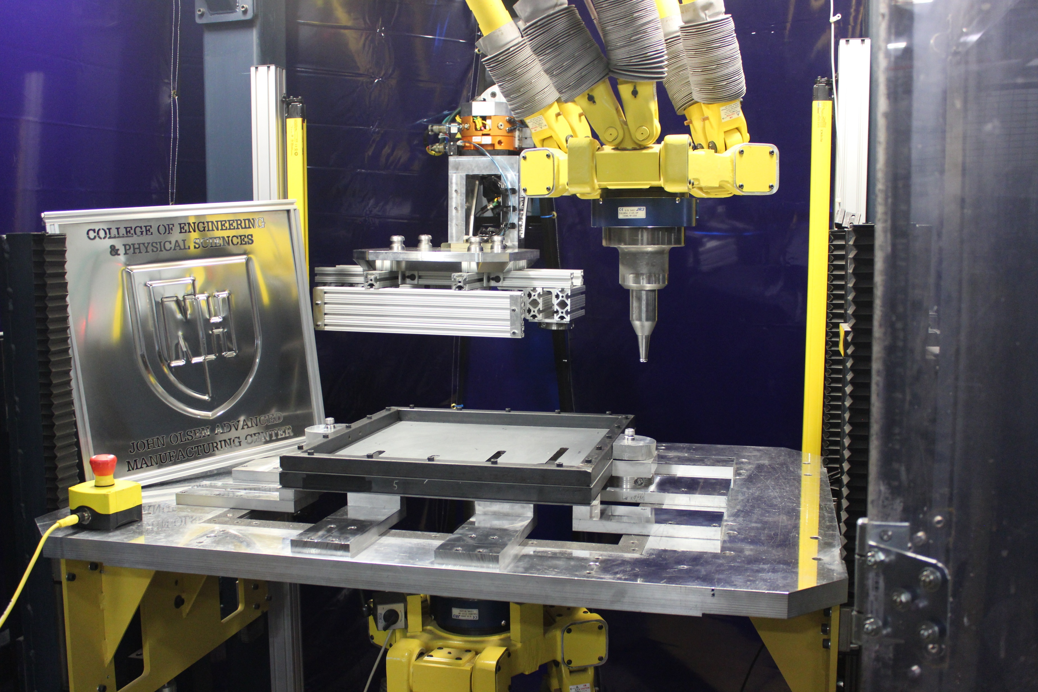
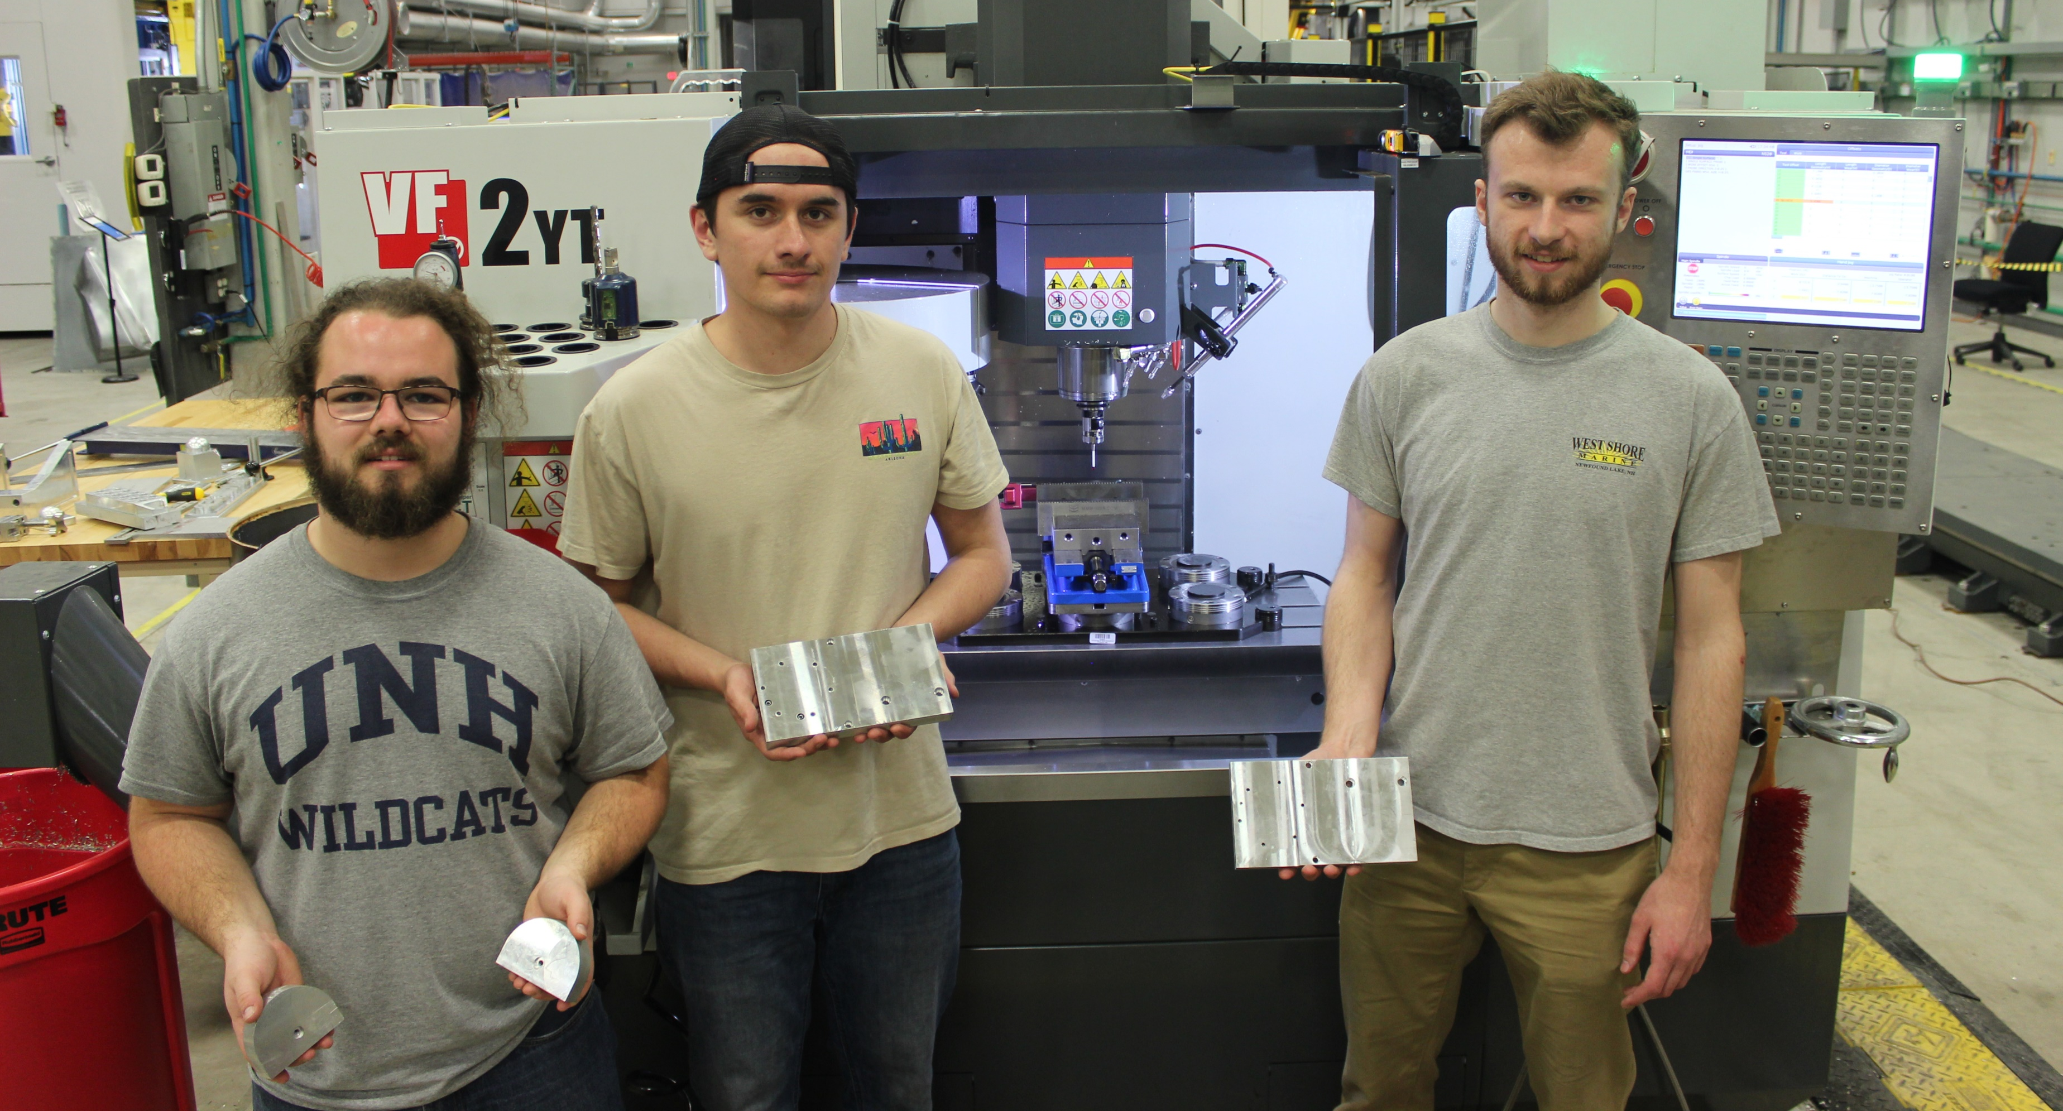
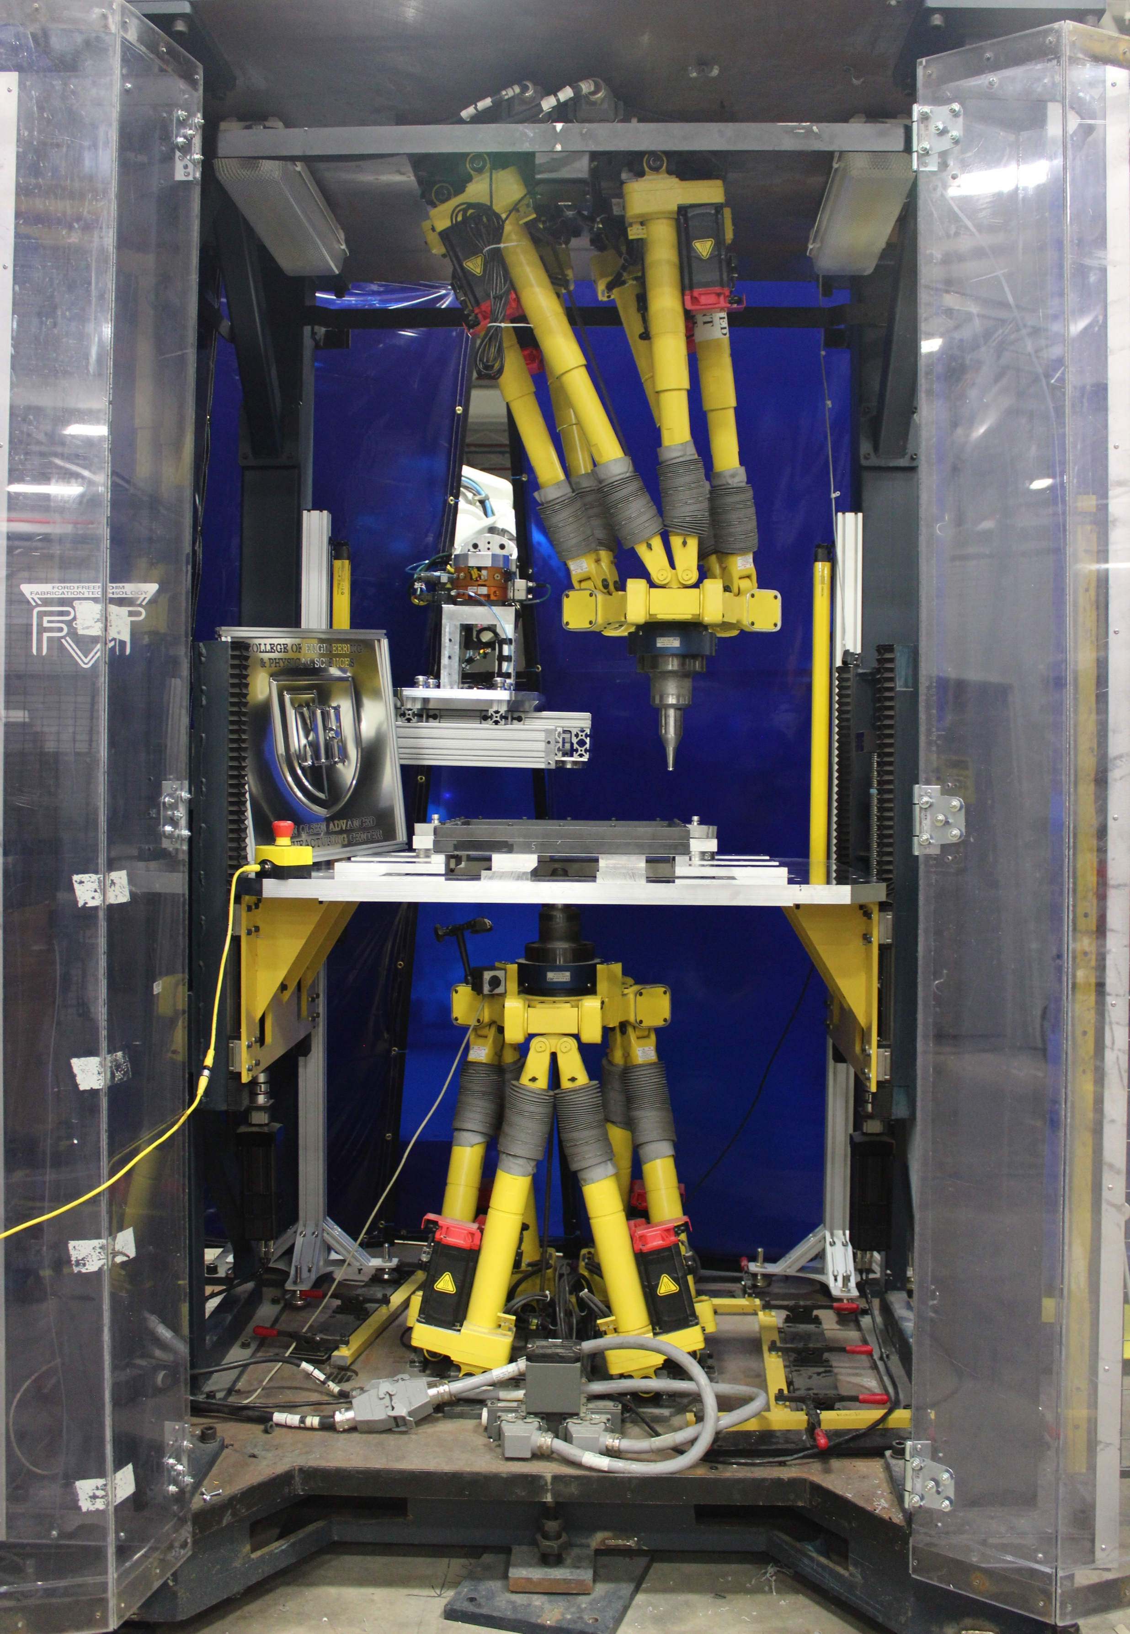
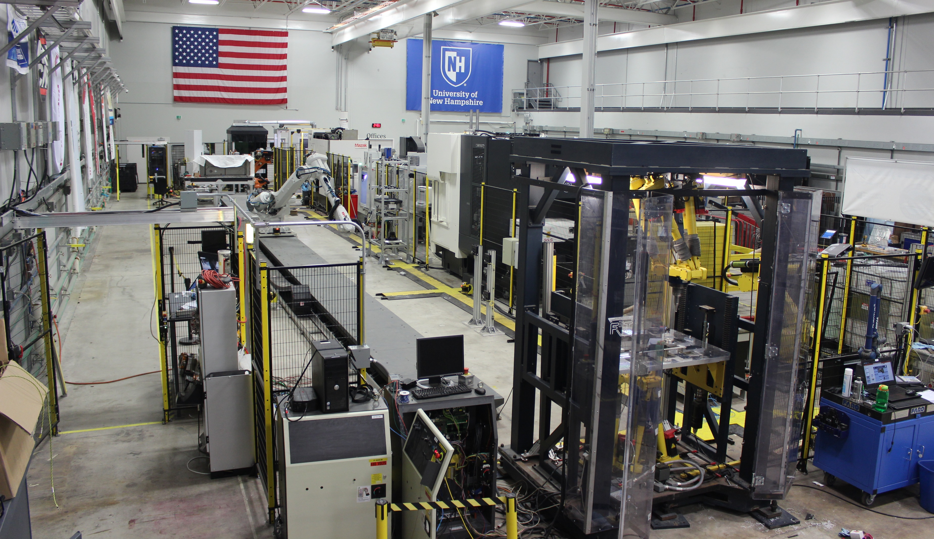
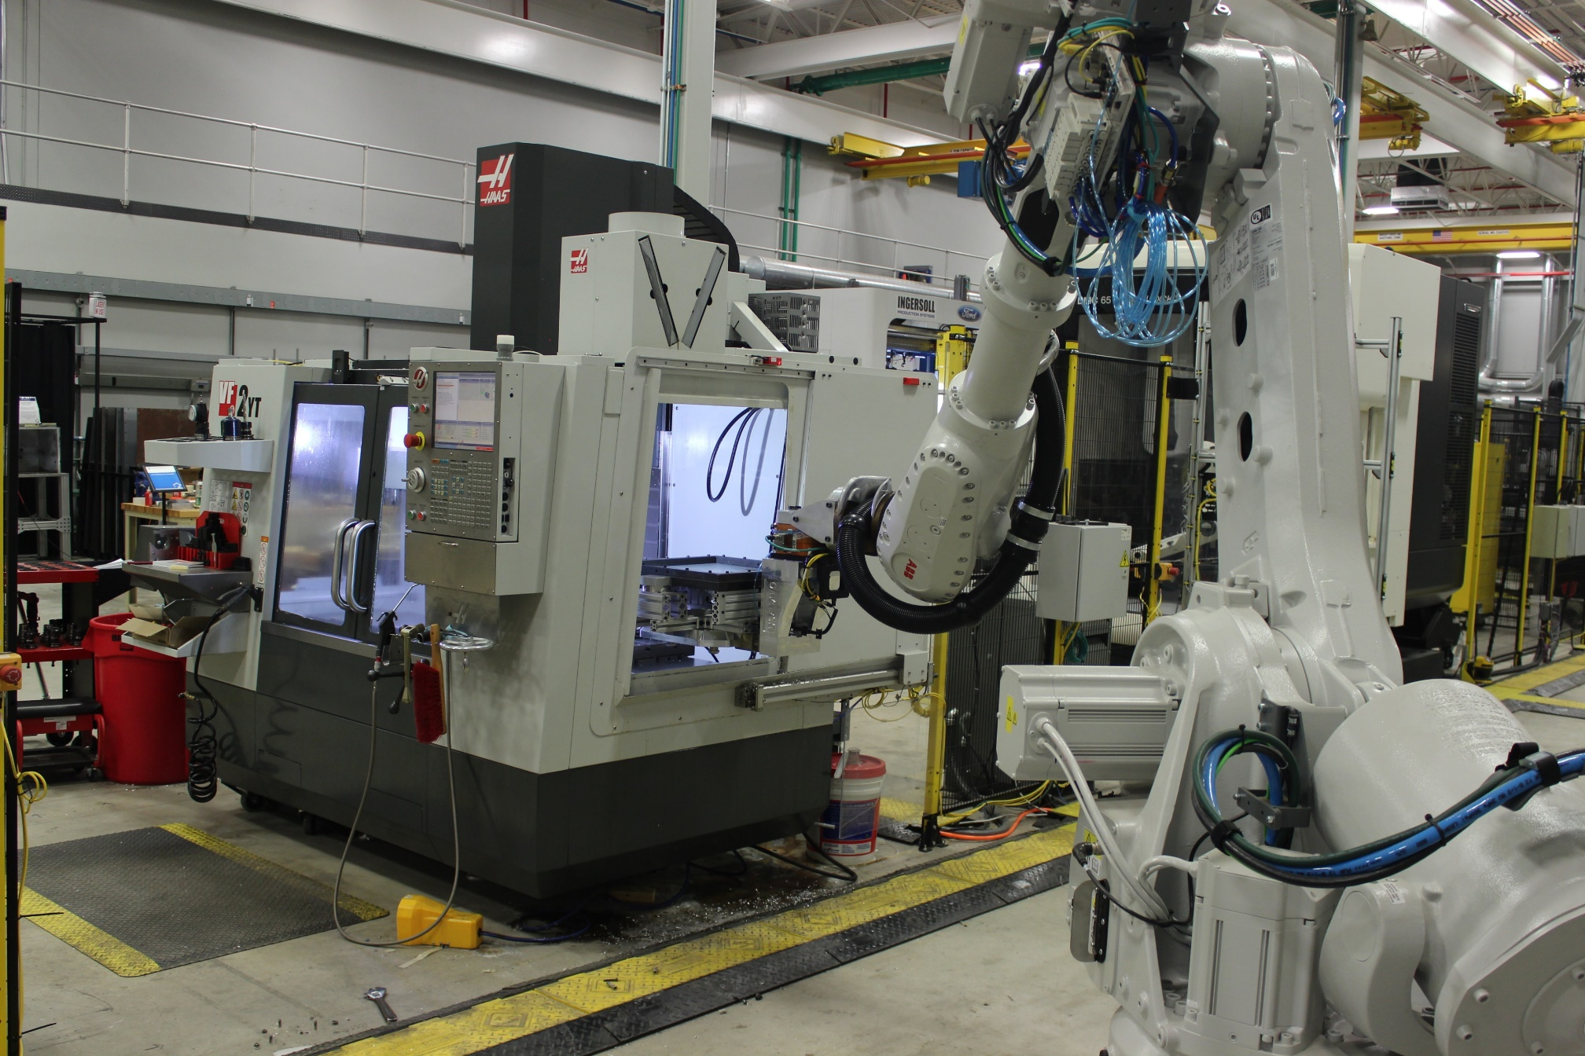
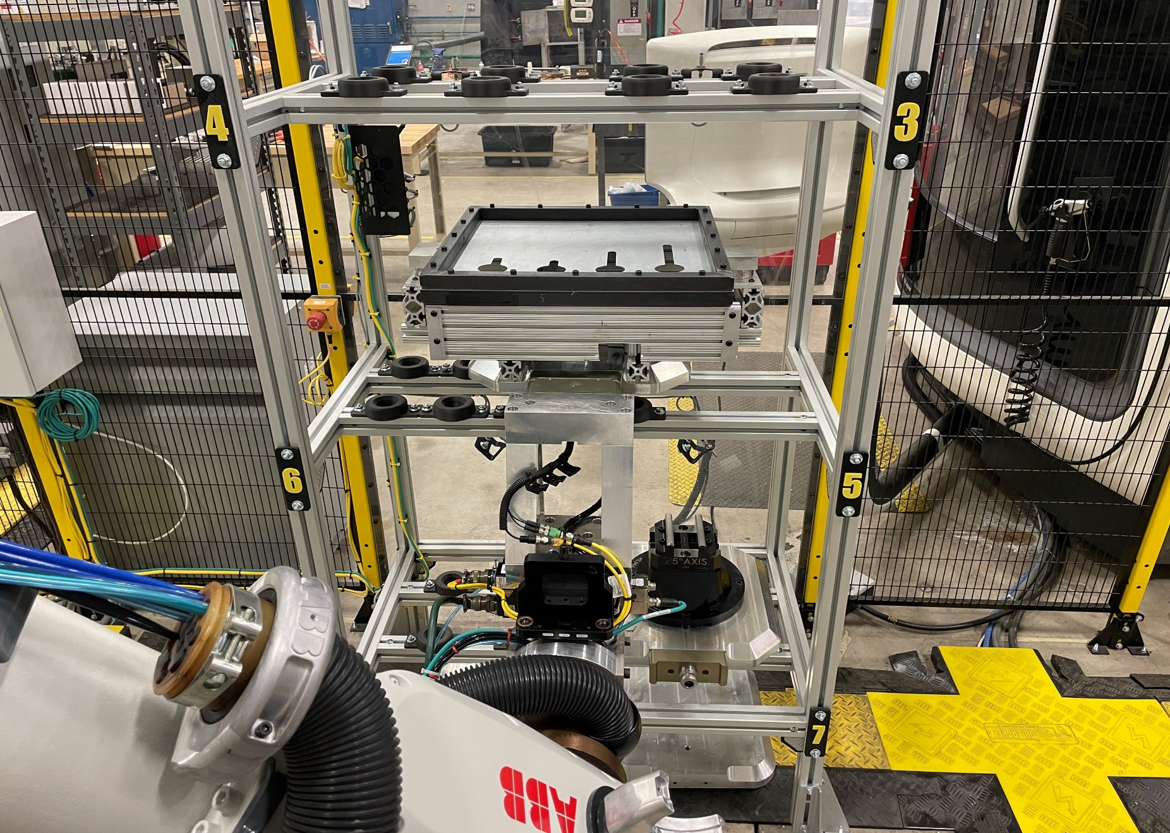
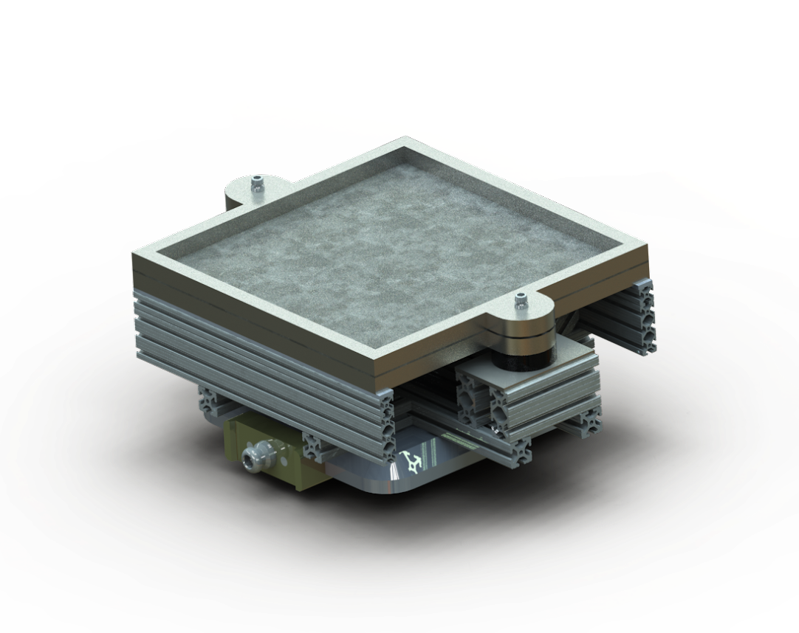
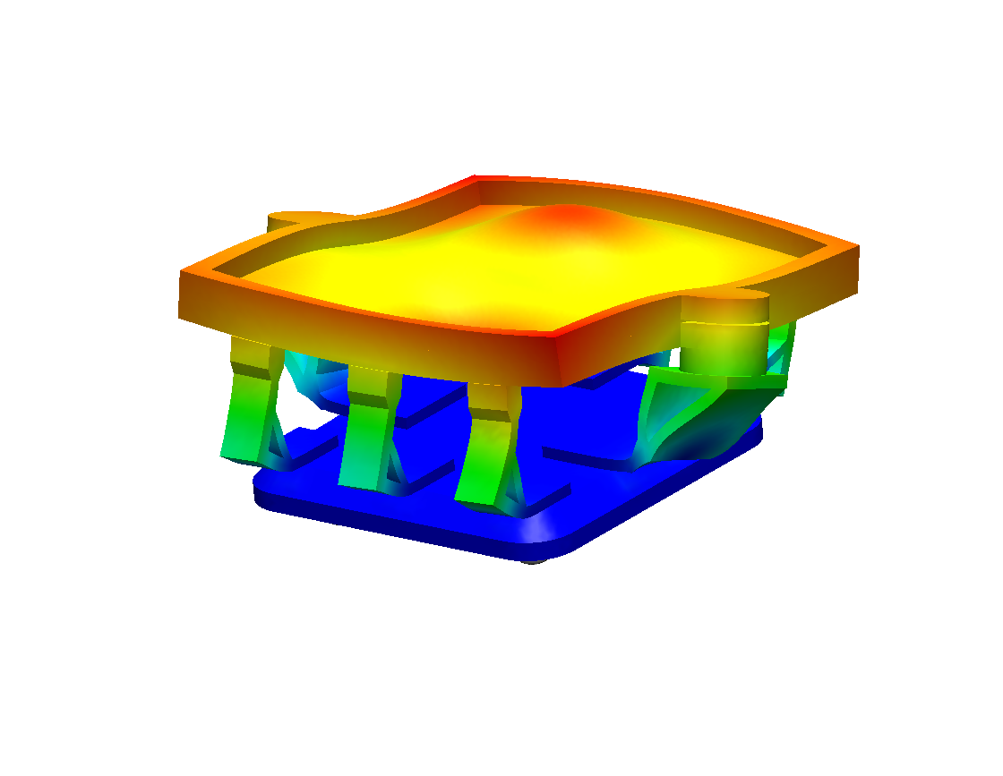
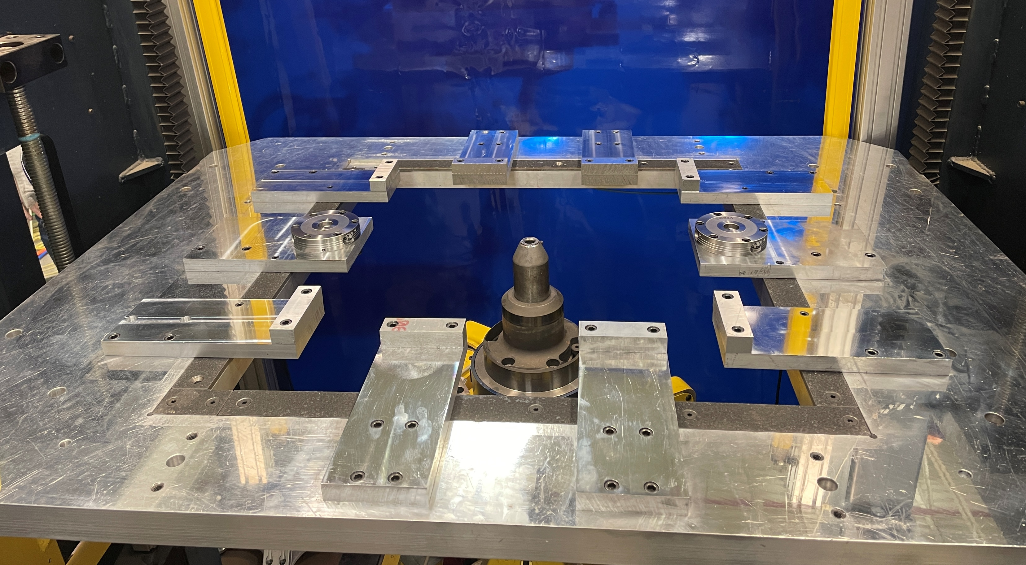
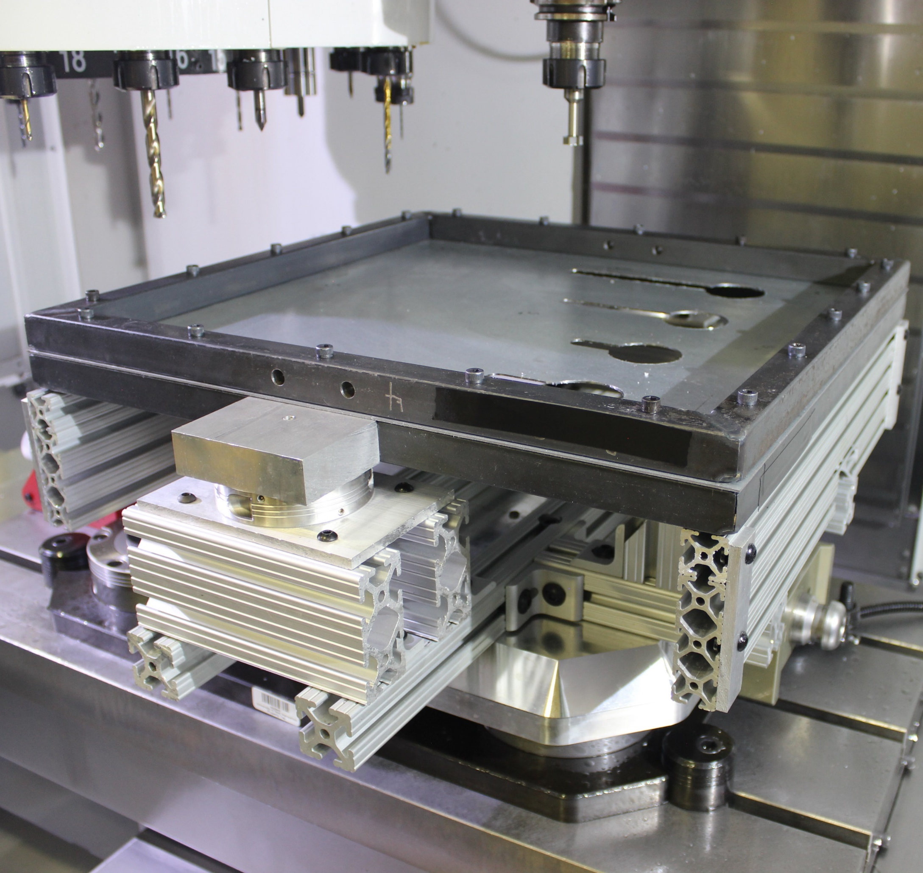
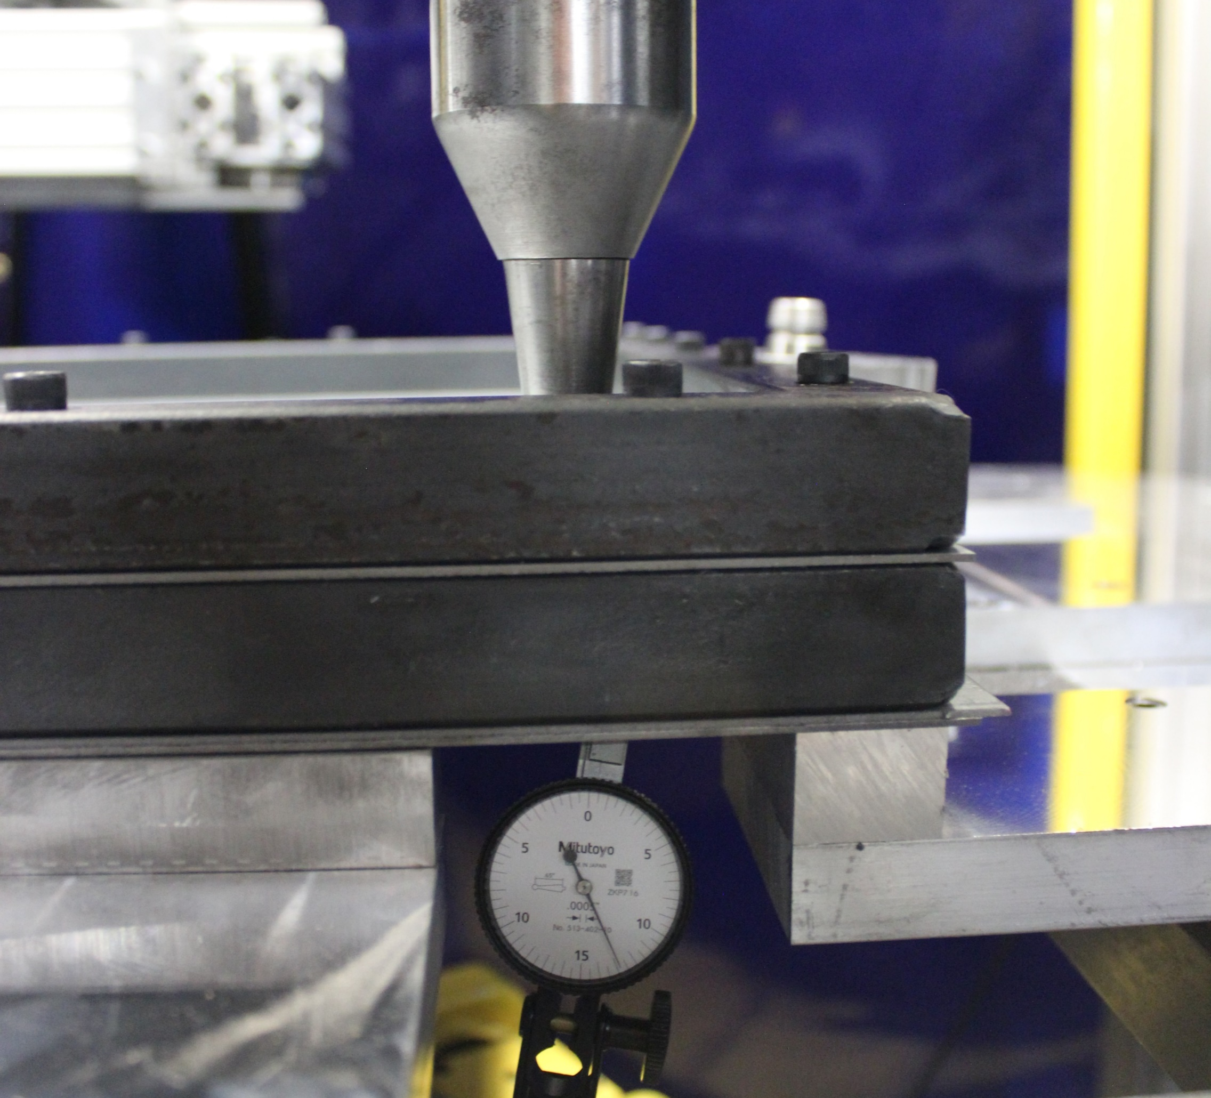
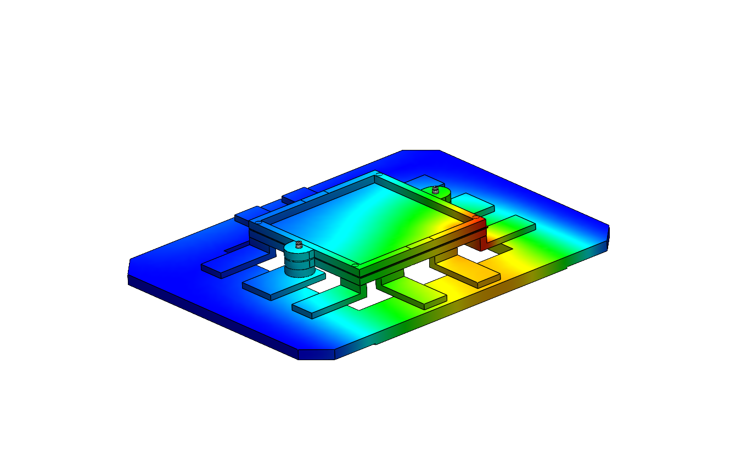
Automating an Incremental Forming Machine
Orrin Bliss, William Fernandes & Jacob Lorden
Department of Mechanical Engineering, University of New Hampshire, Durham, NH 03824 Advisors: Dr. John T. Roth & Nathan Daigle
Overview
System Components
Manufacturing
Purpose: Automate sheet metal forming
Forming Machine Details: Ford Freeform Fabrication Technology (F3T): great for rapid-prototyping and low-volume production; twin hexapods allow for dual-sided forming and undercutting
Location: John Olson Advanced Manufacturing Center
FANUC Hexapod Robots
ABB Robot
Pallet
Loaded Frame
F3T Platform
Pneumatic Clamping System
Safety Light Curtain
Safety Emergency Stop
26 custom machined parts completed in 3.5 weeks
All manufacturing and assembly was done by our team at the Olson Center
7
2
3
1
Design Criteria
7
Allows for sheet metal storage, forming, machining, and metrology
Eliminates human interaction after setup
Platform deflection less than .003 inches during forming
Avoids resonance in the milling machines (8-800 Hz)
Preserves manual operability
4
6
8
5
1
Integrated Systems
Mechanical Design
F3T
Pallet System
Full Cell Safety
Storage Rack
HAAS 3-Axis Mill
Metrology
DMG MORI 5-Axis Mill
Major Components
Frame: Contains sheet metal during all processes
Pallet: Used by ABB robot to transport the frame around the cell; secures the frame in the CNC machines and the metrology station
F3T Platform: Secures frame during forming process
Additional Work
Analysis and Testing
Completed FANUC robot repairs to fix F3T
Reestablished serial communication with the F3T platform adjustment motors
Successfully rigged and moved F3T and controllers to final position
Vibration
Tested on pallet/frame
Iteratively designed to raise first mode above 800 Hz (8000 rpm with 6 flutes)
Tested at varying frequencies to verify results
No resonance found in critical range
Deflection
Tested on pallet/frame and platform/frame
Minimum deflection to ensure accurate forming
Worst case load: single-sided forming
Applied force of 1000 N
Tested multiple critical points on frame
Next Steps
Program Robot Positions
Modify PLC
Complete Pneumatic System
Acknowledgements
Special thanks to Nathan Daigle and Dr. John T. Roth for design, analysis, and manufacturing guidance.
Thanks to Jessica Barker and Reyer Bliss for assembling and machining assistance.

