Slide 1


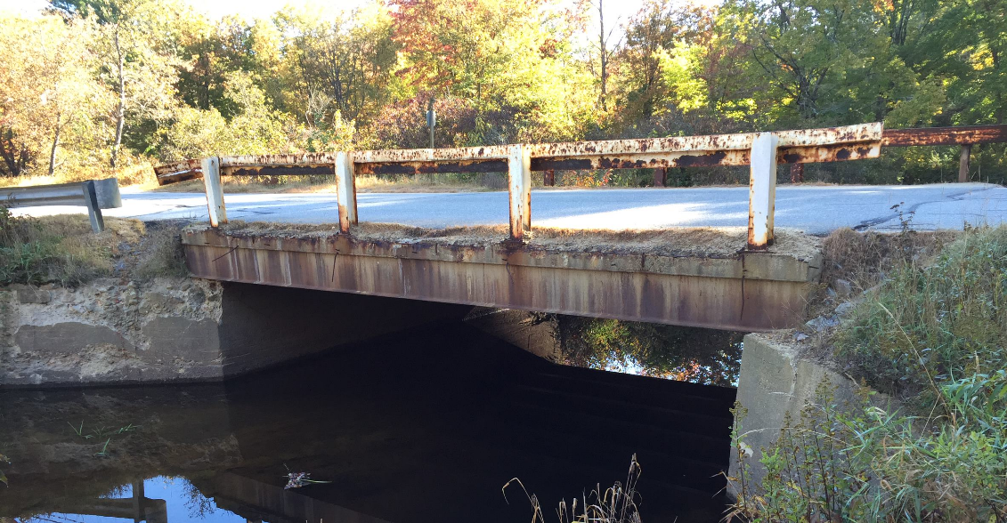
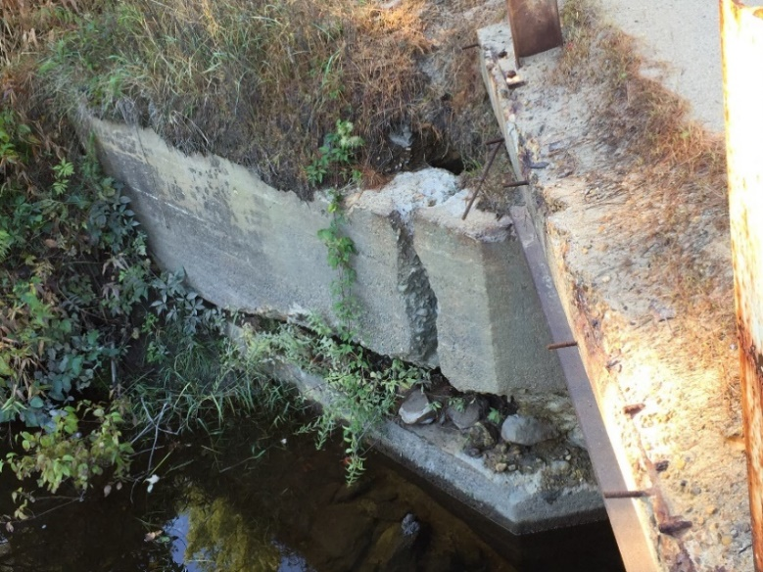
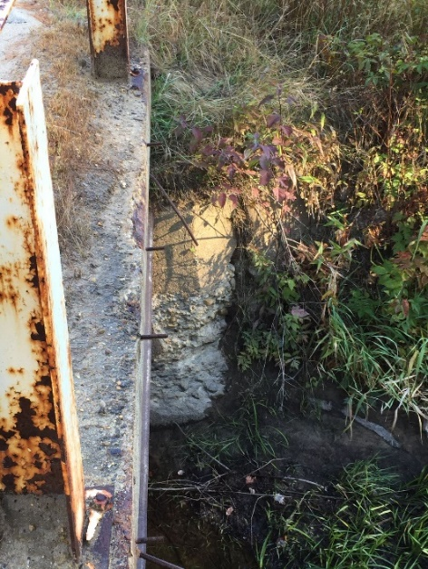
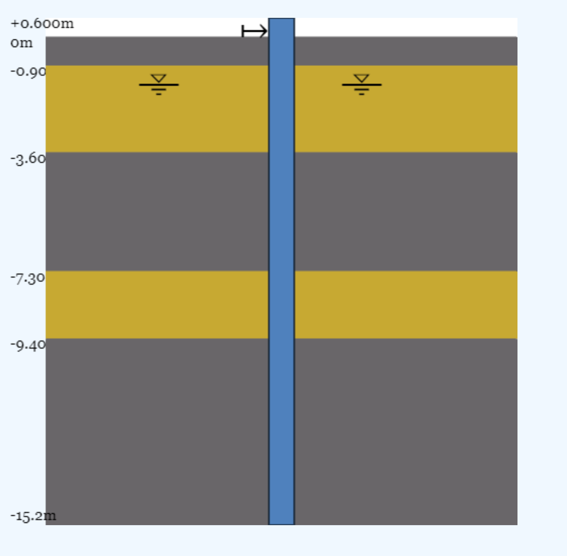
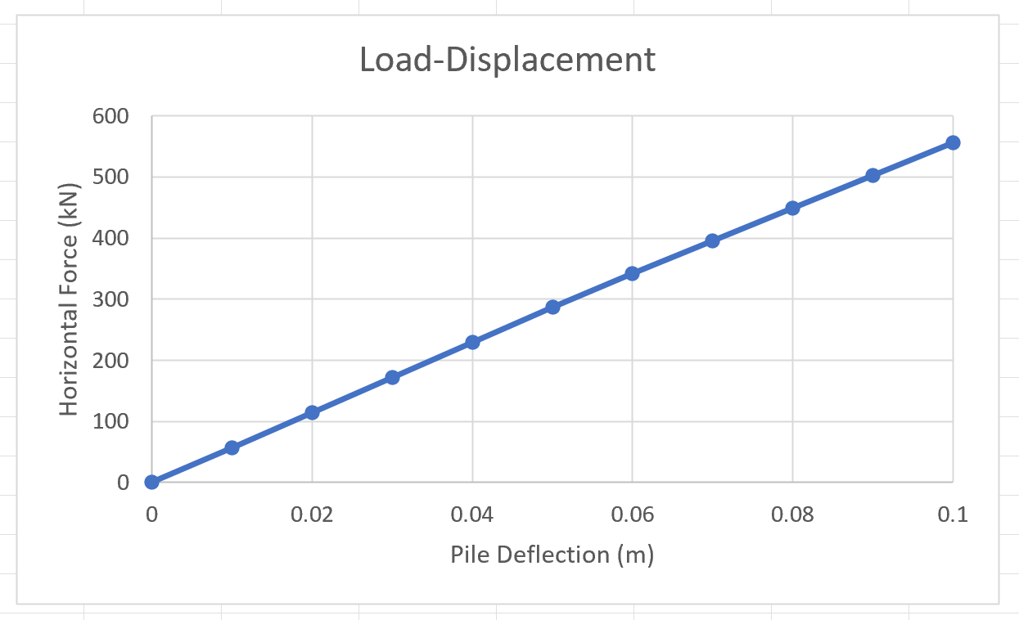
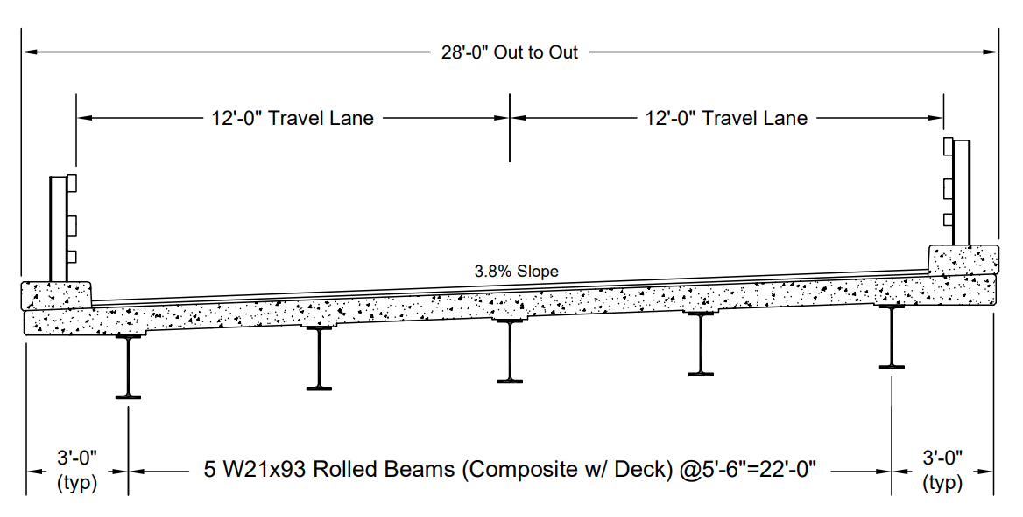
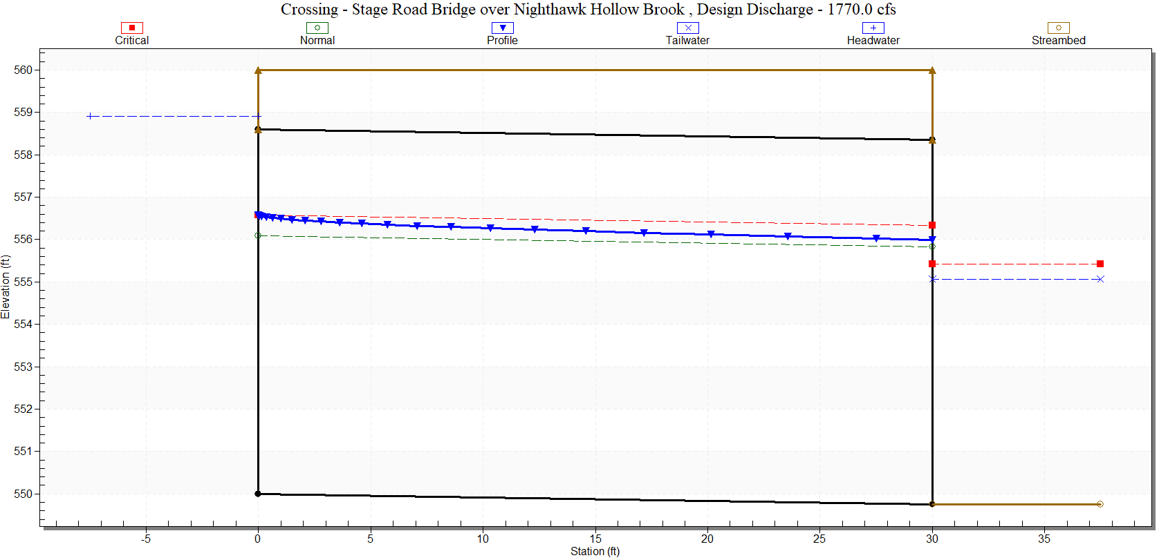
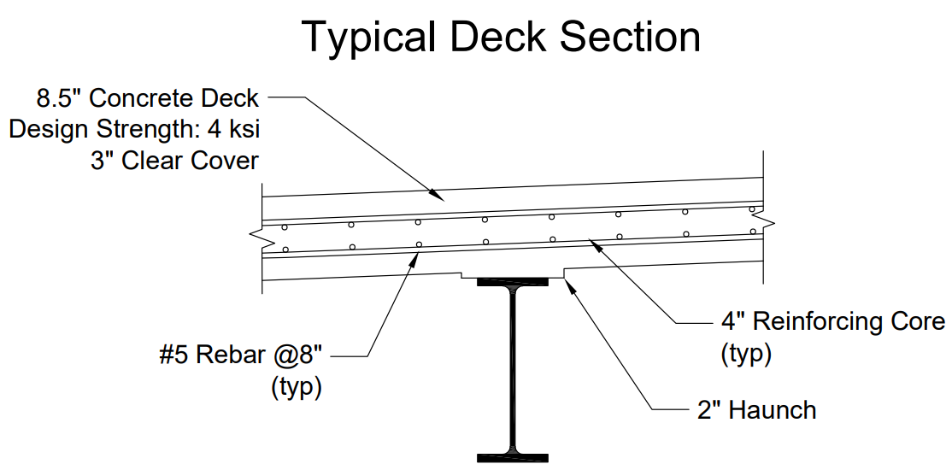
Stage Road Bridge over Nighthawk Hollow Brook Replacement
Gilmanton, New Hampshire
Nick LaBrecque, Timothy LaPorte, Matthew Miloro, and Nicholas Prescott
Department of Civil and Environmental Engineering, University of New Hampshire
PROJECT BACKGROUND
ROLLED STEEL GIRDERS
DRIVEN PILE FOUNDATION
Existing bridge over Nighthawk Hollow Brook, Gilmanton, NH:
Constructed in 1930, rehabilitated in 1960
  Steel beam superstructure
  Gravity wingwall abutments
  25’-0” clear span, 23’-4” paved width
Superstructure and substructure rated 5/9 (fair) on the NBI scale
Hot-rolled steel was the chosen superstructure through an alternatives study completed in the Fall Semester
  Most applicable for spans between 20-100’
Capacities of W-shape were checked against bending, deflection and shear
  MS Excel allowed for quick, comprehensive design iterations
The new design proposes five W21x93 rolled beams spanning 50’-0”
  Deflection was the controlling design parameter
Weak soil conditions led the team to use a pile foundation to prevent settlement
  Boring logs showed clays and loose sand, at some points having one or no blows during SPT test
Five HP12x74 piles
  Lateral and vertical analysis performed
Piles to be driven to bedrock as none of the other soils have adequate bearing capacity
555 kN (~125000 lbf) to displace 0.1 m (0.33 ft)
  Existing Bridge
  Spalled Abutments
  Exposed Rebar
W21X93 Design Results
Ultimate |  |  | Design Capacities |  |  | % Overdesigned
Parameter | Value | Unit | Parameter | Value | Unit
Bending Exterior | 1,264 | ft-kips | Bending | 2,065 | ft-kips | 61% overdesigned
Bending Interior | 1,279 | ft-kips
Deflection | 0.70 | in | Deflection | 0.75 | in | 6% overdesigned
Shear | 143.3 | kips | Shear | 332 | kips | 132% overdesigned
METHODS
Hydrology and Hydraulics (H&H)
  Design flows and bankfull data obtained by USGS StreamStats
  Bridge span estimated using the NH Stream Crossing Guidelines
  Design low chord elevation calculated by 1-D analysis program, HY-8
Superstructure
  AISC Steel Construction Manual consulted for efficient rolled section
  AASHTO design formulas implemented into MS Excel
Substructure
  Geocalcs Lateral Analysis of Piles (LAP)
  AASHTO Specs. & NHDOT Bridge Design Manual to supplement analysis
HYDRAULIC ANALYSIS
ACKNOWLEDGEMENTS
Drainage area: 15.7 square miles
Average bankfull width: ~40’-0”
  Clear span estimate: 50’-0”
Design low chord elevation rose over 2’ from existing low chord of 557.60’
REINFORCED CONCRETE DECK
Thank you to our project sponsors, Josif Bicja, Kayla Hampe, and Katelyn Welch of Hoyle, Tanner and Associates.
Thank you to our CEE faculty advisor, Dr. Fei Han.
REFERENCES
American Association of State Highway and Transportation Officials. (2012). AASHTO LRFD Bridge Design Specifications. Washington, D.C.
Construction, A. I. (2017). Steel Construction Manual 15th Edition. American Institute of Steel Construction.
Federal Highway Administration. (2021). HY-8 Version 7.70 (Culvert Hydraulic Analysis Program). Retrieved from https://www.fhwa.dot.gov/engineering/hydraulics/software/hy8/.
Geocalcs. (2020). Lateral Analysis of Piles (LAP). Retrieved from https://www.geocalcs.com/lap.
Hampshire, U. o. (2009, May). New Hampshire Stream Crossing Guidelines. Retrieved from https://www.nae.usace.army.mil/Portals/74/docs/regulatory/StreamRiverContinuity/nh_stream_crossing_guidelines_unh_web_rev_2.pdf.
NHDOT. (2015). NHDOT Bridge Design Manual. Retrieved from https://www.nh.gov/dot/org/projectdevelopment /bridgedesign/manual.htm.
U.S. Geological Survey. (2019). StreamStats. Retrieved October 10, 2021, from https://streamstats.usgs.gov/ss/.
Check | Return Period | Discharge (cfs) | Headwater Elevation (ft) | Design Low Chord Elevation (ft)
Design Flood | 50-year | 1,770 | 558.90 | 559.90
High Flow Damage | 100-year | 2,120 | 560.31

