Slide 1
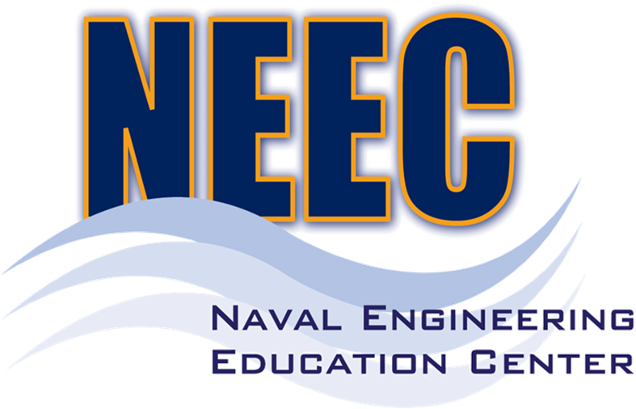
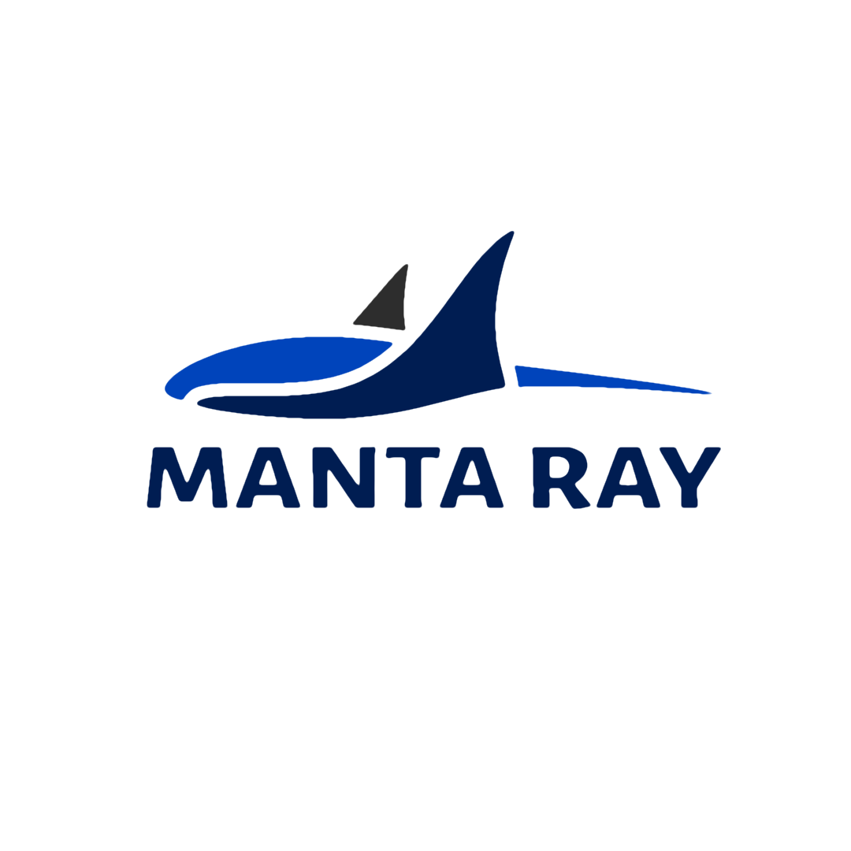
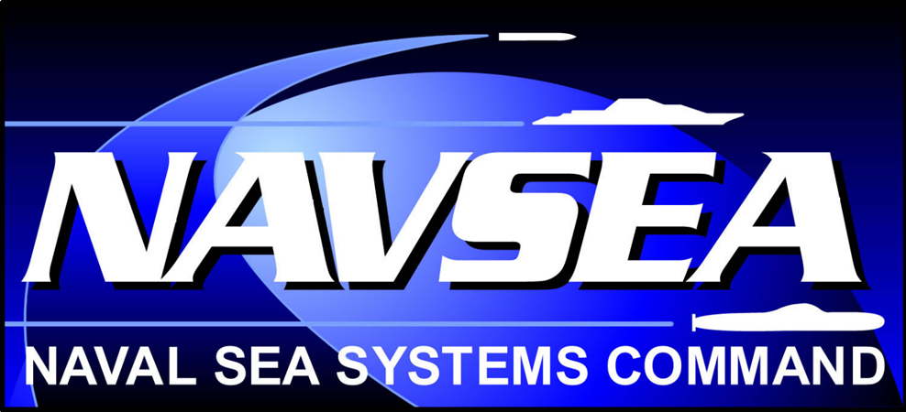

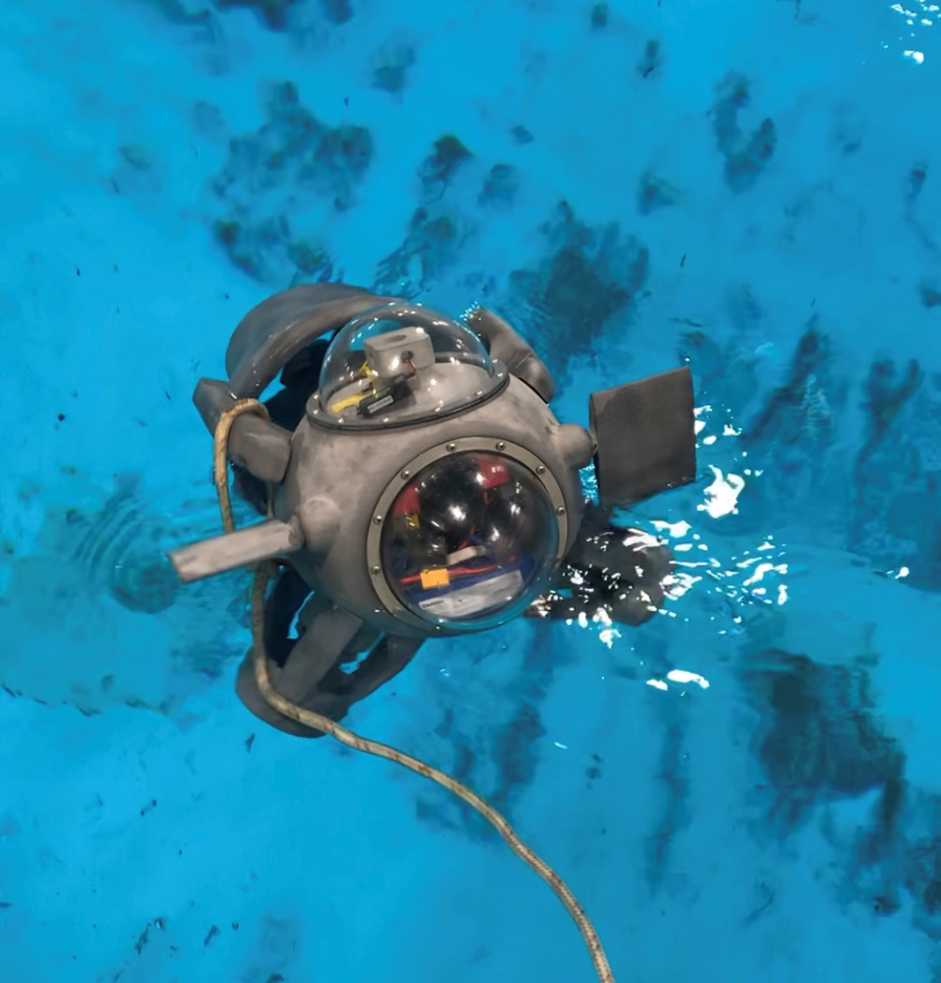
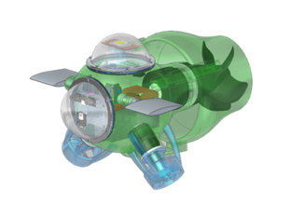
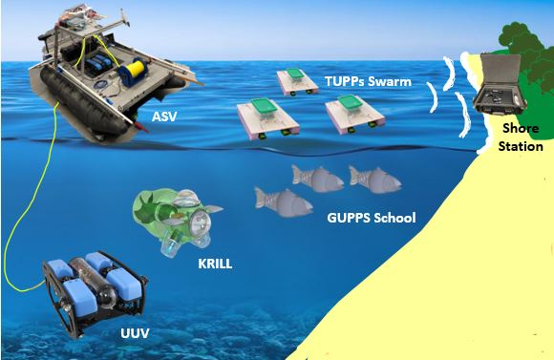
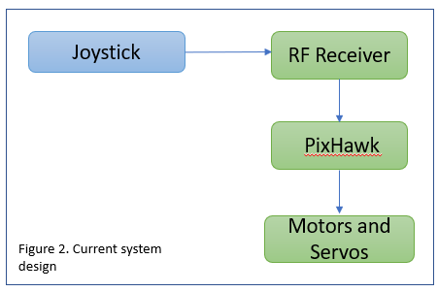
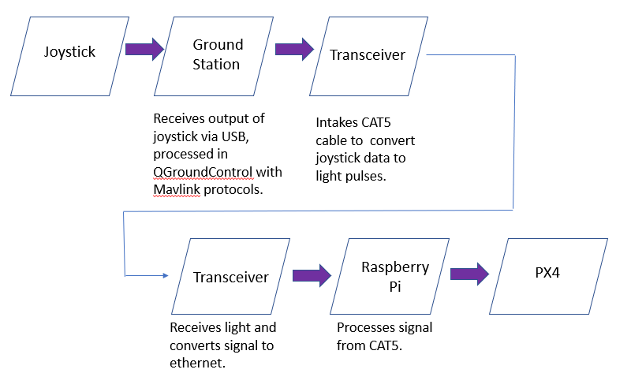
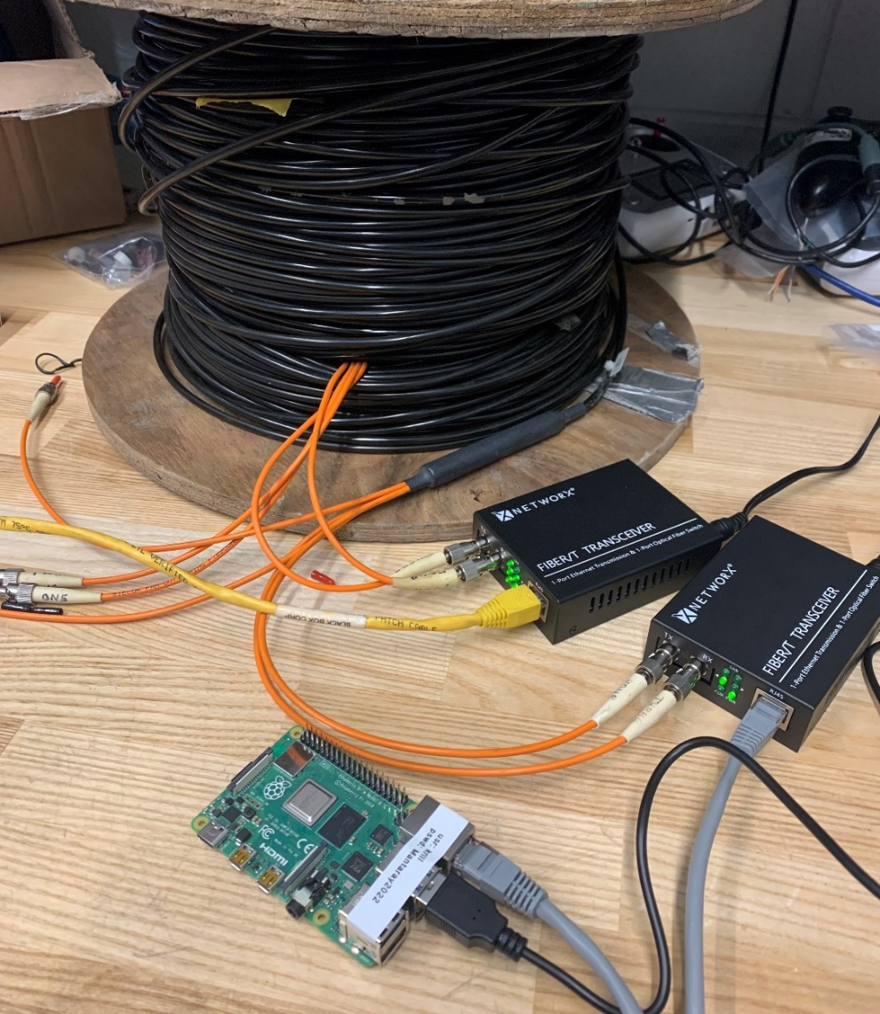
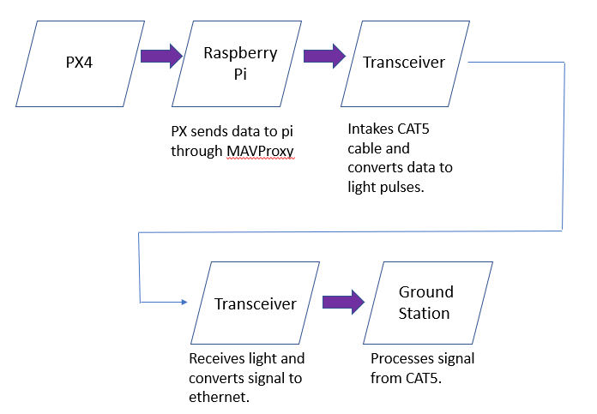
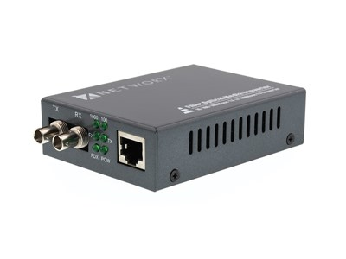
Marine And Naval Technological Advancements for Robotic AutonomY (MANTA RAY):
KRILL Development: US Navy’s Unpiloted Underwater Vehicle
Project Advisors: Dr. May-Win Thein and Dr. Yuri Rzhanov
Faculty Advisor: Dr. Wayne Smith
Graduate Advisors: Nick Custer, Richard Randall, Oguzhan Oruc, Hannah Arnholt, Igor Vladimirov
Team Members: Sydney Chock and Gabriella Liano
background
Manta Ray Mission
Objectives
KRILL is an underwater vehicle developed by the Naval Undersea Warfare Center (NUWC), designed to be modular and low cost.
Constructed with three thrusters and two servos for surface capabilities
Vehicle may be used for communications, imaging, and data collection
Currently in development and testing phases to
address functionality and buoyancy
Team MANTA RAY is an interdisciplinary project dedicated to creating, maintaining, and expanding a network of marine robots for seafloor mapping and underwater perception. The network began as just the autonomous surface vehicle (ASV) and unpiloted underwater vehicle (UUV) but has expanded to include a prototype of the ASV, known as TUPPS, and two kinds of remotely operated vehicles, known as GUPPS and KRILL. With these systems, students work to improve communication between vehicles, develop autonomous behaviors and algorithms, and upgrade existing mechanical systems to improve precision and performance.
Long-term goal is to run KRILL autonomously
Assemble electronic components of KRILL from Navy design
Replace existing control system with PixHawk4 (Px4) from Arduino
Implement fiber optic tether for underwater communication
  Current design requires vehicle to only operate on the water's surface
System Controls
Fiber optic tether
Purpose: Control vehicle's thrusters and servos for six degrees of freedom
Replaced Arduino with PixHawk4 so control and communications are streamlined onto one system
Set parameters in QGroundControl using ArduRov for control of PWM to the motors and servos
  PX4- flight control platform for manual and mission control
Testing:
Tested parameters and obtained
control of vehicle via joystick
and receiver
Thrusters and servos could be
controlled separately
Redesign with Tether:
Implemented ArduSub that allows for better flexibility in controlling the vehicle movements
Purpose: RC signals can't be transmitted underwater so vehicle must be tethered to maintain communication.
To keep cost low, recycled military grade multimode fiber optic cable are used with ST connectors
Media converters are implemented as transceivers to convert signals to ethernet, which are then processed by a Raspberry Pi
Fiber Optic tether specifications:
Designed for distance of 220m over 62.5/125µm
Optical wavelength - 1310nm
Testing:
Cable first tested by passing light through and capturing it on the other end
Tested with transceiver over ethernet to laptop for internet connection
Integrated the Pi and PX4; confirmed communication through MAVProxy
System communications design
Purpose: Transmit signal from joystick to PixHawk4 (PX4) over fiber optic tether, without RC receiver.
Transmitting
Future Work
Add switch and power sense module to monitor battery levels
Measure current to conduct a power analysis
Waterproof fiber optic tether
Configure transceivers to run on battery
Integrate UGPS system and sensors
Receiving
Special thanks to Dr. Martin Renken, Thai Tran, Laura Gustafson, Kelly Danforth, Scott Campbell, Debarpan Bromwick, and the Olson Center

