Slide 1

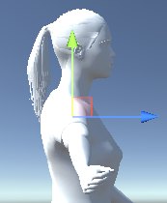
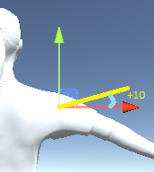

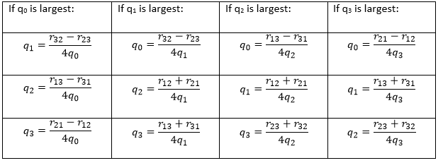
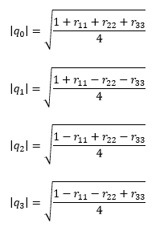
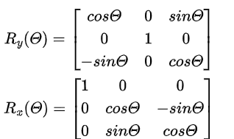
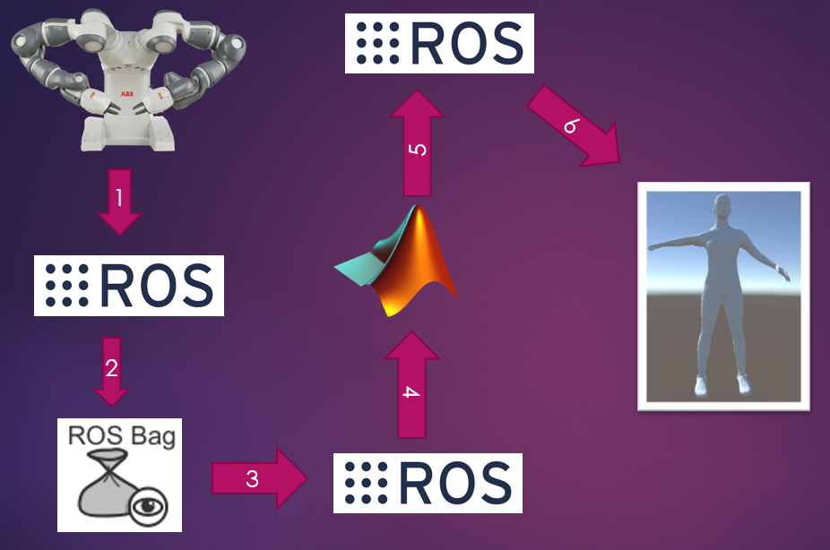
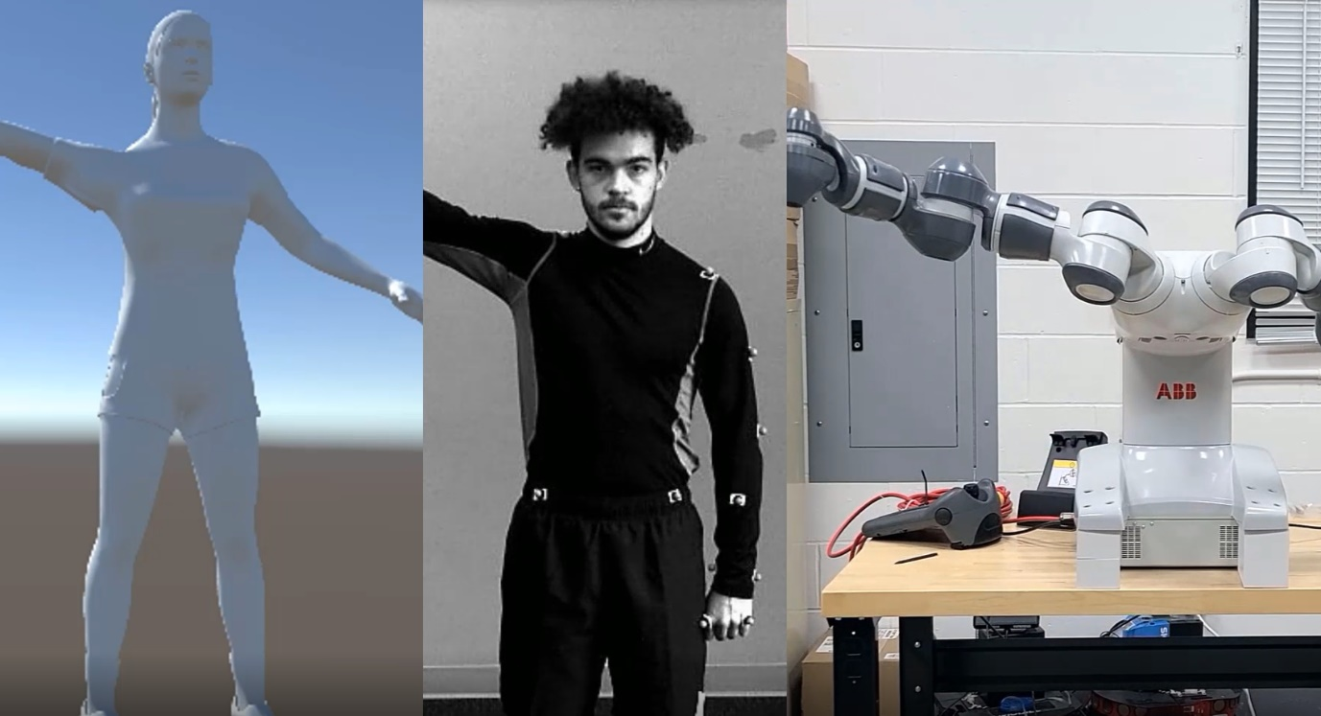
Robot Guided Exercise Training: The Role of The Human Model
Selena Richards, Department of Computer Science, University of New Hampshire
Introduction & Background
Objectives
Python and C# scripts subscribe to the published topics on ROS and work the given data into Pose messages. The Pose messages are used to move the human model and display errors between human movement and Yumi movement.
Physical therapy after an injury is time consuming and costly.
A previous user-study that used virtual reality had a human model demonstrate exercises, but it could be difficult to see the correct angle of a movement depending on where the model was viewed from since it was a 3D model being project onto a 2D plane.
With Yumi, human exercises can be taught to patients through demonstration. Yumi has the advantage of being in a 3D world, making it easier to view from different angles.
Despite being one of the most human-like commercial robots in terms of upper-body anatomy, Yumi has subtle differences from humans that may confuse humans following the exercises.
A human model that allows users to view joints from various angles would complement Yumi’s exercise demonstrations. Users would be able to view the robot in real life as well as a model that may be more legible. The model can also show users potential error in their movements.
Extract Yumi’s movements and store them as transformations.
Use transformations to extract Pose data for the human model.
Figure 5. From this angle, it is difficult to see how much the right arm needs to be raised.
Figure 6. The program allows the model to be viewed from various angles and highlights how much the arm needs be moved upwards to correct the exercise.
Use human model as an avatar for Yumi’s joint movements. If an exercise is performed incorrectly by a patient, have the human model highlight where the error occurred.
Conclusions
The high cost and low-accessibility of physical therapy is often a deterrent for those who need it. Robotics can help mitigates these factors.
To improve legibility, a human model can be used to highlight how an exercise should be performed and what the patient can do to improve their movement.
Figure 2. Equations from Figure 1 leave the signs of q_{0,} q₁, q_{2,} q₃ ambiguous. A further check must be done to determine signs.
Methods
Figure 3. Yumi and Unity have different coordinate systems,
so a rotation must take place to align them. Rotation data is
Multiplied by R_{x}, then R_{y}, where Θ is the required angle.
Figure 1. Equations above are used to convert the rotation matrices to Quaternions for Unity use.
Results
Next Steps
Yumi performs a human motion. The data is published to the JointStates topic.
A rosbag records the data being published for future use.
The rosbag is played and the JointState data is sent over the ROS network.
MATLAB code subscribes to the ROS topics being published and transforms the joint state data into a transformation matrix.
The transformations are sent over the ROS network.
A user study will be conducted to test the robot’s legibility.
Further features can be added to the human model to increase functionality and improve the user-experience.
Figure 4. The human model, exercise demonstrator, and Yumi robot performing a standard exercise involving the shoulder.
Code that reports the angular difference between a patient’s movement and Yumi’s is in progress. This will measure the angular and positional difference between Yumi’s movement and a patient’s every 5 seconds. Arrows highlighting the angles will be shown on the model.
User studies with therapists viewing Yumi’s activity will occur in the coming months.
References
Ben-Ari, Moti. “A Tutorial on Euler Angles and Quaternions.” Version 2.0.1., Ben-Ari, 2014.
Rose. “Quaternions.” DancesWithCode, 2015, danceswithcode.net/engineeringnotes/quaternions/quaternions.html.
Contacts
Selena.Richards@unh.edu

