Slide 1

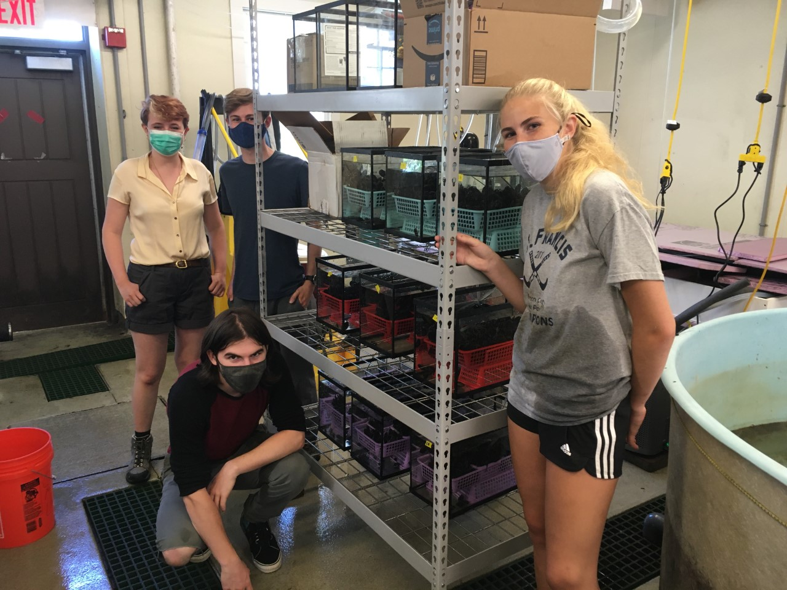
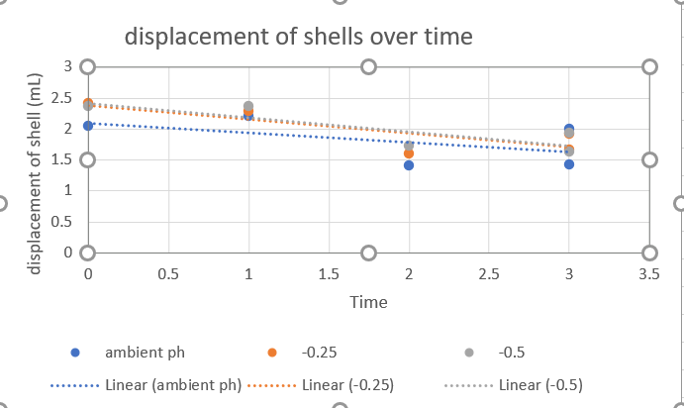
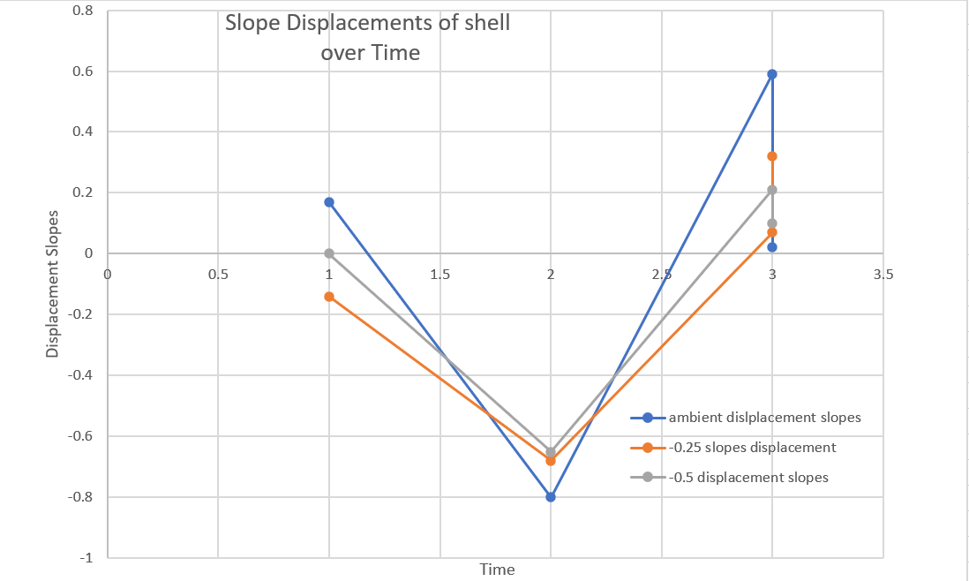
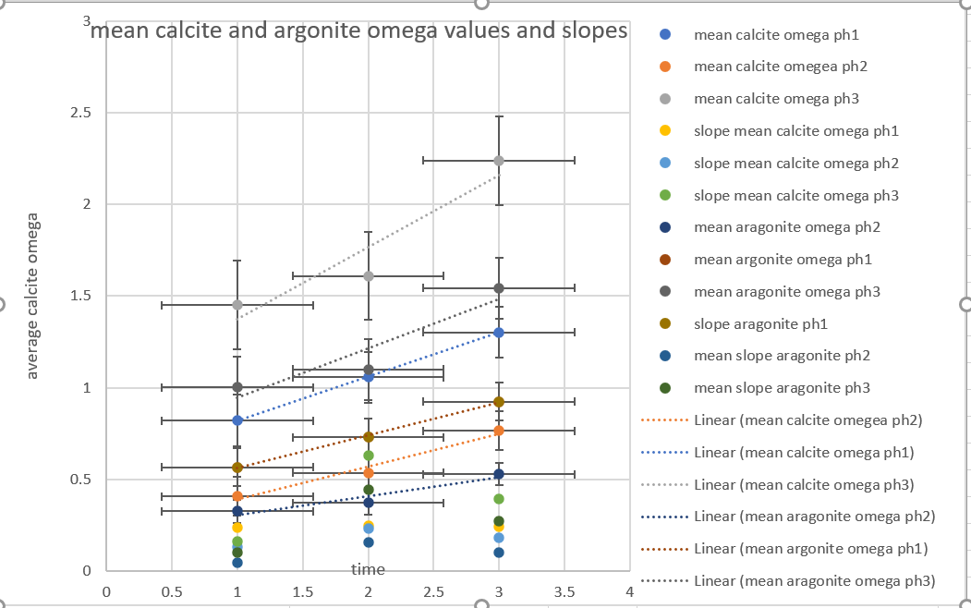
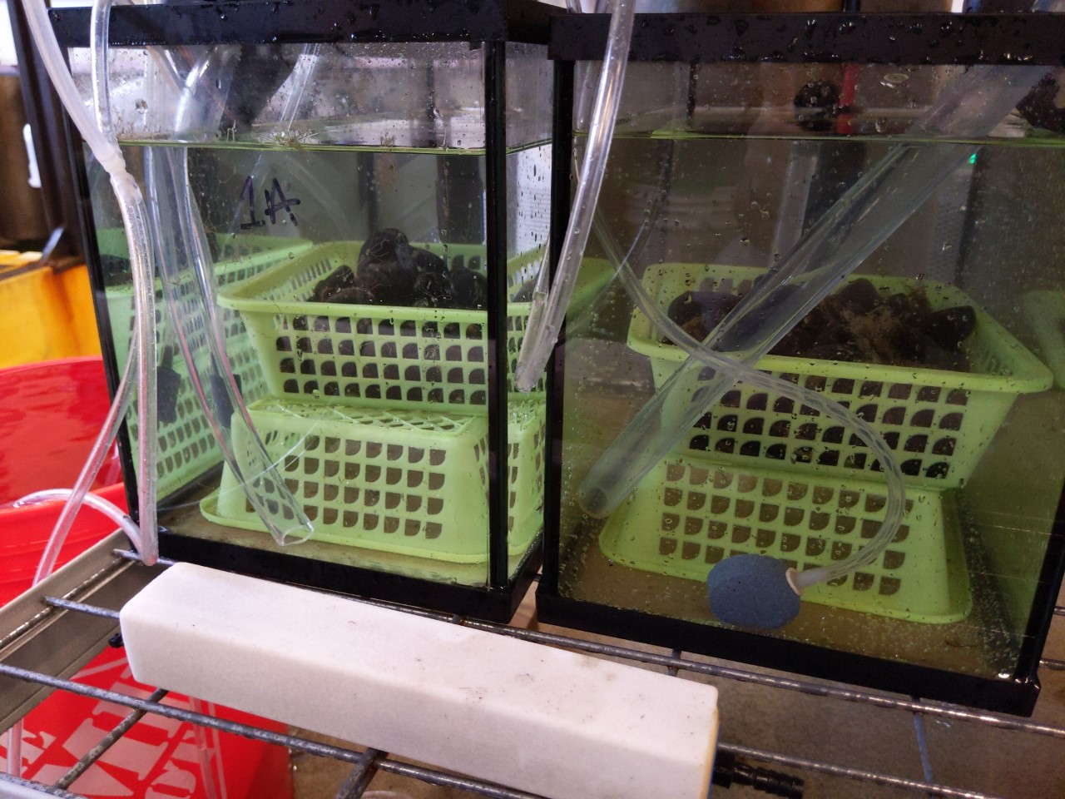
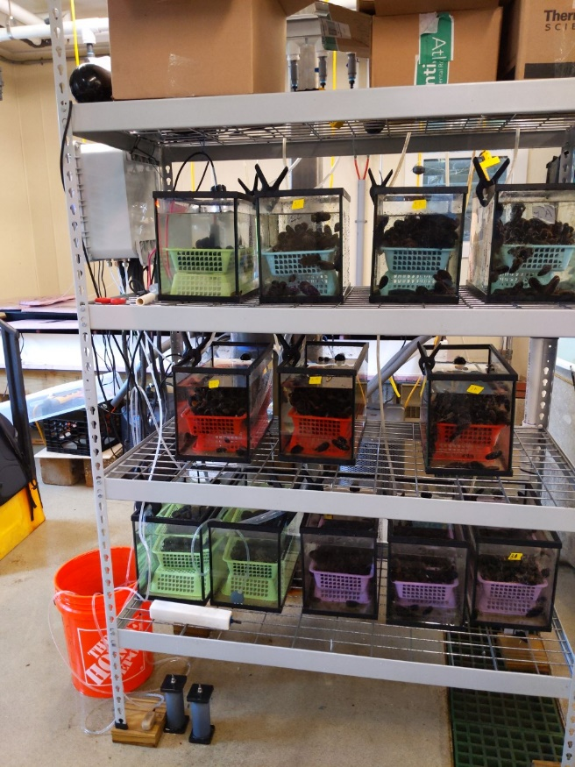
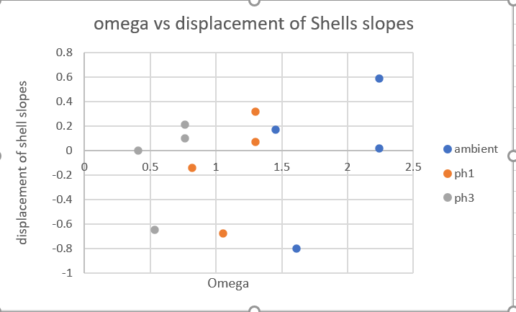
A Look Into Ocean Acidification Effects On Mussels
Emma Thibodeau, Chris Hunt, Department of Earth Science, University of New Hampshire
Introduction
Methods
The graph that shows average omega values of calcite and aragonite over the three time periods shows that the omega values are increasing over time. This graph also shows that the ambient pH group had the biggest omega values compared to pH group -0.25 and pH group -0.5. Overall, the average omega values found are numbers that usually indicate corrosive conditions for mussels, so it makes sense that we see a downward trend of mussel's displacement for each treatment combination group.
The slopes of average omega vs time where calculated and plotted in this graph showing what mussel group had the most rapidly changing omega value in this graph it shows that the ambient group of mussels was more rapidly changing over time for omega of aragonite and calcite.
Conclusions
The purpose of this project is to examine how different pH conditions effects the growth of mussels (Mytilus Edulis). The saturation state of calcium carbonate is a value called omega. For example, if omega is less than 1 then seawater conditions are corrosive or undersaturated, meaning the mussels have less calcium carbonate to build their shells. It is also well known that if omega is over 1.5 this can cause an impairment to the growth of calcifiers. The issue at hand is as ocean water becomes more acidic how this will this affect ocean communities of calcifiers, and ultimately could this cause a change in ocean communities?
Place mussels into three different treatment combinations. One group the ambient pH which will not be treated with CO2 has an average pH value of 7.82, the next group pH is -0.25 from the ambient had an average pH of 7.58 and the last pH group -0.5 had an average pH value of 7.32. All average values calculated in MATLAB.
Next calculate the average omega of calcite and average omega of aragonite for all 3 pH groups using MATLAB and the CO2SYS_Biglow function.
Our mussels were then sent out to a lab to measure displacements of their shells and body. This is equivalent to show growth in their shells or loss. Then calculate the slopes in between the time periods of displacement and the average omega values during the time periods. Then find the average pH during each time period and group calculated in Excel and MATLAB. Values are shown in results section.
As seen from the scatter graph of omega vs slope of displacement of the shells there is no correlation between the two values meaning that ocean acidification is not responsible for the mussels losing mass. There perhaps another process that is causing the lost in mass.
Interesting find in the graph that looks at the individual mussel displacement slopes we can see that each pH groups follows the same trend.
Next Steps
Next time this experiment is run will feeding the mussels impact if the mussels regenerate their shells as fast as they lost them.
If we know the omega condition and the pH of the water is there a value, we can conclusively say the mussels will lose or gain this amount of mass
Objectives
Results
As seen in the displacement of shells over time graph all three pH treatment combinations experienced shell lost indicated by the downward sloping trend lines. The ambient pH group appears to have the least displacement indicated by it having the least steep slope of all the treatment combinations. -0.25 treatment combination and -0.5 treatment combination have similar displacement values over time as seen in the graph. Another factor to bring in was the mussels were not fed in this experiment leading to a time period that had to be left out the data to experimental error.
Determine shell lose or growth from three different pH groups.
See how growth of mussel shells changes over time.
Determine omega values of calcite and aragonite over time and if that coincides with shell growth or loss.
Acknowledgments
A big thank you to the group at CML
Chris Hunt
Steve Jones
Bryson Torgovitsky, and Shelly Lancaster
Contacts
Email:
ert1025@wildcats.unh.edu
christopher.hunt@unh.edu

