Slide 1

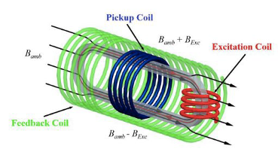
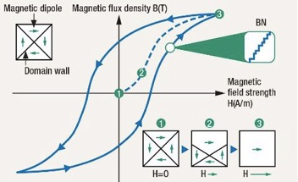
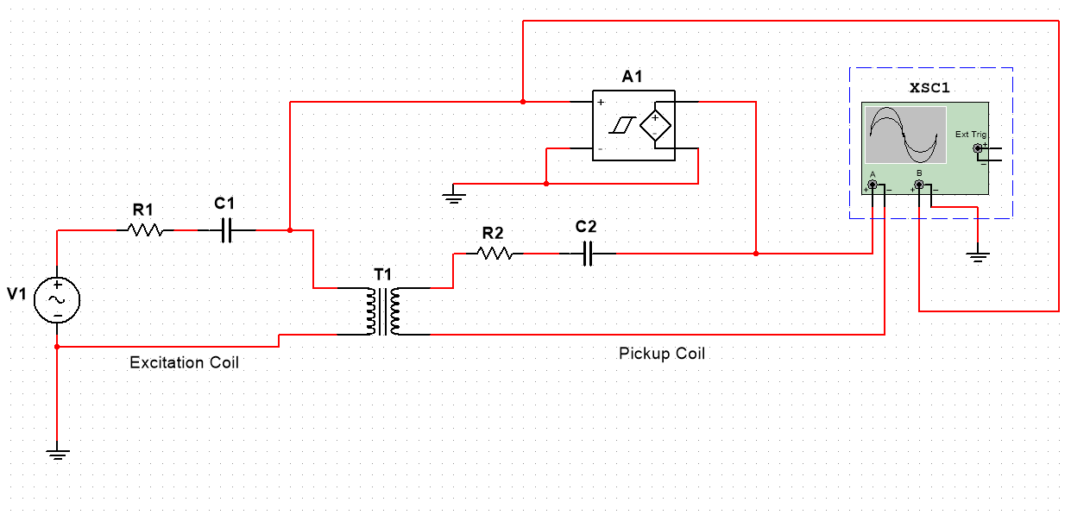
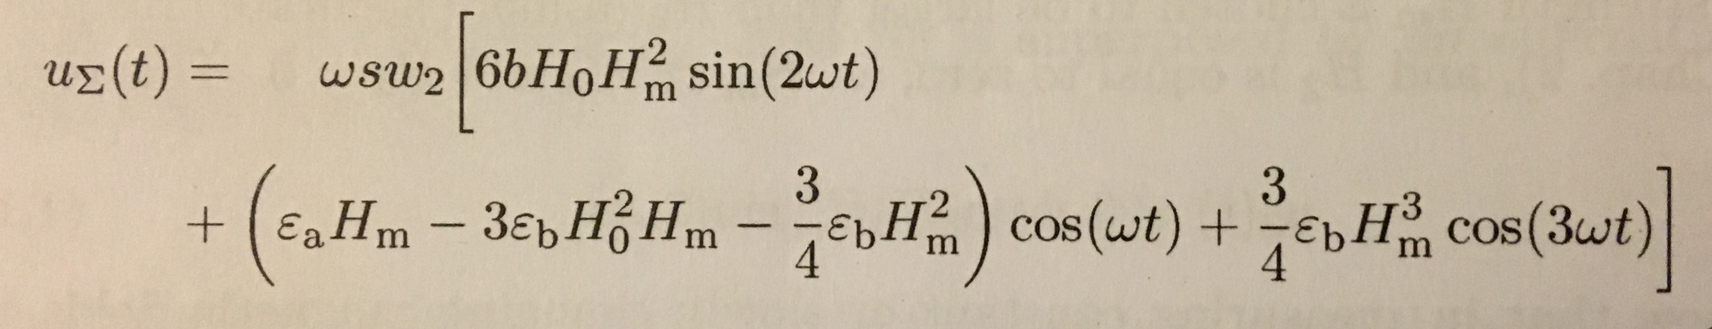
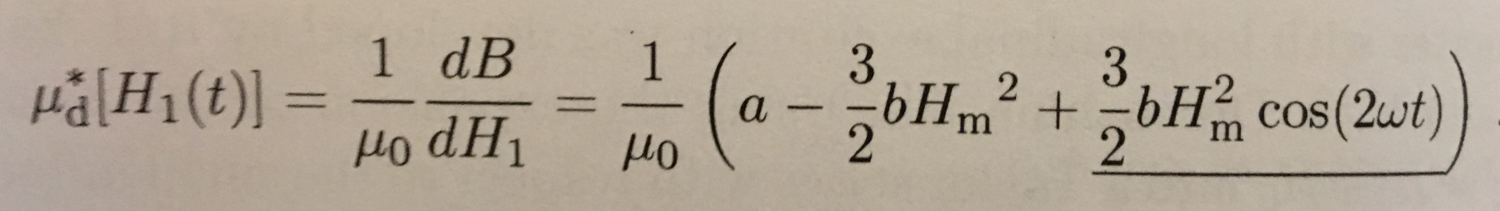
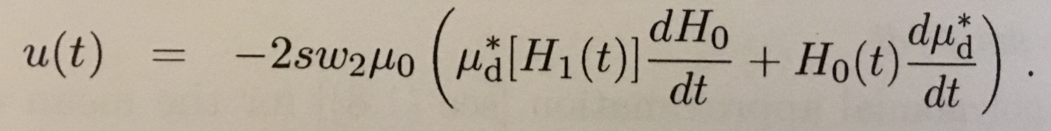
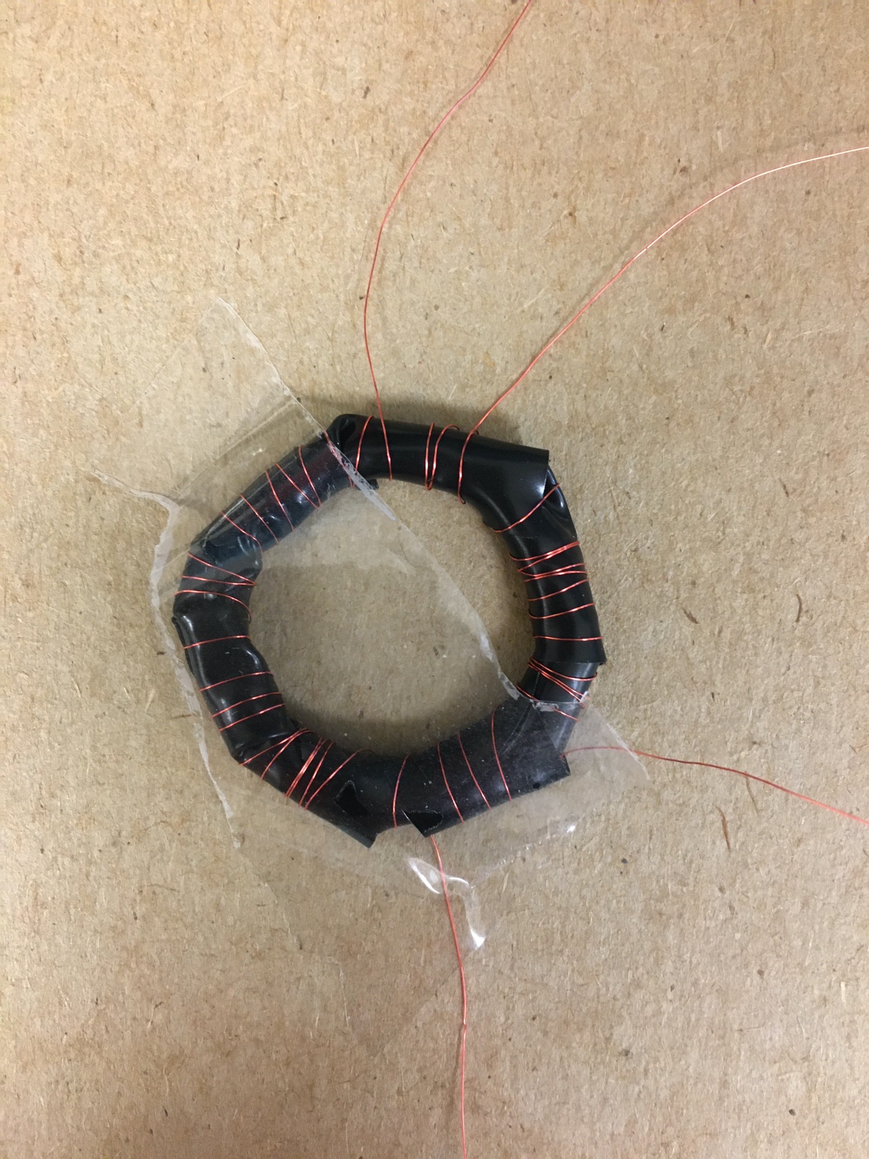
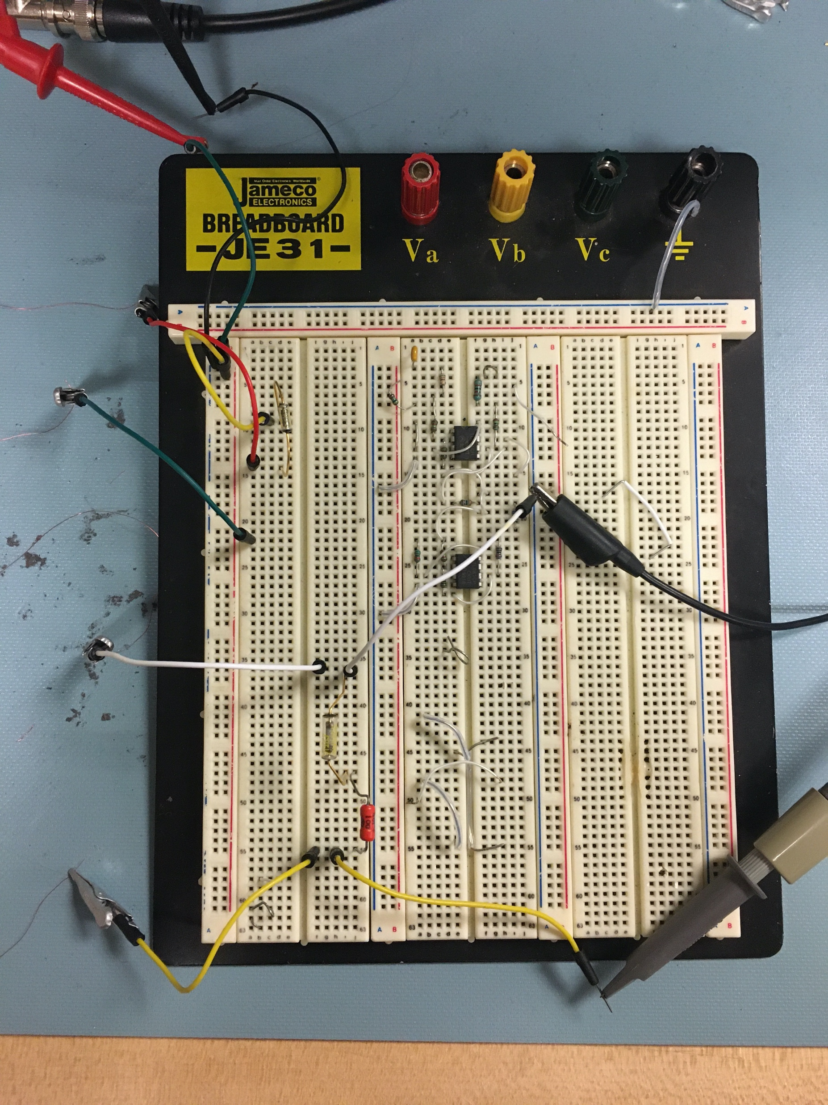
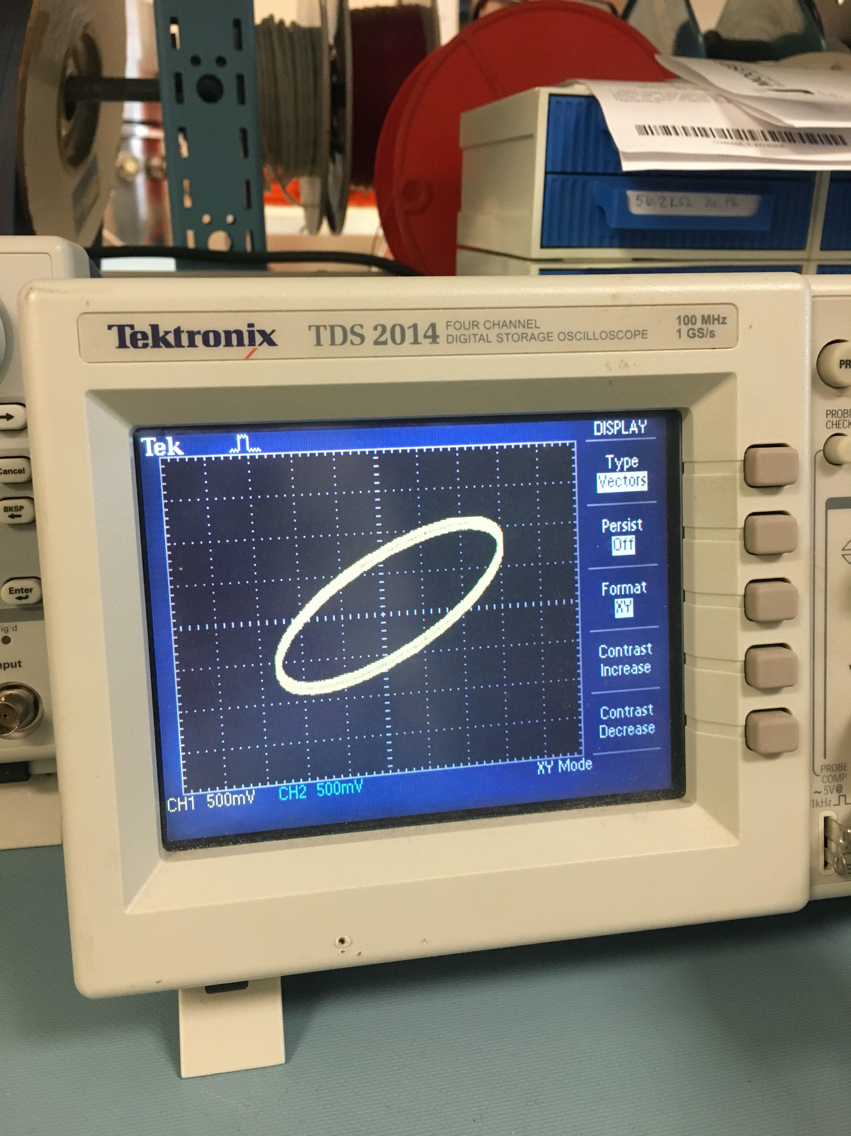
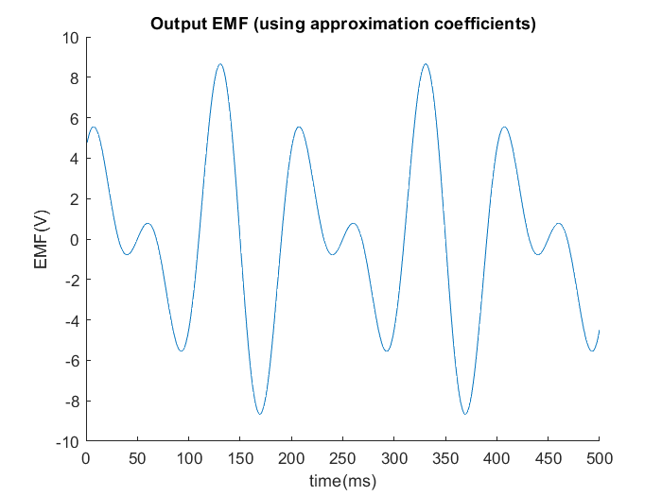
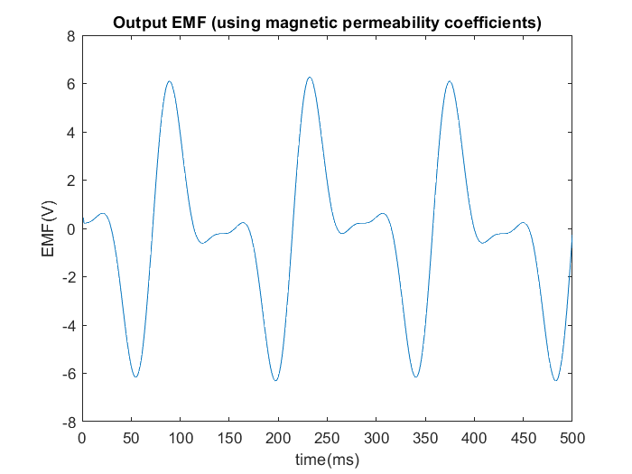
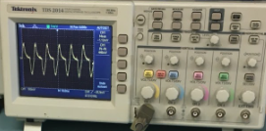
Development of a Fluxgate Magnetometer Model
Eleonora Olsmats & Christopher Howard
Advisor: Professor Matthew Argall
Engineering Physics, University of New Hampshire, Durham, NH 03824
Introduction
Fluxgate Magnetometer
Hysteresis Loop
Conclusions
As a part of the UNH SWFO-L1 mission to monitor space weather, the fluxgate magnetometer is an important component. By measuring the changes in solar magnetic field, predictions of the sun’s behavior can be made which can give useful information if the consequences will be severe enough to warrant turning satellites off. The basic principle of the fluxgate magnetometer is to detect changes in the ambient magnetic field by inducing a magnetic field in a ferromagnetic material via a drive winding. To get accurate measurements of the ambient magnetic field, a model of the relationship between the magnetic field strength (B) and the induced magnetic field (H) (hysteresis loop) must be made on a per-case basis due to the ferromagnetic properties of the core material. By comparing the analytical model to the measurements in the lab from the SWFO-L1 magnetometers, a performance model for future missions can be made.
Simulating the behavior of the fluxgate magnetometer and comparing to measured lab results revealed many benefits. Discrepancies between the two allowed for adjustments to be made to the model to better suit the given equipment.
Calibrations can be done under a variety of conditions (such as varying field strenghts and directions) until the magnetometer’s behavior can be accurately predicted in any situation, which resulted in progressively more accurate models following each test. Future work include to further adjust and optimize the model to compare the hysteresis loops as the input versus the output signals. By getting a more accurate model of the fluxgate magnetometer behavior, the goal is to create a performance model for future missions.
Basic design of a fluxgate magnetometer with a racetrack core
General representation of a hysteresis loop for a ferromagnetic material
RLC Representation
Modeling the EMF
This is one function for defining the output EMF, which uses approximation coefficients to replicate the harmonics seen in testing.
The RLC circuit representation model in MultiSim gave an initial understanding of the fluxgate magnetometer function. The excitation and pickup coils are represented by resistors and capacitors due to the resistance in the wires and the interwinding capacitance in the coils. An inductor is representing the induced magnetic field in the core material caused by an AC current in the excitation coil. By getting an initial understanding of the circuit, an accurate model with the SWFO-L1 core in the laboratory can be easier accomplished. The RLC representation is also useful for trouble-shooting purposes in the laboratory circuit.
Using Matlab, various models were made to simulate the behavior of a fluxgate magnetometer. Initially, the focus was on some general models that utilize approximations. Finally, a model designed specifically to replicate the lab setup, including coefficients for the differential permeability of the fluxgate magnetometer, longitudinal excitation and operating mode 2 (in which internal field strength>external field strength, which is better for measuring a constant or slowly changing field) was created. The differential permeability of the fluxgate magnetometer was simulated using the formula below, which is dependent on the strength of the drive field, which in turn is dependent on time.
This function may seem simpler than the one above but is more advanced in that it replaces the coefficients above of the field’s interaction with the material’s permeability.
RLC model representation of a fluxgate magnetometer
SWFO-L1 Laboratory Measurements
Comparing Simuluation to Lab Measurements
B(H) hysteresis curve measured over the pickup coil during the calibration process
Output from general model and final model compared to measured results. Note that while general output could potentially be improved with a different set of approximations, an accurate representation was easier to accomplish with the final model
Ring core with excitation and pickup coils
Fluxgate magnetometer circuit

