Slide 1


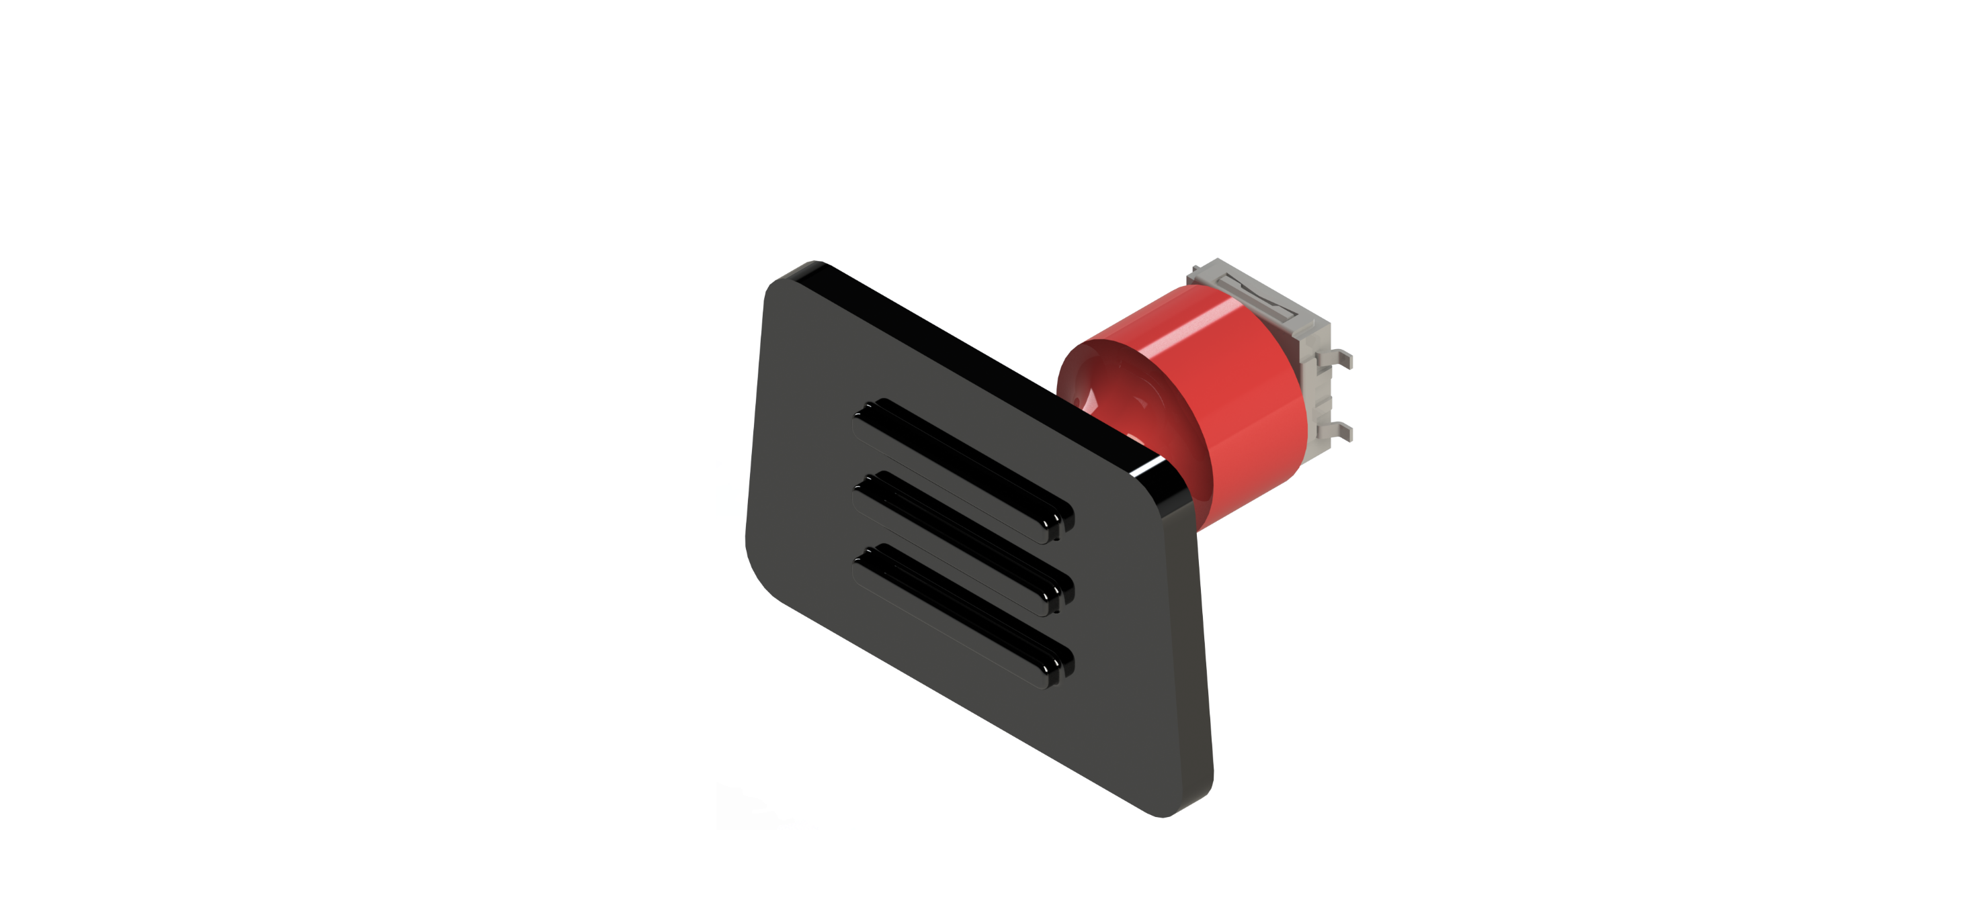
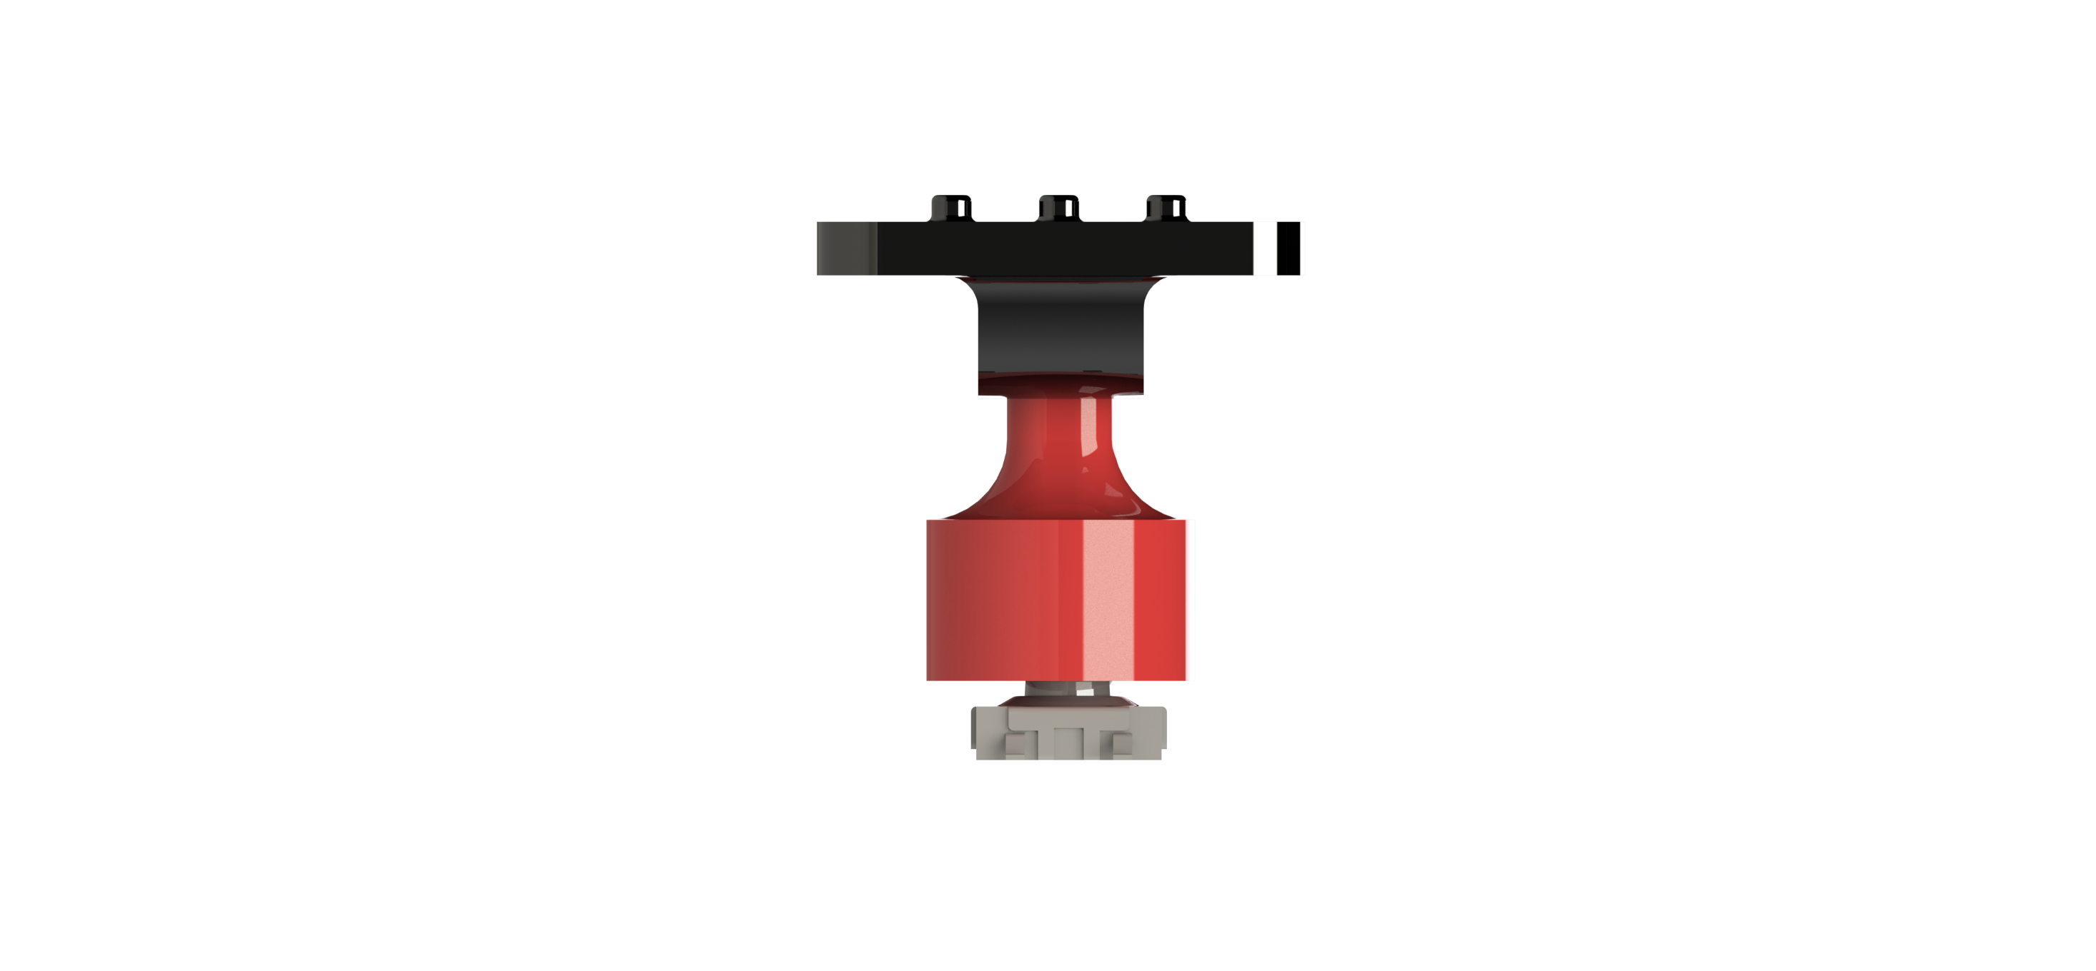
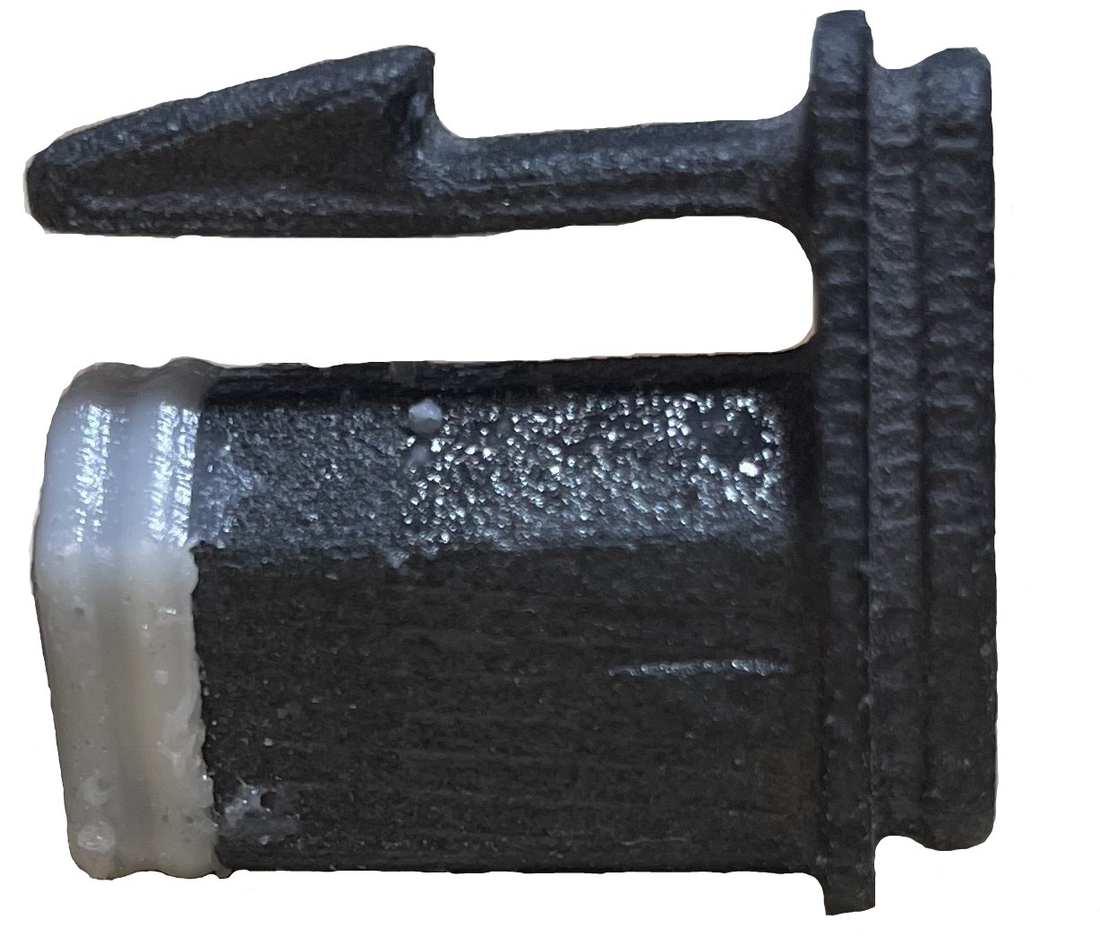
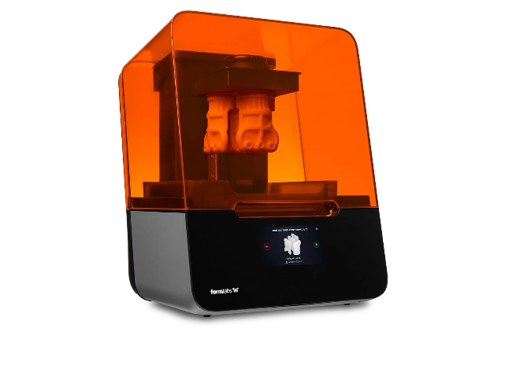
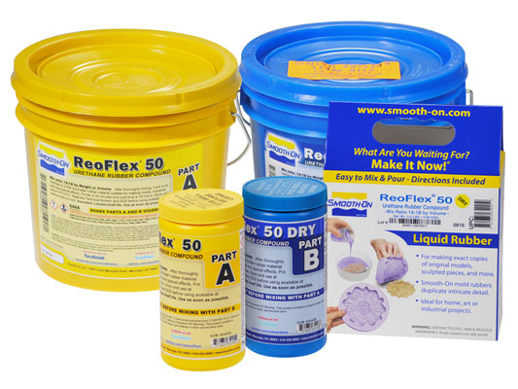
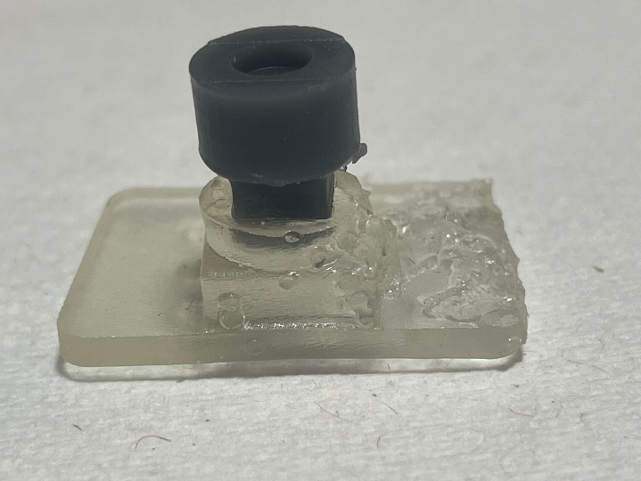
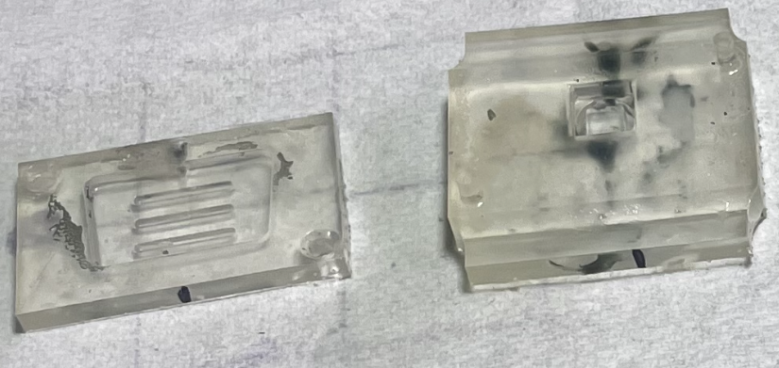
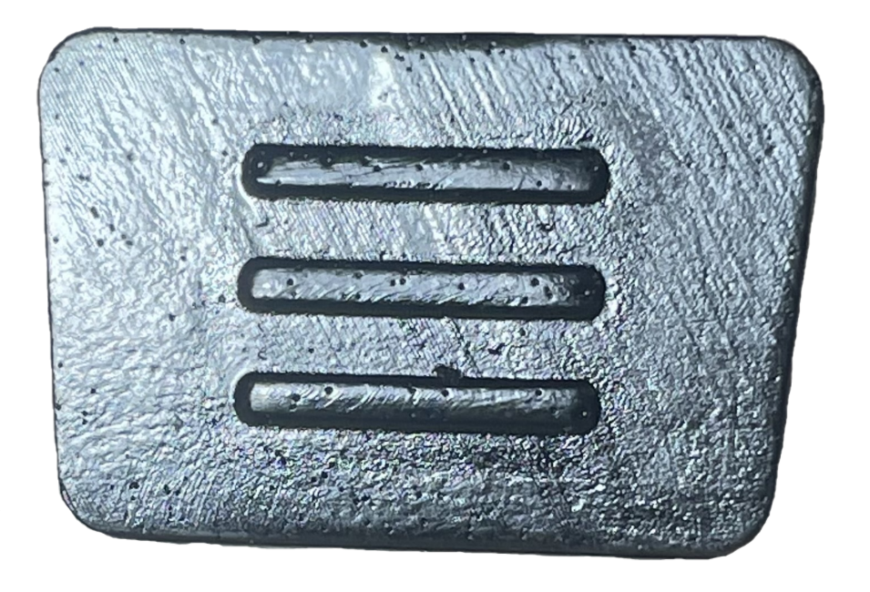
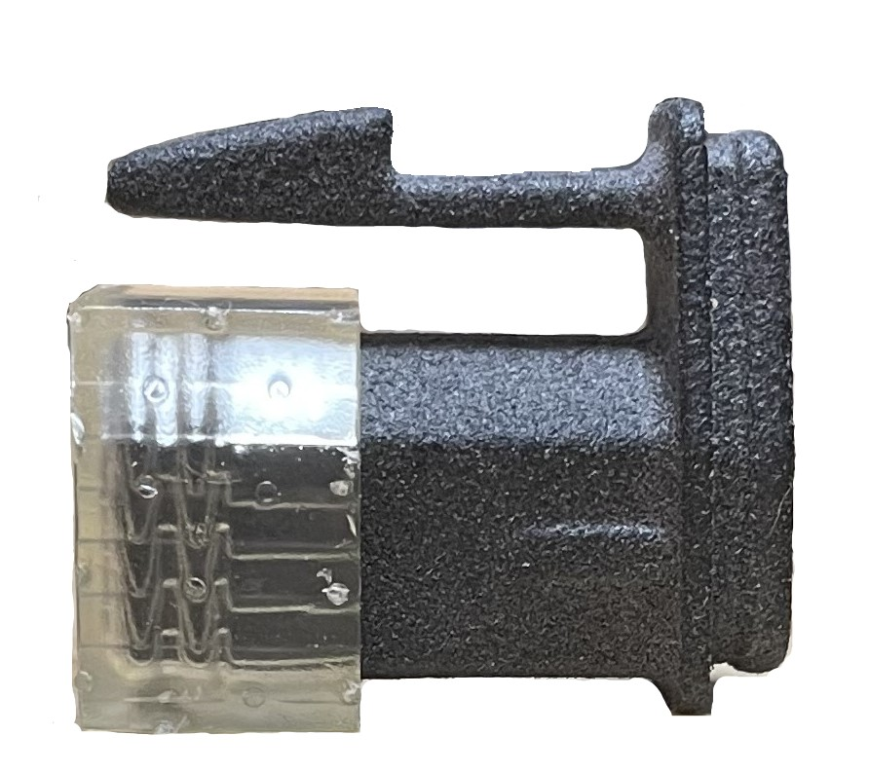
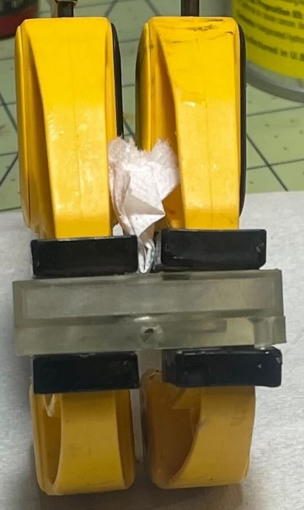
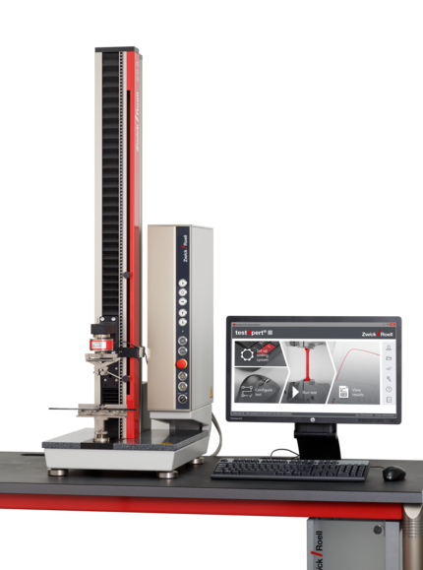
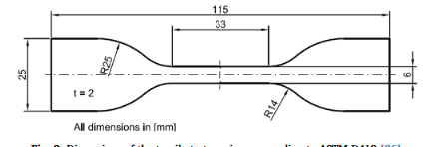
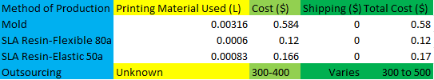
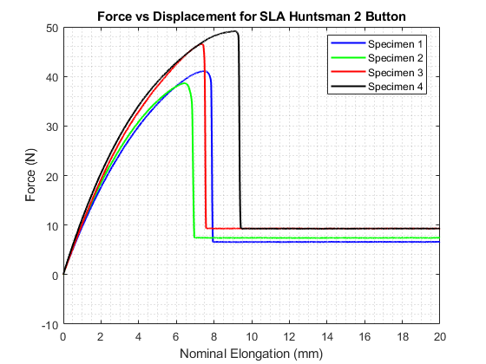
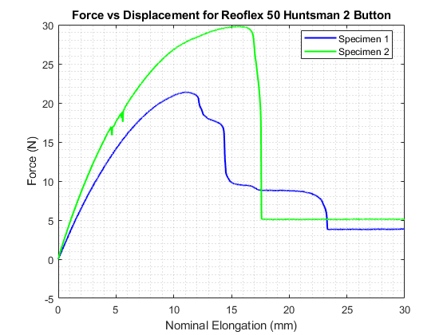
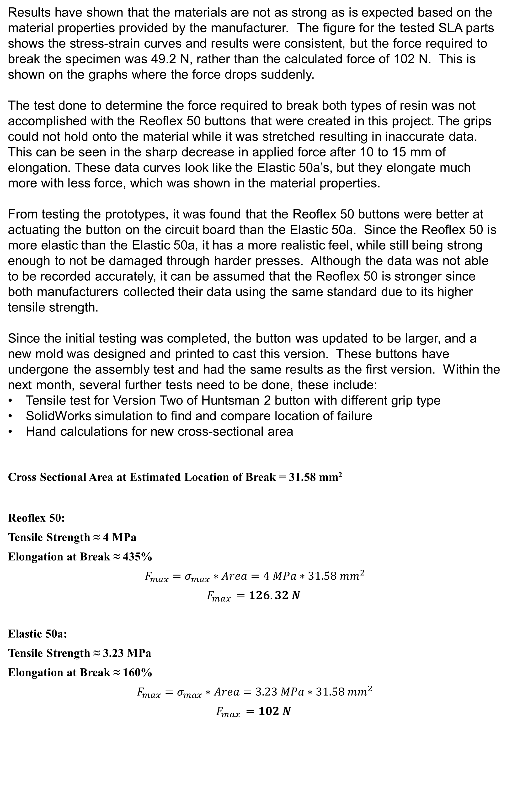
Printed Prototypes vs. Casted Prototypes
Using Printed Molds
Christopher Hazen
Department of Mechanical Engineering, University of New Hampshire
Introduction
Results
Discussion
At Galvion, many prototypes must be produced before going to production. To save time and money, prototypes are produced through 3D printing rather than outsourcing to another company. Currently, no reliable method exists to produce flexible prototype parts such as buttons and overmolds which can be molded and vacuum formed. The purpose of the project is to prove the concept that a mold can be designed and printed that allows for the casting of prototype parts. The parts include seals, buttons, and overmolds. If successful, this process would cut costs by keeping all functionality in-house rather than outsourcing the production of additional prototypes.
Qualities of molds must include:
Inexpensive
Minimal Post-Processing Work
Reusable Form 3 SLA Printer Reoflex 50 Urethane
Create Prototypes Similar to Professionally made Parts
Elastic 50a SLA Printed 3D Printed Button Mold Reoflex 50 Casted Button v Button and Insert
Results have shown that the materials are not as strong as is expected based on the material properties provided by the manufacturer. The figure for the tested SLA parts shows the stress-strain curves and results were consistent, but the force required to break the specimen was 49.2 N, rather than the calculated force of 102 N. This is shown on the graphs where the force drops suddenly.
The test done to determine the force required to break both types of resin was not accomplished with the Reoflex 50 buttons that were created in this project. The grips could not hold onto the material while it was stretched resulting in inaccurate data. This can be seen in the sharp decrease in applied force after 10 to 15 mm of elongation. These data curves look like the Elastic 50a’s, but they elongate much more with less force, which was shown in the material properties.
From testing the prototypes, it was found that the Reoflex 50 buttons were better at actuating the button on the circuit board than the Elastic 50a. Since the Reoflex 50 is more elastic than the Elastic 50a, it has a more realistic feel, while still being strong enough to not be damaged through harder presses. Although the data was not able to be recorded accurately, it can be assumed that the Reoflex 50 is stronger since both manufacturers collected their data using the same standard due to its higher tensile strength.
Since the initial testing was completed, the button was updated to be larger, and a new mold was designed and printed to cast this version. These buttons have undergone the assembly test and had the same results as the first version. Within the next month, several further tests need to be done, these include:
Tensile test for Version Two of Huntsman 2 button with different grip type
SolidWorks simulation to find and compare location of failure
Hand calculations for new cross-sectional area
Cross Sectional Area at Estimated Location of Break = 31.58 mm²
Reoflex 50:
Tensile Strength ≈ 4 MPa
Elongation at Break ≈ 435%
$$F_{max}=σ_{max}∗Area=4 MPa∗31.58 mm^{2}$$
$$F_{max }=126.32 N$$
Elastic 50a:
Tensile Strength ≈ 3.23 MPa
Elongation at Break ≈ 160%
$$F_{max}=σ_{max}∗Area=3.23 MPa∗31.58 mm^{2}$$
$$F_{max }=102 N$$
Casted Sleeve Seal SolidWorks Renderings of Version Two of Button with I with Insert and Circuit Board Button
The difference between the calculated force to cause a failure and the force found through the tensile test can be attributed to several factors. These include:
Testing standard used by manufacturer (ASTM D-412)
Print Orientation of SLA Parts
Curing of material
Grips used for Testing
During testing, it was also discovered that the mechanical properties of the Reoflex 50 improve as it cures after being demolded. As the testing was done before these parts had cured for a week, the potential material properties had not been reached. Since these parts are not put under the forces that would cause them to fail, it can safely be assumed that they will not fail if immediately put into an assembly. Through the analytical, physical, and field testing, it was shown that 3D printed casting molds is a viable option for producing flexible parts.
Each of the desired qualities for the molds has been achieved, and parts produced using them have been used in small scale deliverables to customers. Although the molds have a higher initial cost, as shown in the table below, this cost is relatively insignificant for the small-scale production it is used for. All SLA prints require roughly the same amount of post-processing, using a mold does not cause much extra work. Reoflex 50 is not a harsh material, with no strong chemical reactions causing damage to the mold, allowing it to be used indefinitely. The quality of parts produced with the molds is much higher as well, with a choice in color through dyes produced by the same manufacturer. The length of time and additional effort required to produce a part using a mold must be considered, however. It takes roughly ten minutes to prepare the mold and fill it properly, on top of the time used to design the mold for use.
ASTM D-412 Dimensions Cost Table for Various Materials to Produce Huntsman 2 bb (ASTM International) Button
Methods
The Huntsman 2 button is a flexible prototype which can be produced in one of two methods. It is either be printed using Formlabs’ Elastic 50a resin, or a mold/overmold can be designed for the part, then printed with Formlabs’ clear resin, and then casted using a pourable urethane. Clear resin was chosen because it is inexpensive and allows a view to how well the mold fills, and if there are spots where venting can be improved. To solve this, the gate, vents, and overflow valves can easily be moved around to maximize the fill and minimize air bubbles.
To compare these methods, eight Huntsman 2 buttons, four in each material were tested in a Zwick Tensile Tester. This was done to:
Acquire stress-strain curve
Acquire stress to cause failure
These buttons were also placed into an assembly and tested by repeatedly pressing on it to see how it actuated the internal button on a circuit board.
Sleeve Seal Overmold Clamped Button Mold Zwickiline Tensile Tester (zwickiLine)
References
Contacts
.
      For more information contact:
      John Roth: john.roth@unh.edu
      Craig Haskell: craig.haskell@galvion-usa.com
Ahart, M. (2019, June 3). Protolabs. Retrieved from Protolabs Web site: https://www.protolabs.com/resources/blog/types-of-3d-printing/
Biaxial Tensile Testing. (n.d.). Retrieved from Wikipedia: https://en.wikipedia.org/wiki/Biaxial_tensile_testing#Standards
Smooth-On. (n.d.). Retrieved from www.smooth-on.com: https://www.smooth-on.com/products/reoflex-40/
“zwickiLine” ZwickRoell, www.zwickroell.com/products/static-materials-testing-machines/universal-testing-machines-for-static-applications/zwickiline/. Accessed 13 Apr. 2022.
ASTM D412. Standard test methods for vulcanized rubber and thermoplastic elas-
tomers - tension. ASTM International; 2013.

