Slide 1



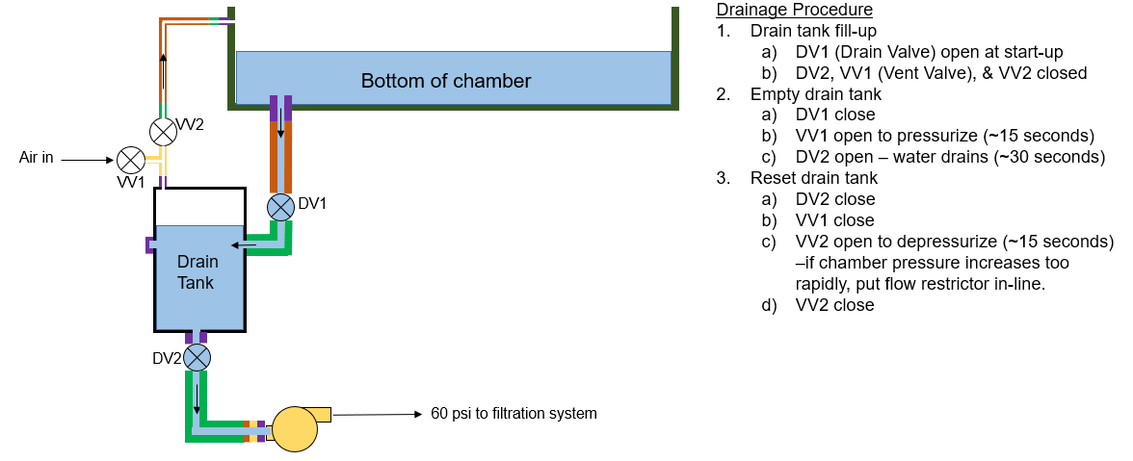
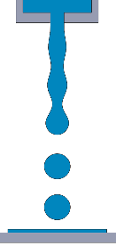
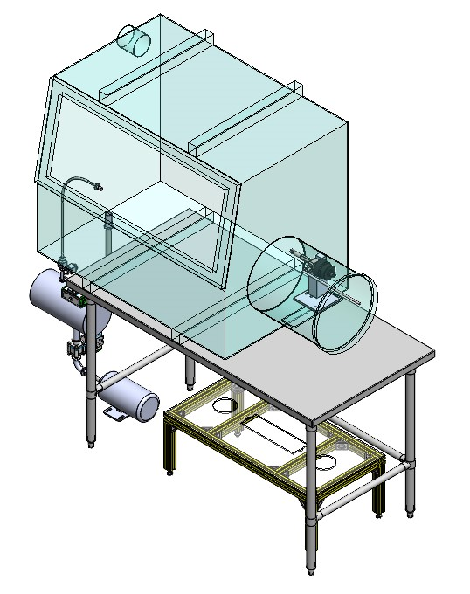
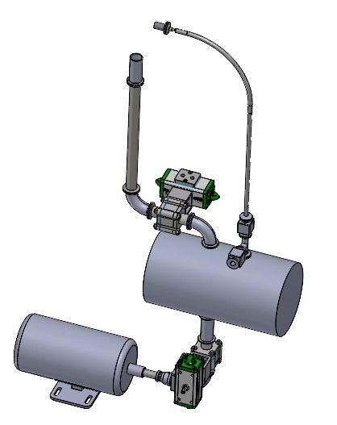
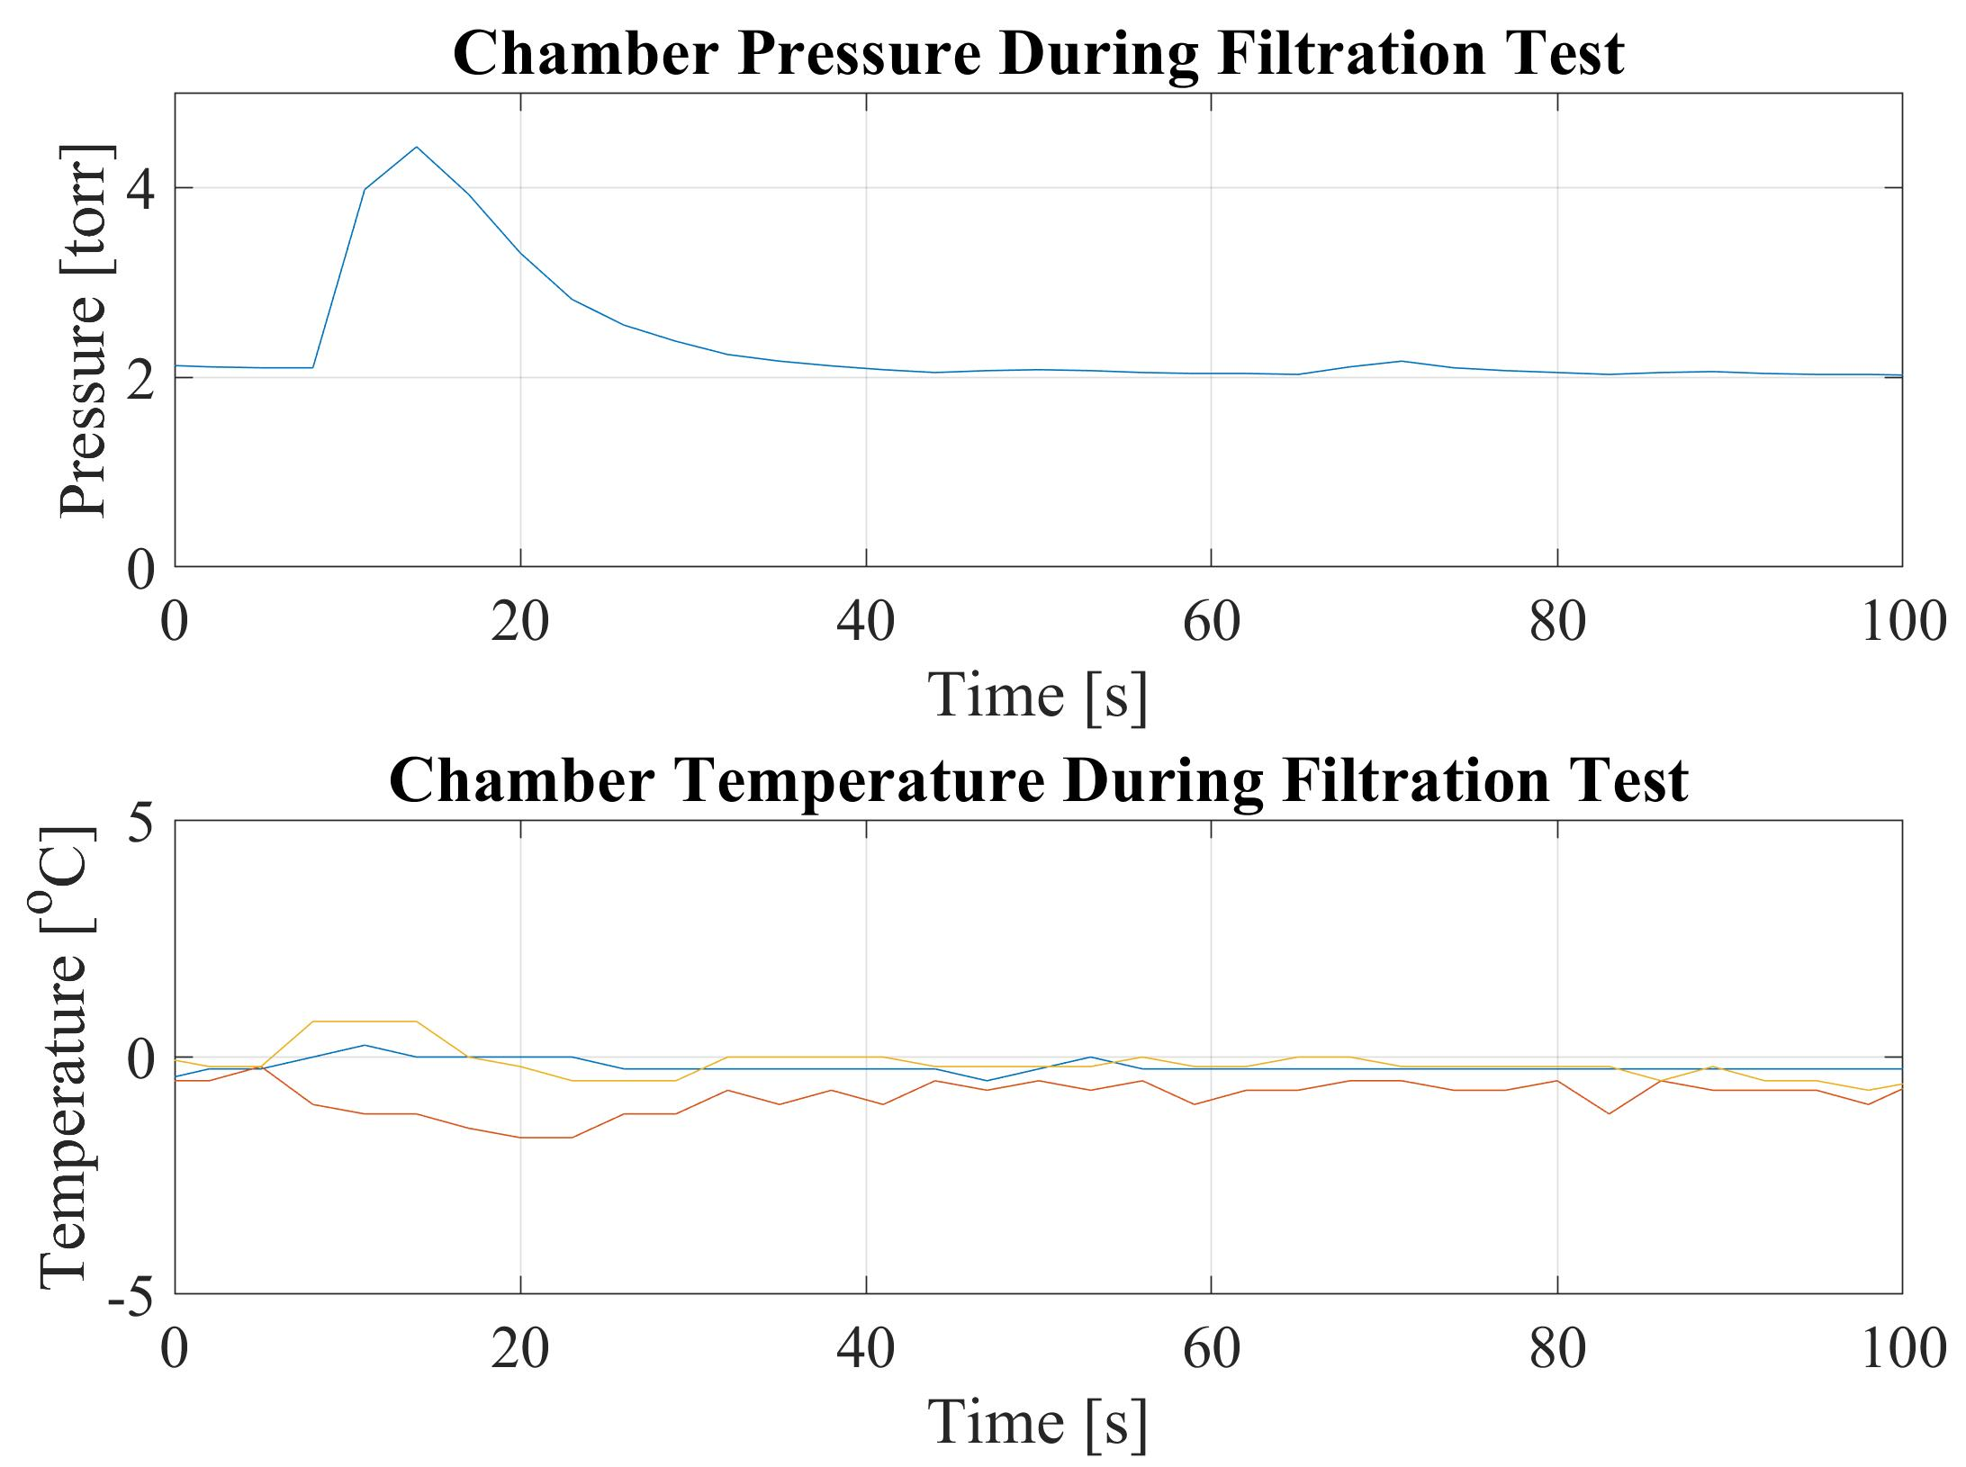
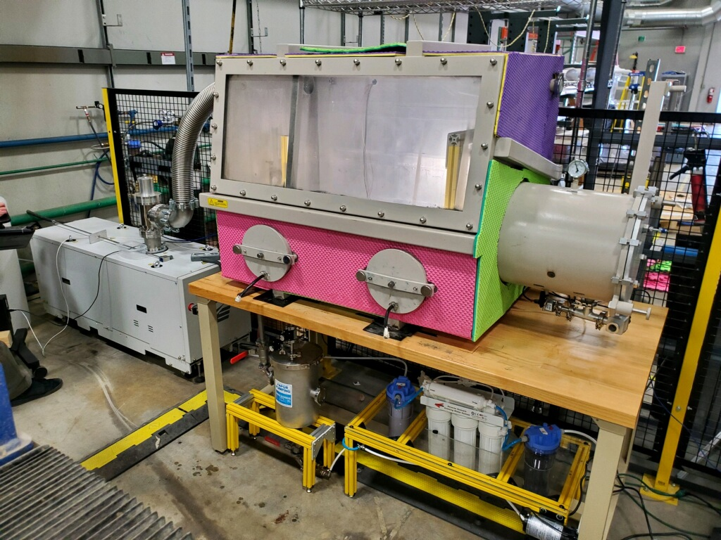
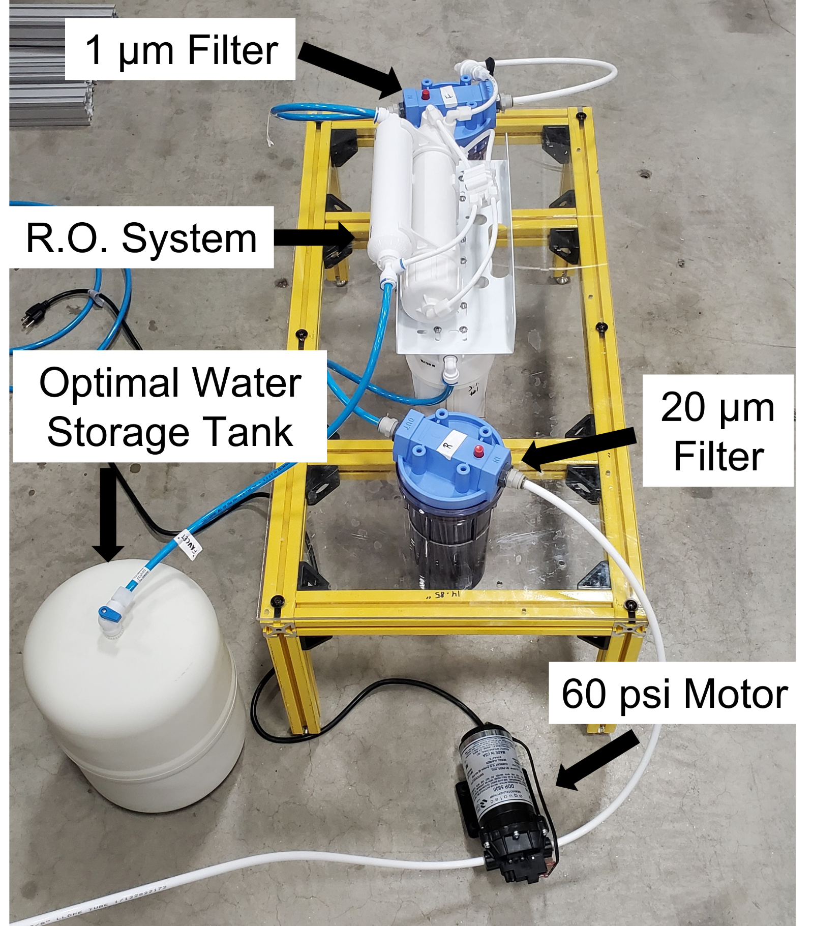
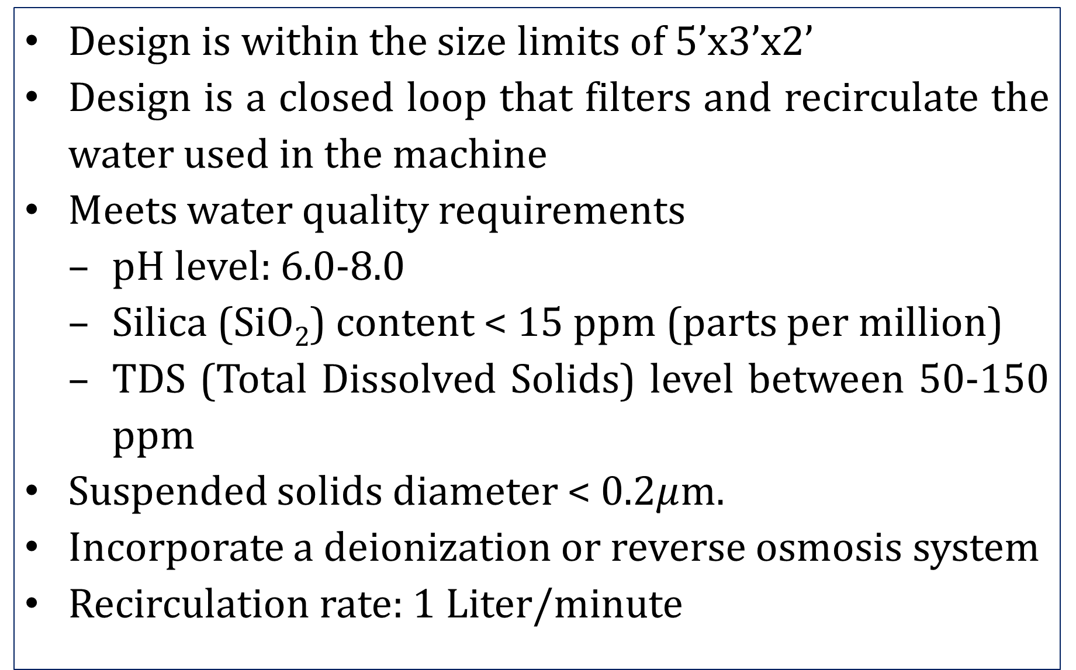
Recirculating Water System for Water Droplet Machining Process
Connor Buckley, Noah Cleary, Colin Mower, Emily Peacock, and Thomas Splagounias
Advisors: Professor Brad Kinsey and Ben Mitchell
Mechanical Engineering, University of New Hampshire, Durham, NH 03824
Introduction
System Setup
Water Droplet Machining (WDM) is a novel manufacturing process comparable to traditional abrasive waterjet machining (AWJ), which uses highly pressurized water to cut a workpiece. AWJ abrasive is financially and environmentally expensive. WDM eliminates the need for abrasive by operating inside a vacuum chamber to eliminate air resistance and produce a concentrated train of water droplets. In WDM, the workpiece moves on a traverse system, while the jet remains stationary. A need for continuous draining is required for steady state operation. Therefore, our task was to create a drainage system that also is used to recirculate and clean the water back through the WDM system.
Vacuum chamber
T2
Saturated mixture (water vapor + liquid)
T3
Waterjet cutting head
High pressure water pump (60ksi)
Vacuum pump
Workpiece
Superheated water vapor
T1
Thermocouple
Liquid pool
Condenser
Fan
Heat released to ambient air
Drain
tank
Reservoir tank
Filter system
Low pressure water pumps
Design Criteria
CAD Models
Testing Results
Design is within the size limits of 5’x3’x2’
Design is a closed loop that filters and recirculate the water used in the machine
Meets water quality requirements
  pH level: 6.0-8.0
  Silica (SiO₂) content < 15 ppm (parts per million)
  TDS (Total Dissolved Solids) level between 50-150 ppm
Suspended solids diameter < 0.2$μ$m.
Incorporate a deionization or reverse osmosis system
Recirculation rate: 1 Liter/minute
Traverse System in Vacuum Chamber
Pressure Release Valve Open
Drain Valve Open
Drainage Tank
Drain Valves
Drainage System
60psi Pump
T3
T1
T2
Drain Valve Open
R.O. System
Pressure Release Valve Open
Testing
Completed Recirculation System
Conclusions & Next Steps
Four different water samples were used in testing. In each testing sample, the water was tested for pH, TDS, temperature, and mass during two-minute intervals.
Further testing of the R.O. system’s effect on pH.
Recirculate the clean water to the high-pressure pump.
Analyze the amount of heat transferred from the chamber with the insulation installed.
Addition of a dirty water reservoir.
 | Pre-Filtering |  |  | Post Filtering
Trial # (4 min) | TDS (ppm) | pH | Temp(C°) | TDS (ppm) | pH | Temp(C°)
1 | 230.2 | 9.96 | 10.1 | 37.44 | 10.23 | 20.1
2 | 223 | 9.86 | 16.8 | 29.65 | 10.07 | 18.4
3 | 155.5 | 9.59 | 18.3 | 31.09 | 10.13 | 19.5
4 | 272.9 | 9.79 | 19.9 | 33.03 | 10.19 | 21.3
Vacuum Pump
Vacuum Chamber
Acknowledgements
Depressurizing Tank
This work has been performed with mentoring from Ben Mitchell and Professor Brad Kinsey with partial funding from the US National Science Foundation through award CMMI-1462993.
Filtration System

