Slide 1
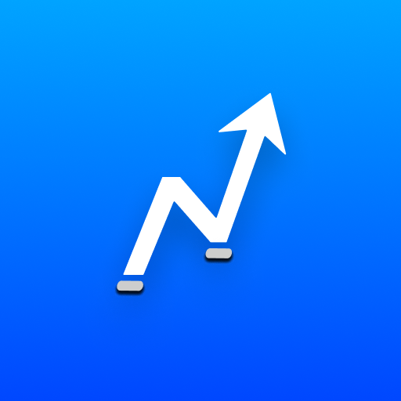
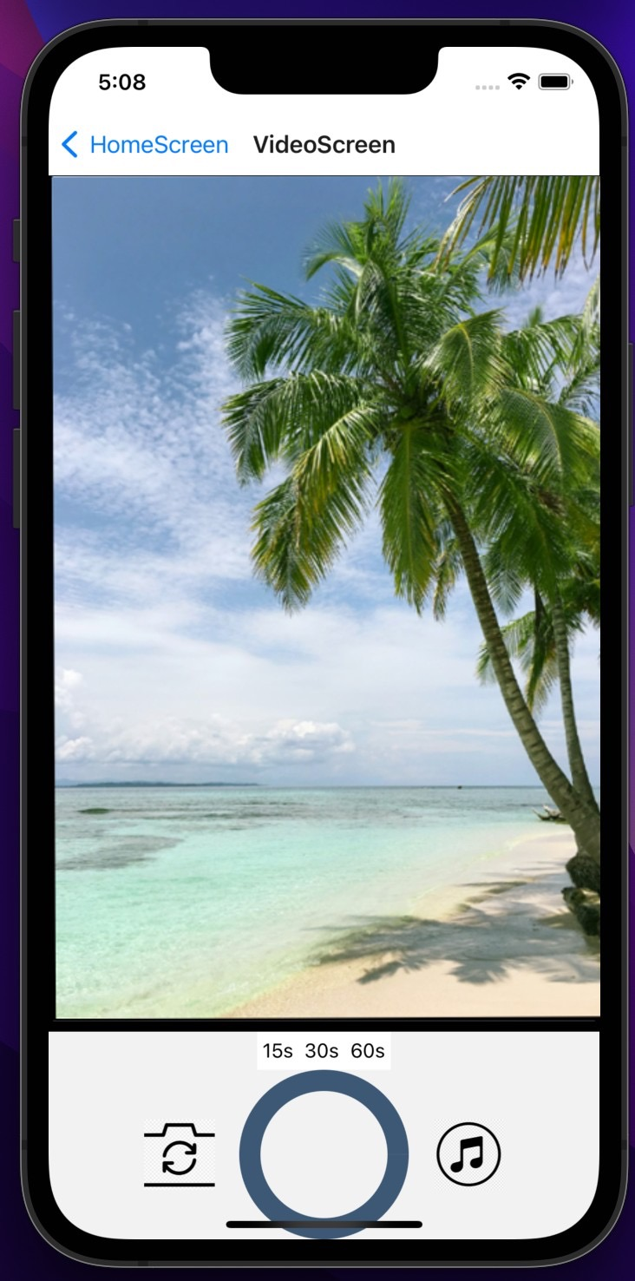
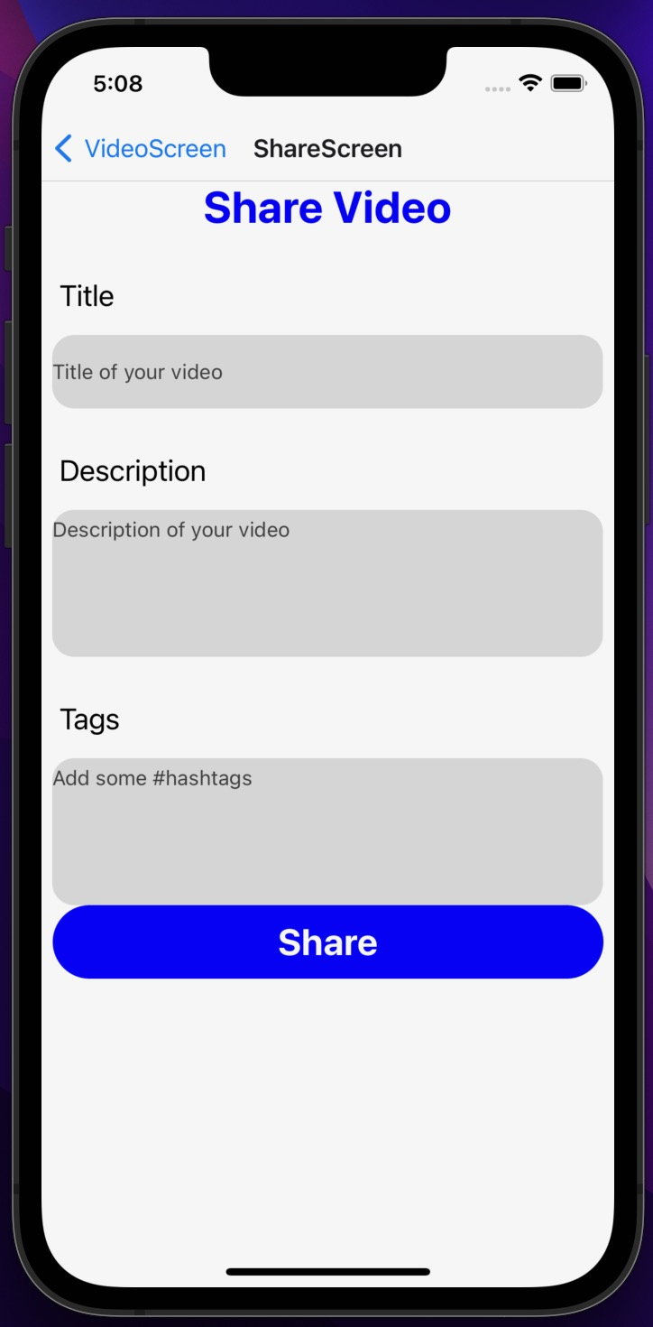
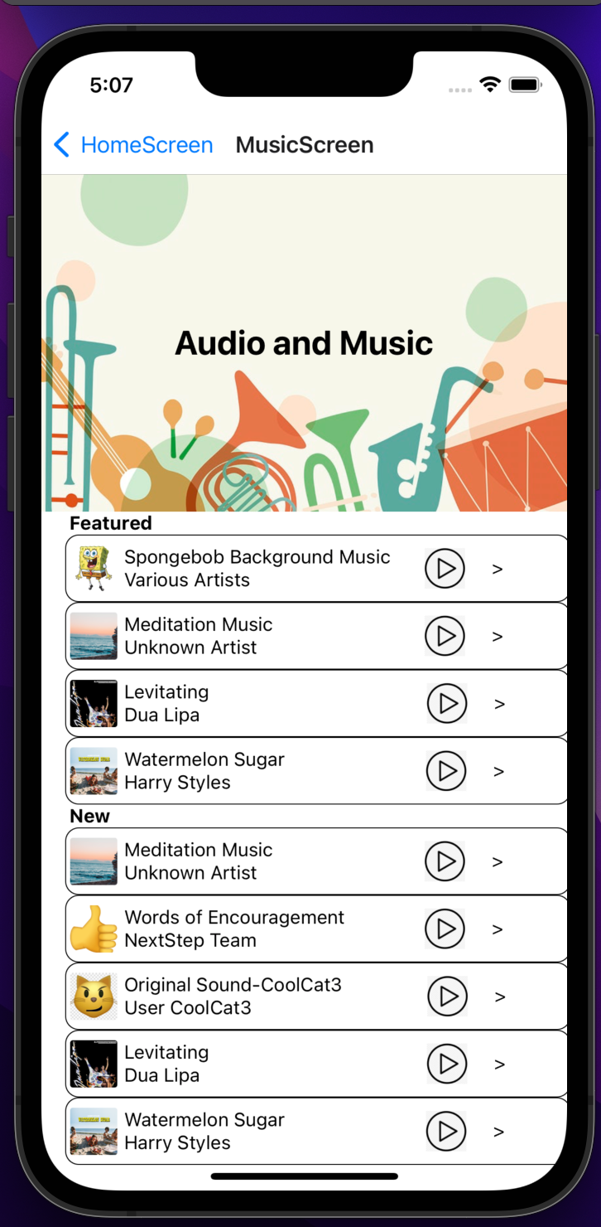
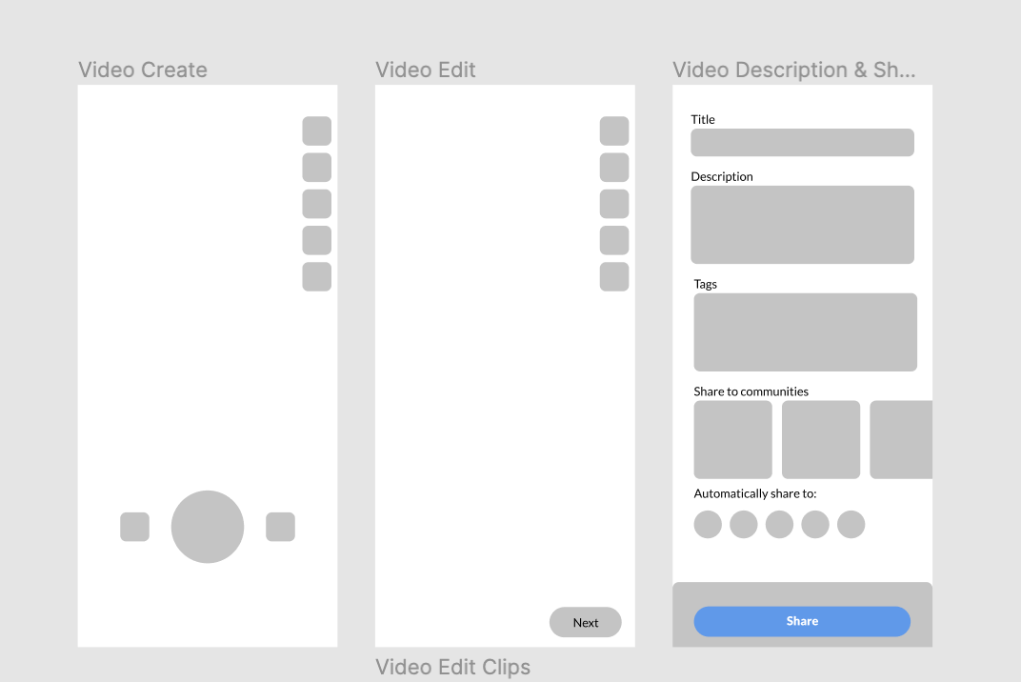
NextStep Feature Development
Gabriella Germany, University of New Hampshire
Daniel McCarthy, University of New Hampshire
Background
Design
Results
The NextStep GoodLife application is a mobile app built for youth and adolescents around the world. NextStep’s goal with this application is to start important conversations about mental health, and to make it engaging for young people to develop health literacy and get the resources they need for mental health resilience. To do so, they launched NextStep GoodLife in partnership with organizations serving youth on a large scale like the NH Department of Education and the New York City Mayor’s Office of Community Mental Health.
We were able to create a feature consisting of these three different viewing screens, all of which make it accessible for the user to navigate. Our feature allows users to easily upload videos to the NextStep GoodLife app and add audio and filters to their content. Users can navigate through all three screens easily, and there is a working back and front camera for users to record content. Users can also select audio to play in the background of their video.
Introduction
For this project, our goal was to create new features in the NextStep GoodLife application in order to increase engagement with the application. Our sponsors wanted us to create video sharing features for users to customize the content they share to NextStep’s platform. We wanted the app to be engaging and easy to use, so we created a list of objectives to do so.
For our final results, we created a timer for users to be able to customize how long their content records for. Once recorded, the user is immediately taken to the second screen, where they are able to post their content with a title, description, and add tags. Once recorded, users are also able to select from the audio player if they would like to add audio to their content.
By bringing relevant features to the NextStep GoodLife app, we will be able to increase user engagement, and the app usability overall.
Objectives
To implement basic screen navigation throughout the application
To implement a countdown timer for video recording
To implement an audio player for users to play audio over their video
To implement video sharing across platforms
Implementation
Utilizing React Native and Xcode, we created a stack navigator to handle having different screens and navigating between them, and installed a dependency. This has a touchable opacity of a circular progress indicator which has a time limit set to a button that the user selects, and when pressed the camera records for that period of time. When that time is finished the app automatically pushes the prompt screen to the top of the stack. For the music player we installed the react-track-player dependency that allows a local .mp3 file to be played when selected.
Next Steps
References
NextStep GoodLife App:
https://nextstepgoodlife.com
Xcode Tutorial:
https://codewithchris.com/xcode-tutorial/
React Native:
https://reactnative.dev/
In the future, the features that we have created will eventually be implemented into the NextStep GoodLife app for other users to use to customize the content they wish to share. NextStep will use what we have created to increase user engagement in their app. With the features that we have created, the app will be come even easier to share and upload customized content.
Acknowledgements
NextStep HealthTech: Thank you for allowing us to work on this project with you!
Professor Benedetto and Professor Plumlee: Thank you for answering all of the questions we had, and guiding us through this process.
Contact Information
Gabriella Germany: gabriella.germany@unh.edu
Daniel McCarthy: daniel.mccarthy@unh.edu

Slide 2
This poster template provided courtesy of
UNH ESRC Poster Printing Services
Trust us to make your poster look GREAT!
Website: http://posters.unh.edu
Poster Guide: http://goo.gl/1E7TJY
DELETE THIS SLIDE BEFORE PRINTING

