Slide 1




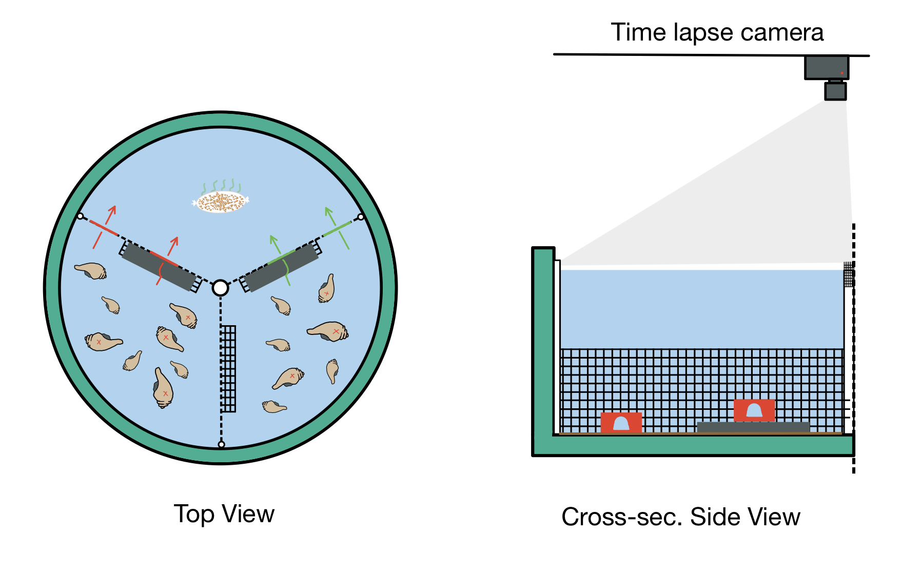
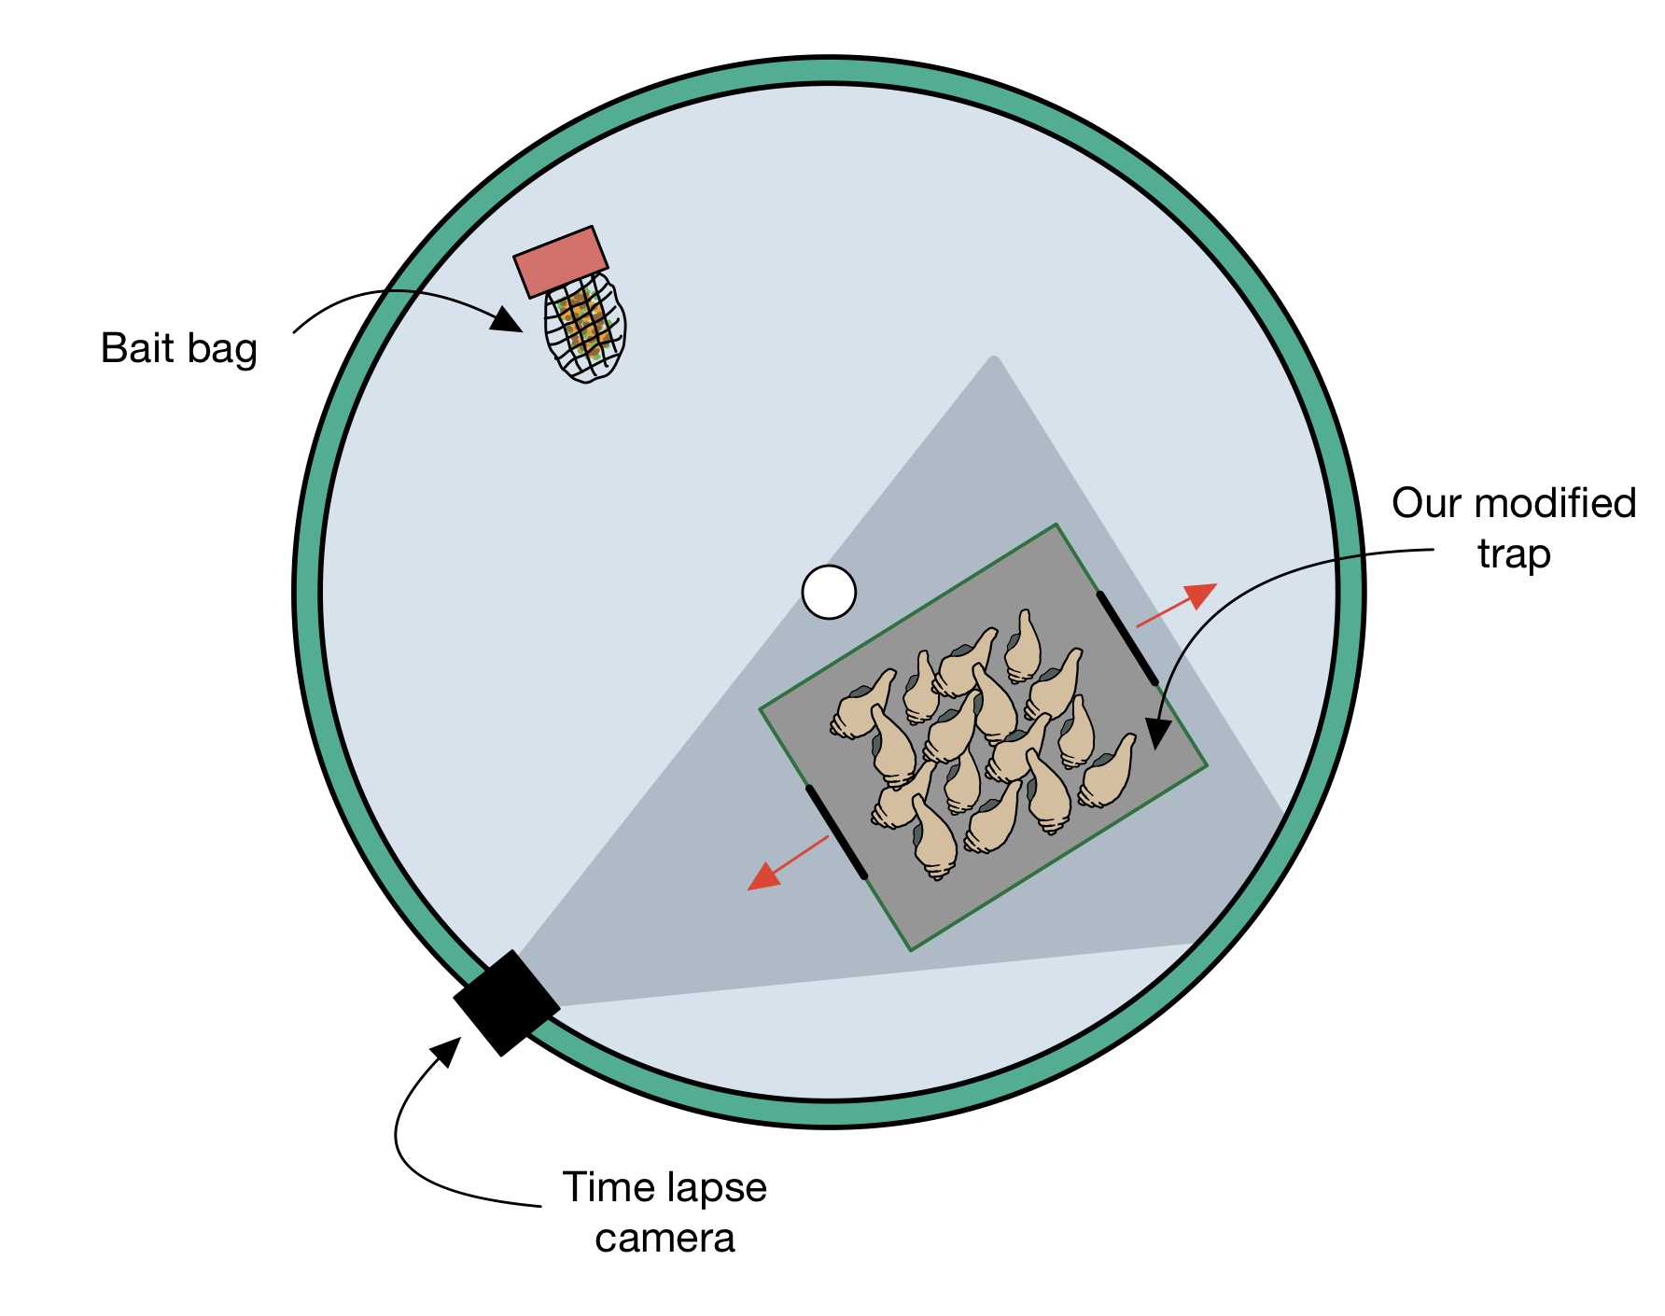
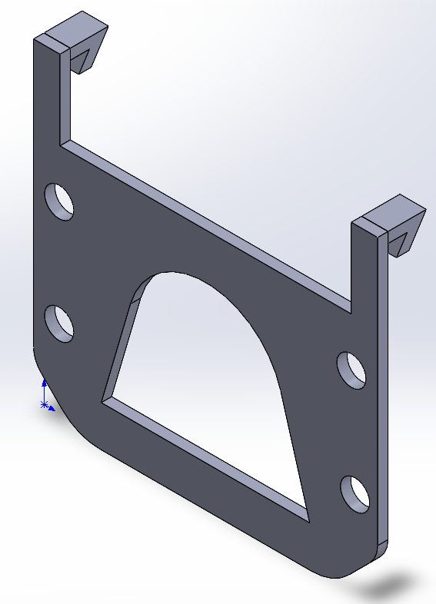
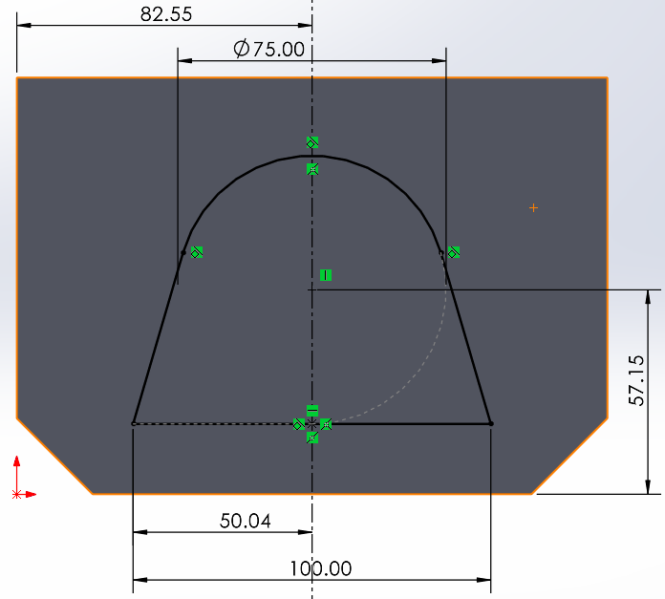
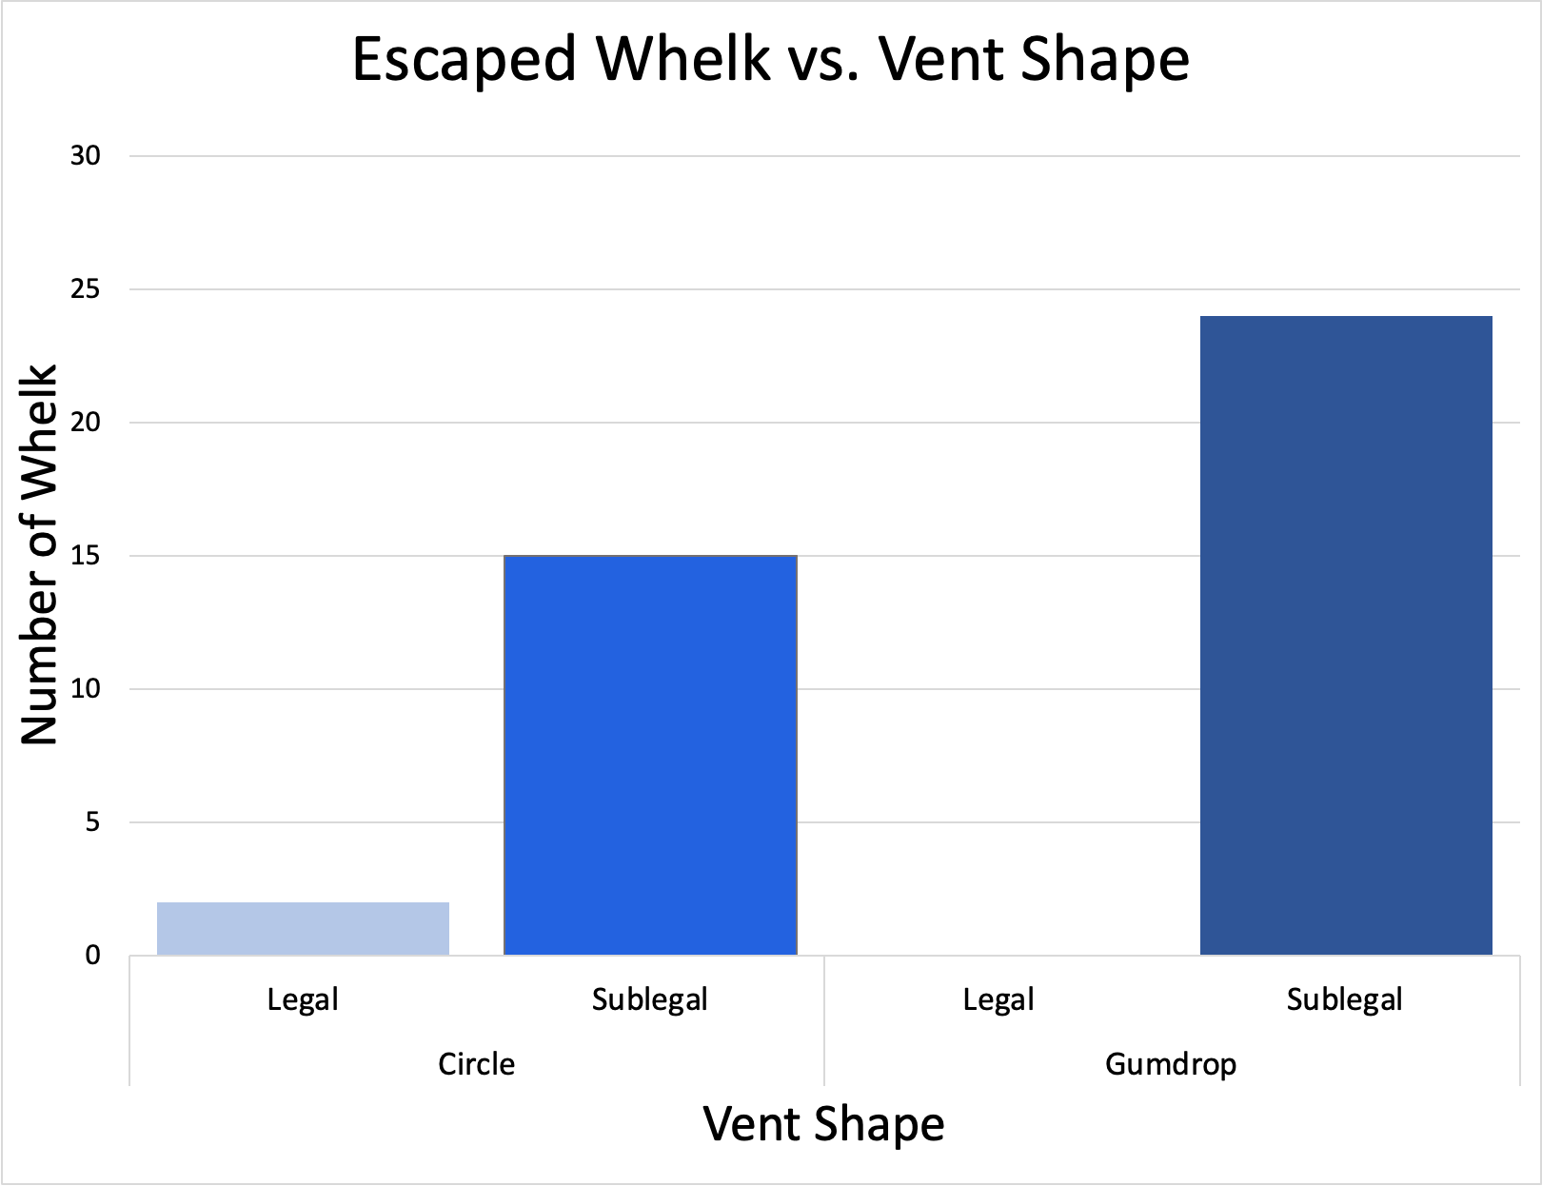
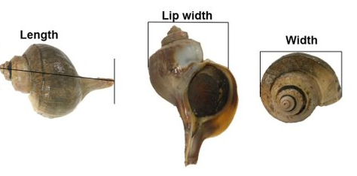
Redesign of Channeled Whelk Traps for Improved Selective Harvesting
Team: Jake Greenland, Anthony Lee, Sarah Leighton, Jack Schreiber, Aidan Thayer
Advisors: Dr. Elizabeth Fairchild, Mary Kate Munley (Graduate Student)
University of New Hampshire College of Engineering and Physical Sciences Durham, NH
Background
Data
Discussion
This design will reduce bycatch by allowing only sublegal to exit
Less bycatch leads to improved haul efficiency and labor
Further experiments should include more legal-size whelk in trials to further confirm/support conclusions
Due to increasing regulations, in minimum legal size, whelk bycatch has increased 60% in recent years (79.375mm, 2021).¹
This leads to increased sorting and labor for fishermen at sea.
Our proposal is to create a new trap design that minimizes labor and handling out at sea.
Escape Trial Setup
Slot Trial Setup
Methods
30 whelk used during the trials (3 legal and 27 sublegal)
Measured by their length, width, and lip width.²
Current trap design control test: Performed by placing whelk placed outside current trap and bait placed inside over 10 days.
Slot tests: Incorporated escape vents in circle and gumdrop shapes for further trials performed for 1 month.
Escape trials: Performed last to test vent usage on a current trap design over 8 days.
Figure 2. Slot Trial experimental set up
Figure 3. Escape Trial experimental set up
Chi-squared values for escape and slot trials <0.05 which means there was a statistically significant preference for the gumdrop shape.
This slot was designed to be 75mm (2.95 in.)
in diameter
Acknowledgements
This work was funded in part by New Hampshire Sea Grant's Workforce Development Project E/WFD-1, pursuant to National Oceanic and Atmospheric Administration Saltonstall-Kennedy Program Award No. NA18OAR4170090. We would like to thank our advisors, Dr. Elizabeth Fairchild and Mary Kate Munley for guiding us on our research. As well as to the other students enrolled in the Undergrad Ocean Research Project course for their feedback over the last few months.
Citations
Figure 1. Whelk measurement parameters
1. Edwards, A.L. and M.G. Harasewych. 1988. Biology of recent species of the subfamily Busyconinae. Journal of Shellfish Research 9: 453-460.
2. Edmundson, S.A. (2016). Channeled Whelk Busucotypus Canaliculatus Ecology in Relation to The Fishery in Vineyard and Nantucket Sounds, Massachusetts. University of New Hampshire.
Figure 4. Graph relating the number of legal sized whelks escaped versus sublegal whelks escaped for Slot trials.

