Slide 1
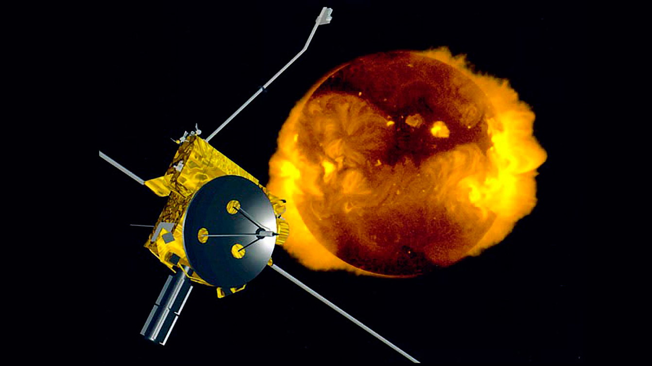
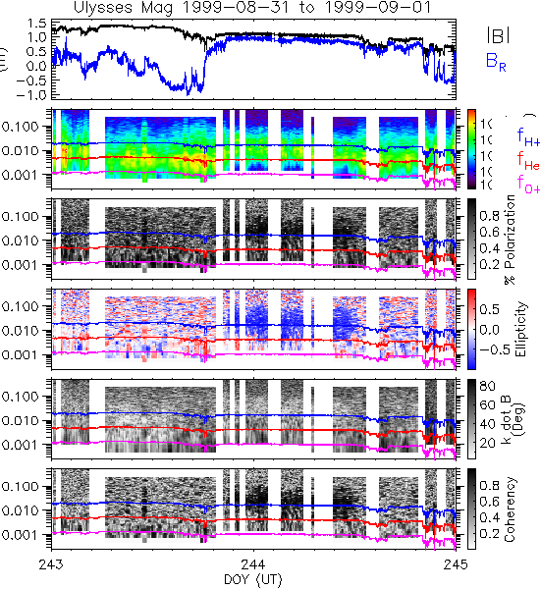
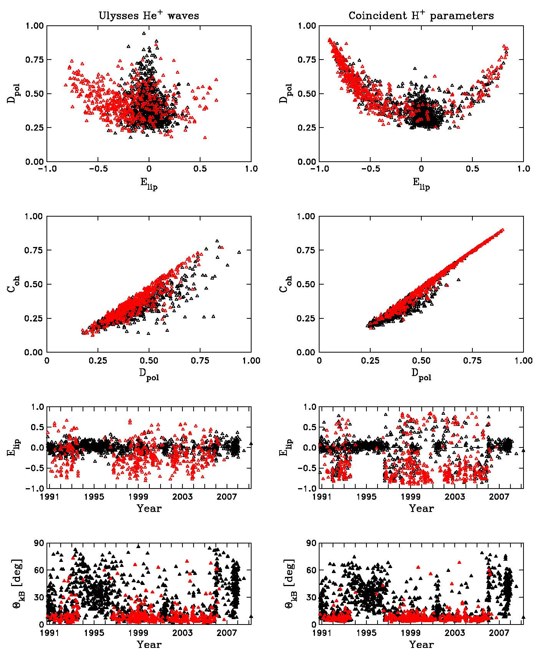
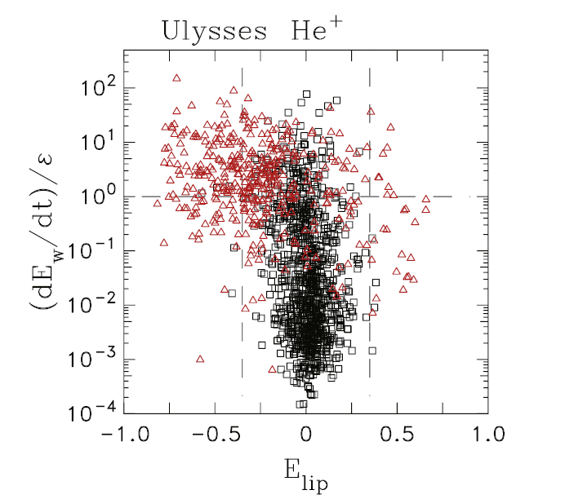
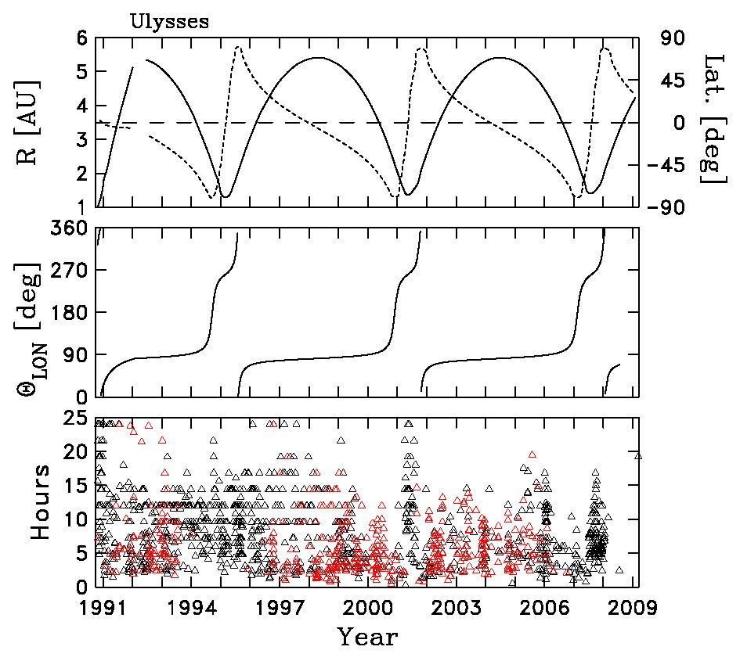
Low-frequency Waves due to Newborn Interstellar Pickup He+ Observed by the Ulysses Spacecraft Anastasia V. Marchuk, Charles W. Smith, Abigale S. Watson Physics and Astronomy Department and Space Science Center, University of New Hampshire, Durham, NH 03824
Introduction
Ulysses Spacecraft
Results
Interstellar neutrals pass through the solar wind and are ionized via collision with either solar wind protons (H+ production) or extreme ultraviolet solar photons (He+ production)
These pickup ions (PUIs) stream along the magnetic field at the solar wind speed
We are reporting observations of magnetic waves created by newborn pickup He+ ions made by the Ulysses spacecraft
They are visible when the wave growth rate exceeds the turbulence rate
Wave events due to pickup He+ are generally found when wave energy is allowed to accumulate over time without dissipating
The dynamics of the turbulent cascade transport the fluctuation energy from large scales associated with transient flow to smaller ones associated with kinetic dissipation – ultimately this heats the background plasma
Waves are seen when the growth rate is comparable to or exceeds the turbulence rate – in fact, the observability of waves depends more on changing turbulence rates than any changing growth rates
This indicates that waves are continuously being excited by PUIs, but are only observable once the growth rate can overcome the background turbulence
Figures
Conclusions
Observability of waves depends on whether the growth rate exceeds the turbulence rate – waves are constantly being excited by PUIs but when the turbulence rate exceeds the growth rate, the wave energy dissipates
Wave events are largely absent from fast-latitude scans during the solar minimum, and more common in fast scans of the solar maximum, because turbulence rates tend to be elevated over a broader range of heliolatitudes during the solar minimum (restricted to near 0⁰ during solar maximum) – turbulence varies with solar cycle and latitude, which affects wave event frequency beyond PUI scattering and wave excitation
Methodology
Analyzed one-second magnetic field observations from the Flux Gate Magnetometer instrument – downloaded highest resolution data as daily files and produced automated spectrograms
Examining the ellipticity plot of the spectrogram is the most reliable method to identify wave events – they appear as uniform bands of color (see Figure 1: large blue patch indicates an event)
We then analyze the power spectra of these possible wave events and look for indicators such as a large enhancement in the power near the helium cyclotron frequency
Extension of the wave signal to frequencies greater than H+ cyclotron freq. indicates H+ involvement; extension to He+ cyclotron freq. without an obvious acceleration source indicates waves due to He+
Figure 6 shows He+ polarization parameters in red compared to the control intervals in black – difference between He+ and H+, as well as both showing an absence of wave events during the fast latitude scans of the solar minima
Theory analysis is based on the assumption that He+ pickup ions are scatters and maintain an asymptotic form
Data
Figure 1: example of a daily spectrogram file showing wave activity
Figure 2: polarization parameters for He+ and H+ frequencies
Acknowledgements
We have 1479 data intervals. 452 contain waves due to He+, and 962 are controls. The controls may have waves due to H+ but are not thought to contain He+ waves
Figure 3 plots the ratio of the wave growth to turbulence rates as a function of the wave ellipticity, showing that control intervals are generally low ellipticity and waves are seen when the growth rate is comparable to, or greater than, the turbulence rate
Figure 4 shows the Ulysses trajectory compared to the location of the wave events [top: heliocentric distance (solid) heliolatitude (dotted), center: heliolongitude]
We calculated the interstellar neutral species densities and PUI production rate using the nWPTM code (Tarnopolski & Bzowski 2009 and Sokół et al. 2015), and growth rates for waves excited by PUIs by using a formula derived by Lee & Ip (1987).
To obtain the turbulence rate we used an extension of the hydrodynamic theory of Kolmogorov (1941a) adapted for MHD
It is rescaled to match the observed proton heating rate
The power spectra we study vary from the prediction assumed in the turbulence rate, likely because of the relatively short data intervals – however we believe this scaling remains reasonable
Matthew R. Argall, Colin J. Joyce, Philip A. Isenberg, Bernard J. Vasquez, Nathan A. Schwadron, Maciej Bzowski, Marzena A. Kubiak, and Neil Murphy
References
For a full list of references, see Marchuk et al. (2021).
Figure 3: ratio of the growth rate over the turbulence rate against ellipticity, showing wave events at favorable growth rates
Figure 4: Ulysses trajectory compared to location of wave events

