Slide 1
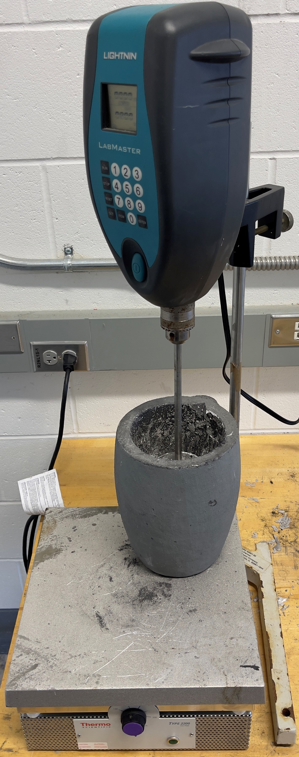
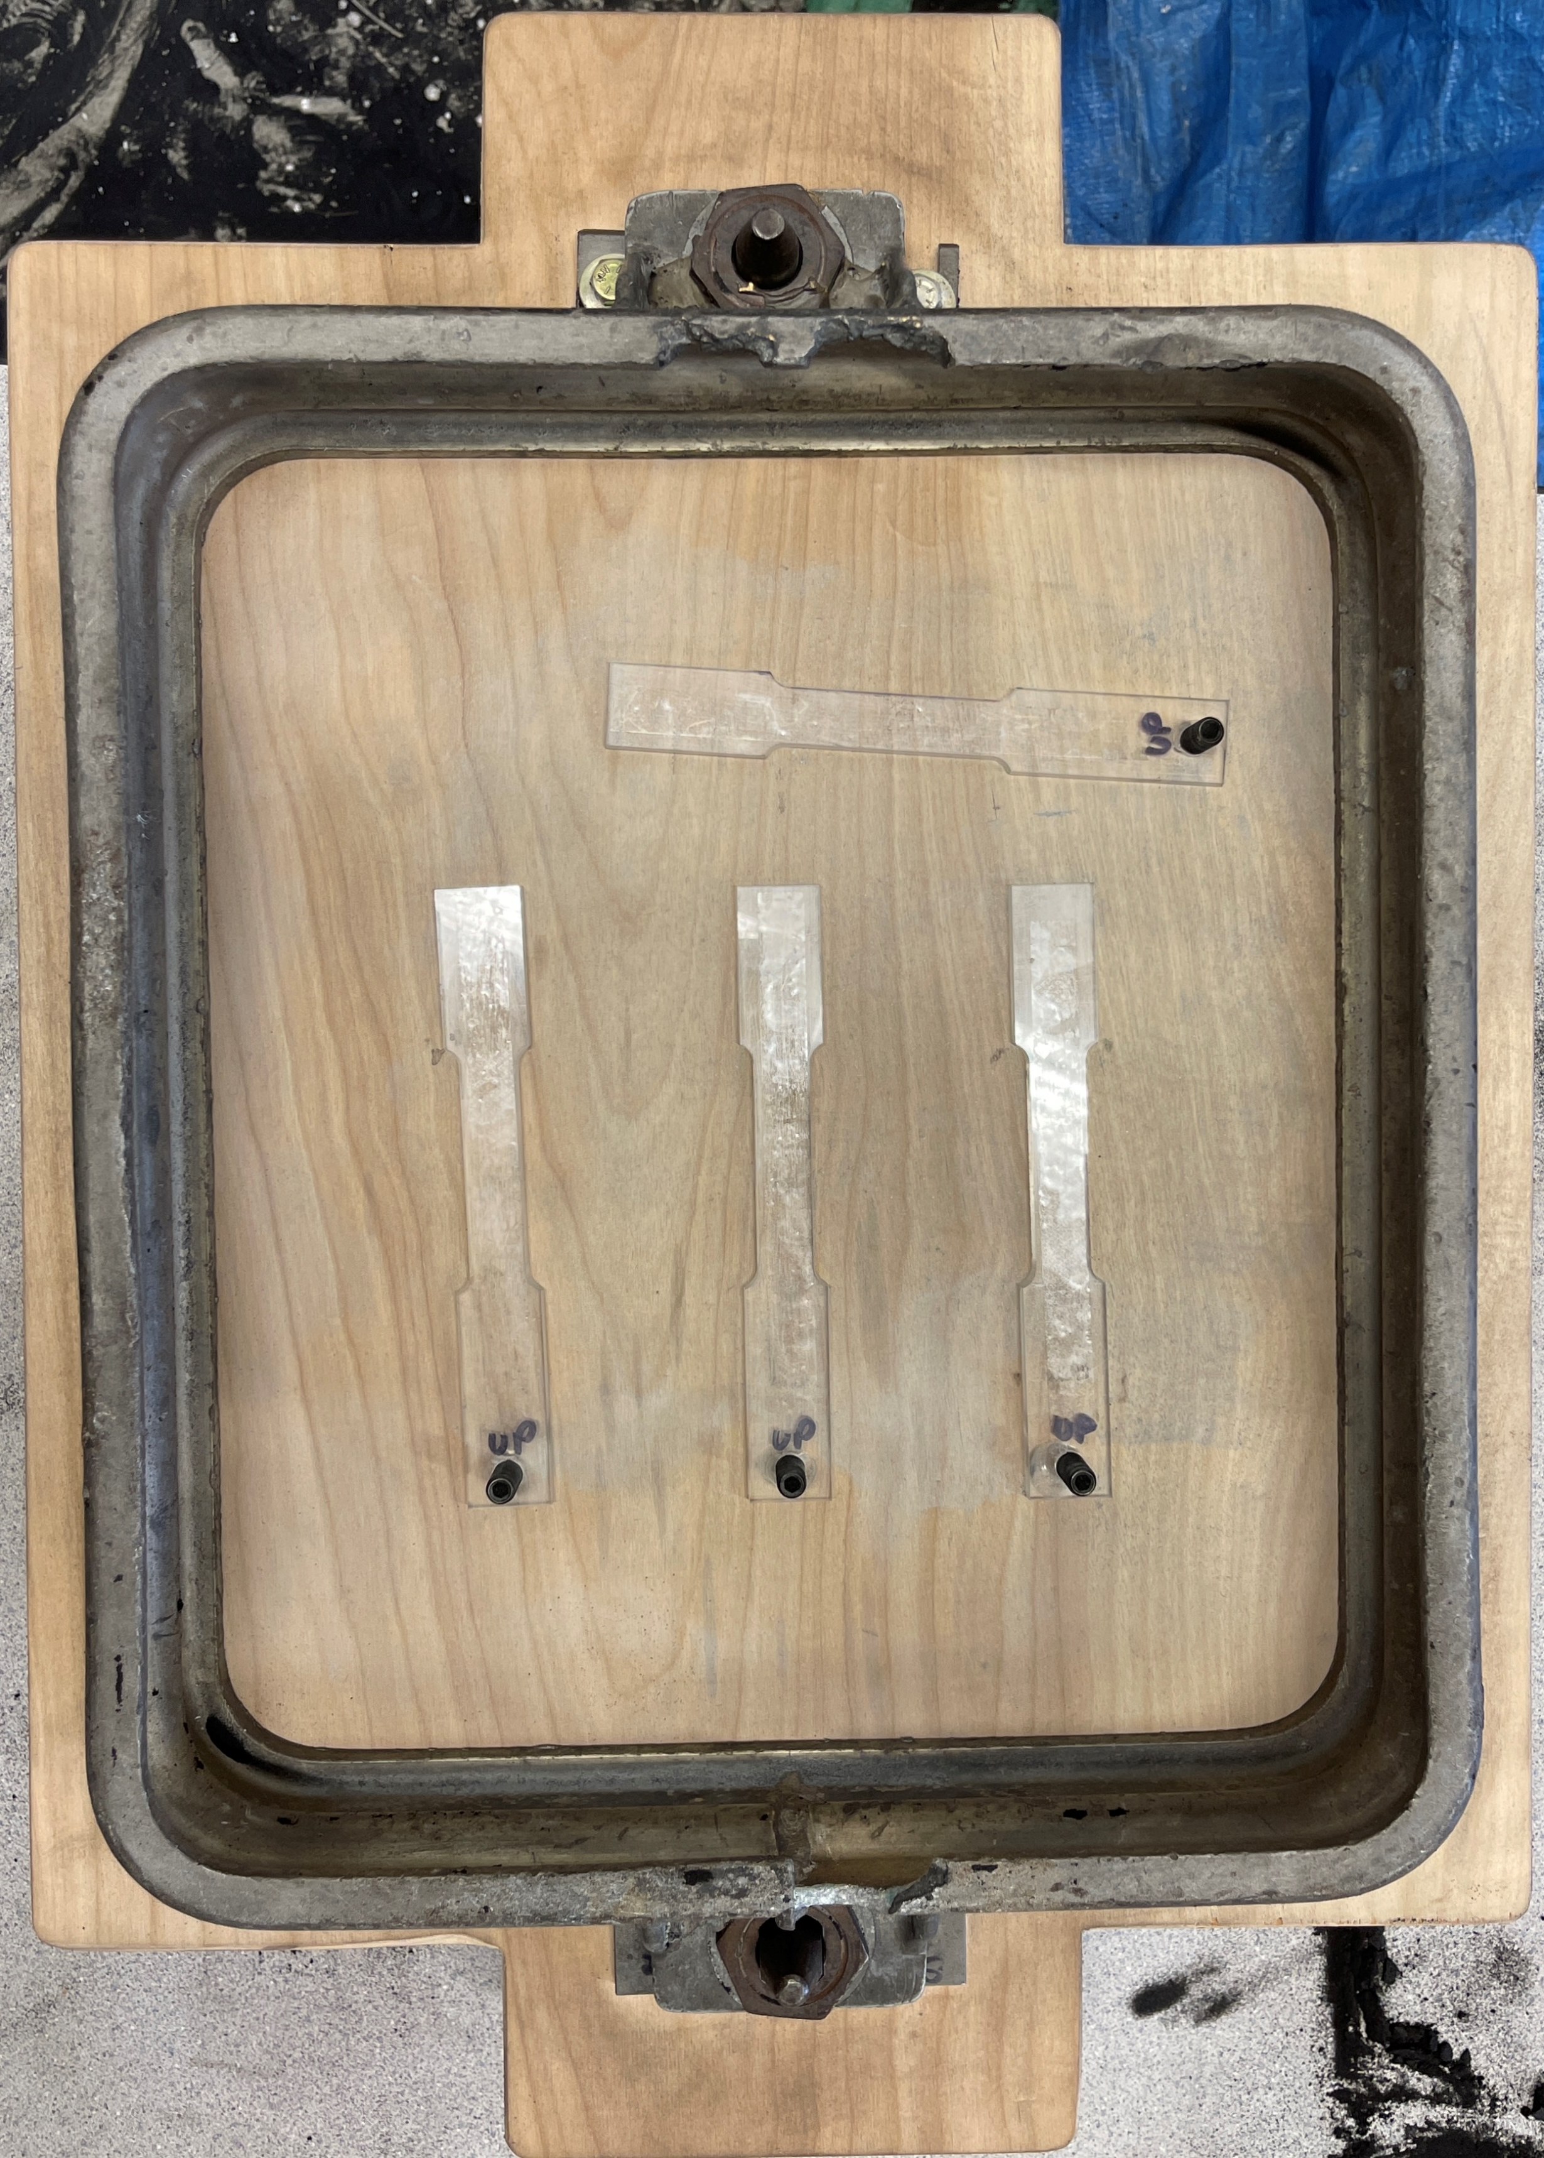
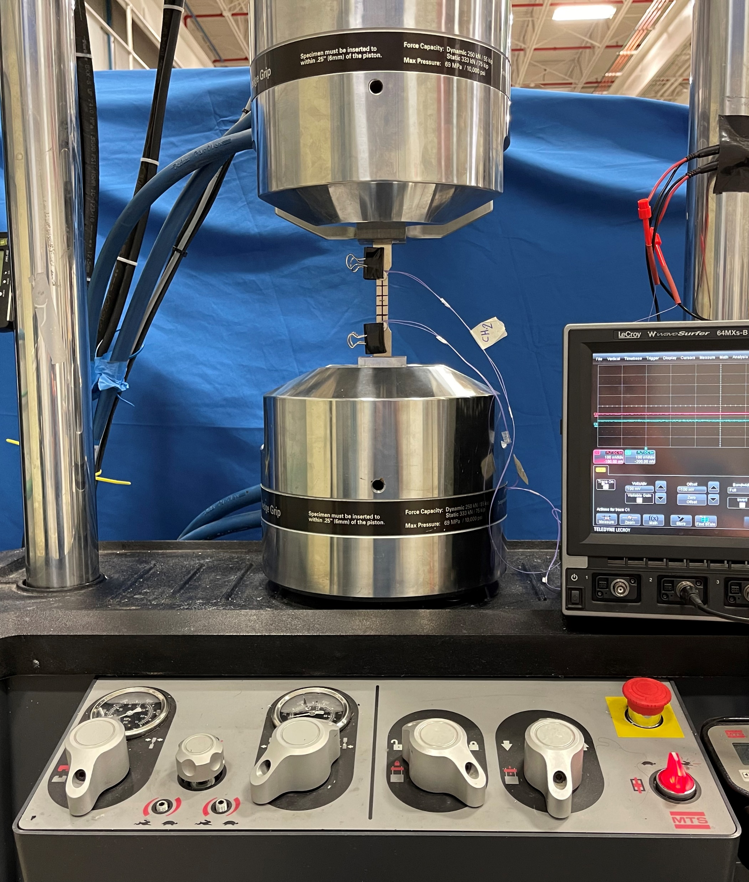
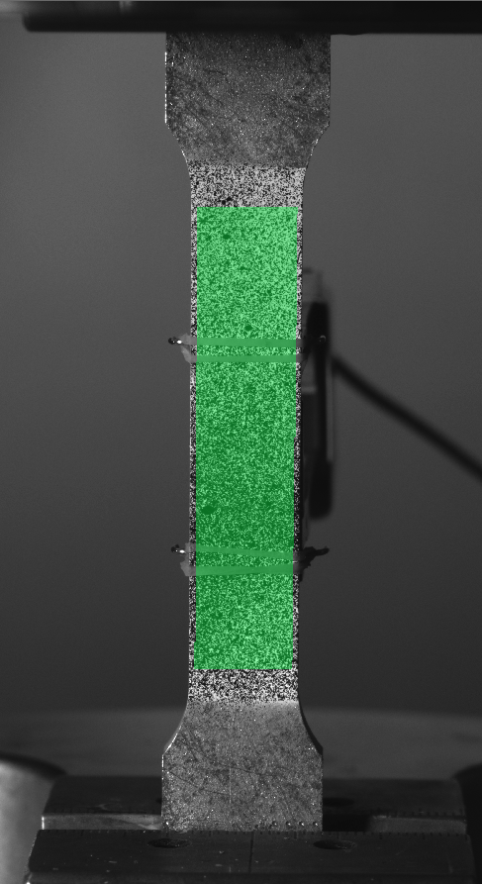
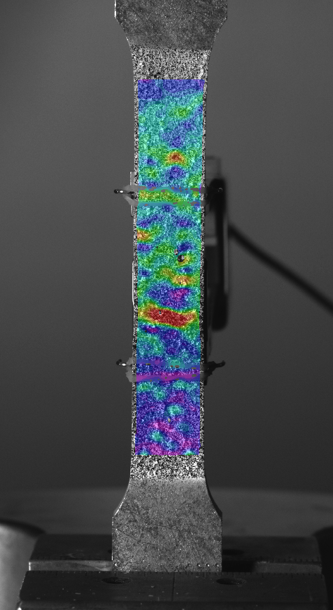
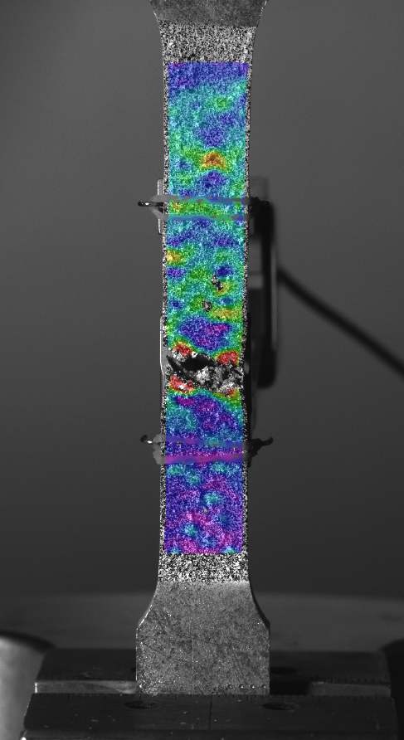
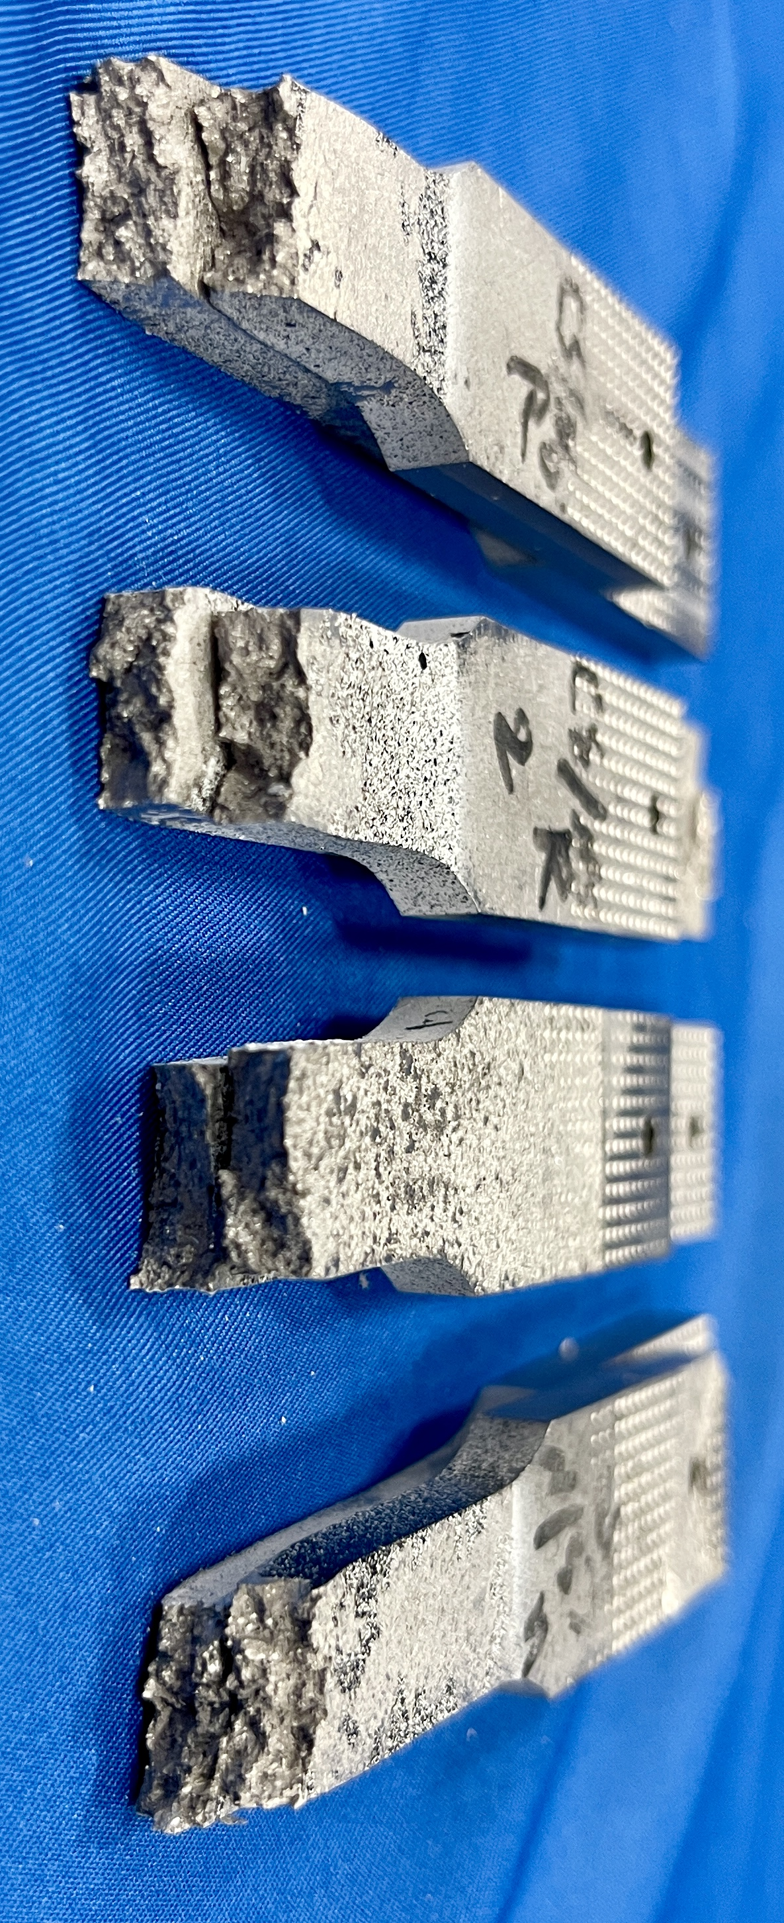
Lunar Regolith Effects on Sand Casted Material Properties Jacob Lewis Advisor: Dr. Brad Kinsey Acknowledgements: Ali Al-Jewad and Scott Campbell Innovation Scholars, University of New Hampshire, Durham, NH 03824
Introduction
Setup
Digital Image Correlation
In-space manufacturing will be a part of the next generation of engineering and space exploration.
However, sending payload to the moon is expensive, costing about $10,000 per pound.
One way to counteract this is by creating a metal mixture utilizing in-situ materials on the moon.
The goal of this research is to gather data as to how adding lunar regolith (moon soil) affects the properties of bismuth-alloy metal.
Uses movement of speckle patterns over time to create displacement vector fields, calculates strain.
Enables the program to assign color gradients that can be digitally overlaid on the test specimen.
1
3
2
1
2
Methodology
1
DIC images at three points in time for pure bismuth-alloy specimen four.
The bismuth-alloy metal was chosen due to its low melting temperature (70°C-88°C).
The lunar regolith simulant was purchased from the Exolith Lab at the University of Central Florida.
Mold patterns are created with a 5° draft, making the casting flask easier to remove from the plate.
A hot plate is set to >150°C in order to melt the metal in the crucible.
An overhead stirrer is used to mix the lunar regolith with the metal.
Tensile test is performed at a displacement rate of 0.5 mm/s.
2
Conclusions
3
We can accurately measure ultimate tensile strength with sand-casted tensile specimens.
Using an overhead mixer to wet the regolith with the bismuth-alloy metal will introduce air into the mixture.
Sand-casting the air-filled mixtures will create air voids within the specimens that will not allow for valid tensile testing results.
1. Casting Flask
2. Mold Patterns
3. Plate
1. Crucible
2. Hot Plate
3. Overhead
Stirrer
1. MTS Tensile Testing Machine
2. ASTM E8 Tensile Test Specimen
Tensile Specimens
Mechanical Properties
Future Work
Use a mixing process that decreases the amount of air trapped in the metal.
Analyze particle distribution within tensile specimen to inform better mixing practices.
Improve sand casting process to get more consistent results.
Test more percentages of regolith with the bismuth-alloy metal.
Test with more commonly used metals, such as aluminum.
Pure Bismuth-Alloy
5% Lunar Regolith
10% Lunar Regolith

