Slide 1

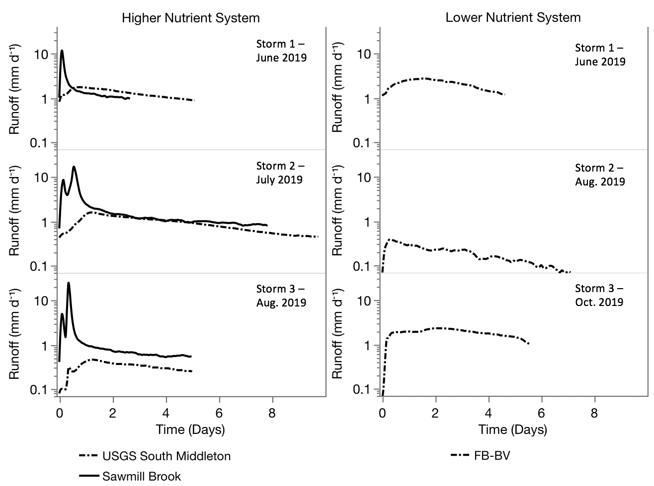
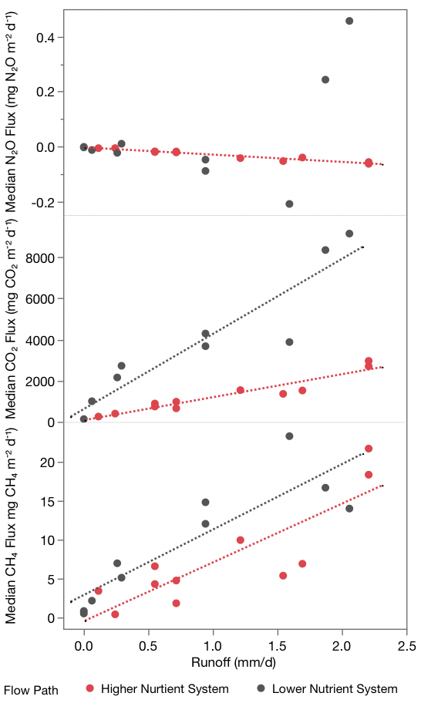
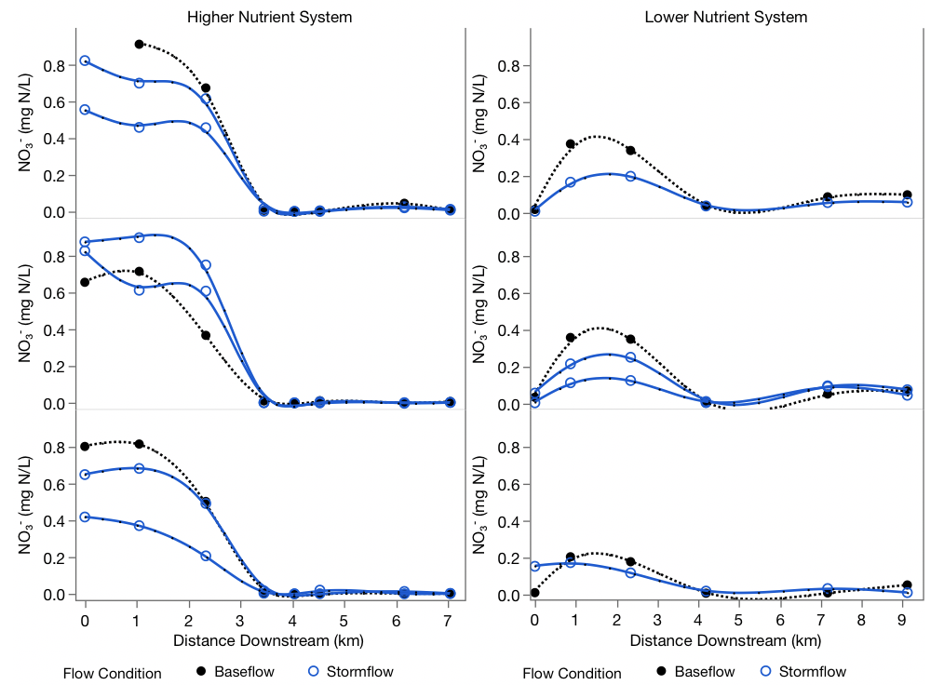
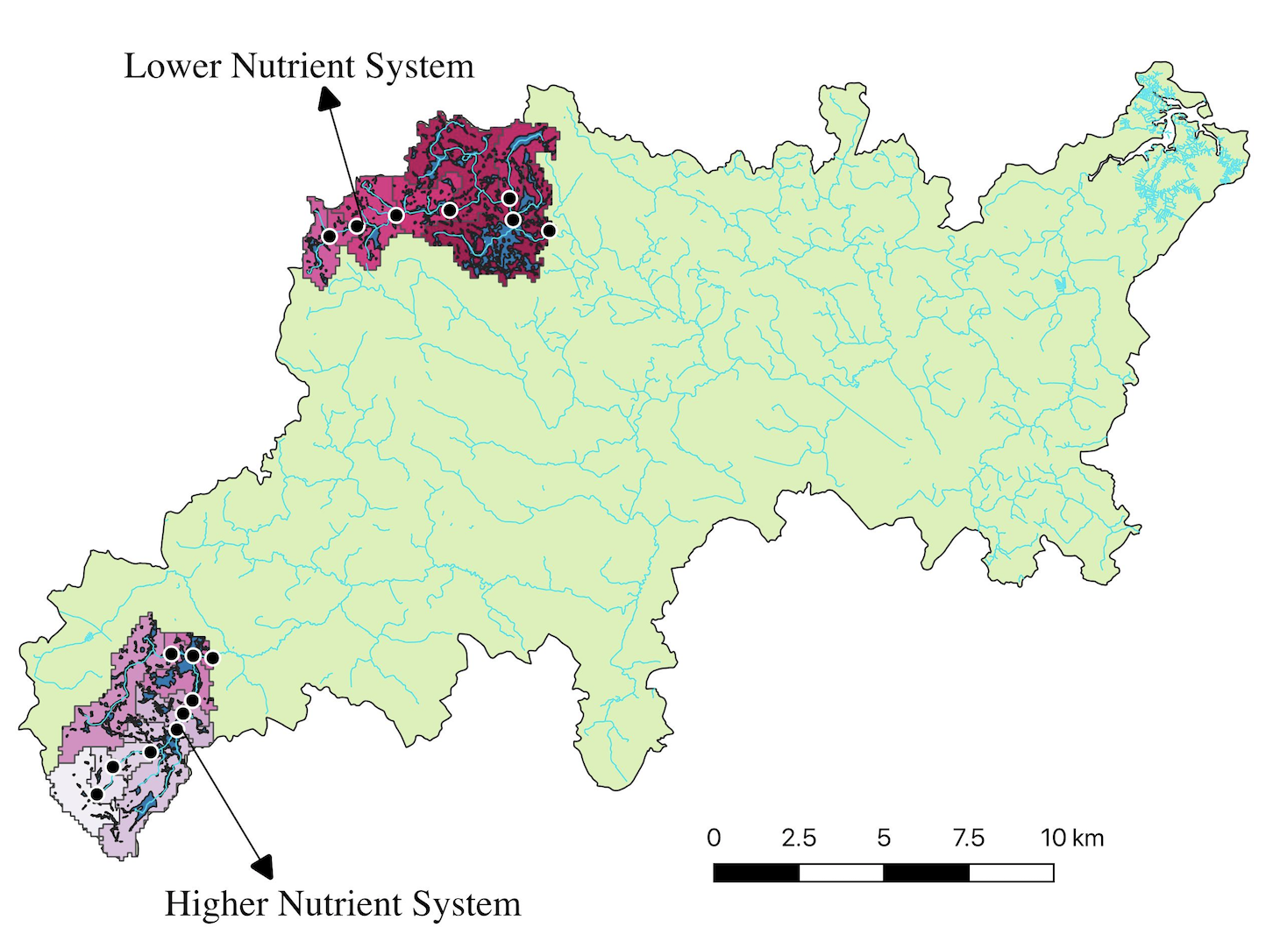
Response of Fluvial Wetland Systems to Storm Events and Elevated Nitrogen Inputs from the Landscape
Sarah Bower*, Wilfred Wollheim
University of New Hampshire, Department of Natural Resources and the Environment *Contact email: sarah.bower@unh.edu
Motivation
6 Storms Sampled
Variable Responses in GHG Emission
Fluvial wetlands act as buffers in river networks to limit nitrogen (N) from reaching downstream ecosystems and causing problems like coastal eutrophication. However, as significant hotspots for N removal, they are also natural sources of greenhouse gas (GHG) to the atmosphere and contribute to global climate change. With ongoing increases in both climate variability and landscape urbanization, the ability for fluvial wetlands to regulate these tradeoffs may decline.
Research Questions
How well do fluvial wetland systems buffer against enhanced N inputs across flow conditions in river networks?
2. Do enhanced N inputs and higher flow conditions lead to greater GHG emissions from fluvial wetland systems?
Strong NO₃⁻ Buffers Across Flows
Study Design
Two fluvial wetland dominated flow paths in the Ipswich River watershed with different nutrient inputs (high vs. low) were sampled synoptically before and after storms over a six-month time period. Six storms (3 for each flow path) of varying sizes were analyzed for N removal and GHG emission dynamics.
Median CH₄ and CO₂ diffusive fluxes were observed to significantly increase with runoff rate for fluvial wetlands within both lower and higher nutrient systems. Negative median N₂O diffusive fluxes (net movement of N₂O from the atmosphere into water) were observed in fluvial wetlands of the higher nutrient system across runoff rates.
CH₄ and CO₂ diffusive emissions from fluvial wetland systems increase during storms/under higher flow conditions, regardless of nutrient inputs upstream. Fluvial wetland systems receiving higher nutrient inputs upstream act as N₂O sinks across flow conditions.
NO₃⁻ concentrations remain very low in fluvial wetland systems across flow conditions for all storms analyzed.
Fluvial wetland systems are strong NO₃⁻ buffers under high flow conditions, regardless of high or low nutrient inputs upstream.

