Slide 1
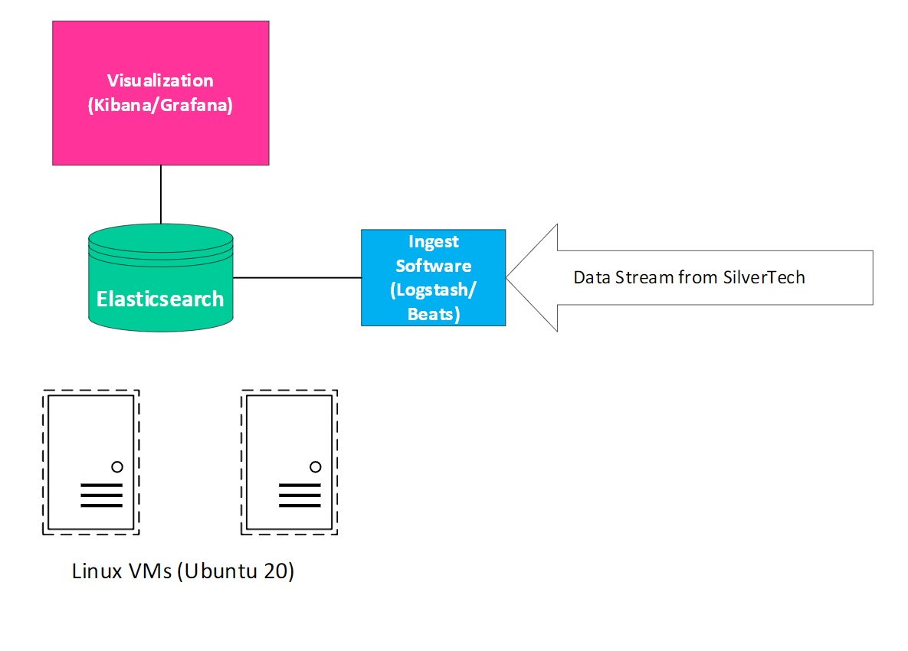
SilverTech ELK Stack Build Cole Stukel, Riley Glover, Isaiah Tauscher Information Technology, University of New Hampshire, Durham, NH 03824
Place your Project Logo Here
Introduction
Node Output
Results
What Silvertech is looking for:
Detect malicious activity more efficiently
deployment of a software solution to aggregate, analyze, and visualize data relevant to the day-to-day operations of their network and systems
Our Goal:
complete an Elastic Stack deployment that provides a visualization of different data streams
MOV
We hope to deliver value to SilverTech Inc. by allowing their network administrators to detect malicious activity more efficiently and gather valuable intelligence regarding the state of the network and systems
Implemented a customizable dashboard with Microsoft IIS data coming in and visualized using Kibana.
Master – overall web server data
Site – site specific data
Elastic – stack health data
Designed and carried out data pipeline throughout many interconnected virtual nodes
Spun up nodes:
Hot node: 7-day lifecycle
Warm node: 30-day lifecycle
Cold Node: 60-day lifecycle
This is output from an Elasticsearch node, confirming that the node is operational, and the cluster is ready.
Our Design
Data Flow
Conclusions
Data will be in the form of IIS logs.
ESXI running on bare metal server; deploy Linux VMs.
Each VM + node in the deployment. Start of project, we deployed one machine, referred to as “master-node”.
Added three more nodes, hot, warm and cold.
Multiplde instances running/networked + cluster.
On master node, installed ES and Kibana.
Filebeats also plays a role, but resides on SilverTech’s web servers.
Kibana is where all data will flow to. IIS logs are shipped from the Filebeat installation on the webserver to the Elasticsearch install on our VM. Kibana hooks into Elasticsearch to provide a visualization dashboard.
Basic Data Flow
Data Pipeline
Accomplishments:
3 functioning nodes
Crisp Kibana Dashboard
Dynamic allocation of data
Encapsulates all server data from SilverTech
Algorithmically sorted our dashboard system intake
Future Plans:
Stress Test
Nodes will cycle indices based on age
Data nodes (on Linux VMs) for ingest into Elasticsearch, which serves as a database. Kibana, our visualization software, is used to create meaningful dashboards based on data from our Elasticsearch instance.
Features/Requirements
Detailed look at the data
Acknowledgements
Functional Features
Customizable dashboards in Kibana; aiming to have two functional dashboards: Master, and site specific
Automated data delivery
Nodes that correspond to the data intake acquired
Multiple node cluster to improve performance/stability
Separation of database indices based on the age of data
Lifecycle management of data (Hot,Warm, and Cold nodes)
Fully functional ELK stack (see Design)
Non-Functional
Proper resources to endure end of project stress test
Healthy ESXi host
Nonfunctional dashboard for monitoring stack health
Kibana Chart Detailing Location Data
World Map of Requests
Advisor: Professor Benedetto
Stakeholder: SilverTech Inc.
Contacts: Rhys Warrior and Christopher Knight
References
https://www.elastic.co/guide/en/elasticsearch/reference/current/index.html
https://www.elastic.co/guide/en/kibana/current/index.html
https://www.elastic.co/guide/en/elasticsearch/reference/current/vm-max-map-count.html
https://www.elastic.co/guide/en/elasticsearch/reference/current/targz.html
This is an example of a Kibana Dashboard utilizing the IIS data from webservers to create a graphical representation of where traffic comes from. Pictured above is a bar graph breakdown of requests from cities around the world, as well as a map of global traffic.

