Slide 1
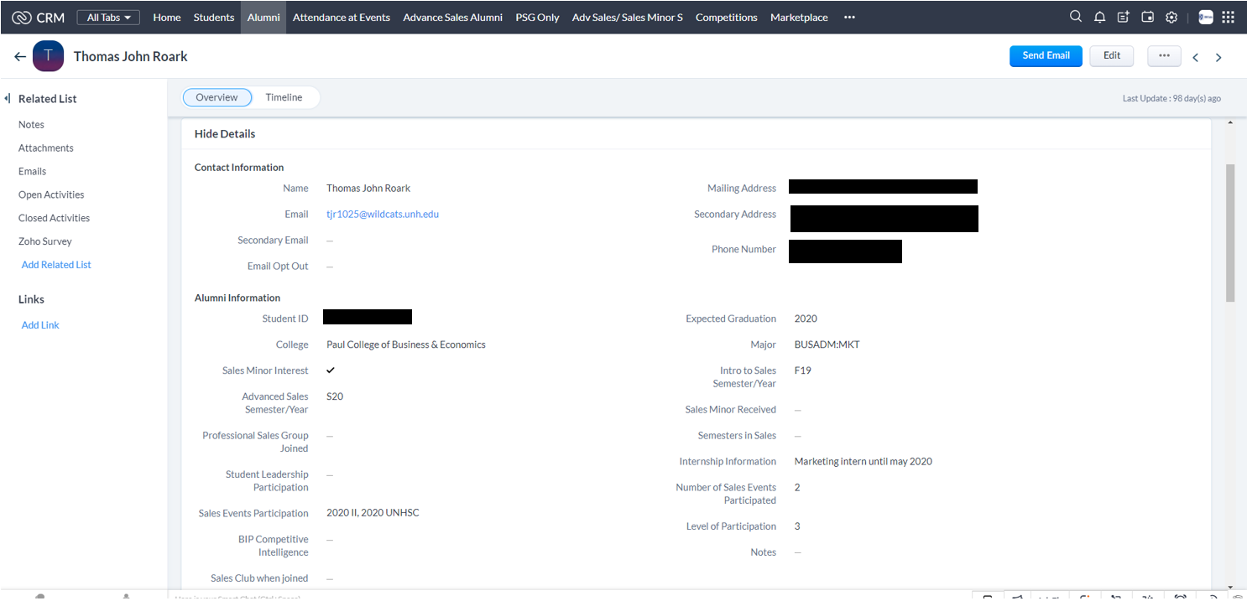
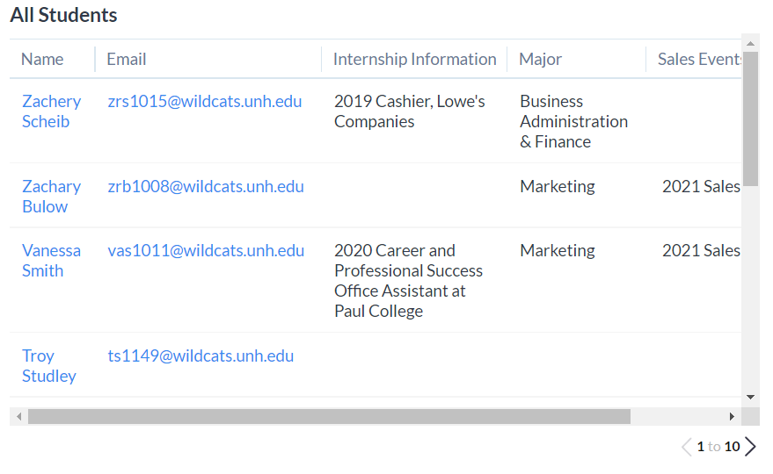
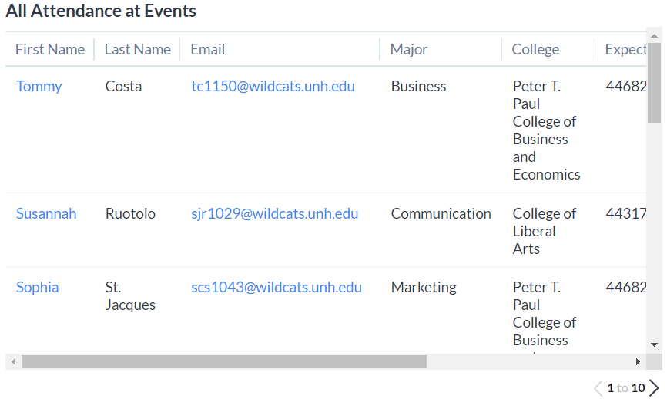
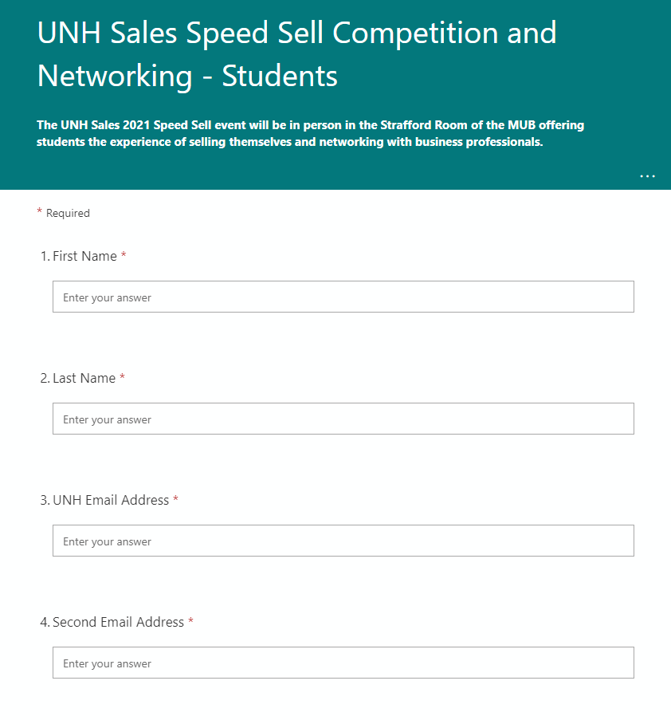
UNH Sales Center: Contact/Event Management Solution (Input) Jennifer Nachatelo, Steven Saing, Nicholas Ippedico Computer Science Department, University of New Hampshire, Durham, NH 03824
Introduction
System Design
Results
We are transitioning the UNH Sales Center from a manual process of updating their Contact Management as well as their campaigns, to an automated solution. With our sponsor's goals and needs, we felt that implementing a customer relationship management, or CRM, would be the best fit for the Sales Center. Through our research and investigation, we chose Zoho CRM as the software that we will implement for the UNH Sales Center. By using the Zoho CRM, the UNH Sales Center will have one dedicated application to organize their contacts rather than their manual excel sheets. We organized their existing data so that it is importable into their new CRM and we have set up the account for the CRM software. The CRM has the ability to allow the Sales Center to use CSVs to import existing contacts, get user data from Linkedin, and to use a web form that can upload their engagement attendance. This is valuable to our sponsor as they can implement their information for contacts along with their event management tasks instead of doing this manually.
Before we created fields for the CRM, there were only default fields of first name, last name, phone number and address. We added in fields for primary and secondary emails. A student information section and after graduation section
Our Goal for the project was to implement a better way for our sponsor to manage their contacts as their network expands and their needs to coordinate with their contacts grows. In this pursuit we:
Designed a designed an organized layout for the client in Zoho CRM
Imported their existing contacts into the program
Our goal was to implement LinkedIn so that so that their contacts would stay up to date but was not able to implement it properly
Created a web form for adding new contacts to the CRM.
Results can be seen from viewing the inputs from the web form and viewing the contacts
1.1: Entry Fields
Conclusions and Going Forward
System Design
There are different ways to view entries on our CRM as well. Our team categorized it by Students, Alumni, Attendance at Events, Advance Sales Alumni, PSG (Professional Sales Group) Only, Adv Sales/Sales Minor, Competition, PSG Leadership Detail, UDay, and Contacts.
After a lot of research, trial and error, and meetings, our group was able to help our sponsor with their needs of developing a usable and easy CRM for them to use.
Our group was able to successfully set up the CRM in a way that Sales Center will be able to modify and use it for the future ahead. They will be able to import existing users and utilize Linkedin. They will be able to now use a web form that can upload all of their engagement attendances
The Sales Center has aspirations of growth and expansion, to do that they need to reach more people. The implementation of the CRM supports that future expansion. Going forward the sales Center will be able to add features that for better marketing and outreach. The CRM as it stands also is a powerful too that can be used by future groups to market the Sales Center and grow their influence.
Measurable
The Sales Center was keeping track of contact information of various groups including students, alumni, event attendance, etc. Much of this information was tracked manually which was viable when the Sales group was new and only had a few contacts. However as the sales center has grown their ability to keep track and input all their contact data became insurmountable.
Our measurables for success on the project were largely related to time saved and ease of use. We automated/simplified many of the processes that our sponsor previously ustilized for their contact management. A few examples include bulk/mass emailing simplified registration form creation, and LinkedIn integration for keeping contact info up to date.
1.2: Views of Entries
sTAMD Simulations
Web Form
The main method that out sponsor uses for collecting registration data is through a web form that is built using drupal on the UNH website. Our sponsor wanted a different solution because their current solution had proved to be difficult to work with due to its complexity in the backend GUI design. The previous method also didn’t offer the ability to generate QR codes and didn’t have intuitive formatting for mobile viewing.
Our solution on the left was Microsoft Forms. The form creator is generally less robust than druple but it satisfied all the needs of our sponsor and was remarkably easier for the users to work with. So far the switch has made it so that designing a usable web form takes less than an hour rather than the old method which would take multiple hours and would require constant redesign for each progressing year.
Requirements
One of the largest issues that our group had to overcome, especially in early sprints, was figuring out how to take the existing data the our sponsor provided and reorganize/format it so that it was usable and could be automated. This involved:
Data Pre-processing: for the existing “database” data
Configuring CRM with add-on features
Populating Database and establishing upload SOP
Creating web form for easy registration to events and data input
1.4: UNH Sales Center
Acknowledgements
Our team would like to thank both our sponsor and project advisor.
Project Sponsor: James McIlroy
Project Advisor: David Benedetto
1.3 Web Form

