Slide 1
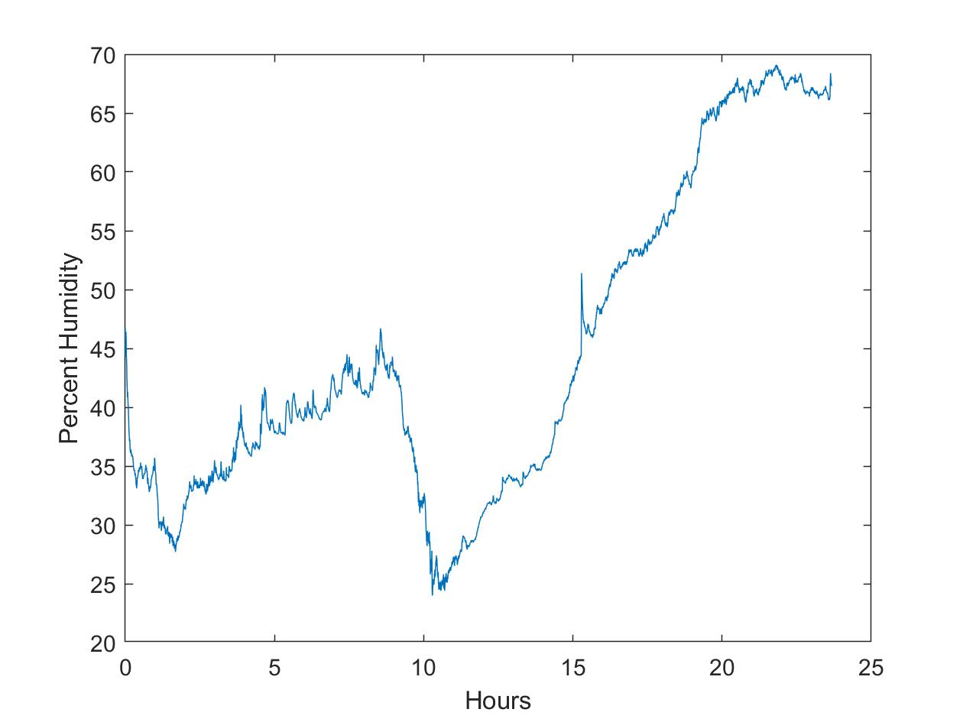
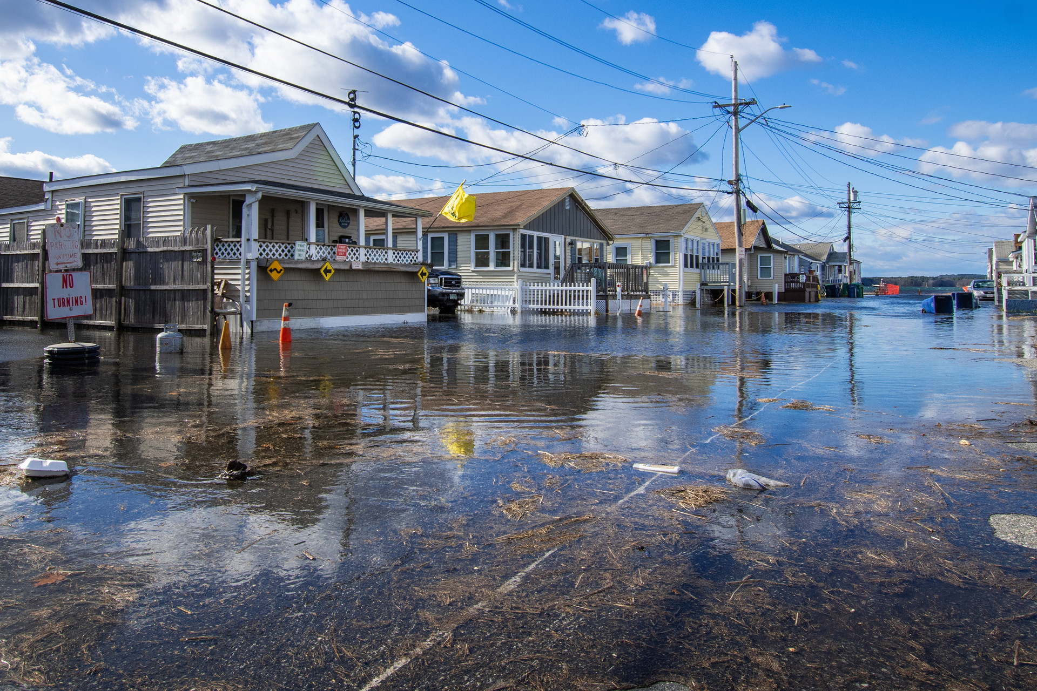
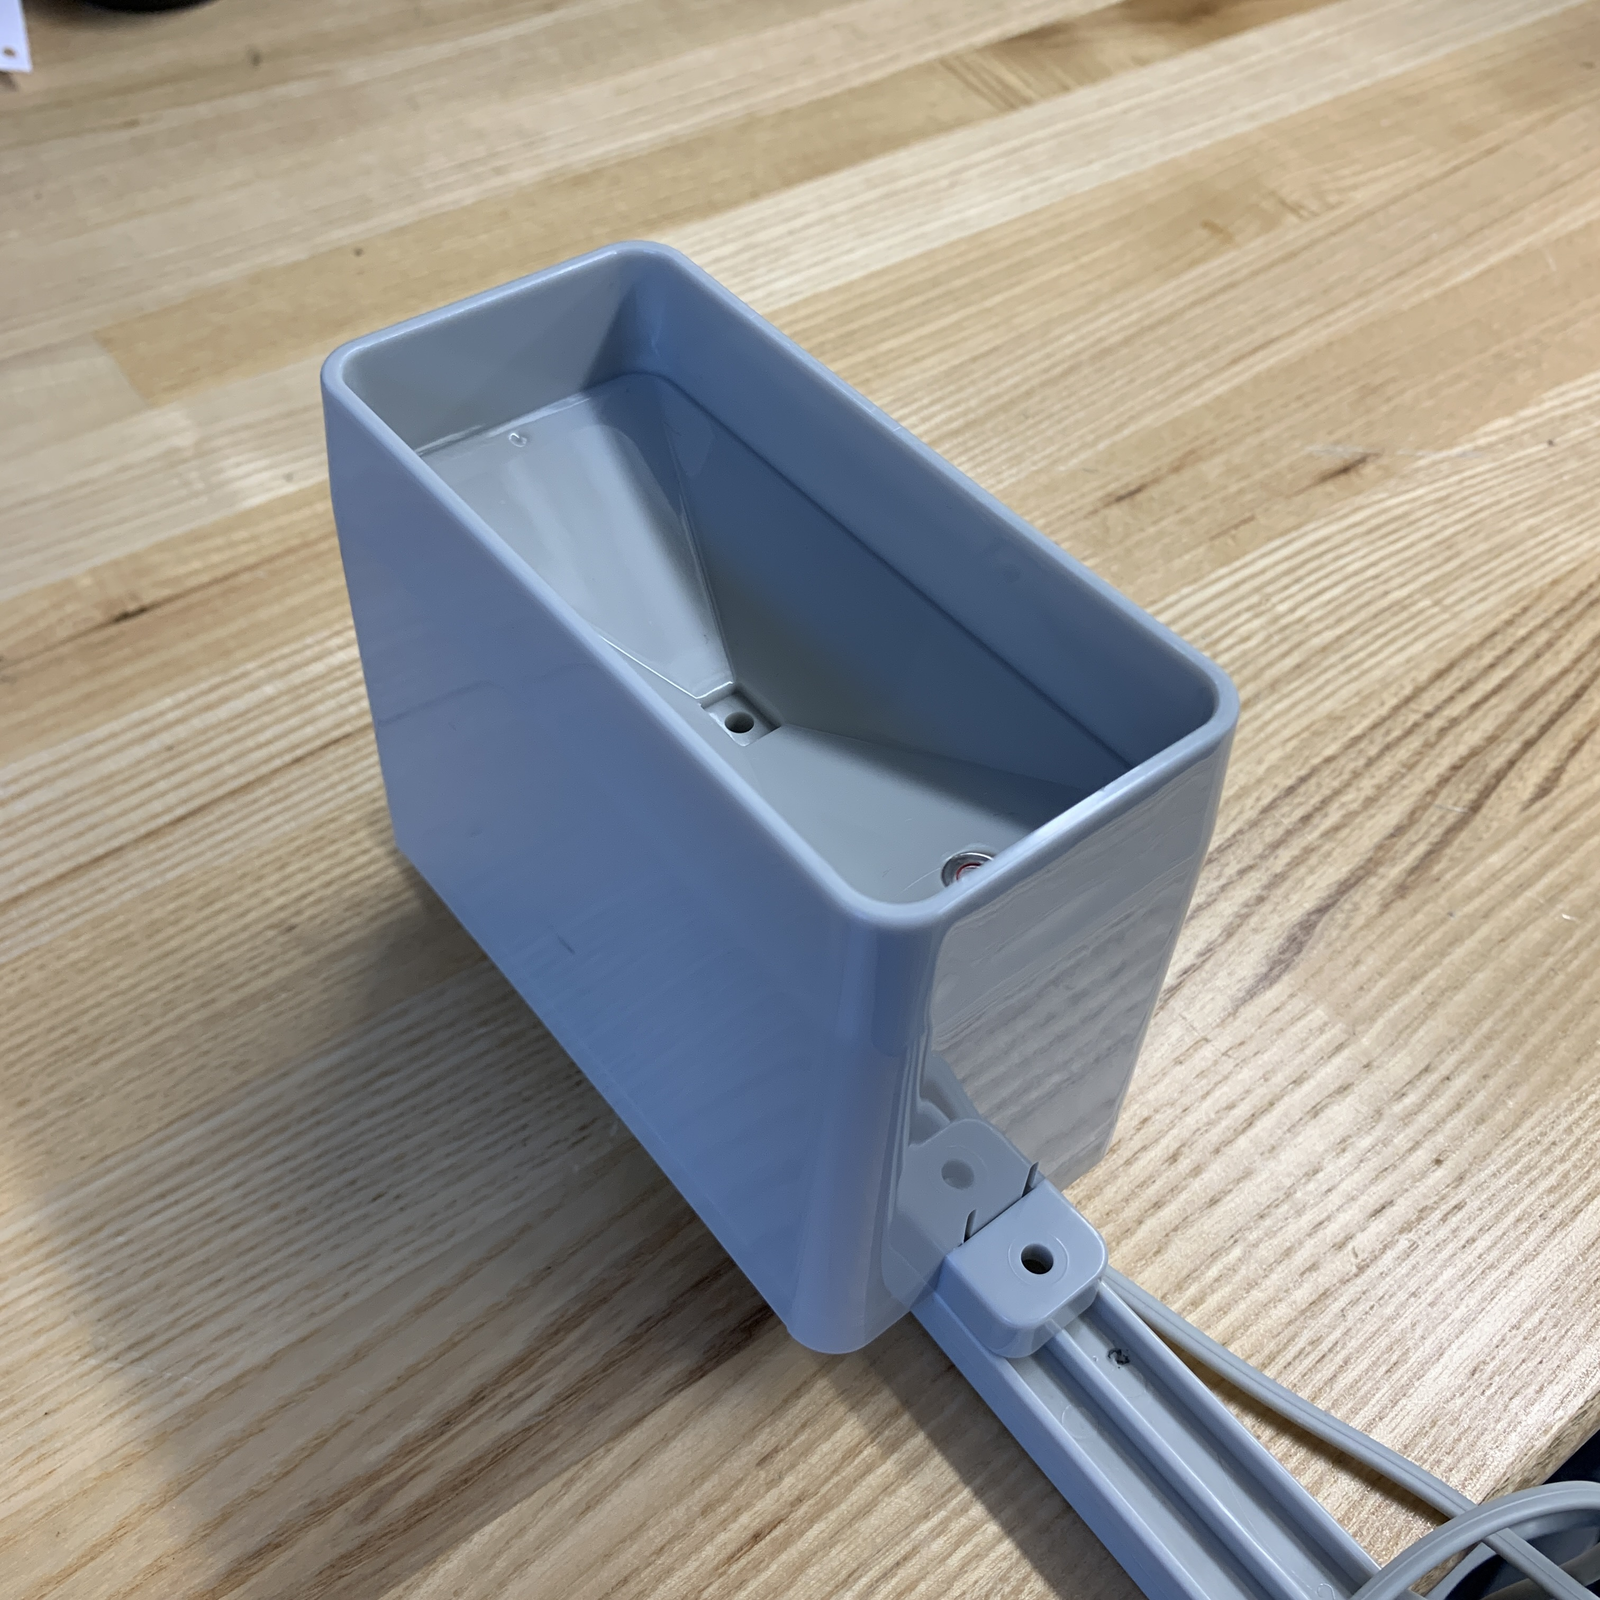
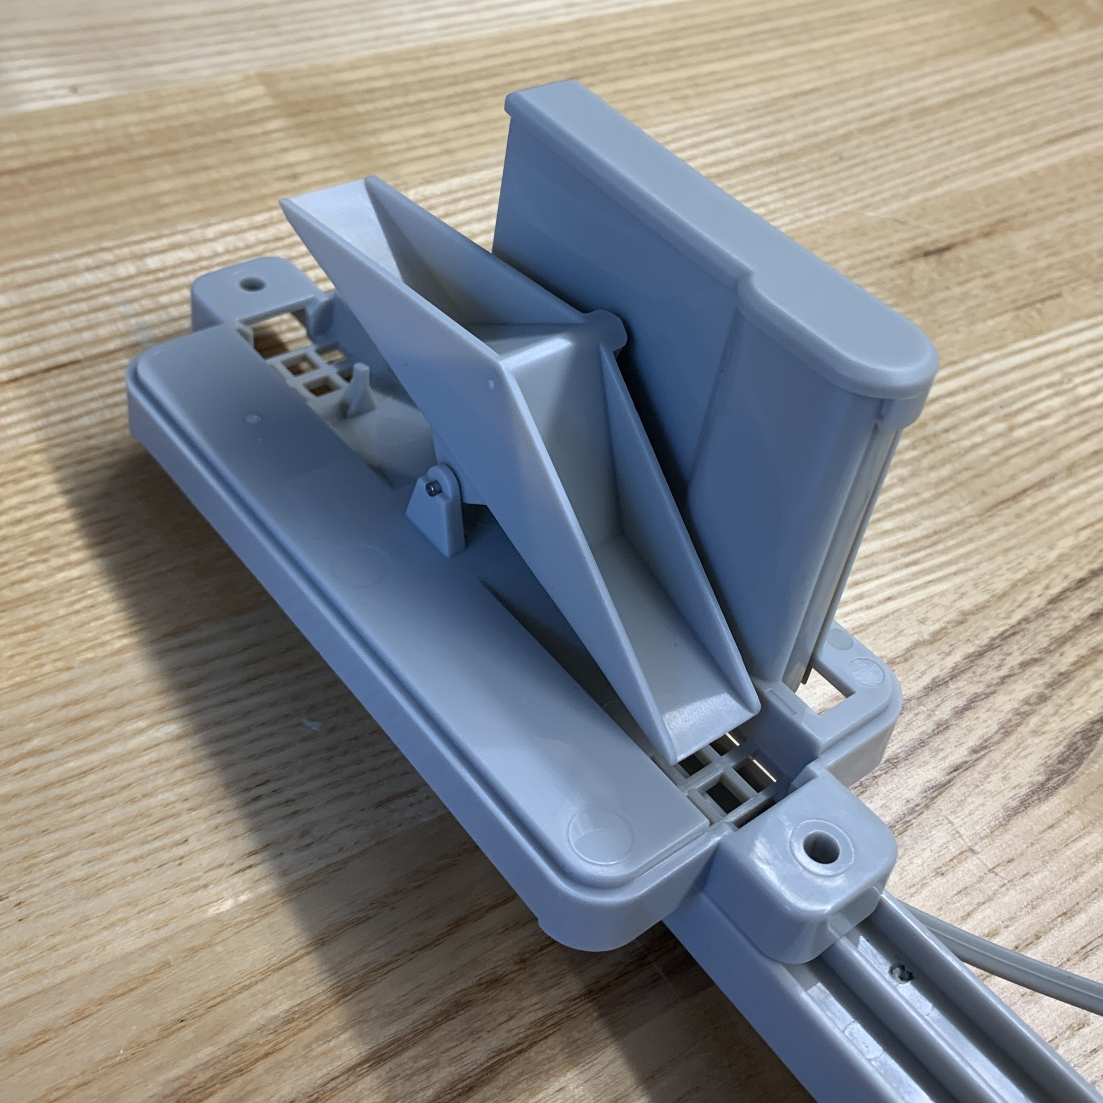
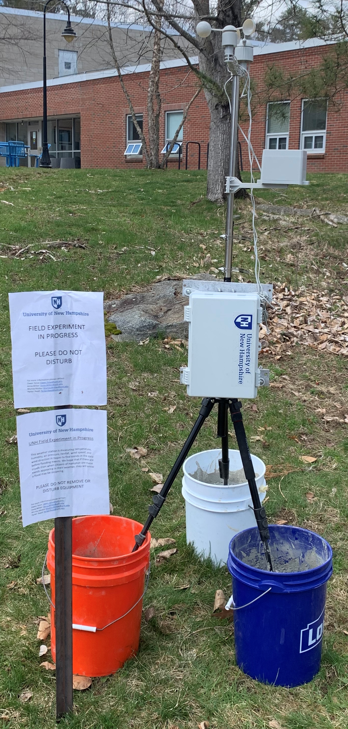
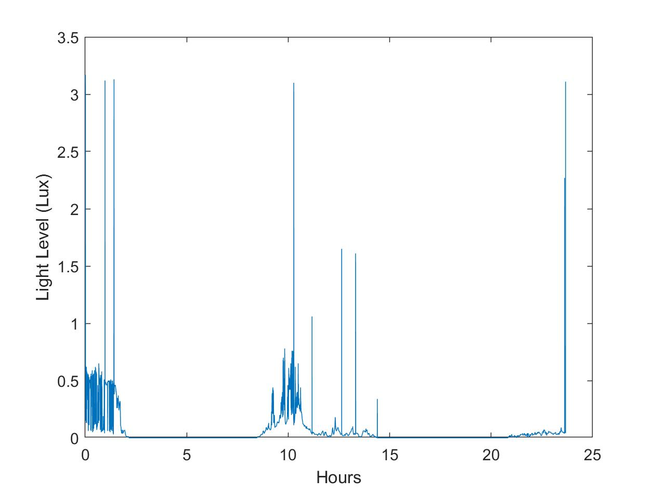
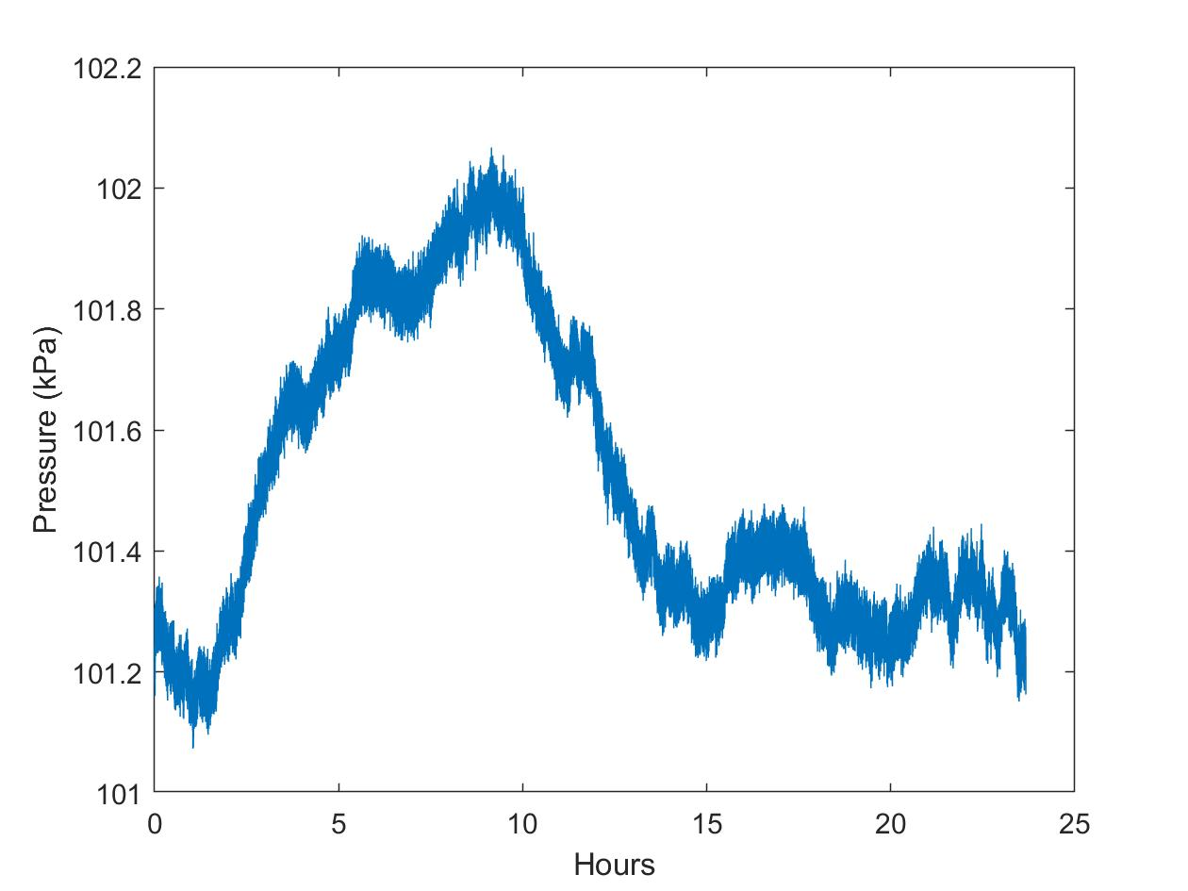
WIMP Weather Station
Anna Miller
Murray McKay
Owen Tolve
Parker Reed
Ocean Engineering
Ocean Engineering
Environmental Engineering
Computer Engineering
University of New Hampshire
University of New Hampshire
University of New Hampshire
University of New Hampshire
Anna.Miller@unh.edu
Murray.McKay@unh.edu
Owen.Tolve@unh.edu
Parker.Reed@unh.edu
Faculty Advisors: Savannah DeVoe, Dr. Diane Foster Acknowledgements: Alyson Eberhardt, Malin Clyde, Peter Howd
Background
objective
results
In Hampton, NH, there are frequent flooding events including sunny day flooding. Currently, Hampton receives their weather data from the national weather station in Gray, ME, which is far from Hampton, causing imprecise data. Hampton has a system to alert the citizens of incoming floods, but we hope to find a way to alert them even sooner.
Find consistent trends in our data before and during flooding events in Hampton. Intending to be able to predict flooding events so in the future the residents may know beforehand.
Weather station was deployed outside Chase Hall from 2:00 P.M. Tuesday to 1:30 P.M. Thursday. Shows percent humidity, light level, and air pressure.
Light rain after a very hot/dry day caused the dip and spike in humidity seen here
Components
Assembled Weather Station
Sunny day flooding occurring on November 16, 2020. Photo by Brooks, David. Granite Geek
Rainfall Sensor
Conclusion
Spikes are around noon-2:00 P,M, when sunlight would make the housing lighter
We were unable to deploy our weather station in Hampton, NH, but did collect data here at UNH. Although we do not have a temperature value, due to a coding error which was realized too late, the rest of the data is adequate. With a better design this factor could be improved.
Wind Speed and Wind Direction
Sensors
Micro-SD
Card
Increase in pressure is due to an increase In temperature since they are proportionate, and Wednesday was very hot
Future Considerations
Our hope is to have next year's class continue this project by fixing our mistakes as well as improve the design of the weather station and have the chance to deploy in Hampton. These changes may include finding a way for the sensors to be more exposed, and many other small details.
Real-Time Clock
Using these components, our weather station is able to measure the following variables:
Temperature
Humidity
Barometric Pressure
Rainfall
Wind Speed
Wind Direction
SparkFun Weather Shield

