Slide 1
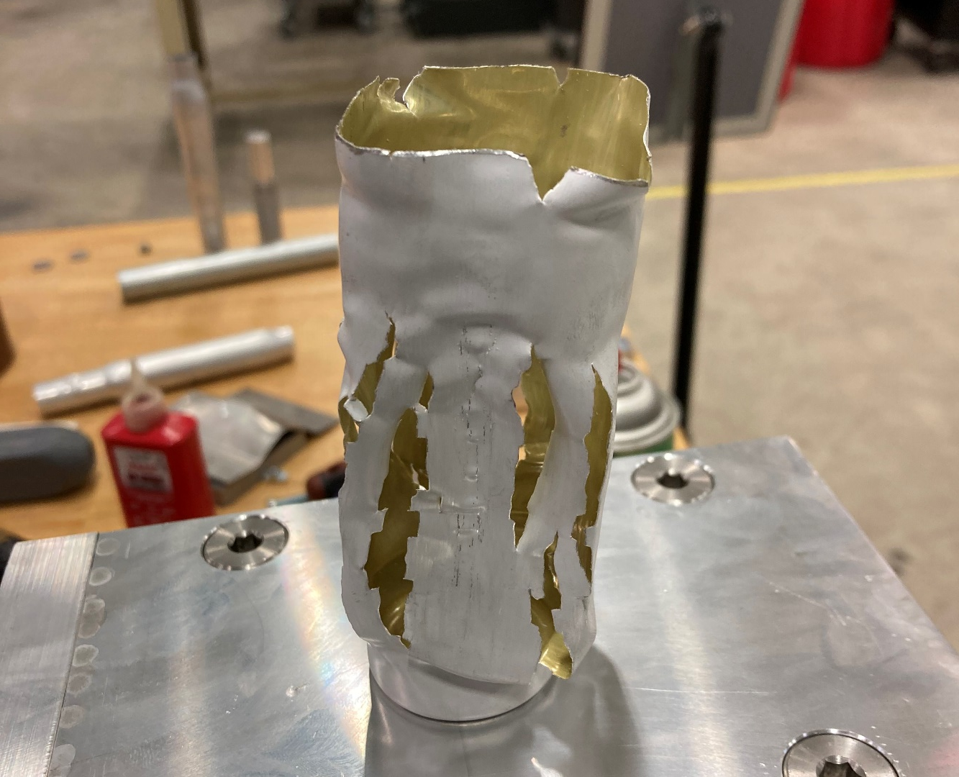
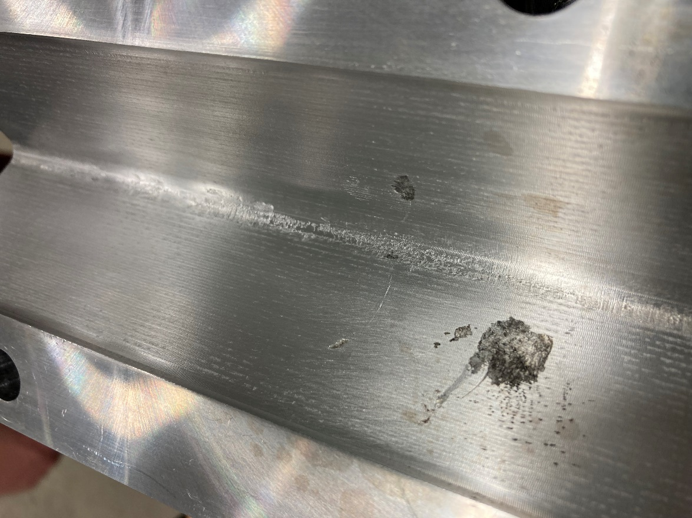
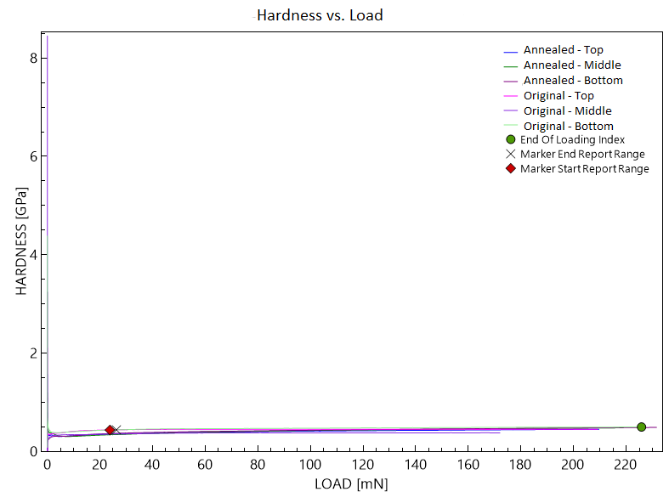
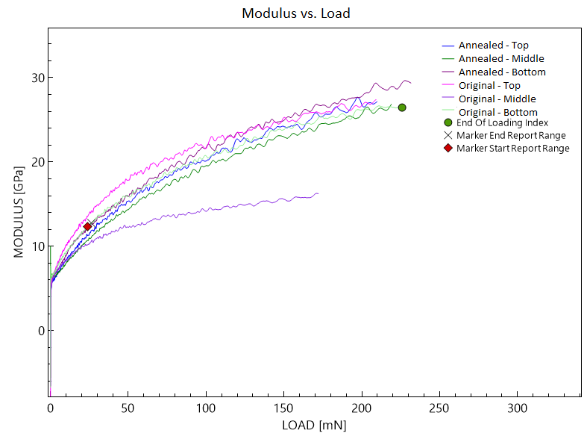
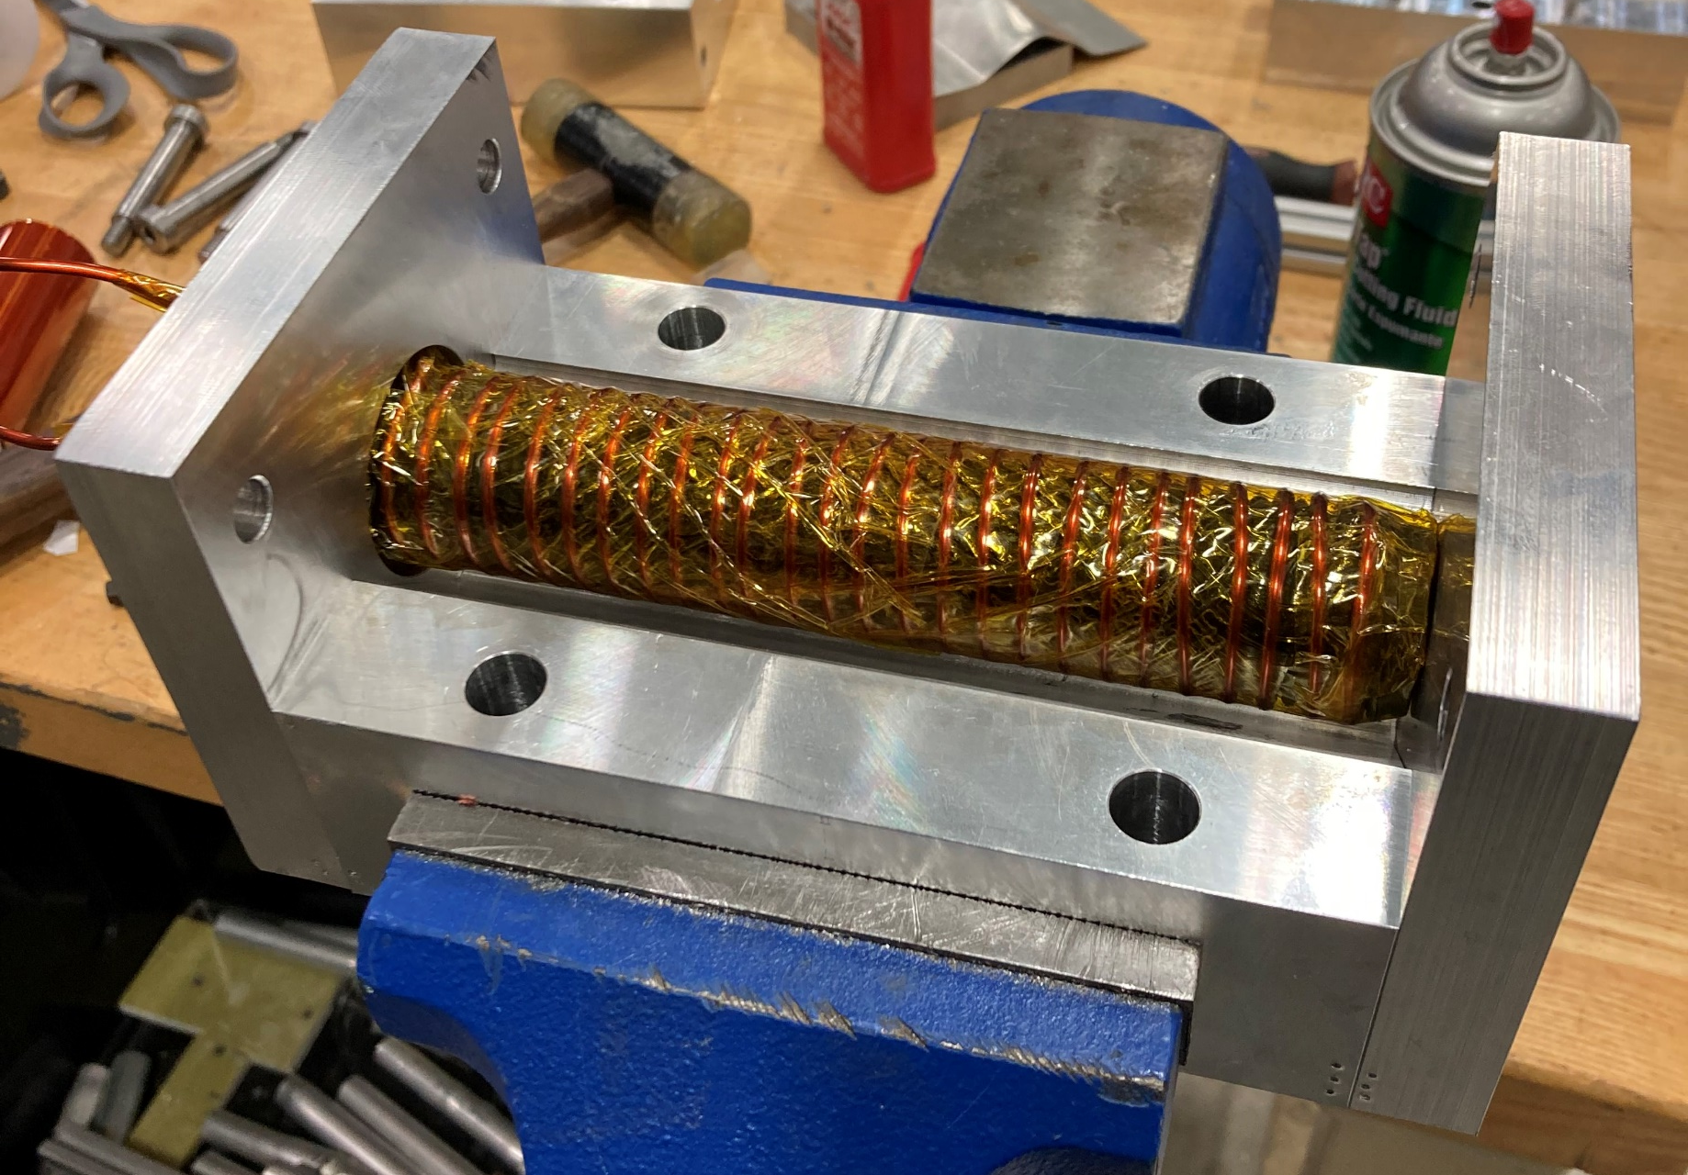
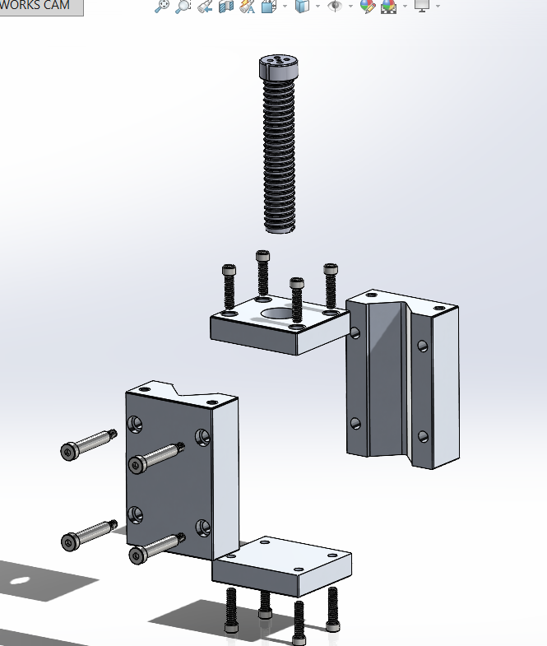
Electromagnetic Forming of Aluminum Bottles Nathan Facteau Department of Mechanical Engineering, University of New Hampshire, Durham, NH 03824
Introduction and Purpose
First Tests
Results
The purpose of this research is to study and optimize the electromagnetic forming process for the reshaping of aluminum bottles from round to square. This involved a study of the material properties of the material using nanomechanical testing and the machining of a basic die and coil assembly.
This process allows the forming of sheet metal using only a small amount of electricity and very little skill and maintenance, as opposed to a costly and high-maintenance industrial press and die assembly.
First test
Wear of die and coils during first test
The wear on the die was very good, which only a small spark patch, however our coil guide failed.
The successes of our first round of tests was that:
the bottles was extruded to fully form the entire shape of the die, yielded a finished part with the correct side radius.
The die sustained minimal damage
Minimal sparking of the electricity
The negatives of the first tests was that:
the can was ripped apart along the sides, which we believe is power related
unable to form the very bottom of the can, as the bottom is hollow and cannot be easily contacted by the coil
our coil guide cracked during the first tests
First test with 4 gauge single-strand copper wire, using 3.6 kJ of energy.
Preparation and Material Testing
Results of Nanomechanical Testing
What’s next?
Before running tests using the electromagnetic forming (EMF) machine, we decided that it would be beneficial to run tests on the material to deduce its properties (hardness, stiffness, etc), and decide if the bottles would benefit from annealing (softening via heating and cooling). To do this, I went to the University Instrumentation Center (UIC) and received training on their nanomechanical tester. This device uses a calibrated diamond that pushes into the material with a calibrate force, created a dimple of a specific depth and shape. Analyzing this dimple can allow for outputs of the material’s hardness, stiffness, and modulus of elasticity.
According to the graphs on the right, we can see that the annealing process did not change mechanical properties of the material by enough to warrant special care.
Comprehensive Hardness vs. Load Graph
Comprehensive Modulus vs. Load Graph
Redesign the coil guide to provide more strength for testing, possibly moving to a different manufacturing method from 3D printing.
Perform electrical calculations and simulations to derive the correct power settings, and to determine how these power settings scale with material properties (height, wall thickness, etc).
Perform micro-abrasion testing to determine if annealing has any effect on microstructure of the material.
Both graphs constructed using University Instrumentation Center’s nanomechanical tester over 6 samples: the top, middle, and bottom of a heat-treated and non-heat-treated bottle.
Die Information and Machining
sTAMD Simulations
Conclusion
Die and Coil Assembly
In order to form the bottles into the desired square shape, there needs to be an enclosure, called a die, surrounding the coil and the bottle to give the right form to the bottles and the magnetic field expands the material outwards. This die needed to:
have suitable mass to resist the magnetism
a good surface finish inside of its cavity to ensure a smooth final product
have the best alignment possible between the 2 halves and the coil guide as possible to avoid lines appearing on the final product
This die was machined entirely by myself in the toolroom of TURBOCAM International, a local machine shop in Barrington NH, from 6061 aluminum alloy.
Exploded View of all Components
Assembly ready to run a forming test
While these first tests are far from perfect, we believe that the die assembly was a success, we received useful results form our material testing, and we have a good direction to continue the project.
Acknowledgments and Thanks
- I would like to acknowledge TURBOCAM International for allowing me to use their toolroom for the machining of the die assembly.
-I would like to thank Brad Kinsey for his advising and direction throughout the duration of this research.
-I would like to thank Joe Camobreco for training me on the EMF machine
- I would like to thank Shawn Campbell for his direction on how to use the nanomechanical tester.
Exploded View of Die Assembly in SOLIDWORKS
Die and Coil assembled, with a bottle, one die half removed for viewing.

