Slide 1
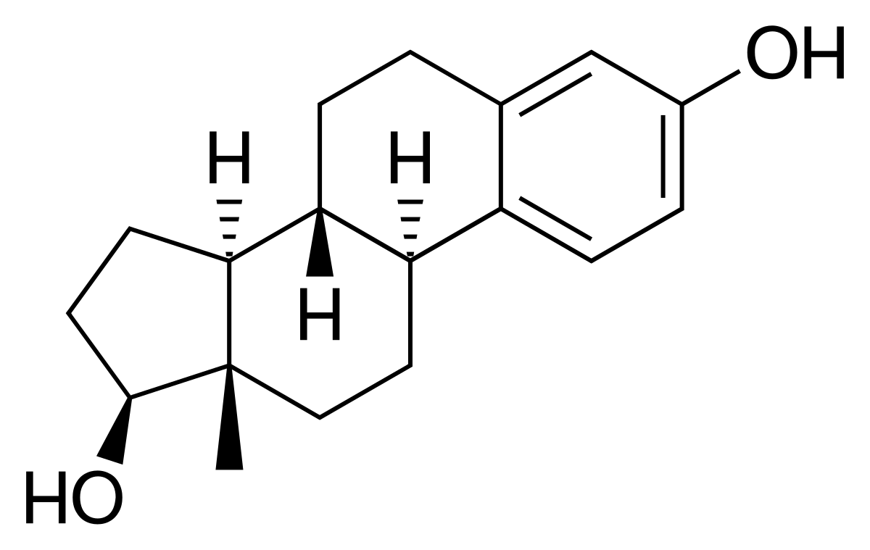
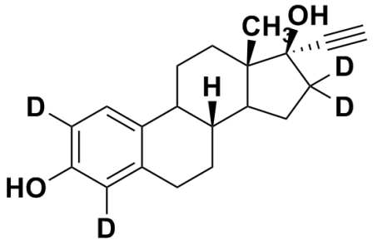
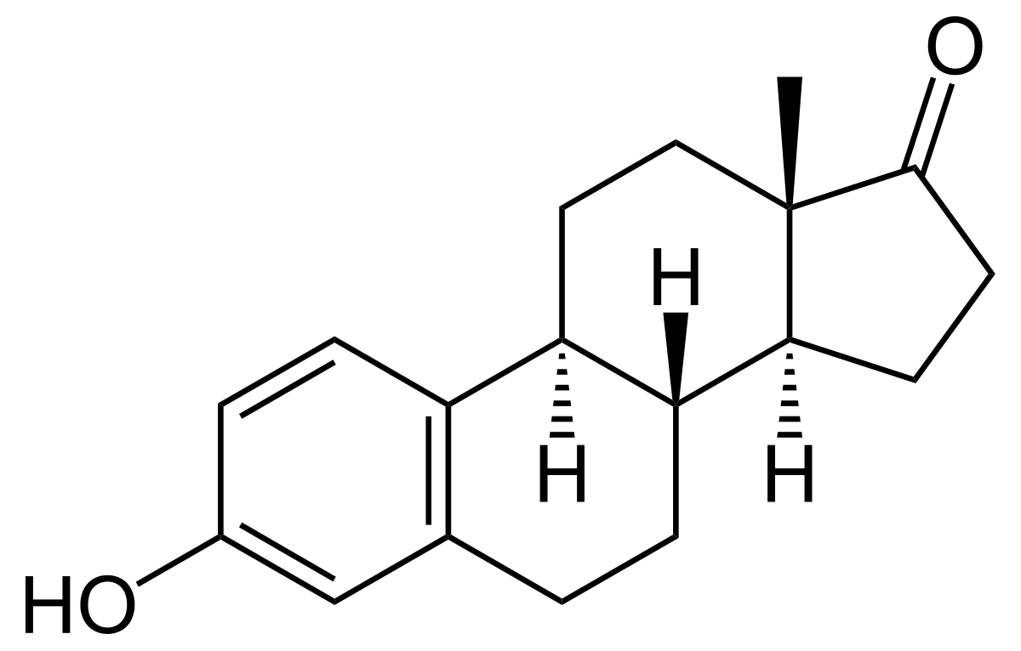
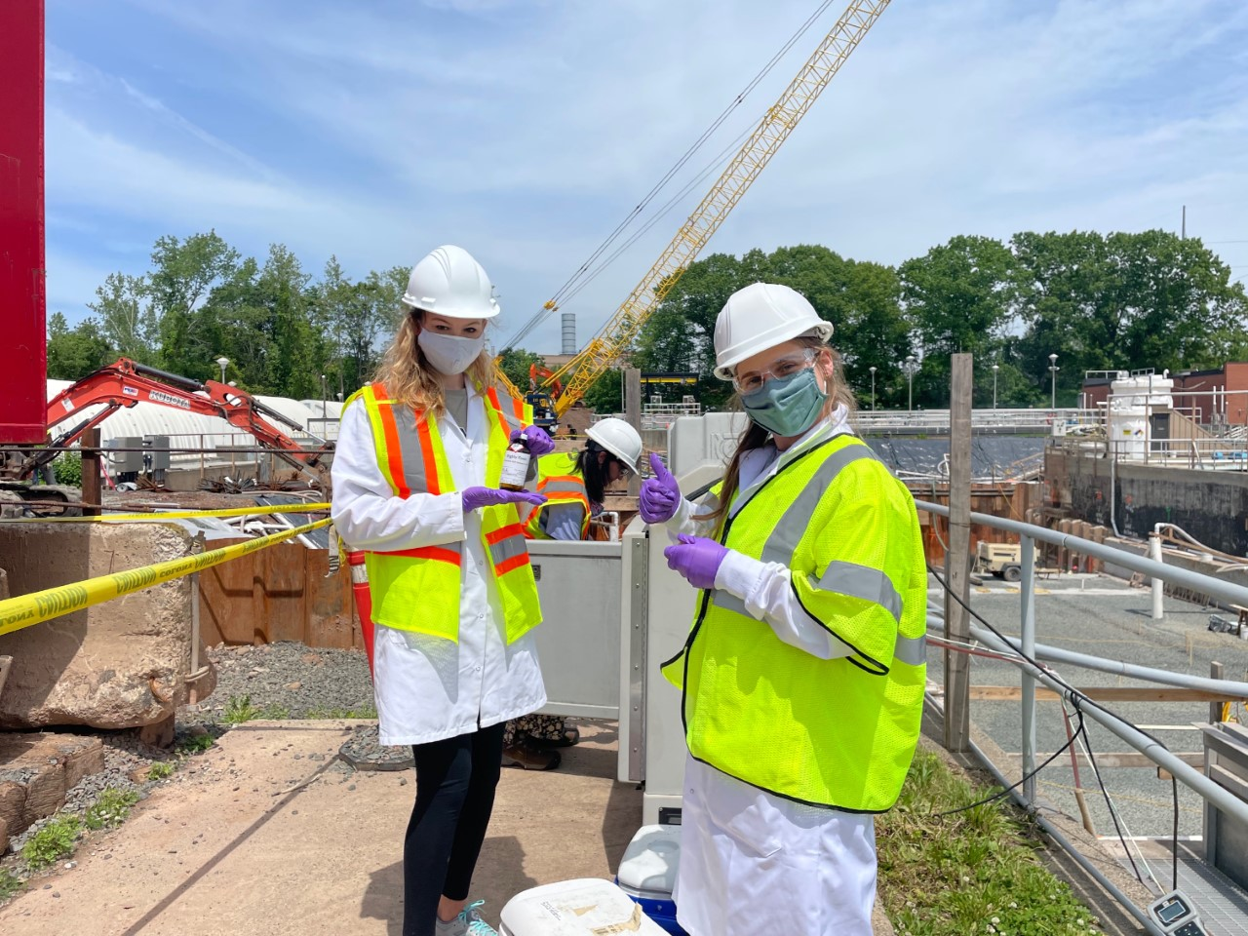
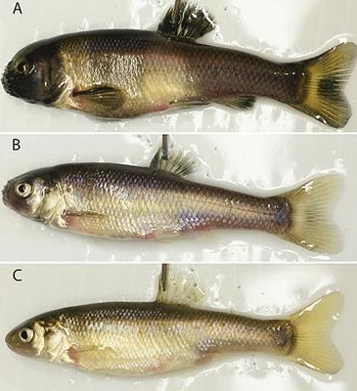
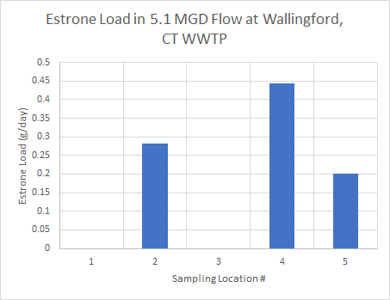
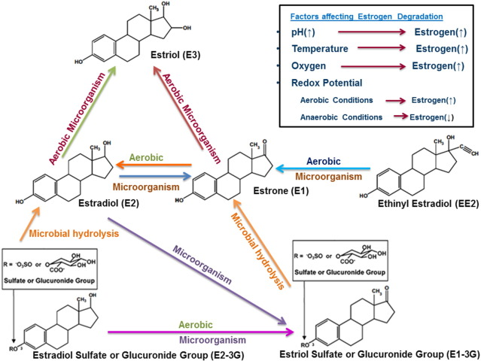
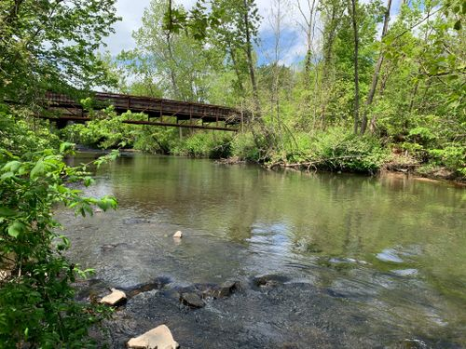
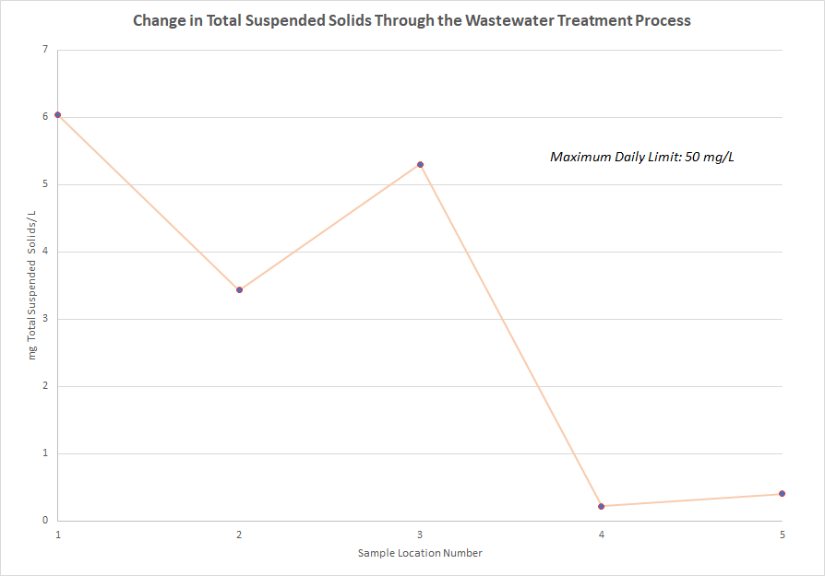
The Fate and Transport of 17-beta Estradiol, 17-alpha Ethinyl Estradiol,
and Estrone in Wastewater Treatment
Alexis Eaton
Advisor: Paula Mouser, Ph.D.
BACKGROUND
OBJECTIVES
METHODS
14% of Women Ages 14-49 Use Oral Contraceptives in the U.S.
Overarching Goal: To better understand the presence and concentration of hormones in wastewater facilities
Goal: Obtain samples from six different treatment stages at Wallingford, CT Wastewater Treatment Facility
-Five wastewater samples
-One activated sludge sample
Wastewater Sample Location | Sample Location #
Influent (Before Grit Removal) | 1
After Anaerobic Selector | 2
After Rotating Biological Contactors | 3
After Secondary Settling Tanks | 4
After UV Disinfection | 5
Two Main Components of Oral Contraceptives:
-Estrogens
-Progestogens
Focus of My Study:
-17-beta Estradiol
-17-alpha Ethinyl Estradiol
-Estrone
17-beta Estradiol
17-alpha Ethinyl Estradiol
Estrone
The body does not absorb all of the compounds in the oral contraceptives. Wastewater treatment facility discharge is a leading source of hormonal contamination in water bodies.
This study will:
-Evaluate which treatment process best removes hormones within the facility of interest
-Emphasize the need for proper removal of hormones from wastewater
-Examine the fate and transport of estrogenic compounds in varying aerobic, anaerobic, and microbial conditions
Impact of Estrogenic Compounds on Aquatic Species:
Exposure impacts development of reproductive organs in male fish species
Partially developed eggs or ova in testes (Nazari et al)
Production of vitellogenin
Reduced testes size
Lower sperm count
Decreased reproductive fitness
Decrease in fish biomass
Disruption of aquatic food chain (Adeel et al)
Impact of Estrogenic Compounds on Humans:
Increased risk of breast cancer in females
Increased risk of prostate cancer in males
Greater chance of cardiovascular diseases in humans (Adeel et al)
Decreased male fertility
Interference with sperm production (Nazari et al)
At Each Location I Collected:
-One liter plastic bottle of wastewater
-Small amber vial of wastewater to be sent to Weck Lab
Samples Collected Via:
-Automatic samplers at treatment plant
-Surface water sampling method in secondary settling tanks
Samples stored in cooler and placed in fridge immediately upon arrival at UNH
Interfacility Flow Diagram of Wallingford, CT WWTP
Fish A is a normal male fathead minnow. Fish B is a normal female fathead minnow. Fish C is a male fathead minnow that has been exposed to prescription drugs.
Image via https://ieamblog.com/2018/05/04/advances-in-evaluating-and-regulation-of-endocrine-disruptors/
Me and graduate student Carmela Antonellis sampling at the Wallingford, CT WWTP
RESULTS
CONCLUSIONS
Hormone Concentration Results from Weck Lab
Sample # | 17-beta Estradiol Concentration (ng/L) | 17-alpha Ethinyl Estradiol Concentration (ng/L) | Estrone Concentration (ng/L)
1 | ND | ND | ND
2 | ND | ND | 210
3 | ND | ND | ND
4 | ND | ND | 330
5 | ND | ND | 150
The findings from this study do not show which wastewater treatment method best targets the removal of 17 beta-estradiol, 17-alpha ethinyl estradiol, and estrone.
Many digitally published studies have shown that activated sludge systems for nitrification and denitrification are most effective for the removal of natural and synthetic estrogens (Koh et al).
Wastewater Sample Location | Sample Location #
Influent (Before Grit Removal) | 1
After Anaerobic Selector | 2
After Rotating Biological Contactors | 3
After Secondary Settling Tanks | 4
After UV Disinfection | 5
No compounds were detected in the sludge sample
This study suggests that:
-Estrone is present in significant quantities in Wallingford WWTP, and fish species in the Quinnipiac River could be impacted in the near future.
-Estrone adsorbs to suspended solids.
-Estradiols and ethinyl estradiols are converted to estrone under certain microbial and aerobic conditions.
Analytical Challenges:
-Samples 1 and 3 had the most suspended solids
-Estrone adheres to solids:
- Koc range: 457-18,000 (NCBI)
Samples were leached and underwent a solid phase extraction in processing, followed by elution.
-17-beta estradiol and 17-alpha ethinyl estradiol were most likely present in each sample
-Precautions had to be taken because of mixed matrix interference; there was a chance that the extraction apparatuses could be flooded
-Serial dilutions were performed, ND results were the lowest readings the contract lab was able to take
The metabolic pathway of estrogen.
Image via https://www.sciencedirect.com/science/article/pii/S0160412016304494
-> Under aerobic conditions with certain microorganisms present, ethinyl estradiol (EE2) can be converted to estrone
-> With certain microorganisms present, estradiols (E2) can be converted to estrone
-Data suggests that the adsorbed estrone might not have been properly eluted and that some might have remained on the extracted solids
-No compounds were found in sludge
-Due to solid sample detection limit (15 ppb) being much higher than wastewater sample detection limit (.004-.2 ppb)
The Quinnipiac River
in Wallingford, CT
REFERENCES
Adeel, Muhammad, et al. “Environmental Impact of Estrogens on Human, Animal and Plant Life: A Critical Review.” Environment International, Pergamon, 29 Dec. 2016, www.sciencedirect.com/science/article/pii/S0160412016304494.
“Contraceptive Use in the United States.” Centers for Disease Control and Prevention, Centers for Disease Control and Prevention, 10 Nov. 2020, www.cdc.gov/nchs/fastats/contraceptive.htm.
“Estrone.” National Center for Biotechnology Information. PubChem Compound Database, U.S. National Library of Medicine, pubchem.ncbi.nlm.nih.gov/compound/5870#section=Ecological-Information.
Koh, Y.K.K., et al. “Treatment and Removal Strategies for Estrogens from Wastewater.” Taylor &amp; Francis, 7 May 2008, www.tandfonline.com/doi/full/10.1080/09593330802099122.
Nazari, Emad, and Fatihah Suja. “Effects of 17β-Estradiol (E2) on Aqueous Organisms and Its Treatment Problem: a Review.” De Gruyter, 24 Nov. 2016, www.degruyter.com/document/doi/10.1515/reveh-2016-0040/html.

