Slide 1



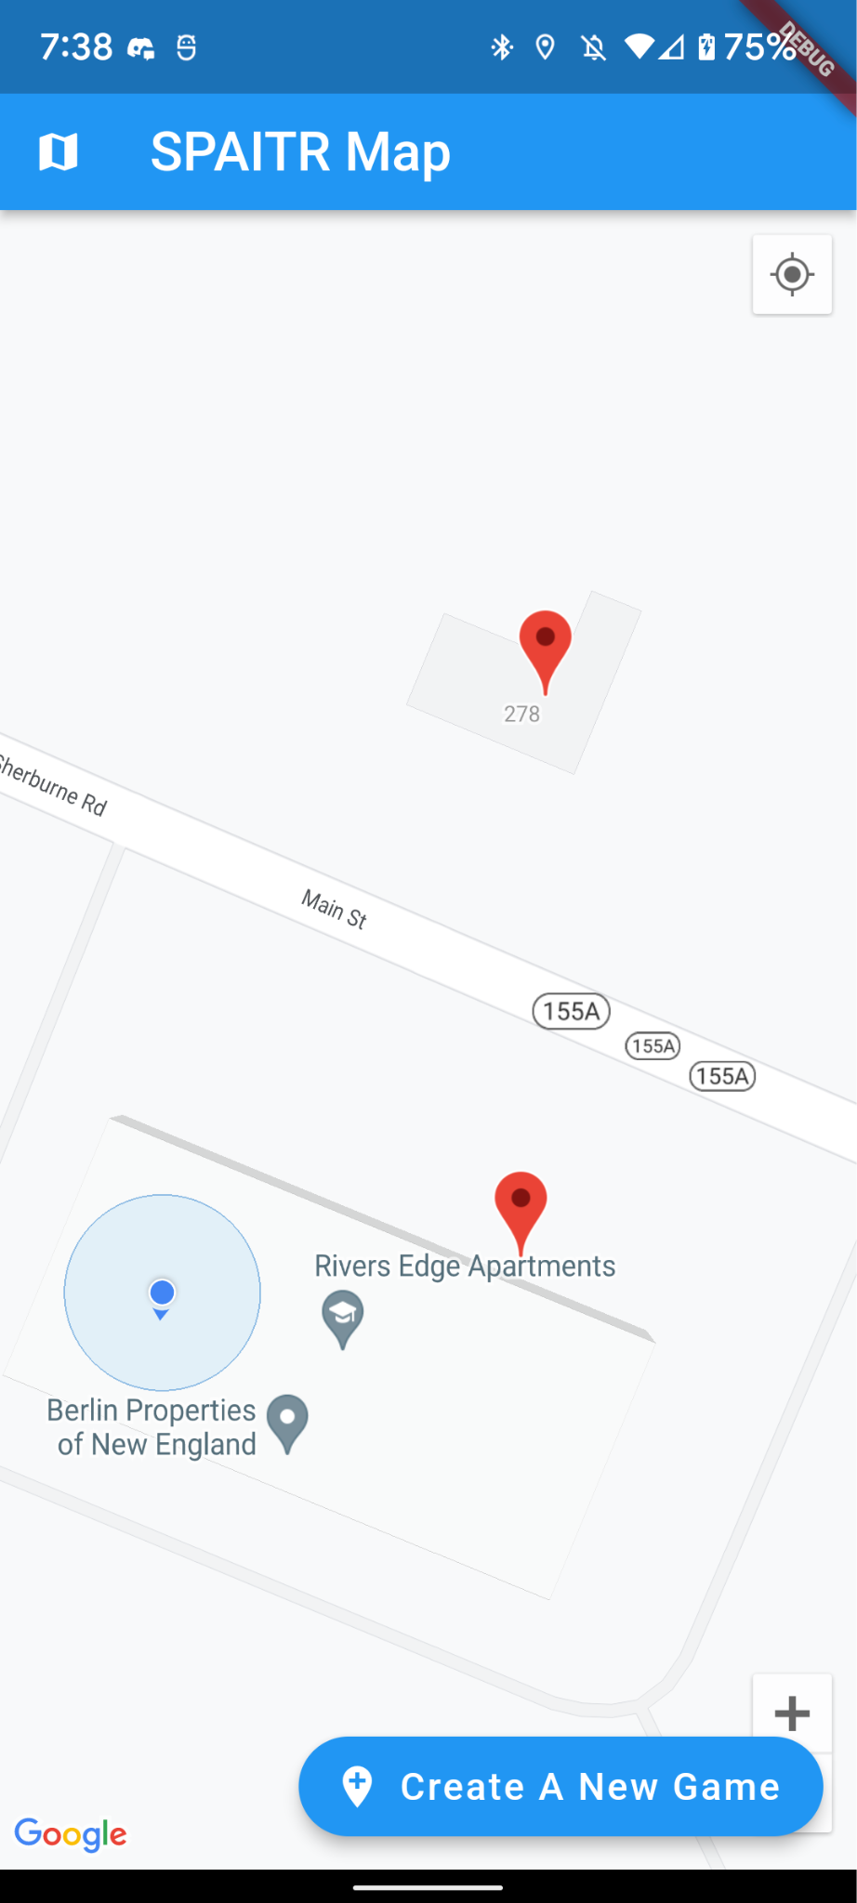
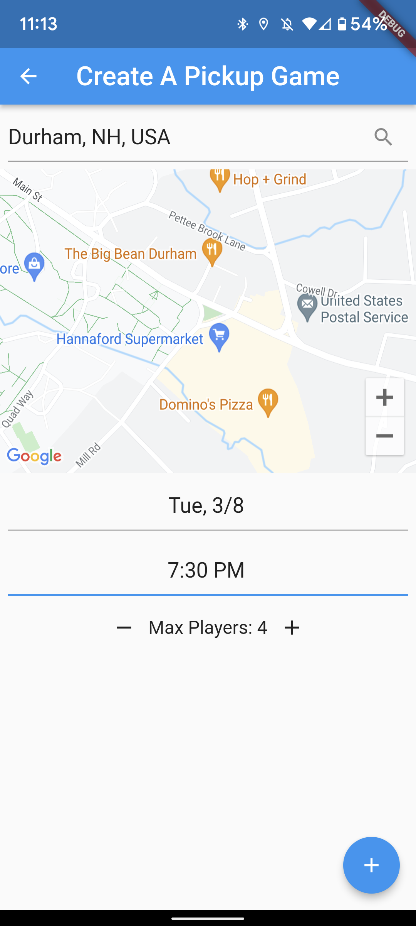
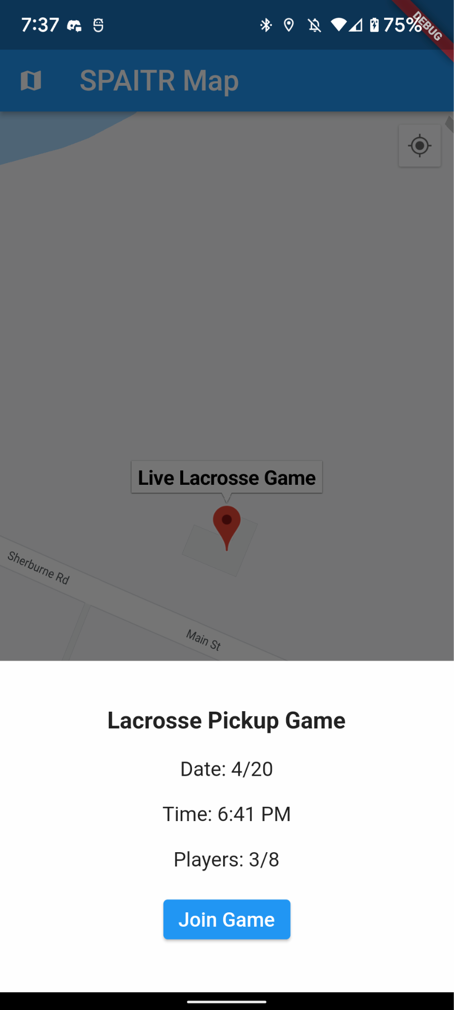
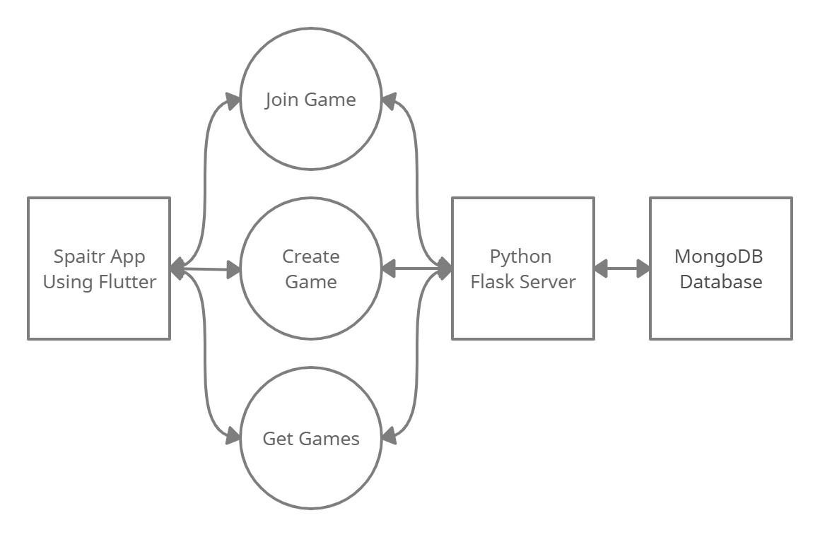
SPAITR Map
Elvis Hidalgo, Elijah Johnson, Dan Kirichok
Department of Computer Science, University of New Hampshire, Durham, NH 03824
What is SPAITR Map?
Design
Testing
SPAITR Map is a mobile app where nearby lacrosse players can coordinate pick-up lacrosse games locally.
This is designed to be an extension of the main SPAITR app which provides lacrosse players with their game data to optimize improvement.
With the SPAITR Map, lacrosse players can organize lacrosse games and play with new people more easily. The overall goal is to strengthen community involvement in lacrosse and to help the SPAITR app gain more users.
Map with nearby games
A player can scroll and find games of interest to play.
Create game with options
A player can choose to organize a game to happen at a specific time, day, and place.
Menu to join game
If a player wants to join a game, they can see its details and confirm their attendance.
Client
Unit tests were used to test core client functionality like game validation and the REST controller. When required, partial mocking was used to replicate complex objects like the server to help isolate the testing of functionality like JSON parsing.
Server
Unit tests were used to test main REST functionality with the client application. Interacting with the database was done with unit tests and confirming the data was correct was done both manually and through the unit tests.
Measurable Organizational Value
Project Results
The SPAITR Map is going to be successful if at least 30% of current SPAITR users use the SPAITR Map to play pickup games with a consistent turn out of at least 5 players per game by the end of the Spring 2022 semester.
We couldn’t test the value of the project for SPAITR since we didn’t get to integrate it with the main SPAITR app due to time constraints. In the future, we hope to use analytics to track how users are using the SPAITR Map to better understand the value it provides.
Finished features
A player can schedule a game to happen at a location
Other players on separate devices can see and join games on an interactive map
Implemented algorithm to determine relevant nearby games to the player based on location
Backend server created to support necessary REST API calls that the SPAITR Map app can use
Requirements
Functional Requirements
Allow players to schedule a pick-up lacrosse game to happen at a location
Let players specify relevant game options like time, date, and total expected players
Let other players see active games and join them
Let players control who their games are visible to on the map
Provide a history of where games were played in the past to determine popular locations
Non-Functional Requirements
App must be compatible with iOS and Android
Updates of new game information should be received at an interval of ~10 seconds
Security
Authentication system needed to determine player identity and handle malicious activity
Architecture
A client-server communication model is used for the SPAITR Map (client) to stay in-sync and exchange information with the Flask server.
Process
The SPAITR Map app sends REST calls to the Python Flask server through Flutter’s HTTP library based on the user’s inputted actions
The Flask server queries or updates the MongoDB database and sends back any necessary information based on the request
Once the SPAITR Map receives the server response for its respective query, it parses the JSON and displays a visual update to the screen
Next Steps
Add feature where users can see popular spots for previous games
Add login support for improved security and player tracking
Add privacy functionality where users can restrict their scheduled game and block other users
Integrate with SPAITR app and use analytics to track how users are interacting with the map
Tools
Acknowledgements
Flutter/Dart: Library used for mobile app development. Can be built into both an iOS and Android app.
Flask: Backend library used for server to communicate with app and database.
MongoDB: Database used to store user information in the app.
Sponsors:
Nicolas Silberstein Camara
Joey Neleber
Advisor:
Professor Benedetto
In collaboration with SPAITR
Diagram of client/server communication between SPAITR Map, server, and database
Notes:
NOTES:
Add old MOV
If asked by judges, clarify that the MOV is the goal after integration. We can’t realistically do real-world testing by the end of the semester to be able to have enough users to achieve the MOV.
The current MOV is our realistic goal which is to get a user to create a game, and another to join
PROJECT RESULTS THIRD BULLET: What mile radius do we want nearby games displayed?
OLD MOV —--------> The SPAITR Map is going to be successful if at least 30% of current SPAITR users use the SPAITR Map to play pickup games with a consistent turn out of at least 5 players per game by the end of the Spring 2022 semester.

