Slide 1
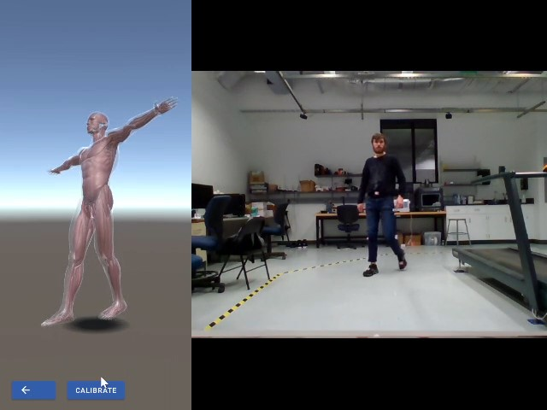
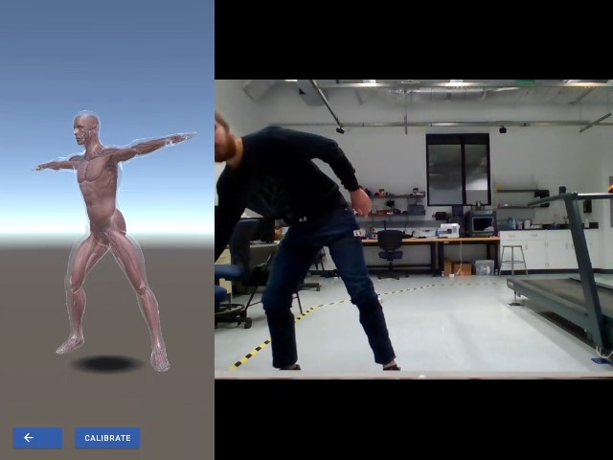
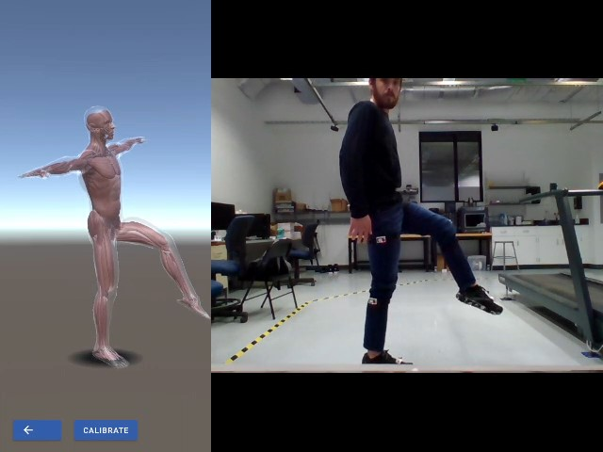
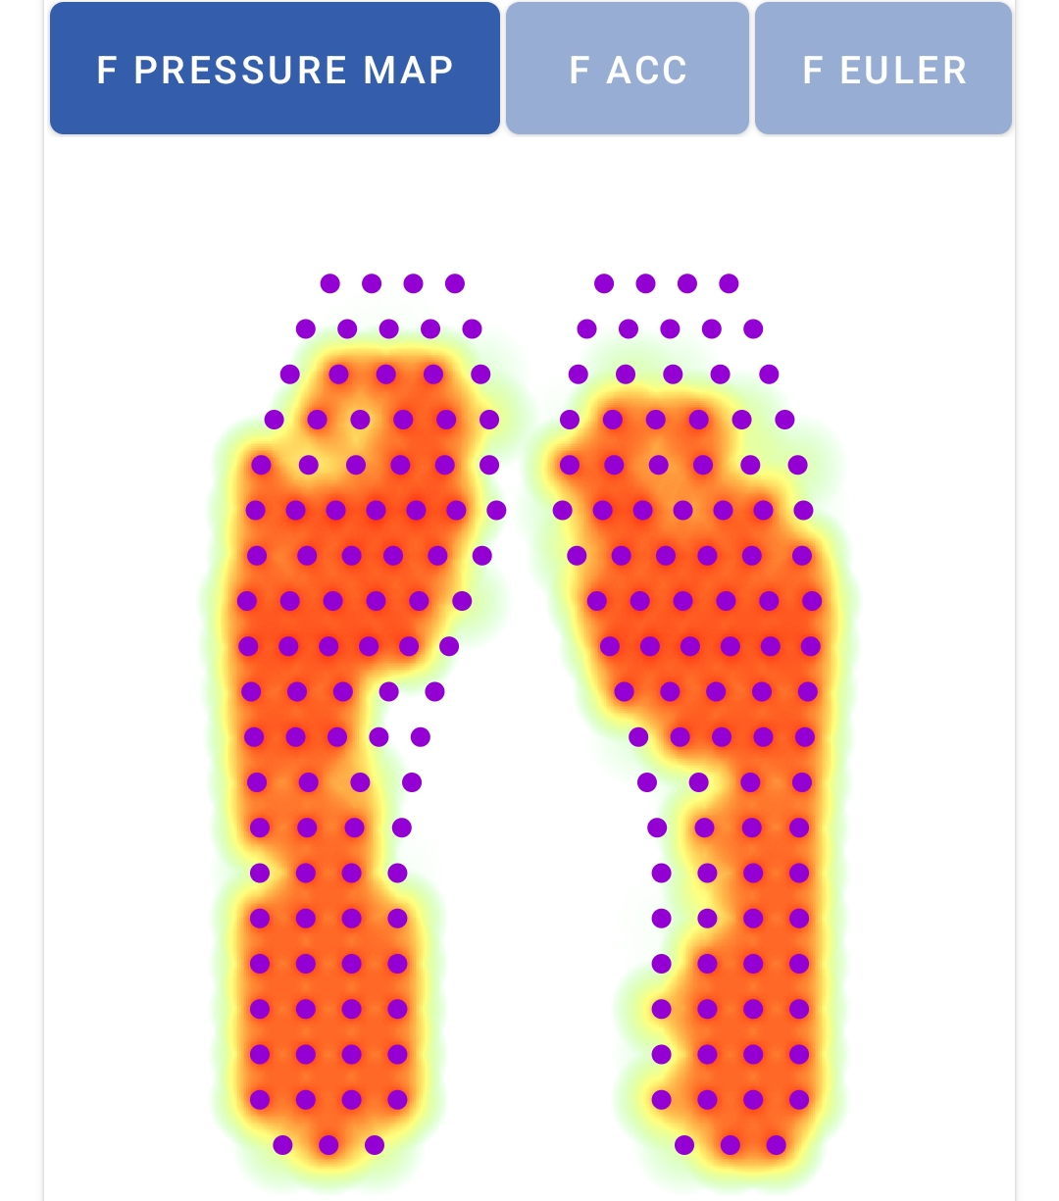
A Wearable Motion Tracking System to Detect WrMSD Zachary Taylor¹ Faculty Advisors: Diliang Chen², Dongpeng Xu¹ Department of Computer Science¹, Department of Electrical and Computer Engineering², University of New Hampshire, Durham, NH 03824
Introduction
Android App
Hardware Description
Manually intensive jobs often come with increased risk of injury. Some of the most prevalent injuries are work-related musculoskeletal disorders (WrMSD) where a worker suffers injuries to their muscles, tendons, ligaments, or bones. These injuries account for 30% of workplace injuries and cost employers roughly $53 billion dollars annually to treat. Effectively preventing WrMSD involves avoiding repetitive and damaging motions at the workplace. To assist in detection of these motions, I designed a wearable motion tracking system that could in the future detect a worker’s motions and alert them of potentially harmful actions during their workday.
The system consists of three different types sensing devices: motion tracking devices, Smart Insoles, and Smart Gloves.
The motion tracking devices include an ICM-20948 inertial measurement unit (IMU) which is equipped with a digital motion processor (DMP) that fuses data the gyroscope, accelerometer, and magnetometer data. This fusion results in a quaternion that represents the rotation of the device.
The Smart Insoles and Gloves consist of a pressure sensor array formed in their respective insole and glove shape.
Each sensing device is connected to a sender board built on the ESP32 microcontroller unit (MCU), allowing for wireless transmission of the sensor data. The system also consists of a receiver board that is also built on the ESP32 MCU which aggregates and forwards the data. Each board has its own battery and an LED to indicate the status of the board.
Figure 1. Motion tracking visualization in Unity
Data Flow
Updating Unity
ESP-NOW
$$newQ=senderQ ∗calibrationQ^{−1} ∗startingQ$$
Figure 2. Smart Insole pressure visualization
Figure 3. Smart Glove pressure visualization
Hardware
Quaternion reported by the IMU
Quaternion representing the orientation of the IMU during the T-pose
Quaternion representing the starting rotation of the bone
UDP
Acknowledgements
A big thanks to everyone at the Wearable Sensing and Control Systems Laboratory and to UNH as a whole!
References
Alwasel, Abdullatif & Elrayes, Karim & Abdel-Rahman, Eihab & Haas, Carl. (2011). Sensing Construction Work-Related Musculoskeletal Disorders (WMSDs). Proceedings of the 28th International Symposium on Automation and Robotics in Construction, ISARC 2011. 10.22260/ISARC2011/0027.
D., Kothandaraman & Chellappan, C.. (2016). Human movement tracking system with smartphone sensing and Bluetooth Low Energy in Internet of Things. 15. 661-669. 10.3923/ajit.2016.661.669.
Shanshan Lu, Xiao Zhang, Jiangqing Wang, Yufan Wang, Mengjiao Fan, Yu Zhou, "An IoT-Based Motion Tracking System for Next-Generation Foot-Related Sports Training and Talent Selection", Journal of Healthcare Engineering, vol. 2021, Article ID 9958256, 14 pages, 2021. https://doi.org/10.1155/2021/9958256.
Wang, Di & Dai, Fei & Ning, Xiaopeng. (2015). Risk Assessment of Work-Related Musculoskeletal Disorders in Construction: State-of-the-Art Review. Journal of Construction Engineering and Management. 141. 04015008. 10.1061/(ASCE)CO.1943-7862.0000979.
Yushuang Tian, Xiaoli Meng, Dapeng Tao, Dongquan Liu, Chen Feng, Upper limb motion tracking with the integration of IMU and Kinect, Neurocomputing, Volume 159, 2015, Pages 207-218, ISSN 0925-2312, https://doi.org/10.1016/j.neucom.2015.01.071.
Y. Zhang, Y. Fei, L. Xu and G. Sun, "Micro-IMU-based motion tracking system for virtual training," 2015 34th Chinese Control Conference (CCC), 2015, pp. 7753-7758, doi: 10.1109/ChiCC.2015.7260871.
Zhao, J., Obonyo, E., & G Bilén, S. (2021). Wearable Inertial Measurement Unit Sensing System for Musculoskeletal Disorders Prevention in Construction. Sensors (Basel, Switzerland), 21(4), 1324. https://doi.org/10.3390/s21041324
Zhu, K., & Shi, L. (2016). Motion Control in VR — Real-time Upper Limb Tracking via IMU and Flex Sensor.
Figure 4. Motion sensors
Figure 5. Smart Insoles
Figure 6. Smart Gloves

