Slide 1
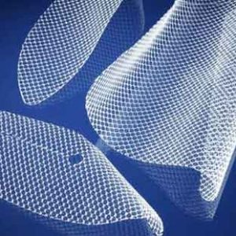
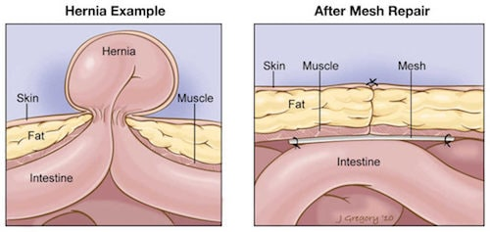
The Problems with Hernia Meshes Hernia Mesh Research Christian Lamers, Eric Langley, and Luke Cava Advisor: Nikhil Padhye Department of Mechanical Engineering, University of New Hampshire
Introduction
Methods
Considerations
Hernia Repair is the most common operation in general surgery as of 2008
Affects 28 people per 100,000 in US
20 million surgeries/year worldwide
$48 Billion / year in revenue for US hospitals
Manufacturing Methods:
Woven
3D-printed
Adhesive Methods:
Sutures
Bio-Glue
Minimize recurrence
Pore Size and Shape
Correct Material
Tensile Strength
Durability
Weight
Elasticity
Toughness
Biocompatibility
Minimally invasive
Adhesion to Muscle
Allow for flexibility
Right amount of strength
Overview
Tests
Hernia: A bulging of an organ/tissue through the abdomen
Hernia Mesh: Most common treatment
Stress and Strain Testing (Tensile)
Peel Testing
Adhesion Testing
References
Baylón, Karen et al. “Past, Present and Future of Surgical Meshes: A Review.” Membranes vol. 7,3 47. 22 Aug. 2017, doi:10.3390/membranes7030047
Ballard, David H et al. “3D printing of surgical hernia meshes impregnated with contrast agents: in vitro proof of concept with imaging characteristics on computed tomography.” 3D printing in medicine vol. 4,1 13. 7 Dec. 2018, doi:10.1186/s41205-018-0037-4
.
Contacts
For more information contact: Nikhil Padhye and Ammar Jebur

Slide 2
This poster template provided courtesy of
UNH ESRC Poster Printing Services
Trust us to make your poster look GREAT!
Website: http://posters.unh.edu
Poster Guide: http://goo.gl/1E7TJY
DELETE THIS SLIDE BEFORE PRINTING

