Slide 1

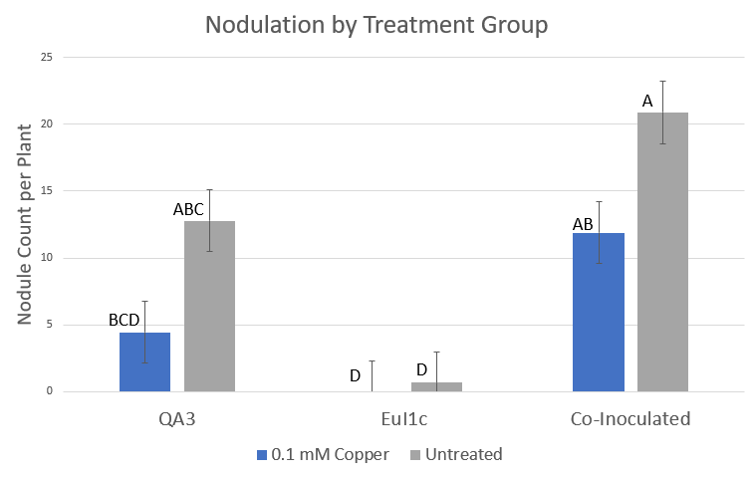
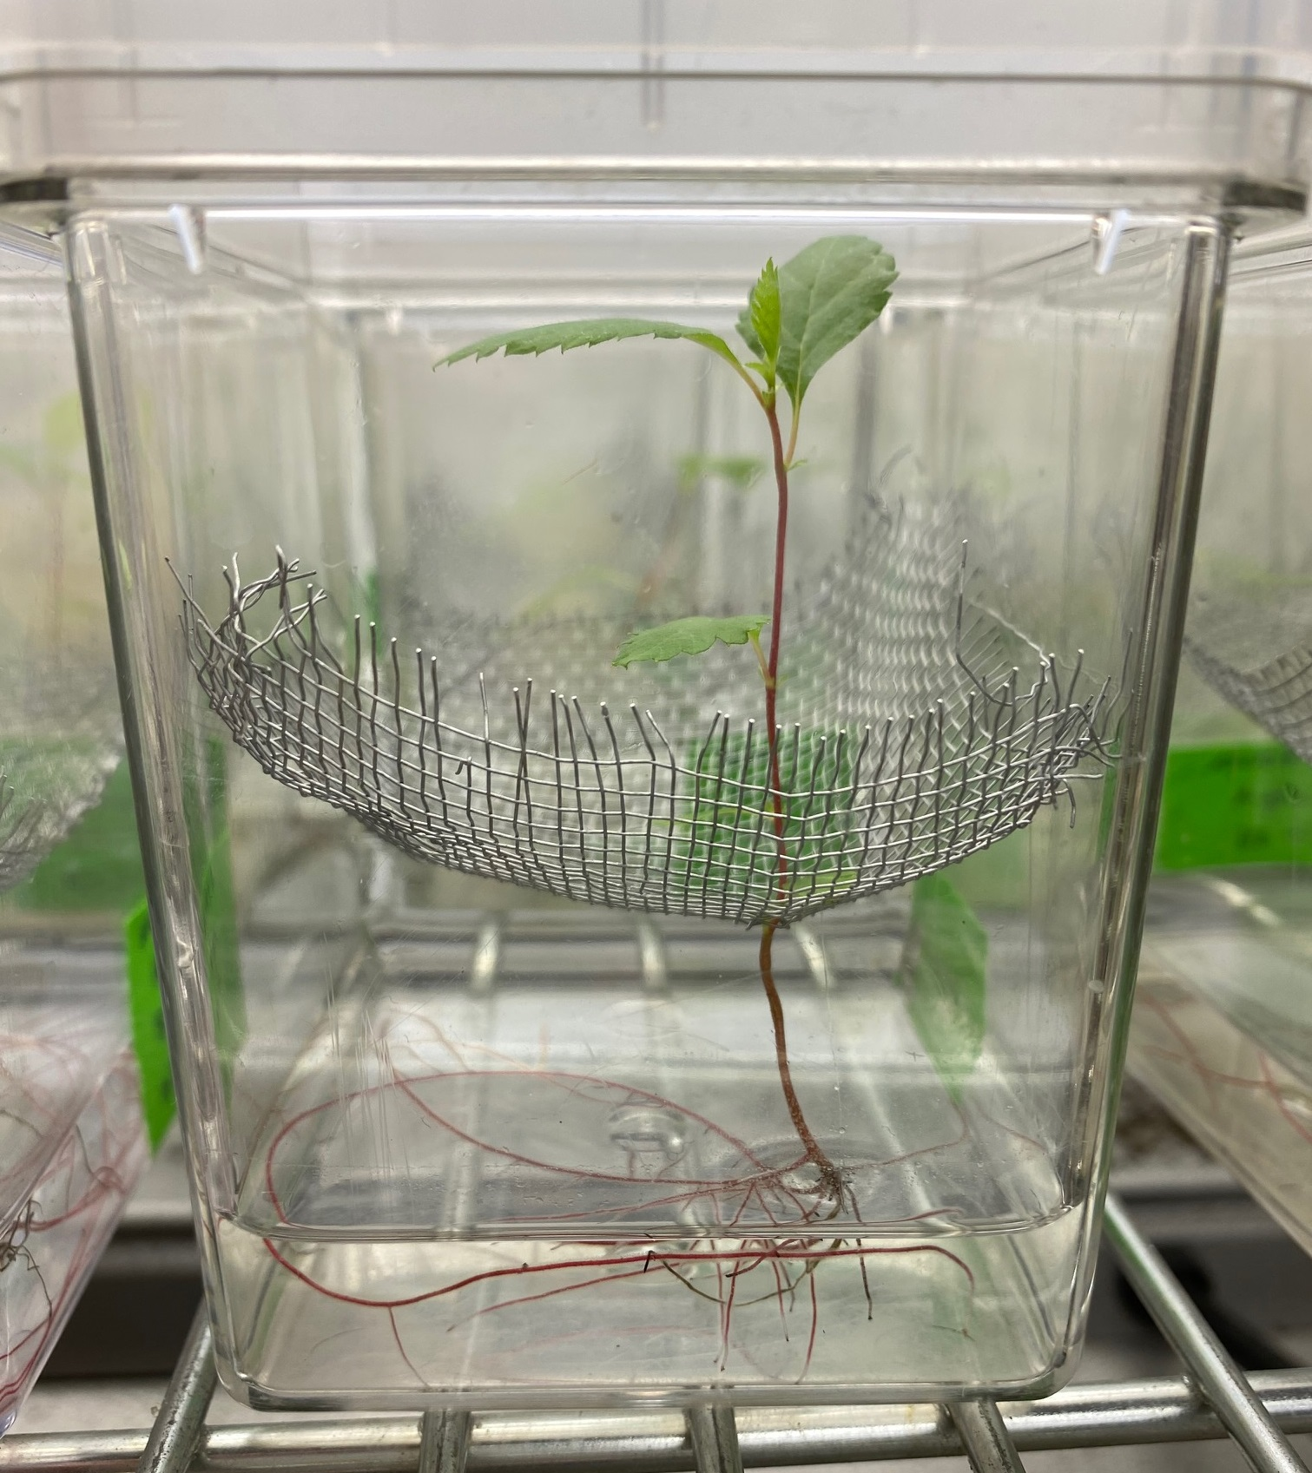
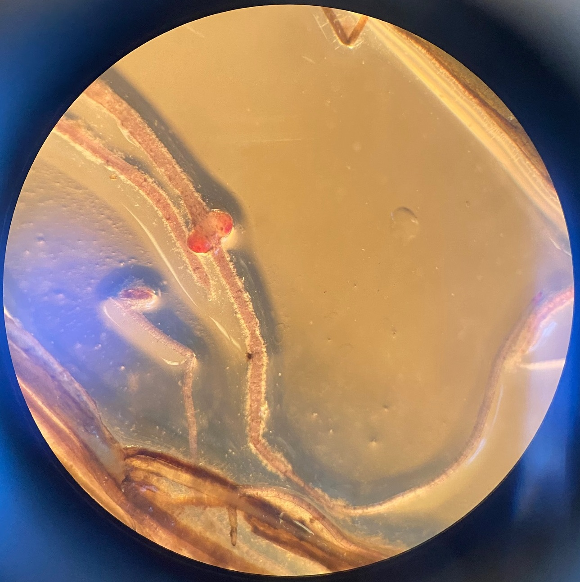
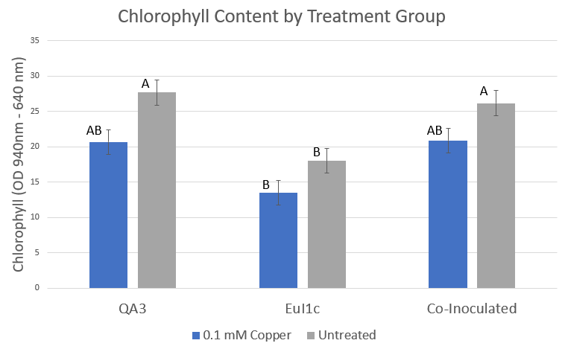
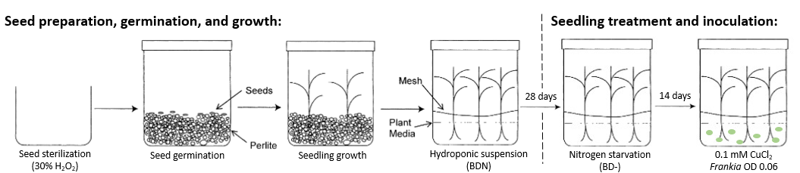
Co-inoculation of copper-stressed Alnus glutinosa seedlings with Frankia sp. QA3 and Frankia inefficax EuI1c
Megan P. Worth and Louis S. Tisa
University of New Hampshire, Durham, NH, USA
Background
Results
Alders can colonize and reclaim mining and industrial sites, whose soils are contaminated by high concentrations of heavy metals.
These plants form a nitrogen-fixing mutualistic relationship with bacteria in the genus Frankia. Due to this relationship, these plants can overcome a range of environmental stresses including heavy metals, high salinity, and drought.
Phylogenetic analysis of the genus Frankia has identified four clades. Each clade is distinguished by their plant host range.
Alders tend to associate only with clade 1 Frankia strains. However, in studies at polluted sites, Frankia clade 3 and 4 strains were identified in alder nodules.
We were interested in determining if environmental stress may play a role in inducing plant host flexibility between host plant and symbiont in heavy metal polluted soils.
To investigate, ten-week-old alder seedlings were inoculated with either a clade 1 Frankia strain (QA3), a clade 4 Frankia strain (EuI1c), or co-inoculated with both strains. Alders in each inoculation condition were treated with either 0.1 mM copper chloride or left untreated.
For all alders, nodule formation was counted, and plant health observed. For co-inoculated alder seedlings, population dynamics within nodules will be measured via qPCR.
Results suggest that co-inoculation with Frankia strains EuI1c and QA3 under copper-stress may increase plant nodule production and consequently, copper tolerance.
Nodulation by Treatment Group
Conclusions
Figure 1. Nodules were counted and averaged for each treatment group 10 weeks post-inoculation. Data is representative of three experimental replicates. Group comparisons were made using Tukey’s HSD in JMP.
No significant differences were observed in nodule count or chlorophyll content within inoculation conditions, regardless of presence or absence of copper treatment, which confirms the known benefit of Frankia in aiding plant health under stress.
More nodules were formed per plant in co-inoculated conditions versus single-inoculated, suggesting a role for the non-typical symbiont in nodulation.
Chlorophyll content under copper treatment was not significantly different in any inoculation condition, despite a lack of nodulation by EuI1c, which may have a beneficial role in plant health outside of nodules.
Chlorophyll Content by Treatment Group
Figure 2. Chlorophyll content was measured using atLEAF standard chlorophyll meter 10 weeks post-inoculation. Values are calculated as the difference of optical density readings between 940 nm and 640 nm. Recordings were averaged per plant and per treatment group. Data is representative of three experimental replicates. Group comparisons were made using Tukey’s HSD in JMP.
Next Steps
qPCR to determine nodule occupancy by both the typical (QA3) and atypical (EuI1c) alder symbionts.
Repeats of this experiment currently in progress using 1 mM copper treatment
Production of knockout mutants of EuI1c copper-tolerance genes to determine the mechanisms Frankia strains use to tolerate heavy metals and establish symbiosis with their hosts under these conditions.
Methods
Acknowledgements
Thank you to Dr. Louis Tisa and all members of the Tisa Lab. We would like to thank the University of New Hampshire Graduate School as well as the USDA NIFA Hatch 686 for funding this research.
0.1 mM CuCl₂
Frankia OD 0.02

