Slide 1

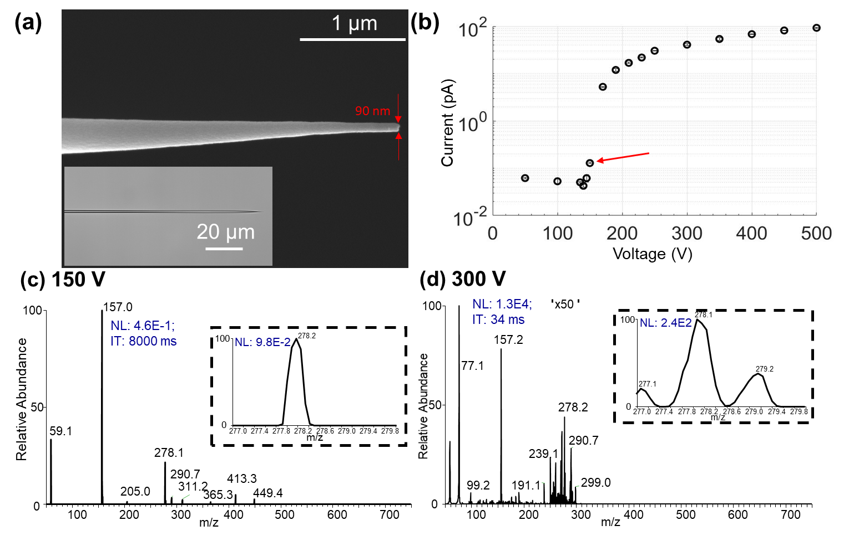
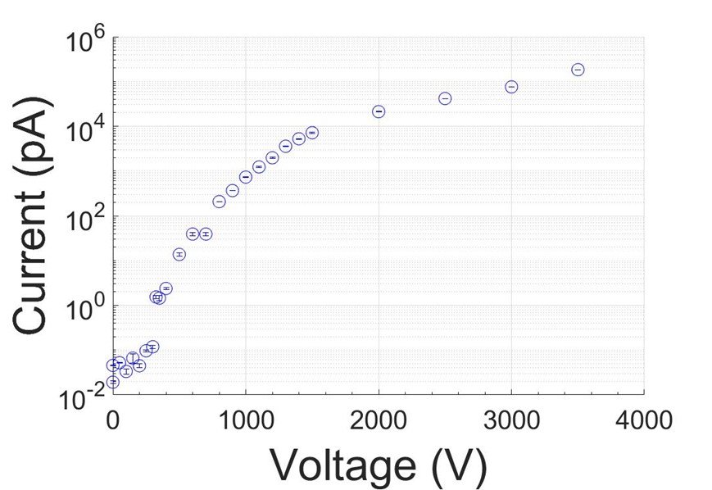
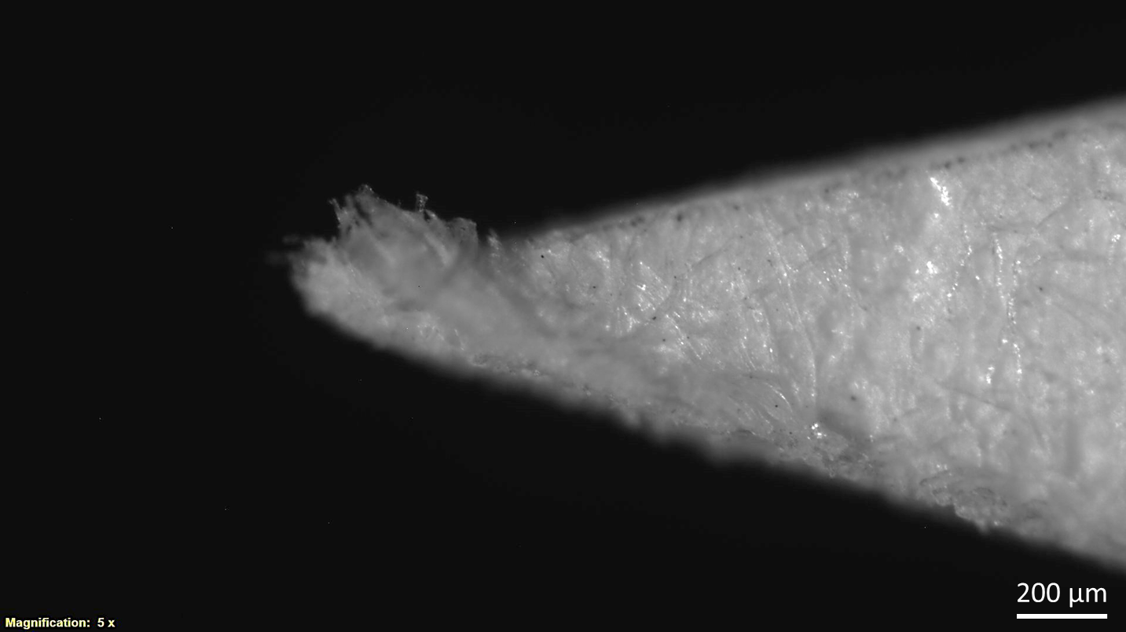
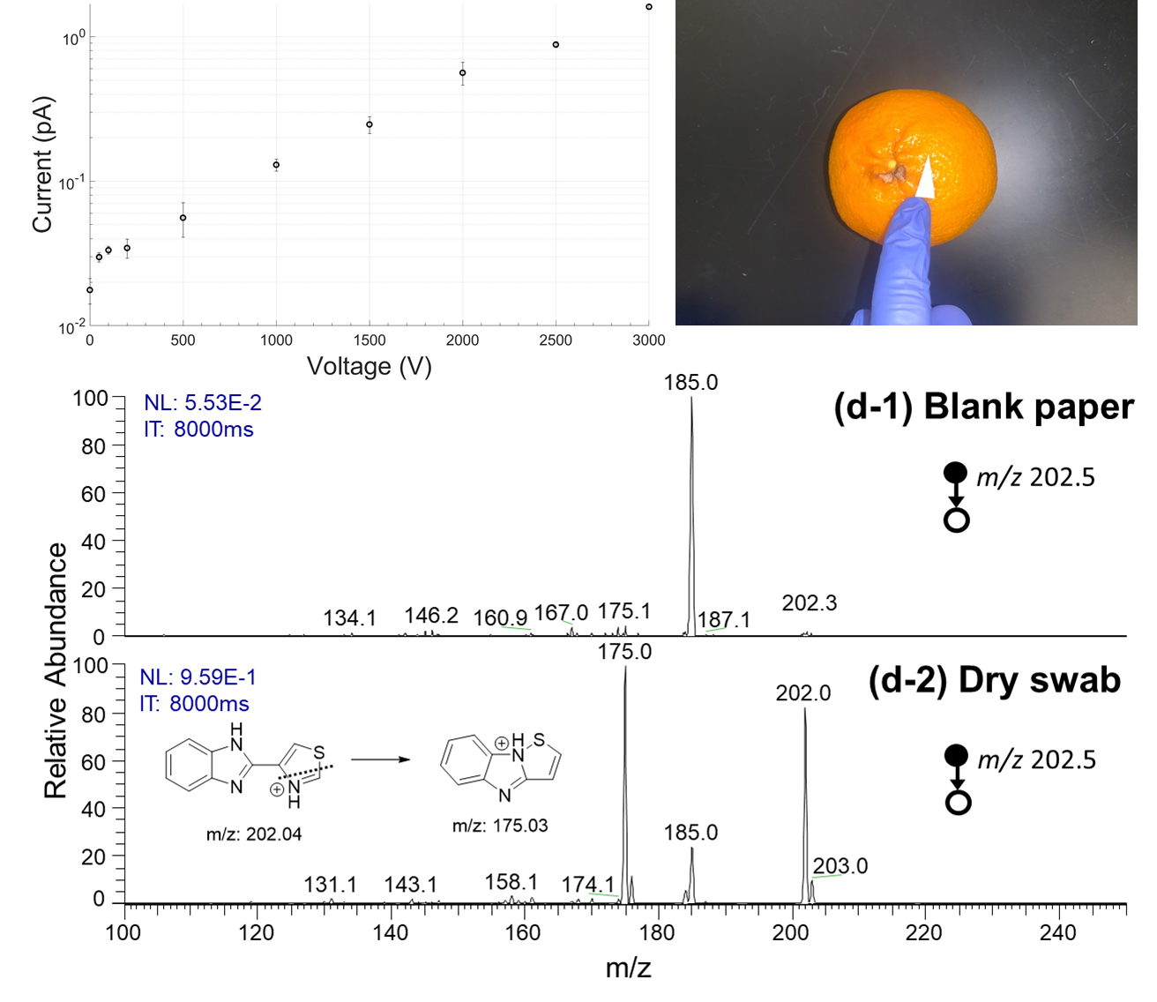
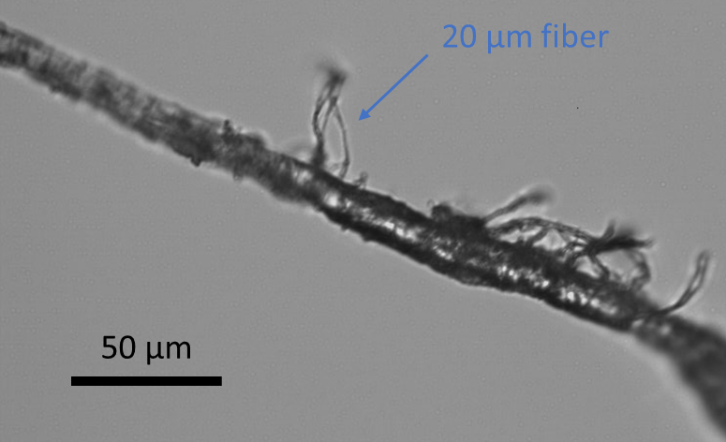
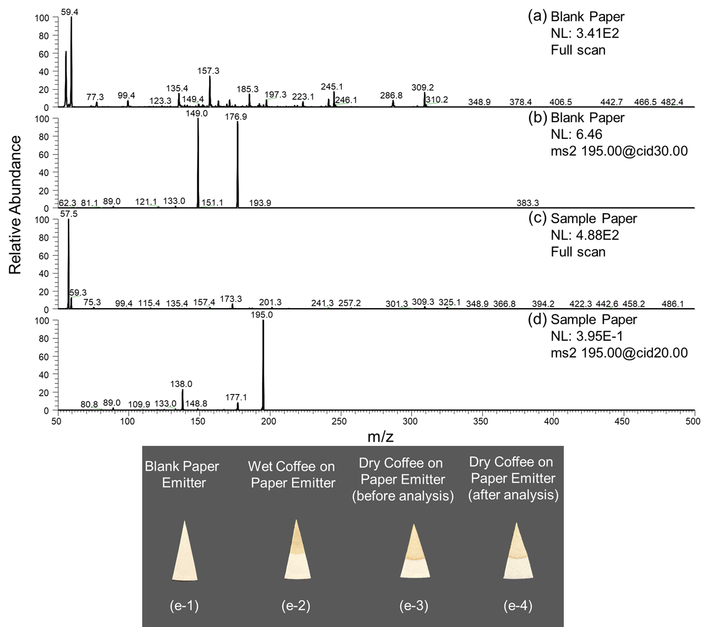
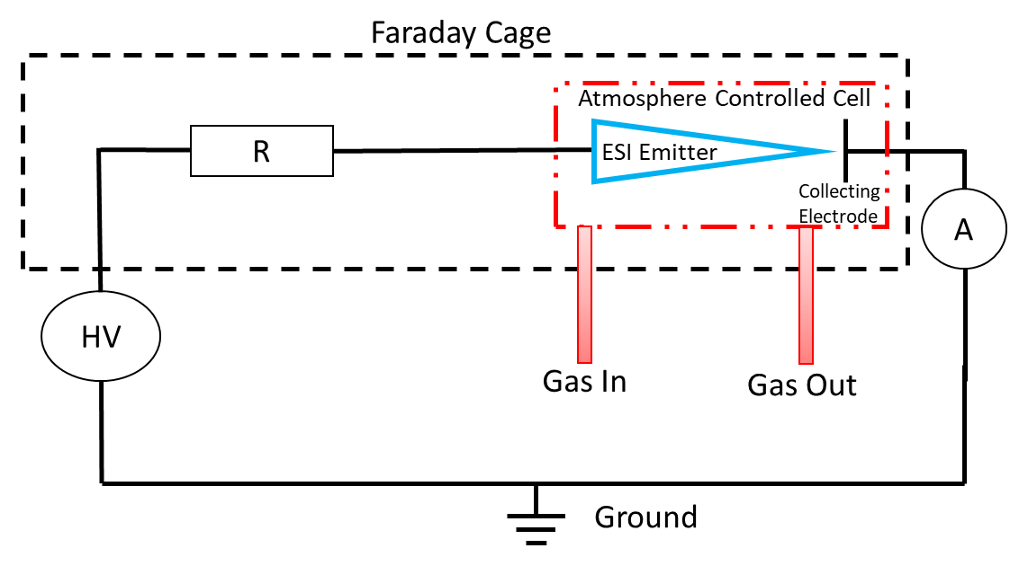
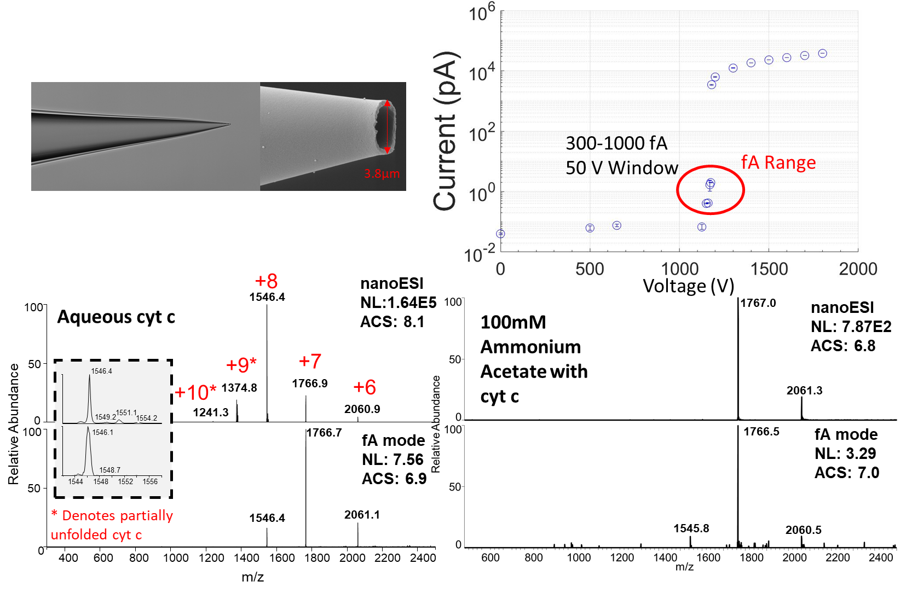
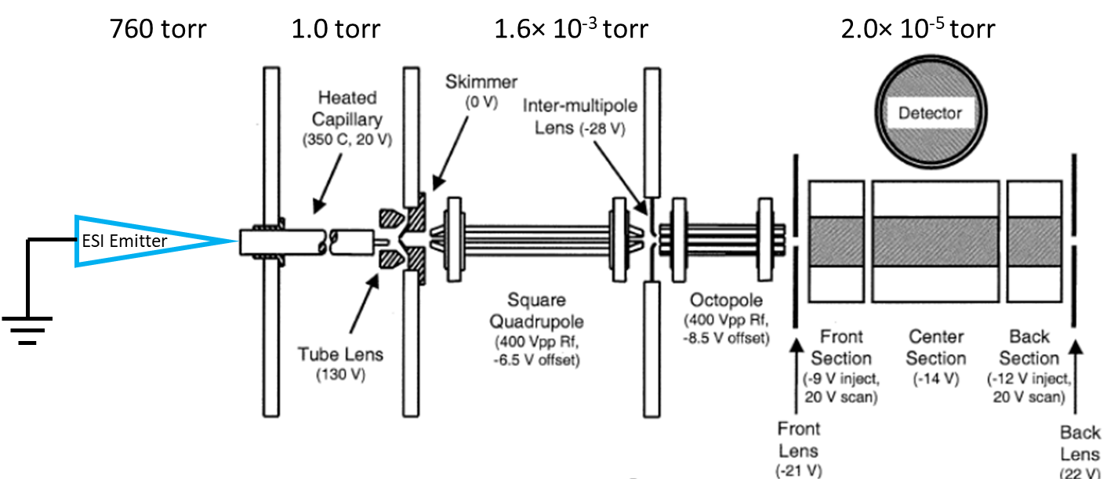
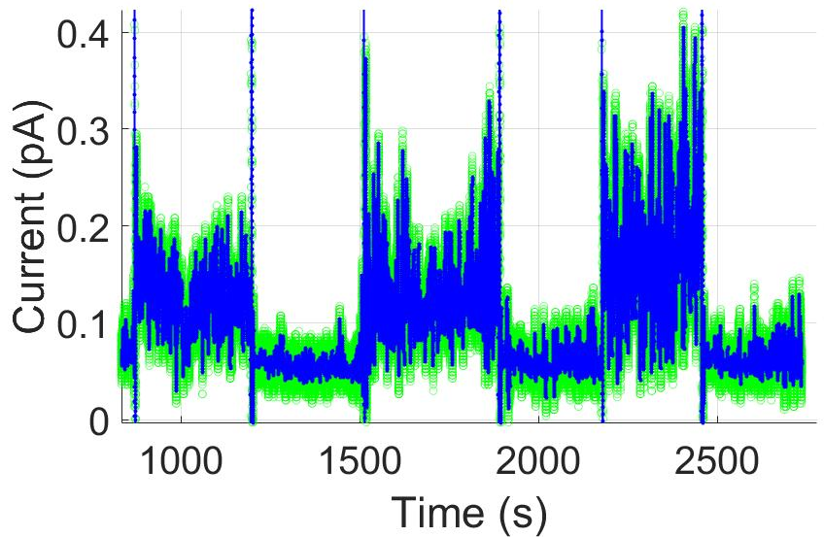
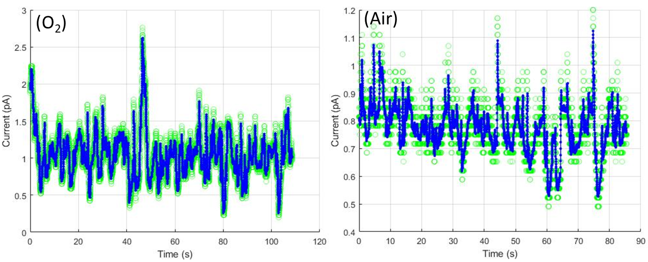

Femtoamp and Picoamp Modes of Electrospray and Paper Spray Ionization
Nicholas R. Allen ^{a,1}, Huishan Li ^{a,1}, Alexander Cheung ª, Guoqiang Xu ^{b}, Yunlong Zi ^{b}, Anyin Li ^{a,*}
ª Department of Chemistry, University of New Hampshire, 23 Academic Way, Durham, NH, 03824, USA
^{b} Department of Mechanical and Automation Engineering, The Chinese University of Hong Kong, Shatin, N.T., Hong Kong, China
Highlights:
Nanometer Emitter Tips: fA and pA currents
Wet Paper Substrate: fA, pA, and nA currents
Discovery of ultra-low ionization currents (100s fA) for µm scale emitter tips and paper substrates
Native protein charge states generated in fA without using any buffering agent
fA current enable direct analysis of neat sample without contamination
Paper triangle with isopropanol produced an ionization current of 150-300 fA at 250 V, increased to 100 nA when at 3000 V
When 250 ng melezitose sample was present on the paper, the normalized level (NL) was observed to be 7E-2 at 250 V, and 2E3 at 1300 V
nA
Introduction:
pA
Conventionally known onset current for ESI is in the nanoamps
More sensitive instruments and the analysis of individual ions require picoamp currents or lower ion beams
pH changes in the evolution of ESI droplets could alter the conformation of the proteins carried in the droplets which is usually overcome by introducing buffering agents such as ammonium acetate
Lower ionization current is believed to produce smaller initial charged droplets for ESI.^{[1]}
fA
Dry Paper Substrate: fA to pA current
Methods:
MS signal for the fA ionization current were >3 order of magnitude less intense than those produced by 50 pA ionization current
The 100s fA ionization current is >3 orders of magnitude lower than those in previous literature reports for nm-sized emitter tips^{[2]}
Default (10-100 ms injection time) parameters could overlook this fA regime as not enough ions are trapped for each scan
Electrometer and a faraday cage to measure ionization current (DC) as low as 20 fA
Ion trap with extended injection time (up to 8 s) to accumulate detectable signal for ion beam as low as 1 ion/s.
Current Measurement Scheme
Mass Spectrometry Scheme
Micrometer Emitter Tips: fA and nA current
Onset of 80-100 fA at 400 V, current increased with voltage to 1 pA at 2500 V
Ion signals could last for more than 30 min
No contamination of sample holder and MS inlet
Sample collection, storage and analysis without preparation and any solvent
Results 1: Capturing femto amp Currents!
Conclusions and Questions for the Future:
Ultra-low fA to pA ionization currents exist for various ESI emitters
    What form of meniscus does it have?
    What flow rates does it have?
Native protein charge states indicate ultra-small initial droplets
    How small exactly are they, and what determines their size?
Trends to more uniform response observed for novel ESI conditions^{[5]}
    Will the fA mode ESI help to produce the ideal charged droplets?
    Could we demonstrate universal uniform response for a few classes of compounds?
Without ammonium acetate (AA), nanoESI produced average charge state (ACS) of 8.1
Without AA, fA mode ESI produced a lower ACS of 6.9
The cytochrome c (cyt c) protein likely retains its native structure from aqueous solution in fA mode ESI
With AA, fA mode ESI produced an ACS higher than nanoESI
AA suppressed protein signal in nanoESI but had little effect on fA mode ESI
(Left) Low fA ionization current verified by on/off switching
(Middle/Right) High fA ionization current recorded under 1 kHz sampling rate.
Air vs. O₂ atmosphere shows no air discharge breakdown involved
Ionization appears continuous (no pulsing) at a sampling rate of 1kHz
References:
[1] Bush, M. F. et al. Int. J. Mass spectrom. 2017, 420, 35-42.
[2] Yuill, E.M. et al. Anal Chem. 2013, 85, 8498-8502.
[3] Susa, A.C. et al. Anal Chem. 2017, 89, 3116-3122.
[4] Marginean, I. et al. J Am Soc Mass Spectrom. 2014, 25, 30-36.
[5] Li, M.T. et al. Chemical Science. 2021, 12, 1907-1914.
Link to this published paper
Notes:
Regenerate and reorganize figures
Add a methods section
Reduce text

