Slide 1
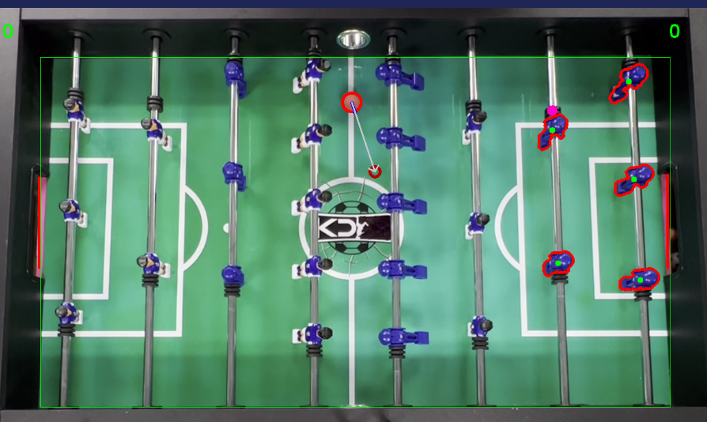
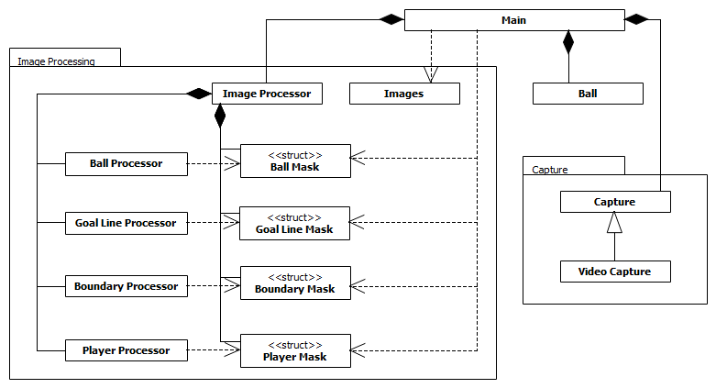
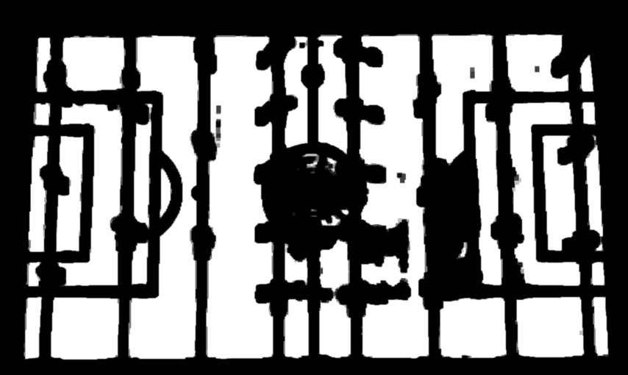
Automated Foosball Goalie Software Adam Judge, Reid Leclerc, Cameron Scott, Zhouhai You
Spencer Couture, Project Sponsor Department of Computer Science, University of New Hampshire, Durham, NH 03824
Introduction
Table Information and Annotation
Software Design
The goal of this project is to extend our sponsor’s previous application in order to create software that detects shots taken against an AI player and generate simulated commands that would cause the computer’s defensive players to block upwards of 80% of incoming shots.
This software is meant to provide a base from which to create an actual foosball table with the necessary hardware to automate defensive play. As such, this project is made with extensibility in mind; making it easy for maintainers to add a hardware interface and also live footage capabilities.
Figure 3. Video Output
The software consists of three major components:
Main (Figure 1, A)
Coordinates all components of the application.
Runs the processing loop, consuming a single frame of a video at a time.
Performs operations based on the information within the image.
Capture (Figure 1, B)
Handles video input.
Types of video hand using different forms of Capture.
Currently only handles pre-recorded footage, using File Capture (Figure 1, C).
Image Processing (Figure 1, D)
Extracts features of the table from a frame.
Each feature has its own processor (Figure 1, E)
Uses a color masks to target specific information.
Masks turn the input frame into a black-and-white image.
Only the color being targeted turns white.
Color masks for table boundaries and defensive players shown (Figure 2).
Draws over the input frame with key info.
Boundaries (Figure 3, A).
Goal lines (Figure 3, B).
Ball (Figure 3, C).
Projected ball position (Figure 3, D).
Goalies (Figure 3, E).
Video Output that shows all elements being tracked
A
C
B
D
E
Requirements
The software should be able to:
Process pre-recorded footage
Map the table boundaries and goal lines
Track the position of the foosball
Predict future positions of the foosball
Track the position of AI controlled players
Detect when a goal is scored
Pause/resume the game
Display all tracked features (Figure 2)
Simulate move commands for defensive players
Adjust difficulty of AI
View performance statistics
Create an easy to use GUI
Conclusions
Design and Extraction
While the project has all the functionality required to support making predictions, our team still needs to implement the generation of commands to simulate blocking shots. Once block commands are completed, it is a matter of improving the system until we reach our goal of an 80% block rate.
Requirements such as adjusting AI difficulty, viewing performance statistics, and creating an easy to use GUI, along with are still incomplete and will be left for future maintainers to develop. Creating a hardware interface is also left for future iterations.
Figure 1. UML Design Overview
Figure 2. Field and Player Masks
An overview of the class design, showing how classes interact.
The color masks used to track the boundaries and players.
A
A
D
E
B
B
C
D
C
Acknowledgements
UNH Interoperability Lab
Advising Professor: Matthew Plumlee

