Slide 1

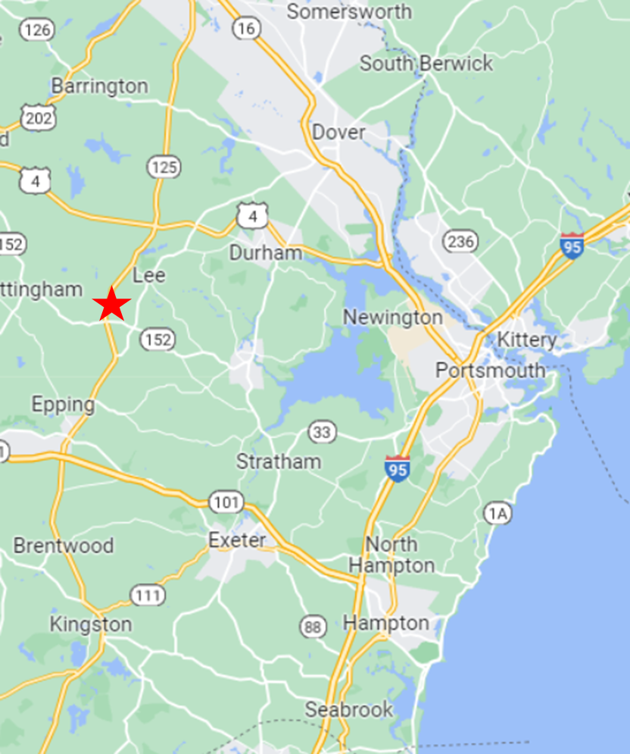
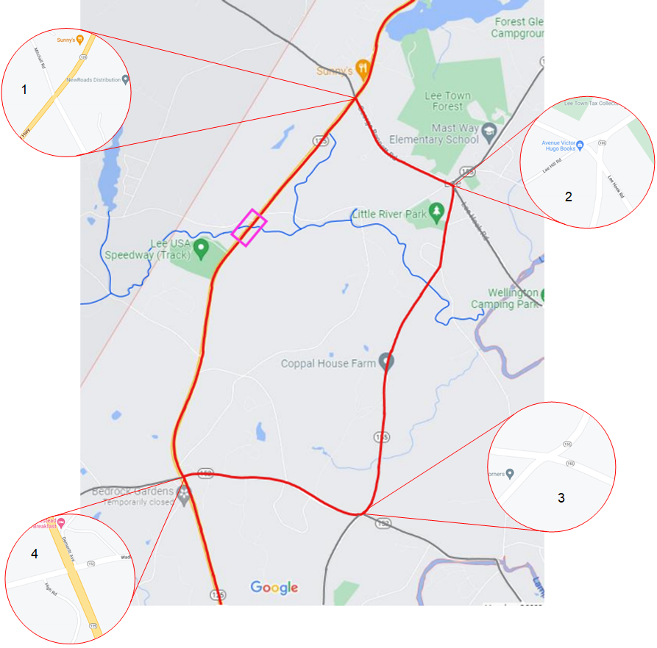
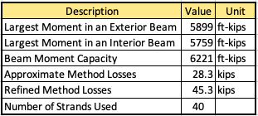
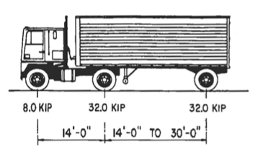
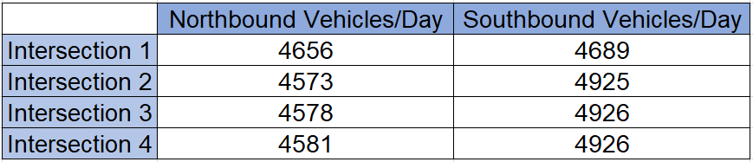
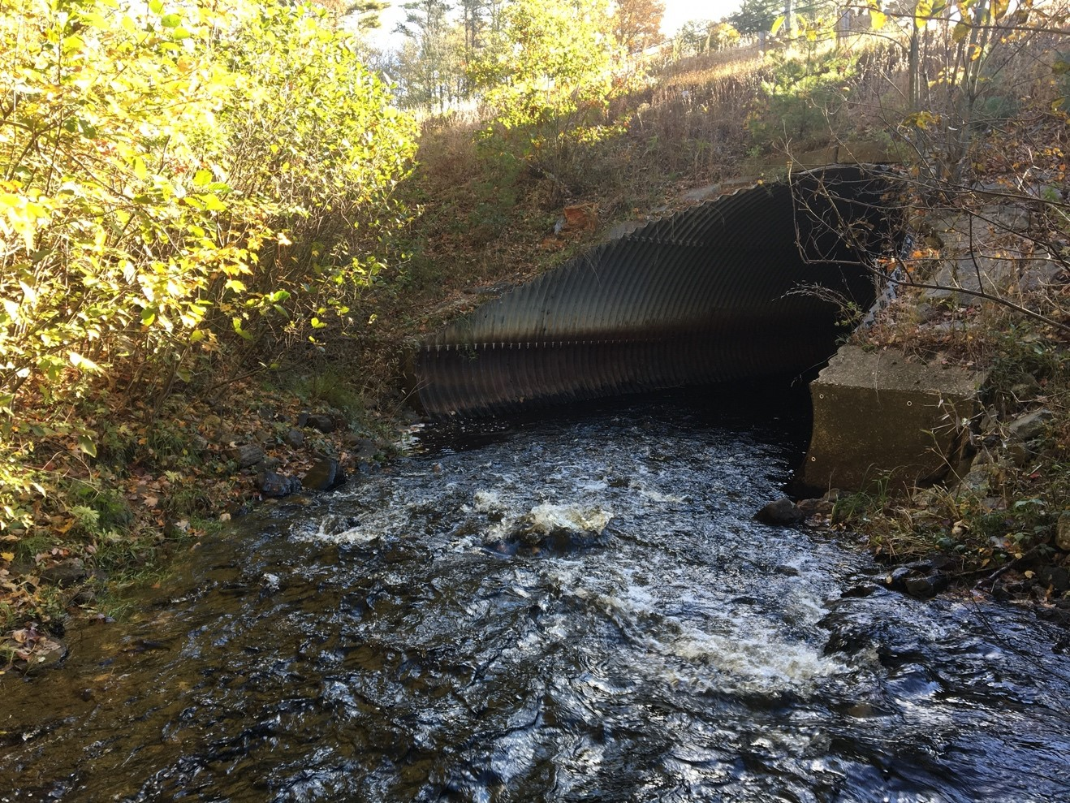
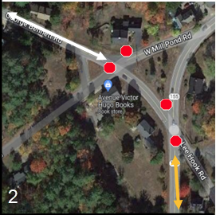
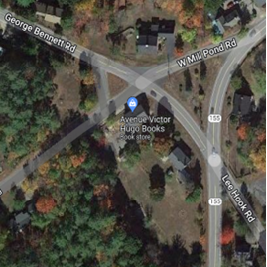

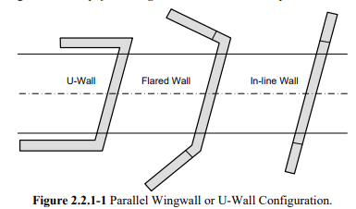
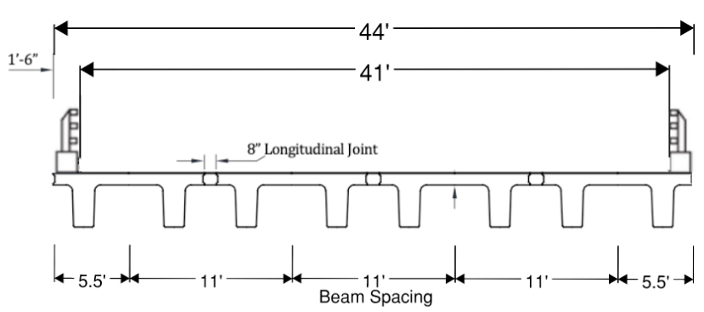
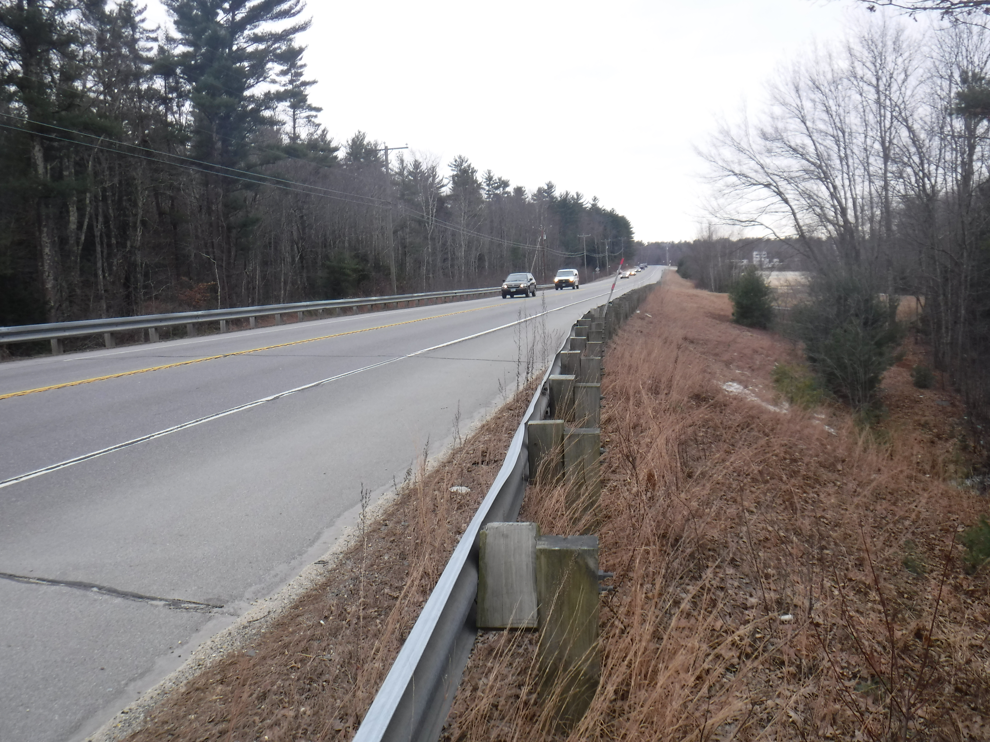
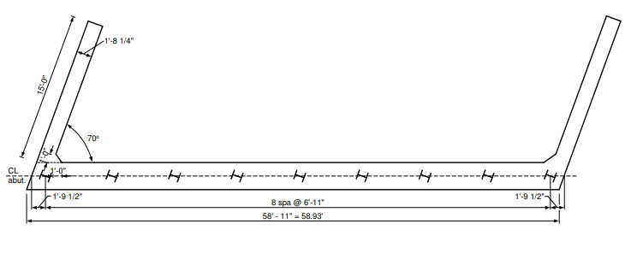
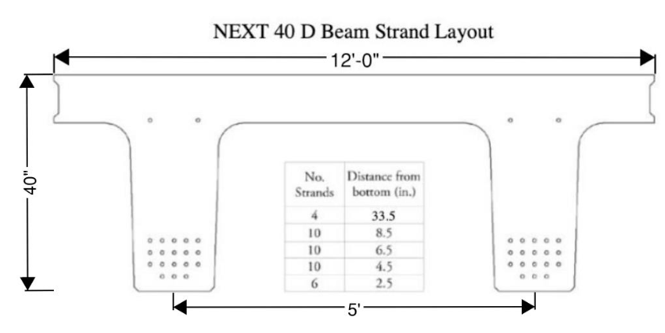
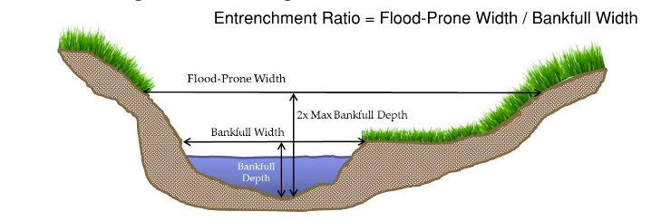

Bridge Replacement & Traffic Control Plan
NH Route 125 over Little River – Lee, NH
Nicholas Munroe (PM), Sierra Dahl, Jack Meade, Tess Priest, & Payton Surprenant
Faculty Advisor – Dr. Jo Sias, P.E., Project Sponsor – Samuel White, P.E. of McFarland Johnson
Introduction
Road Closure & Detour
Prestressed Beam Design
Existing structure is an 18’ x 12’ corrugated metal pipe (CMP) under 8 feet of fill and constructed in 1972
Roadway consists of two 12-foot travel lanes and two 8-foot shoulders
ADT of 20,272 with a speed limit of 55 MPH
On NH State Red List since August 2014
CMP has severe invert section loss and heavy rusting and pitting on lower 1/3rd
Hydraulically undersized pipe causes upstream flooding on West Mill Pond Road
NH Roue 125 is a Tier 2 Roadway
Linear regression of traffic counts, 2009-2019 show increase in traffic over time
Due to high traffic volume, road closure with detour will be enforced to ensure safety of motorists and construction workers
Detour length is kept to 6 miles (~9 minutes) from one side of construction to the next
Each intersection along the detour was investigated and modified to provide an efficient route around construction
Minimal impact on residential and business areas along NH Route 125 using a 2-month closure during the summer
AASHTO HL-93 design truck and lane loading used
Strength 1 limit state used for load factoring
Interior beam vs Exterior Beam
Mid Span is point of interest
Strength 3 limit state used for determining required number of strands
Moment influence line used to calculate factored moments
Bridge cross section i used for live load distribution factors
1
Project Site
2
AASHTO Design Truck
Substructure Preliminary Design
3
Integral abutment chosen
Criteria for simplified design method met
An abutment height of 13 feet will not be exceeded
Abutments of equal heights will be strived for
Parallel wingwalls (u-walls) to be 10 feet maximum in length
H-piles to be Grade 50 steel with flanges 12 inches
The number of piles will be equal to the number of beams, with the spacing at 6 ft
A minimum of four piles required per abutment
Structural and geotechnical analysis is required for further design
Ideal layout depends on whether the slope is steeper than 1:1.5
Scope of Work
Traffic data provided by the New Hampshire Department of Transportation (NHDOT)
Each intersection yielded roughly the same traffic counts
Chapter 4C, Warrant 1 of the Manual on Uniform Traffic Control Devices (MUTCD) displays “Traffic Control Signal Studies”
According to this Warrant, all four of the intersections along the detour will require traffic signals.
Detour design with road closure for traffic control plan
Design of NEXT Beam superstructure
Preliminary design of integral abutment substructure
4
Southbound Traffic
Northbound Traffic
These modified intersections include signals to ensure efficient and timely traffic flow throughout the detour
Key:
Stop sign
Traffic Signal
Detour Route
Traffic on George Bennett Rd
Traffic on NH Route 155
2
Existing Intersection 2
Modified Intersection 2
Flow Direction
Superstructure Design
Single 75’ span
Span developed from entrenchment ratio
Match existing lanes and shoulders
44’ out-to-out deck width
0° skew angle
(4 EA) maximum width NEXT 40D beams utilized
3” thick wearing surface
No deck pour needed
8 ksi concrete used
No diaphragms needed
No utility loads
UHPC closure pour longitudinal joints to tie beams together
U-wall Configuration - VTrans Integral Abutment Design Guidelines
Sample Plan View of Integral Abutment - Indiana DOT
Approximate CMP Location
References

