Slide 1
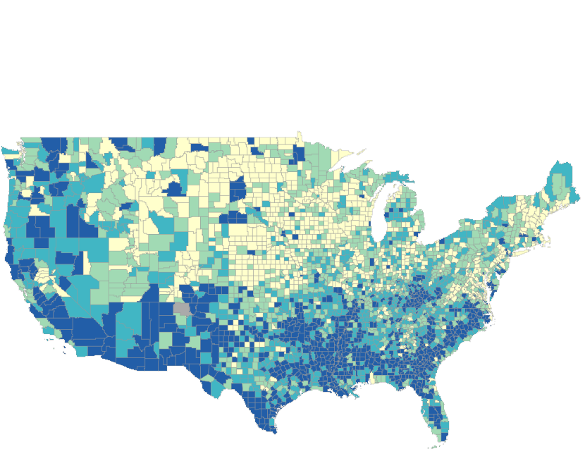
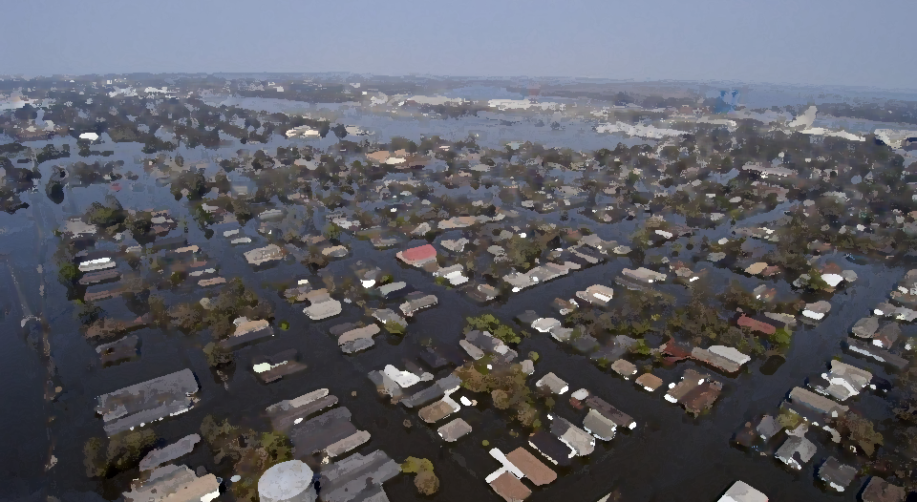
Putting Justice on the Map: Lessons Learned from the Development of Environmental Justice Mapping Tools
Claire McGlinchey, Dr. Catherine Ashcraft
Environmental Policy, Planning, and Sustainability Lab, Department of Natural Resources and the Environment

Slide 2
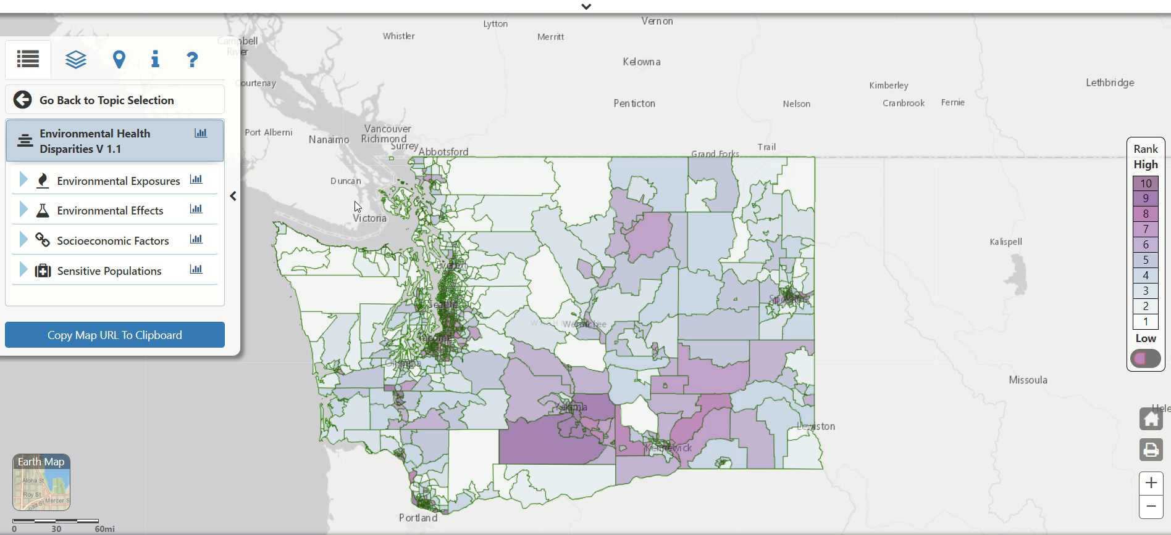
Example: Washington Environmental Health Disparity Tool

Slide 3
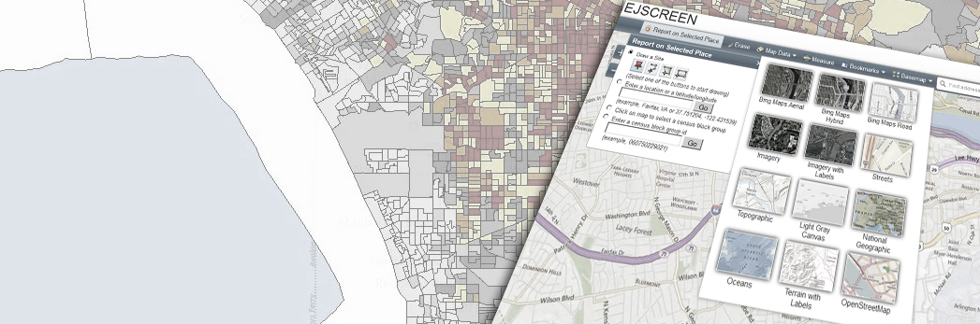
Why develop environmental justice
(EJ) mapping tools?
EJ Mapping Tools
Notable Tools:
EJScreen, CalEnviroScreen, Climate and Economic Justice Screening Tool
Common purposes:
Outreach and engagement
  Richmond, VA: “…to identify the communities in Richmond that are on the frontlines of crises such as climate change and conduct intentional engagement to include these underrepresented voices.”¹
Fund and project distribution
  Connecticut: “…the [tool] can be used to make more informed decisions on future development and infrastructure investments. The tool will also help identify potential Resilient Connecticut pilot projects.”²
Emergency management
  Maine: “The Coastal Risk Explorer helps communities plan for sea level rise by identifying roads that may be flooded and inaccessible in an emergency.”³
The Context: EJ in the United States
Low-income communities & communities of color are environmentally overburdened and under-resourced
Policy: Title VI, Executive Order 12898, Justice40, state EJ laws
  Procedural justice → distributive justice?
1. Richmond Office of Sustainability. (n.d.). Climate Equity Index. [Interactive mapping tool]. https://arcg.is/XbvvD
2. Connecticut Institute for Resilience and Climate Adaptation. (2021). Climate Change Vulnerability Index (CCVI). https://resilientconnecticut.uconn.edu/wp-content/uploads/sites/2761/2021/10/CCVI-Fact-Sheet.pdf
3. The Nature Conservancy. (n.d.). Coastal Risk Explorer. [Interactive mapping tool]. https://maps.coastalresilience.org/maine/
EPA’s EJSCREEN
Image Credit: US EPA

Slide 4
How are EJ mapping tools developed and used in the United States?
How and in what ways does the process of EJ mapping tool development impact use and community outcomes?
Next Steps
Creation of public database of existing EJ tools at state, regional, and local levels
Survey of tool developers identified through database (n=150)
Semi-structured interviews with subset of tool developers (n=20)
Analysis of key themes identified through literature review and coding

Slide 5
Database Progress
152 EJ mapping tools
38 states captured
78 state tools
34 regional tools
40 local tools
All regions, including Hawaii and Alaska

Slide 6
EJ Mapping Tool Development: Trends and Considerations
Who makes these tools?
State, regional, local government offices
  Health
  Environmental protection
  EJ/Equity
  Regional planning commissions/Council of Governments (CoGs)
Non-profit organizations/ advocacy groups
Higher ed or private sector research teams
Partnerships between all the above
How are these tools constructed?
Scale: State, planning region, other regional boundaries, county, city
Groupings: County, municipality, census tract, block group
Data
  Individual layers: Social vulnerability; climate projections/data; environmental hazards and pollutants; infrastructure and built environment; natural resources; resiliency opportunities
  Vulnerability scores
    Percentiles, rankings, indexes, or thresholds⁴
    Social vulnerability indexes
      Most common indicators: poverty, no HS, over 65, linguistic isolation
    Physical vulnerability indexes
      Flooding, heat, environmental toxicology, housing
Who is involved?
Community leaders, general public, CoG members, tool users
Timing: before release, after release, or not at all
Before release:
  Interviews with community leaders
  Workshops and listening sessions
  Public comment period
  CoG stakeholder engagement
After release:
  Comment box or email link on tool
  Workshops and listening sessions
  Public comment period
  Survey about tool
5. Konisky, D., Gonzalez, D., & Leatherman, K. (2021). Mapping for Environmental Justice: An Analysis of State Level Tools. Environmental Resilience Institute. https://eri.iu.edu/research/ej-mapping-tools-report.pdf

Slide 7
Failure to critically examine EJ tool development, use and outcomes may lead to the perpetuation of the same patterns of unequal participation and representation that fed existing EJ conditions.
“Data is abstract.
Pollution is personal.”⁶
6. Climate Cabinet Education & Texas Rising. (n.d.). Texas Environmental Justice Explorer. [Interactive mapping tool]. https://ej.txrising.org/

