Slide 1


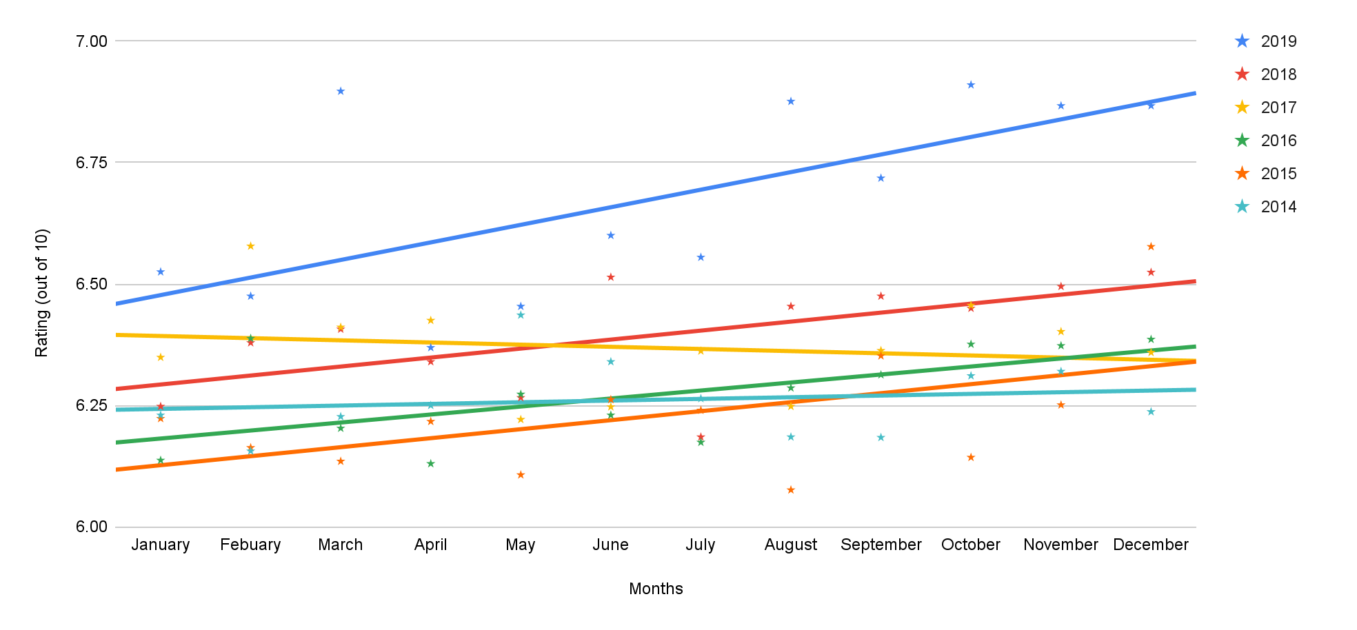


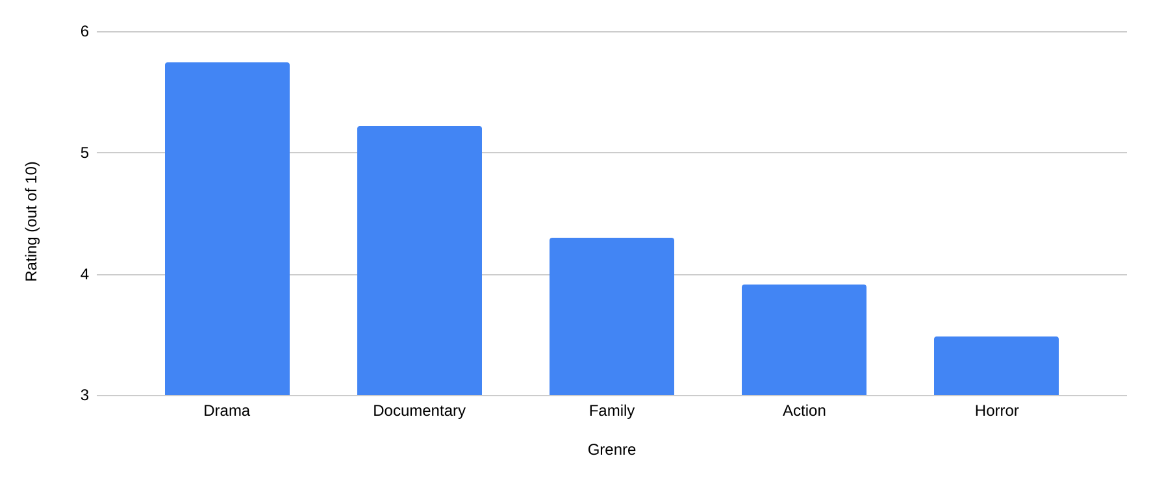
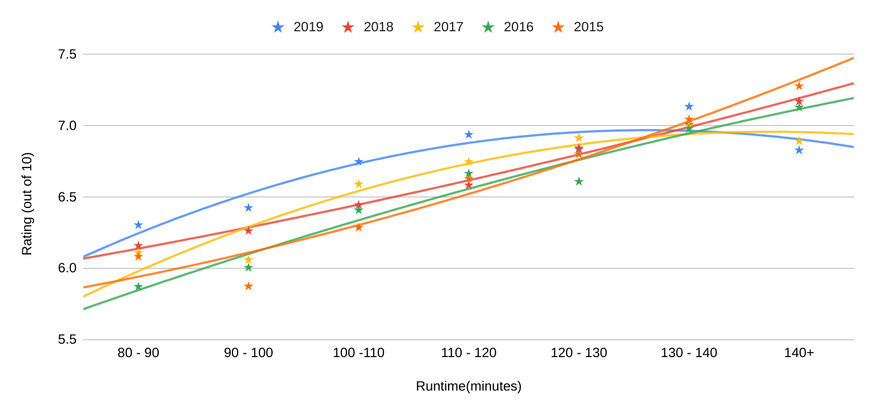

Movie Characteristics and their Impact on Rating
Emerald Bell, Kevin Terwilliger, Adam Vogler
IS, Internet Engineering Cohort, University of New Hampshire, Durham, NH 03824
Introduction
Average Rating by Release Month
Results and Conclusion
We set out to test how different factors affect the average rating of different films. This was done by consolidating the ratings of all movies released in an exact month or year over five years and noticing any trends. Then looking at a certain runtime or genre, getting the average rating, and comparing the data also over five years.
We believed that movies released closer to the end of the year would rate better overall and set out to see if we were correct.
Our hypothesis was formulated due to a couple of reasons, one being that vacations give people have more free time near the end of the year, so they are more likely to go out and watch a movie. The end of the year is also closer to award season, so production companies would release their best movies to have them fresh in the minds of critics and general audiences for award season.
Looking at the top middle graph, you can see there is a positive correlation between the time of year a movie is released and its rating, therefore proving our hypothesis correct.
On the bottom middle graph you can see the affect Runtime has on rating, though not a part of our original hypothesis, it also has a positive correlation. .
Methodology
Resources
Other Factors
Our movie data was gathered from a free and popular database called The Movie Database(TMDB). Then wrote a handful of python scripts created to turn the data we got from the API to a comma-separated value document to use for our graphs.
Next, we used another script to calculate average ratings and compile them into a final CSV document which was then imported into Google sheets and made into a graph. We started by graphing the average rating of all movies released in certain months. Later, we went on to collect and graph average rating vs genre, and average rating vs runtime for the same five years.
When comparing genres, it became apparent that horror and action films consistently rate lower on average year to year, and dramas and documentaries rated much higher.
Another fascinating thing we discovered is that the runtime of a movie seems to have a clear correlation to its rating. As the runtime rose from 80 minutes the rating rose with it. What was interesting is that there were outliers for almost all years where the 70-80 minute range was much higher than expected and bucked the curve (not included in the graph due to ruining best fit lines).
Data
Correlation of Rating and Runtime
sTAMD Simulations
We’re using months as our time splices, as they’re a natural grouping and long enough to be usable. The movies released each month have been grouped, then their ratings were compared to other months.
Though TMDB has a free API, we didn’t want to overwhelm them, so we only got the first ten-twenty pages for each year, about 300 movies.
When the data was first gathered, we didn’t think there was much of an actual correlation, since all of the ratings were within a point of each other, but when graphed under a limited point range the correlation we expected to see was in fact there.
Acknowledgements
Special thanks to:
TMDB
Our instructors, Kyle Ouellette, Daniel Moss, Mason McDonald, & Joseph Heacock.

Slide 2

This poster template provided courtesy of
UNH ESRC Poster Printing Services
Trust us to make your poster look GREAT!
Website: http://posters.unh.edu
Poster Guide: http://goo.gl/1E7TJY
DELETE THIS SLIDE BEFORE PRINTING

