Slide 1
Relationship Between Dietary Fiber and Allergy Prevalence in a College Population
Presented by Brandy Moser BS BA

Slide 2
Presentation Outline
Background
Objective
Methods
Population Characteristics
Results
Key Findings & Conclusion
Future Directions
Acknowledgements

Slide 3

Fiber
Dietary fiber is a non-digestible carbohydrate¹
Fiber has been identified as a potential modifiable risk factor in the pathology of allergic diseases²
Among ages 19-59 in the United States, less than 10% of women and 3% of men meet the dietary fiber intake recommendations³

Slide 4
Allergic Diseases
Rates of allergic diseases have been increasing globally, particularly among children and young adults^{4,5}
Allergic diseases place a high strain on the quality of life of college students, due to missing classes and interference with college activities⁶
National College Health Assessment identified 21% and 8.9% of college students have been diagnosed with allergies and asthma respectively⁷
What is an Allergic Disease?
Allergic diseases encompass multiple inflammatory diseases such as asthma and allergic rhinitis

Slide 5
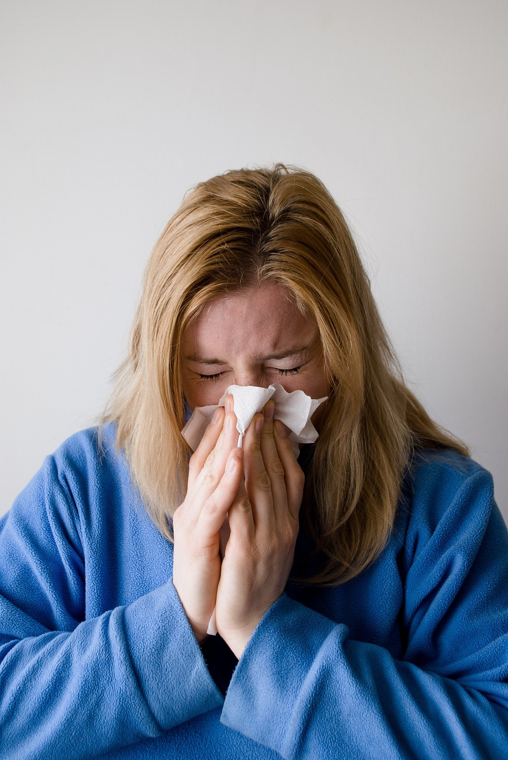
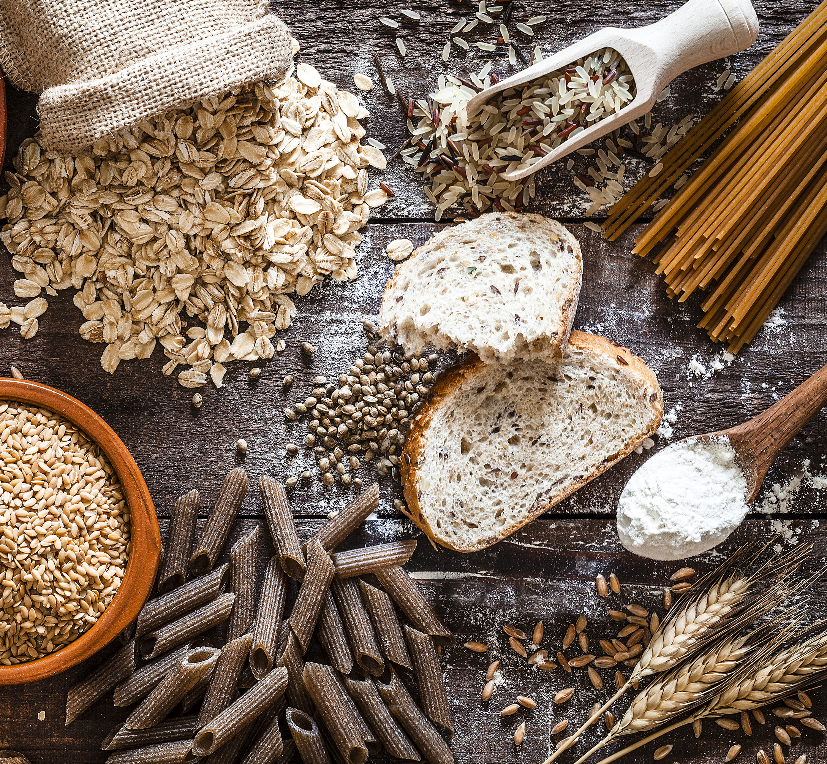

Objective
To characterize the relationship between dietary fiber intake and the prevalence of the allergic diseases, seasonal allergies and asthma, in a college student population.

Slide 6
Methods
CHANAS Data
Fiber Intake
Allergy Status
Data were from the ongoing cross-sectional College Health and Nutrition Assessment Survey (CHANAS) from 2012-2022
Measured via 3-day average using an online self-reported food record (Diet and Wellness Plus)
Identified via online questionnaire self-reported diagnosis ever of asthma or seasonal allergies
Logistic Regression
Chi-Squared Analysis
Fiber Quartiles
Covariates
Odds of seasonal allergy and asthma among lowest quartile fiber intake
Analyze differences in allergy and asthma prevalence across quartiles
Students’ average fiber intake (g/day) were grouped into quartiles
BMI smoking status alcohol use
All Analyses Stratified by Sex
Literature has shown sex specific differences

Slide 7
Fiber Intake Trends

Slide 8
Study Population Demographics
Table 1. Study population demographics and characteristics according to sex
 | Men Mean ± SD or n(%) | Women Mean ± SD or n(%)
Age (y) | 19.2 ± 1.3 | 18.8 ± 10
Sex (n[%]) | 1350 (32.6%) | 2875 (67.4%)
BMI (kg/m²) | 24.3 ± 3.8 | 23.0 ± 3.6
Kcal Intake (kcal/day) | 2490.3 ± 779.5 | 1704.4 ± 483.2
Smoking Status (n[%]) | 114 (8.4%) | 87 (3.1%)
Alcohol Use (n[%]) | 1098 (81.3%) | 2104 (75.5%)
Allergic Diseases
Seasonal Allergies (n[%]) | 504 (37.3%) | 1052 (37.8%)
Asthma (n[%]) | 261 (19.3%) | 531 (19.1%)
Fiber Intake
Total Fiber Intake (g/day) | 22.1 ± 10.8 | 19.9 ± 8.8
Adjusted Fiber Intake (g/1000kcal) | 9.0 ± 3.6 | 11.9 ± 4.8
Met Fiber Recommendation (n[%]) | 165 (12.2%) | 508 (18.2%)
*No statistically significant difference in the proportions of students who met the recommendation according to allergic disease
Notes:
Fiber rec determined by sex and age

Slide 9


Results
Chi-squared analysis found an association with fiber quartile and seasonal allergy but not with asthma, in both men and women
Seasonal Allergy
Fiber Intake
Quartile
Asthma

Slide 10
Logistic Regression Results
Table 3. Logistic Regressions of Allergies and Asthma
 | Seasonal Allergies |  |  |  | Asthma
 | B | Exp(B) OR | 95% CI | P-value | B | Exp(B) OR | 95% CI | P-value
Male
Fiber Quartile 1 | 0.184 | 1.202 | 0.933-1.549 | 0.156 | 0.053 | 1.055 | 0.773-1.440 | 0.737
BMI | 0.004 | 1.004 | 0.976-1.034 | 0.764 | 0.034 | 1.035 | 1.000-1.071 | 0.050*
Smoking Status | 0.138 | 1.148 | 0.776-1.700 | 0.489 | -0.109 | 0.897 | 0.546-1.473 | 0.667
Alcohol Use | 0.298 | 1.348 | 1.006-1.806 | 0.046* | 0.378 | 1.460 | 1.002-2.128 | 0.049*
Female
Fiber Quartile 1 | 0.326 | 1.386 | 1.164-1.651 | <0.001* | 0.121 | 1.141 | 0.920-1.414 | 0.230
BMI | 0.000 | 1.000 | 0.979-1.022 | 0.998 | 0.032 | 1.032 | 1.007-1.059 | 0.013*
Smoking Status | 0.190 | 1.209 | 0.783-1.865 | 0.392 | -0.161 | 0.851 | 0.483-1.501 | 0.578
Alcohol Use | 0.205 | 1.228 | 1.023-1.473 | 0.027* | 0.085 | 1.089 | 0.870-1.363 | 0.455
*Statistical significance at alpha level <0.05

Slide 11
Logistic Regression Results
Table 3. Logistic Regressions of Allergies and Asthma
 | Seasonal Allergies |  |  |  | Asthma
 | B | Exp(B) OR | 95% CI | P-value | B | Exp(B) OR | 95% CI | P-value
Male
Fiber Quartile 1 | 0.184 | 1.202 | 0.933-1.549 | 0.156 | 0.053 | 1.055 | 0.773-1.440 | 0.737
BMI | 0.004 | 1.004 | 0.976-1.034 | 0.764 | 0.034 | 1.035 | 1.000-1.071 | 0.050*
Smoking Status | 0.138 | 1.148 | 0.776-1.700 | 0.489 | -0.109 | 0.897 | 0.546-1.473 | 0.667
Alcohol Use | 0.298 | 1.348 | 1.006-1.806 | 0.046* | 0.378 | 1.460 | 1.002-2.128 | 0.049*
Female
Fiber Quartile 1 | 0.326 | 1.386 | 1.164-1.651 | <0.001* | 0.121 | 1.141 | 0.920-1.414 | 0.230
BMI | 0.000 | 1.000 | 0.979-1.022 | 0.998 | 0.032 | 1.032 | 1.007-1.059 | 0.013*
Smoking Status | 0.190 | 1.209 | 0.783-1.865 | 0.392 | -0.161 | 0.851 | 0.483-1.501 | 0.578
Alcohol Use | 0.205 | 1.228 | 1.023-1.473 | 0.027* | 0.085 | 1.089 | 0.870-1.363 | 0.455
*Statistical significance at alpha level <0.05

Slide 12
Logistic Regression Results
Table 3. Logistic Regressions of Allergies and Asthma
 | Seasonal Allergies |  |  |  | Asthma
 | B | Exp(B) OR | 95% CI | P-value | B | Exp(B) OR | 95% CI | P-value
Male
Fiber Quartile 1 | 0.184 | 1.202 | 0.933-1.549 | 0.156 | 0.053 | 1.055 | 0.773-1.440 | 0.737
BMI | 0.004 | 1.004 | 0.976-1.034 | 0.764 | 0.034 | 1.035 | 1.000-1.071 | 0.050*
Smoking Status | 0.138 | 1.148 | 0.776-1.700 | 0.489 | -0.109 | 0.897 | 0.546-1.473 | 0.667
Alcohol Use | 0.298 | 1.348 | 1.006-1.806 | 0.046* | 0.378 | 1.460 | 1.002-2.128 | 0.049*
Female
Fiber Quartile 1 | 0.326 | 1.386 | 1.164-1.651 | <0.001* | 0.121 | 1.141 | 0.920-1.414 | 0.230
BMI | 0.000 | 1.000 | 0.979-1.022 | 0.998 | 0.032 | 1.032 | 1.007-1.059 | 0.013*
Smoking Status | 0.190 | 1.209 | 0.783-1.865 | 0.392 | -0.161 | 0.851 | 0.483-1.501 | 0.578
Alcohol Use | 0.205 | 1.228 | 1.023-1.473 | 0.027* | 0.085 | 1.089 | 0.870-1.363 | 0.455
*Statistical significance at alpha level <0.05

Slide 13

Key Findings
This population has an above average rate of seasonal allergies and asthma
Fiber intake was found predictive of seasonal allergies in females
No clear associations between fiber and asthma, instead BMI is strongest predictor

Slide 14
Conclusion
Consistent with previously identified associations, our findings suggest fiber intake is related to seasonal allergies but not asthma, with a stronger relationship among females.
Women
Men
Seasonal Allergy
Fiber Intake
Quartile
Asthma

Slide 15

Future Directions
This study further emphasizes the need to investigate potential dietary risk factors for allergic diseases and to inform institutions on key dietary priorities for college student health as fiber intake continues to decrease and rates of seasonal allergies increase.

Slide 16
Acknowledgements
Project funded by the New Hampshire Agriculture Experiment Station and USDA National Institute of Food and Agriculture Hatch Project 1010738 and the department of Agriculture, Nutrition, and Food Systems.

Slide 17
References
1. Makki, K., Deehan, E. C., Walter, J. & Bäckhed, F. The Impact of Dietary Fiber on Gut Microbiota in Host Health and Disease. Cell Host & Microbe 23, 705–715 (2018).
2. Sdona, E., Georgakou, A. V., Ekström, S. & Bergström, A. Dietary Fibre Intake in Relation to Asthma, Rhinitis and Lung Function Impairment—A Systematic Review of Observational Studies. Nutrients 13, 3594 (2021).
3. Dietary Guidelines for Americans, 2020-2025. 164.
4. Jolicoeur, L. M., Pharm, D., Boyer, J. G., Reeder, C. E. & Turner, J. Influence of Asthma or Allergies on the Utilization of Health Care Resources and Quality of Life of College Students. Journal of Asthma 31, 251–267 (2009).
5. Saeed, M. A. et al. Association of Dietary Fiber on Asthma, Respiratory Symptoms, and Inflammation in the Adult National Health and Nutrition Examination Survey Population. Annals ATS 17, 1062–1068 (2020).
6. Pawankar, R. Allergic diseases and asthma: a global public health concern and a call to action. World Allergy Organization Journal 7, 1–3 (2014).
7. Reports_ACHA-NCHAIIc. https://www.acha.org/NCHA/ACHA-NCHA_Data/Publications_and_Reports/NCHA/Data/Reports_ACHA-NCHAIIc.aspx.

Slide 18
Thank you!
Any Questions?
Contact Information:
Brandy Moser
Brandy.Moser@unh.edu
Kendall Hall Rm 411

