Slide 1



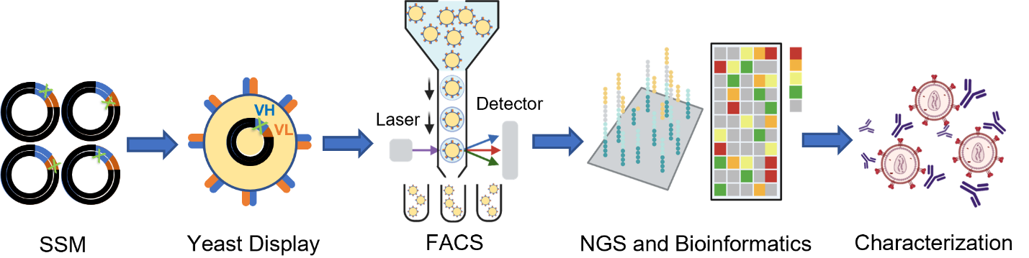
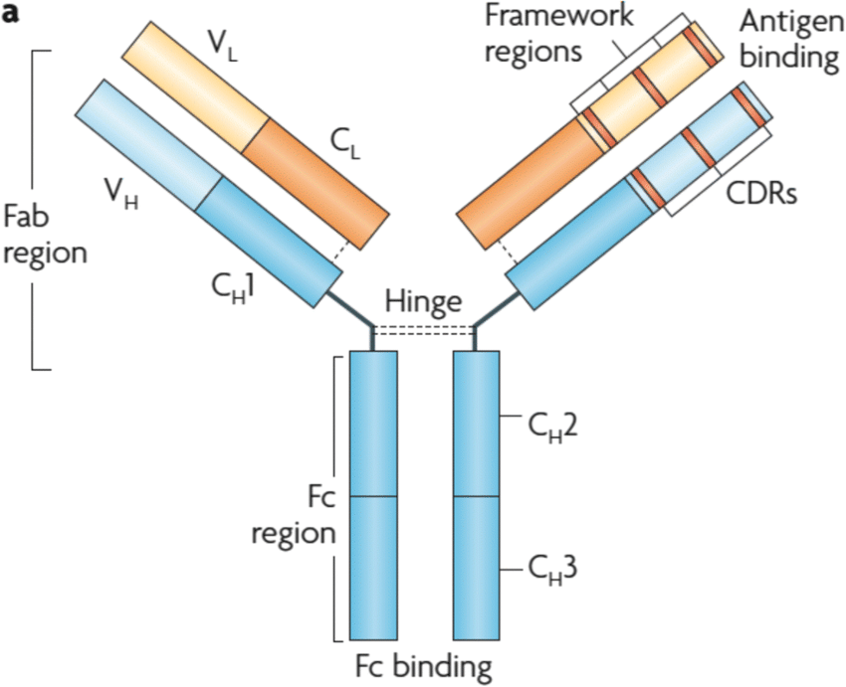
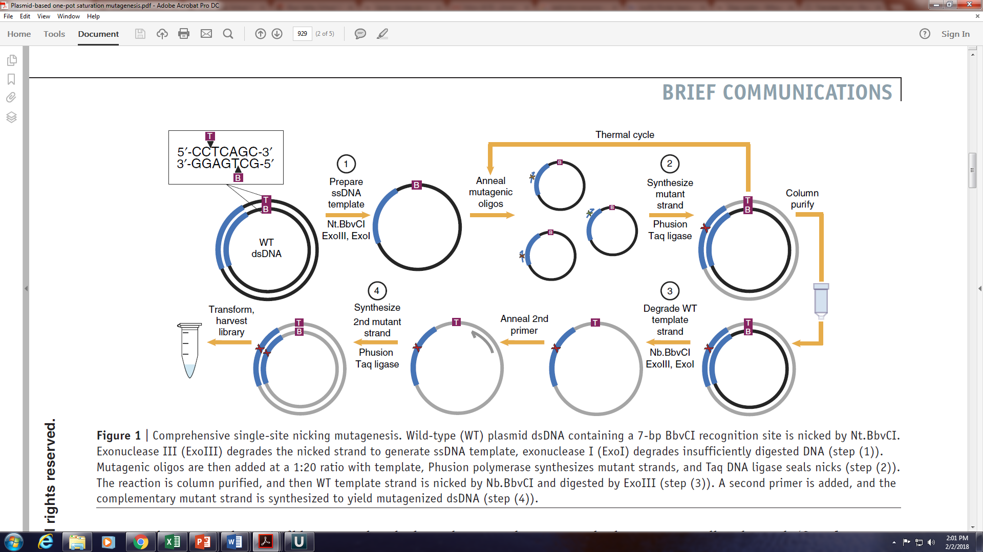
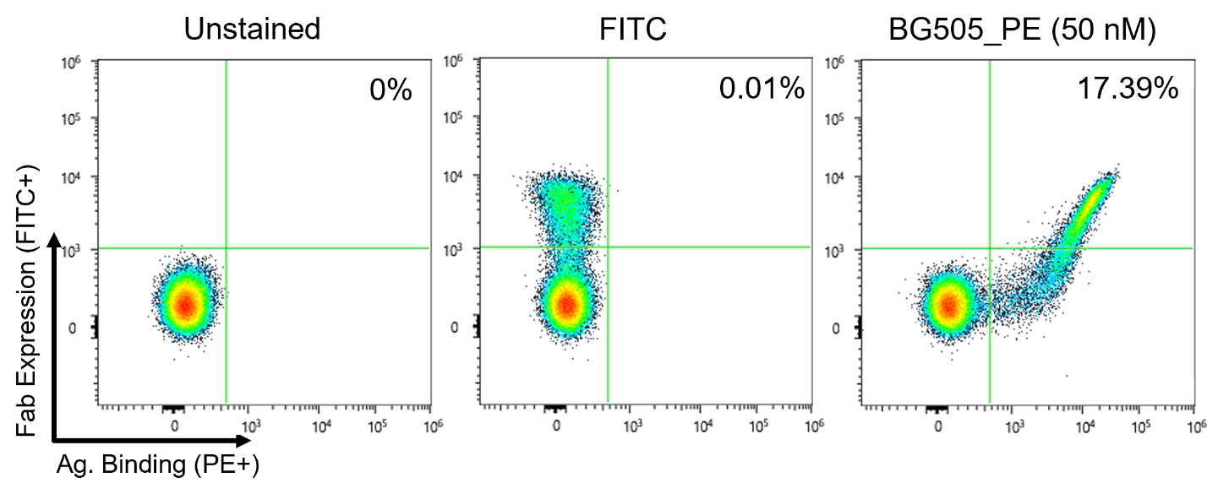
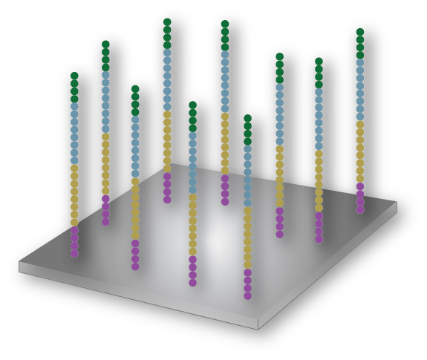
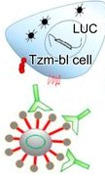
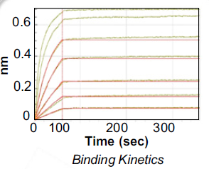





Anti-HIV Antibody Optimization via Site Saturation Mutagenesis
Eli Duggan^{1,2}, Brunojoel Hatungimana³, Matheus Oliveira de Souza^{2,3}, Bharat Madan^{2,3}, Dr. Paolo Lusso,⁴ Dr. Qingbo Liu,⁴ Prof. Brandon DeKosky^{2,3,5}
University of New Hampshire, Department of Chemical Engineering, Durham, NH,¹ Ragon Institute of MGH, MIT and Harvard, Cambridge, MA,² University of Kansas, Department of Pharmaceutical Chemistry, Lawrence, KS,³ National Institute of Allergy and Infectious Diseases, Bethesda, MD,⁴ Massachusetts Institute of Technology, Department of Chemical Engineering, Cambridge, MA ⁵
Introduction
Methodology
An estimated 38 million people carry HIV globally and 1.5 million new patients are infected annually. If untreated, HIV develops into acquired immunodeficiency syndrome (AIDS), which killed 680,000 globally in 2020.¹ Novel HIV treatments are urgently needed to reduce the toll of AIDS and prevent new infections.
Site saturation mutagenesis (SSM) and preliminary fluorescence-activated cell sorting (FACS) preparation are complete
Agilent QuikChange Primer Design™ was used to create mutagenic oligonucleotide primers for single-codon substitutions, insertions, and deletion throughout VH and VL region
SSM was performed with the oligonucleotides to generate VH/VL substitution and indel E. coli plasmid libraries
Mutant plasmid lbraries will be transformed into yeast display vectors that are sorted via two rounds of FACS and mutants with high affinity for antigens will be isolated
High-affinity clones will be sequenced and the resultant mAbs will be synthesized with mammalian cell culture and characterized
Monoclonal antibodies (mAbs) are a potential solution. mAbs have variable heavy (VH) and light (VL) regions that bind to a specific epitope on a pathogen. As shown by their use during the COVID-19 pandemic, mAbs are effective at neutralizing viral pathogens. However, HIV is highly mutative and there are thousands of circulating strains. Broadly neutralizing mAbs (bNAbs) address this issue by targeting highly conserved epitopes, allowing them to neutralize many viral strains.
Figure 2. Experiment workflow. Created using BioRender.com.
c-myc
HA
VH
Figure 1. mAb architecture.
T Hansel, et al., “The safety and side effects of monoclonal antibodies,” Nature Reviews Drug Discovery, March 22, 2010
Aga 2
VL
Aga 1
In this project, site saturation mutagenesis was performed to improve neutralization potency and breadth of the bNAb VRC07-523LS-FR303 (median IC50 of 0.063 µg/ml)² against a standard panel of 208 HIV viral strains. It is hoped that this research will culminate in a novel bNAb that can be used clinically to prevent HIV infection or progression and serve as a template for future vaccine development efforts.
Transformed Yeast
Figure 4. Yeast surface display mechanism using A-agglutinin receptor complex
Figure 3. Site saturation mutagenesis workflow for VH and VL library generation.
EE Wrenbeck, et al., “Plasmid-based one-pot saturation mutagenesis,” Nature Methods, October 10, 2016
Advantages
Primer Design and SSM Results
FACS and Model Antigen Selection
Conclusions and Next Steps
Table 1. Oligonucleotide primer library sizes
Annealing temperature of 50 is optimal for indel preparation
Plasmid libraries are ready for yeast transformation
0.6
Library | Codon | Codon Length | Theoretical Library Size
HS | NNK | 132 | 2640
LS | MNN | 101 | 2020
HD | N/A | 132 | 132
LD | N/A | 101 | 101
HI | NNK | 132 | 708
LI | MNN | 101 | 92
0.4
~100 fold coverage was adequate to assume full representation of theoretical mutant library
During indel mutagenesis, very low efficiency (0 to 5%) and low transformant counts led to inadequate fold coverage
PCR annealing temperature was varied from 55C during SSM
nm
0.2
0
0
100
200
300
Pseudovirus Neutralization
Time (sec)
Binding Kinetics
Figure 6. Antibody Functional Interpretation from NGS Data.
AS Fahad, et al., “Functional Profiling of Antibody Immune Repertoires in Convalescent Zika Virus Disease Patients,” Frontiers in Immunology, February 24, 2021
Figure 7. Monoclonal antibody characterization.
B Madan, et al., “Mutational fitness landscapes reveal genetic and structural improvement pathways for a vaccine-elicited HIV-1 broadly neutralizing antibody,” Proceedings of the National Academy of Sciences, March 1, 2021
Table 2. Fold coverage calculations for SSM plasmid library generation.
Library | Size | Transformants | Efficiency | Coverage
HS | 2640 | 1.32E+06 | 37% | 188
LS | 2020 | 6.10E+05 | 50% | 151
HD | 132 | 6.46E+05 | 20% | 979
LD | 101 | 1.114E+07 | 10% | 11,030
HI | 2680 | 5.13E+05 | 37% | 708
LI | 2060 | 5.13E+06 | 37% | 92
Figure 5. FACS data from VRC07-523LS-FR303 using BG505_PE model antigen.
Acknowledgements
Table 4. Selection of VRC07-523LS-FR303-resistant strains for use as trimer probes
Round 1 FACS
Clones screened against BG505 at 50 nM
Round 2 FACS
High-affinity Round 1 clones flowed against the five trimer probes
Dual color sorts employed for high-affinity Round 2 clones to determine if strong BG505 and trimer probe binding
Funding Provided by the National Science Foundation Research Experiences for Undergraduates (REU) Site: IDEA Incubator for Porous Materials, Award # 1852308.
This research was supported by the University of Kansas Departments of Chemical Engineering and Pharmaceutical Chemistry and the Vaccine Research Center/NIAID.
Thank you to the members of the DeKosky Lab, particularly Brunojoel Hatungimana, Matheus Oliveira de Souza, and Dr. Bharat Madan, for their guidance and support.
Table 3. Fold coverage results of PCR temperature variation for LD Library
Resistant Strain | Clade | IG50 (µg/mL)
6540.v4.c1 | AC | >50
6545.v4.c1 | AC | >50
620345.c1 | AE | >50
T278-50 | AG | >50
BL01.DG | B | >50
DU172.17 | C | 0.165
Temp (C) | Size | Transformants | Efficiency | Coverage
50 | 101 | 1.114E+07 | 10% | 11,030
48 | 101 | 3.36E+07 | 0% | 0
References
Hypothesized that 50C was an optimal temperature because it improved stability of indel binding without causing too many instances of nonspecific replication
Elangovan, R. et al., “Global and Regional Estimates for Subtype-Specific Therapeutic and Prophylactic HIV-1 Vaccines: A Modeling Study,” Front. Microbiol, July 15, 2021
Q Liu, “Improvement of antibody functionality by structure-guided paratope engraftment,” Nature Communications, February 13, 2019
LR Tsuruta, et al., “Display Technologies for the Selection of Monoclonal Antibodies for Clinical Use,” Antibody Engineering, December 20, 2017
GM Cherf, JR Cochran, “Applications of Yeast Surface Display for Protein Engineering,” Methods in Molecular Biology, January 1, 2016
Notes:
FITC tag attaches to proteins

