Slide 1
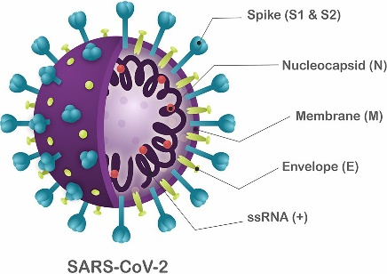
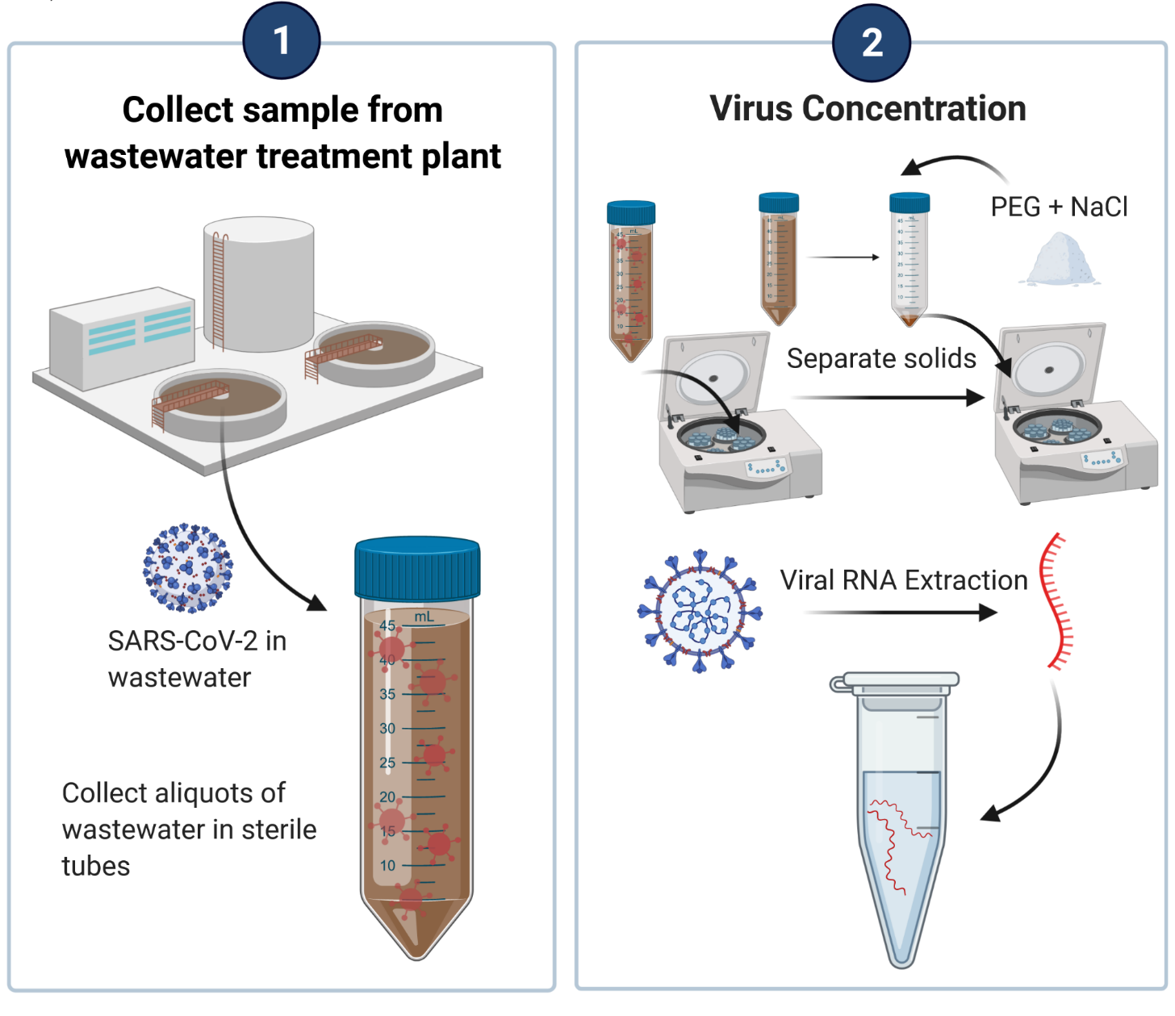
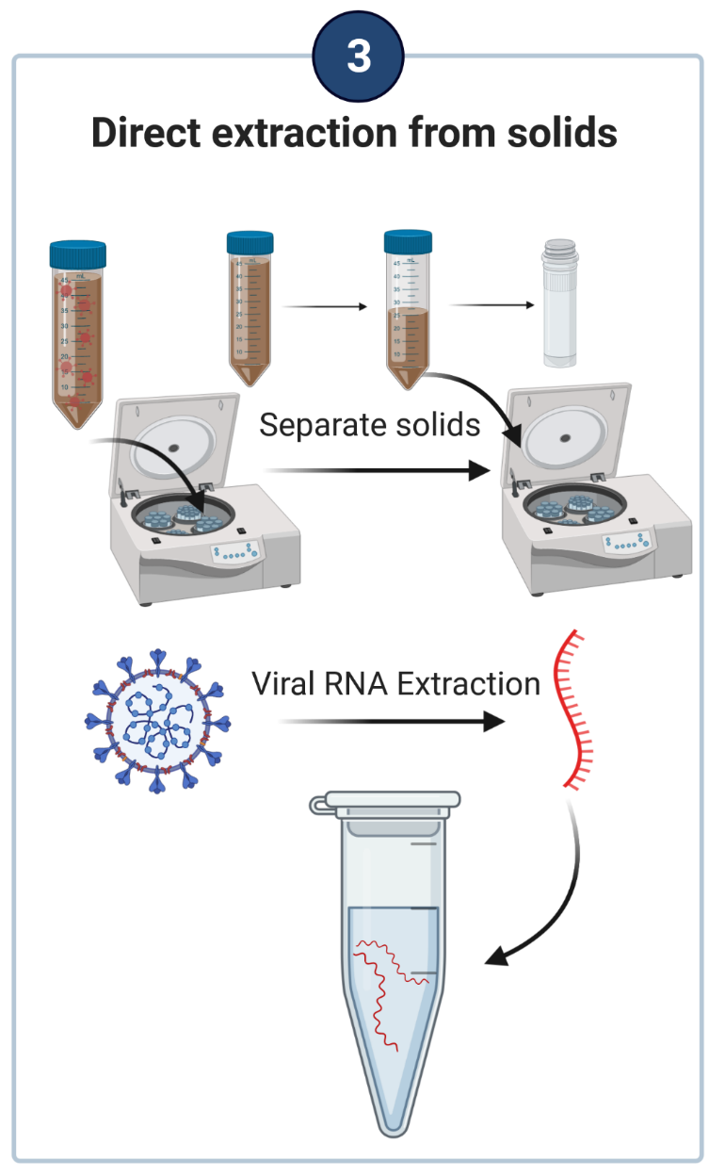
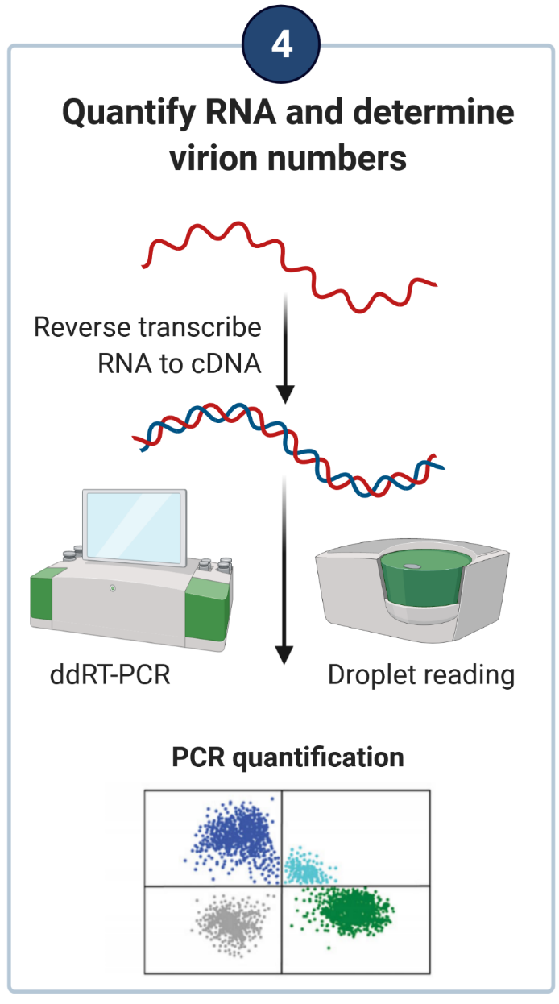
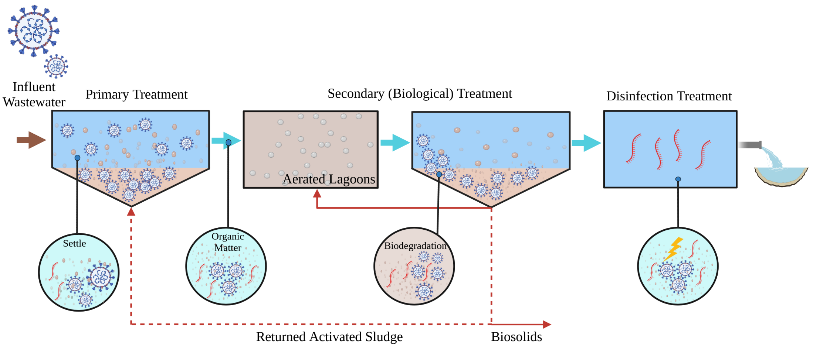
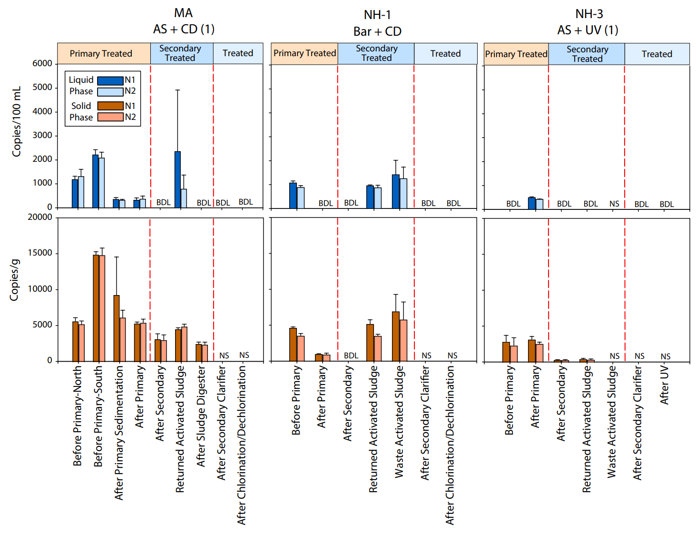
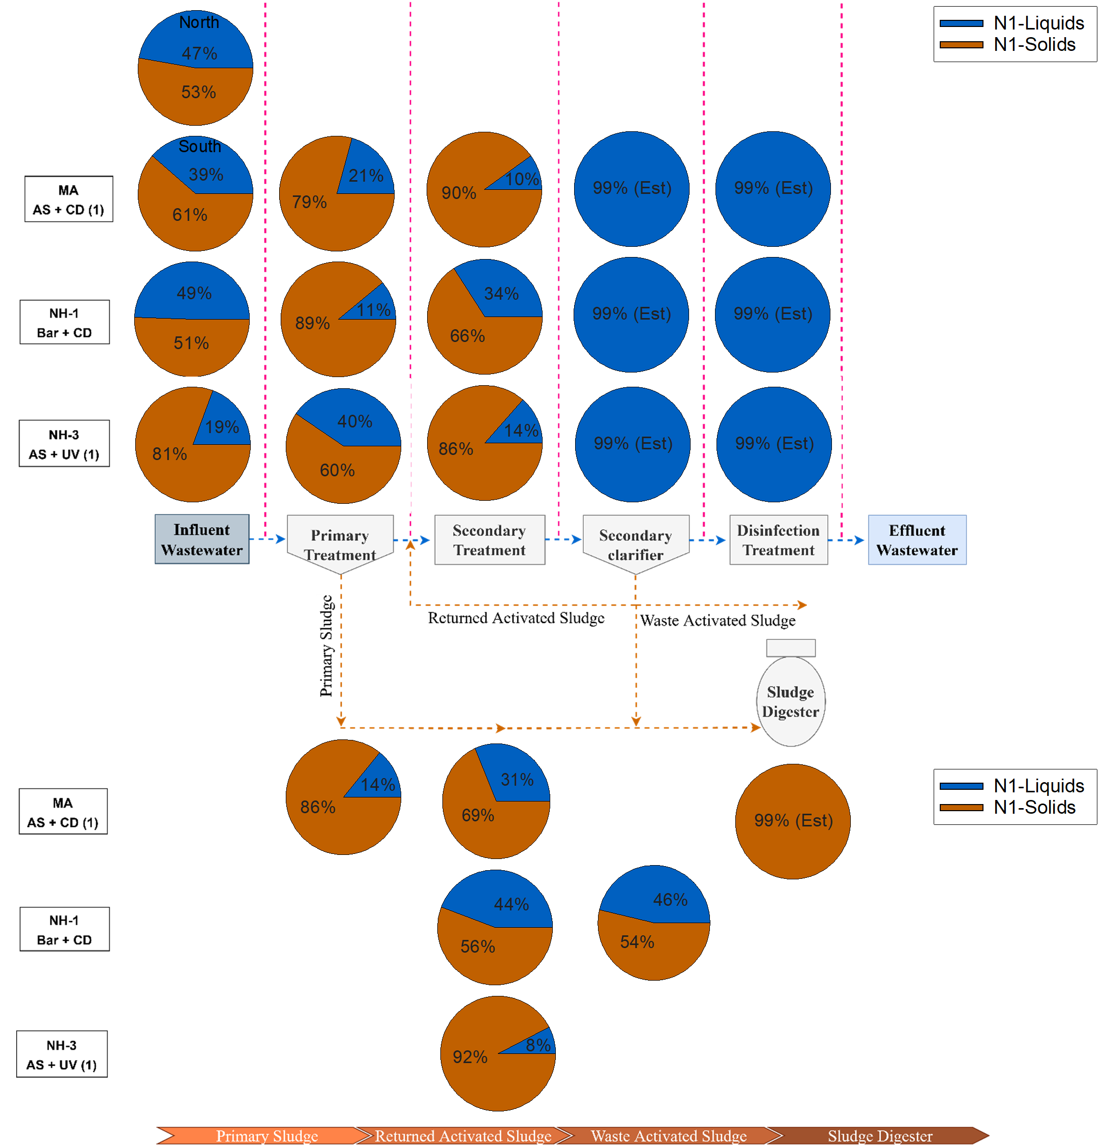
The Fate of SARS-CoV-2 Viral RNA in Coastal New England Wastewater Treatment Plants
Mina Aghababaei†, Fabrizio Colosimo*, James P. Malley†, and Paula J. Mouser† † Department of Civil and Environmental Engineering, University of New Hampshire, Durham, New Hampshire
* New England Biolabs, Ipswich, Massachusetts
Abstract
Background
Methods
Municipal sewage carries SARS-CoV-2 viruses shed in the human stool by infected individuals to wastewater treatment plants (WWTPs). It is well established that increasing prevalence of COVID-19 in a community increases the viral load in its WWTPs. Despite the fact that wastewater treatment plants serve a critical role in protecting downstream human and environmental health through removal or inactivation of the virus, little is known about the fate of the virus along the treatment train. To assess the efficacy of differing WWTP size and treatment processes (Figure 1) in viral RNA removal we quantified two SARS-CoV-2 nucleocapsid (N) biomarkers (N1 and N2) in both liquid and solids phases for multiple treatment train locations from seven coastal New England WWTPs. SARS-CoV-2 biomarkers were commonly detected in the influent, primary treated, and sludge samples (returned activated sludge, waste activated sludge, and digested sludge), and rarely detected after secondary treatment or disinfection. Solid phase biomarker concentrations were generally 400 to 4000 fold higher than those quantified from the liquid phase. Sludges had overall the highest concentrations, suggesting viral biomarkers accumulate or adsorb to solids during treatment. Secondary treatment and clarification removed the largest portion of viral RNA. Our results indicate that a variety of treatment train designs are efficient at achieving high removal of SARS CoV-2 RNA; therefore, viral RNA fragments cannot be detected in the secondary and treated effluent. This study demonstrates the important role municipal wastewater treatment facilities serve in reducing the discharge of SARS-CoV-2 viral fragments to the environment and highlights the need to better understand the fate of this virus in wastewater solids.
Figure. 2. Methods used in quantifying SARS-CoV-2 RNA in wastewater samples (liquid and solid phase).
Taken from Andrade Santos et al., (2020)
The nucleocapsid (N) protein is responsible for defense and replication
We use primers recommended by the CDC that target N1 and N2 regions of the nucleocapsid (N) gene in our assay
Motivation
Project Goal:
Characterize the fate of SARS-CoV-2 genetic material along the treatment train in conventional wastewater treatment systems.
Research Questions:
Is there a reduction in SARS-CoV-2 biomarkers in each wastewater treatment stage?
2. How does SARS-CoV-2 partition between the liquid and solids fraction in wastewater?
Field Sample Approach
Locations: 7 coastal New England WWTP locations in NH, MA and ME
Populations Served: <2000 to >3 Mil persons
Sample Dates: Oct 2020 to Feb 2021
Sampling:
Grab samples, from influent to effluent
Collected before noon
Biomarker Quantification Approach
Liquids and Solids Fractionated
In Liquids:
Solids removal, centrifuge
PEG/NaCl precipitation
QiaCube RNA extraction
ddPCR (N1, N2 and RP)
In Solids:
QiaCube RNA extraction directly from solid
ddPCR (N1, N2 and RP)
We use molecular methods to quantify RNA biomarkers that come from SARS-CoV-2 virus
RT-qPCR
RT-ddPCR
ddPCR advantages:
Absolute quantification
Higher precision
Higher reproducibility
Higher sensitivity
VS
One fluorescence measurement
Thousands of fluorescence measurement
Figure. 1. Conceptual schematic showing how SARS-CoV-2 viral particles move through wastewater treatment plants.
Results
Implications
Table 1. The sorption coefficient, Log KD, for SARS-CoV-2 virus based on the N1 and N2 biomarker counts.
Viral biomarkers decreased in the liquid phase from the influent to after the secondary clarifier.
Viral biomarkers decreased in the solids fraction from the influent to after the secondary clarifier, but were concentrated in the return and waste activated sludge at levels similar to influent
Viral particles partition to sludge 400 to 4,000x higher concentrations than liquids
Acknowledgements
We thank the New Hampshire Sea Grant (NHSG) and UNH STAF programs.
We greatly appreciate sampling assistance from Kellen Sawyer and wastewater treatment personnel.
Figure 3. SARS-CoV-2 RNA concentrations detected by RT-ddPCR N1 and N2 assays in both liquid and solid phase of untreated and treated wastewater from three different WWTPs.
Figure 4. Variation in SARS-CoV-2 biomarkers in the liquid versus solid phase collected from three different wastewater treatment plants.

