Slide 1

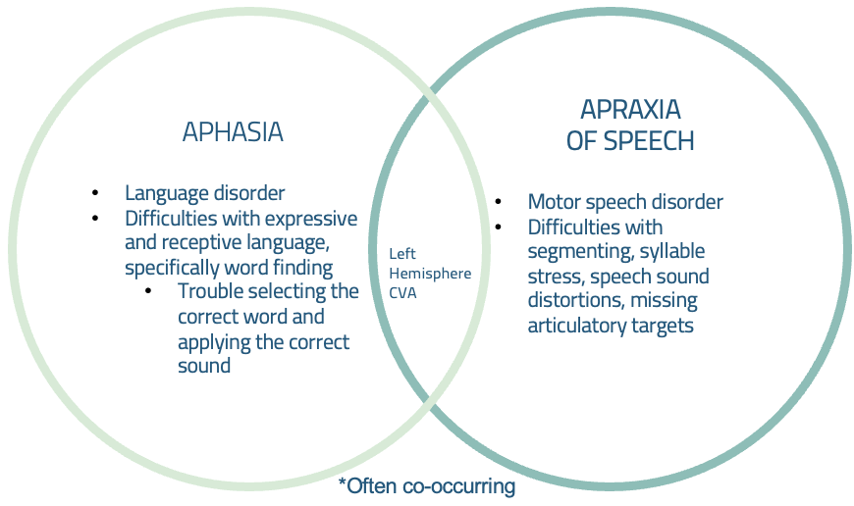
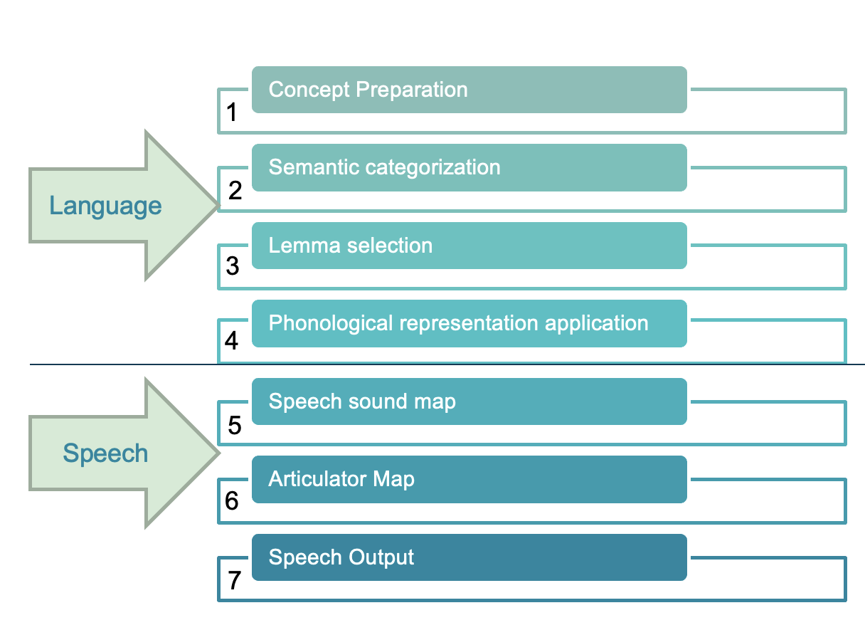
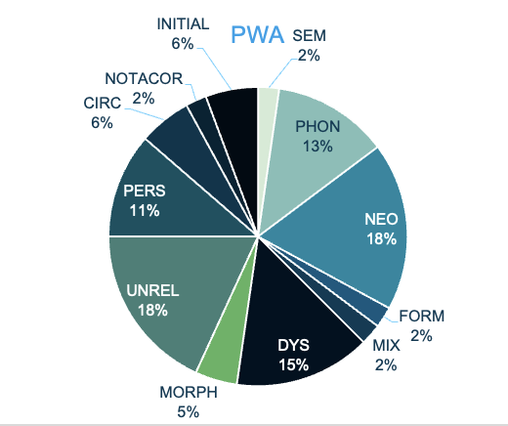
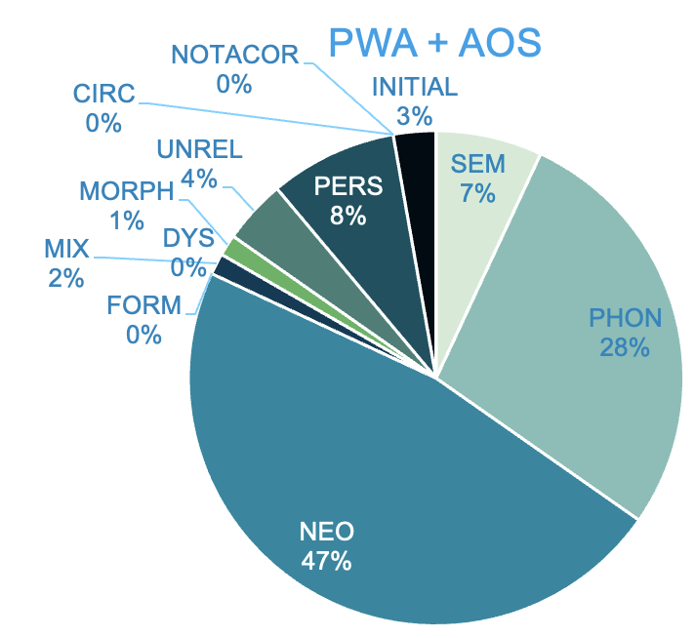
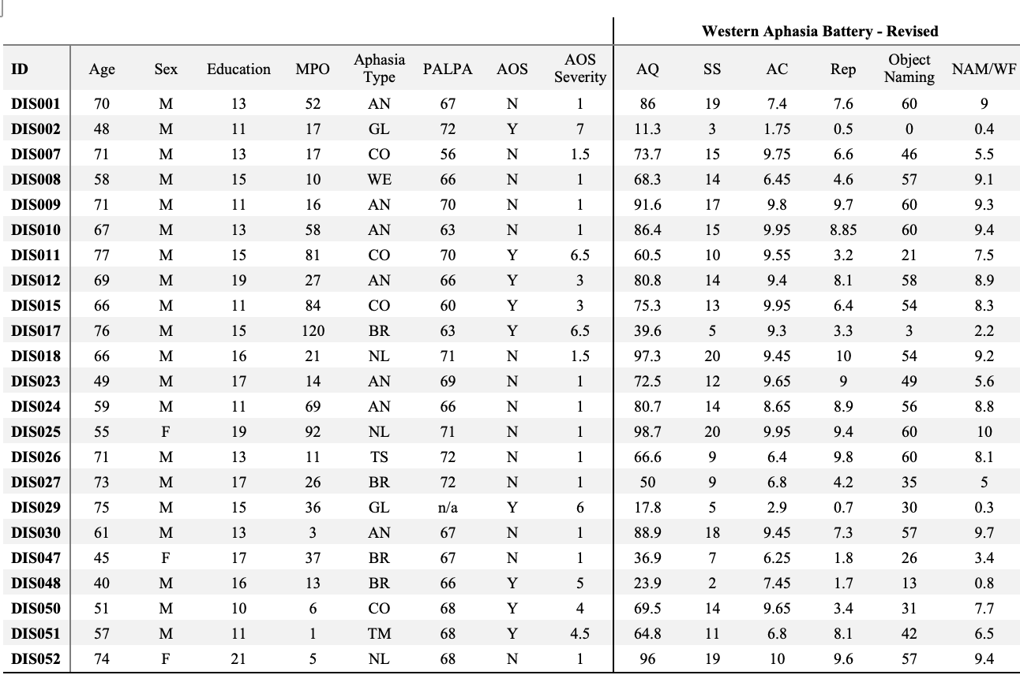
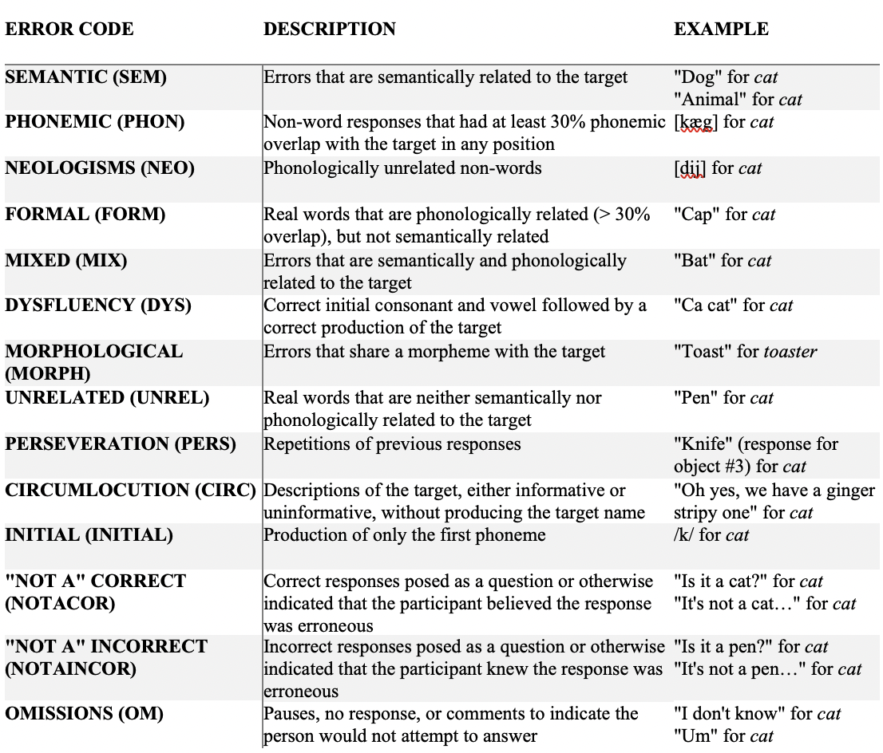
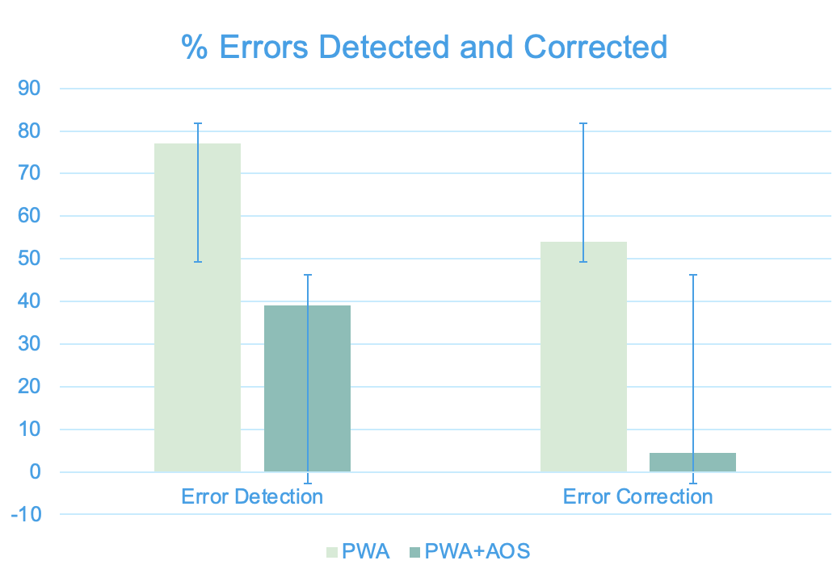
Error Detection and Correction in Object Naming in Individuals with Aphasia
Anne O’Donnell
Master’s Thesis Advisor: Dr. Amy E. Ramage, PhD, Committee: Dr. Don Robin, PhD, Dr. Kathryn Greenslade, PhD
Communication Sciences and Disorders, University of New Hampshire, Durham, NH 03824
Introduction
Figures
Aims and Hypotheses
Aphasia is associated with difficulties in word retrieval (i.e., selecting the correct lexical entry (lemma) or may have trouble accessing its phonological representation, both are necessary to name an item).
The type of errors, timing of detection and repair attempts, and the nature of these errors to support the models of linear processing have been investigated in neurotypical individuals and in people with aphasia (PWA).
Little research has been done to determine what happens after error detection, that is, how error detection leads to correction and where the breakdown occurs that makes an individual unable to correct errors.
Additionally, while it is widely known that PWA make a variety of errors in both language and speech, minimal research has been done to classify the types of errors and discover which errors are most likely to be detected and corrected (e.g., semantic versus phonemic errors).
Aphasia versus Apraxia of Speech
Proposed Model of Verbal Output
To characterize error types relative to the level of word retrieval processing per the models described above in PWA with or without comorbid AOS.
  Participants with aphasia will have errors arising from lexical/sub-lexical levels of processing while those with comorbid AOS will have errors arising from later stages of processing.
To characterize the relationship between error type and the presence of error detection and/or correction.
  Participants will have more difficulty detecting semantic-type error versus phonemic-type errors.
Methodology
Error Type Differences Between PWA and PWA+AOS
Results
Two raters independently listened to 23 audio recordings of PWA, nine with comorbid AOS, and coded the first, best, and last naming attempts for each participant.
For each naming attempt, the response was transcribed verbatim and, if there was an error, transcribed phonetically and coded for error type, evidence of error detection, and presence of correction. If a cue was provided by the clinician, the type of cue and if it was presented for the first, best, or last response was also coded.
The coding rule book as agreed upon and used by the raters included operational definitions of error types that were modified from Tochadse et al. (2018).
All responses were assessed for the presence of error detection and correction.
Minimum agreement of Cohen’s Kappa > .80 was met for all error detection/correction and error types except for error detection for participant DIS002 (Cohen’s Kappa = 0.68) and phonemic paraphasias for participant DIS050 (Cohen’s Kappa = 0.66). The raters met to achieve consensus for these two counts.
Across the 23 participants, 14 were PWA and nine had a comorbid diagnosis of AOS (PWA+AOS).
PWA and PWA+AOS did not differ for age, t(21) = .279, p = .783; years of education t( 21) = .980, p = .338; or month post onset of stroke (U = 70.500, z = .473, p = .643).
PWA had significantly better spontaneous speech (U = 20.000, z = -2.719, p = .005), repetition (U = 18.000, z = -2.835, p = .003), naming/word finding (U = 23.000, z = -2.520, p = .011) , and fluency, t(21) = -4.552, p = < .001 scores compared to participants with co-occurring AOS, but there were no significant group differences for auditory comprehension (U = 49.000, z = -.883, p = .403).
PWA and PWA+AOS did not differ for total number of errors (U = 73000, z = 1.167, p = .267).
Error detection did not significantly differ between PWA and PWA+AOS (U = 47.500, z = -.588, p = .570).
Error correction was significantly better for PWA than PWA+AOS (U = 19.000, z = -2.585, p = .010).
Only PWA made circumlocution, dysfluency, “not a” correct, and formal errors which are all early-stage errors.
PWA+AOS made more neologisms and phonemic paraphasias which suggests these errors occurred at a later stage of verbal output.
Demographics
Error Type and Error Detection and Correction
Conclusions
Error Types
Error Detection and Correction by Group
People with motor programming difficulties (i.e., AOS), produce later-occurring errors such as phonemic paraphasias compared to PWA.
Because phonemic paraphasias share phonemes with the target word, this suggests that the errors either occurred at the lexical or sub-lexical levels in the event of a purely language error occurrence, or the motor programming level in the event of an error made by a participant with AOS.
Descriptive statistics suggest that non-phonemic-type errors (e.g., errors with a stronger semantic influence) are more likely to be detected than phonemic-influenced errors.
Phonemic-type errors are more likely to be corrected which is possibly due to existing phonemic overlap.
Given the findings of this study, the majority of PWA do not have trouble selecting the lemma, rather they were unable to apply the correct phonemes.
Aphasia treatment typically involves semantically-based approaches which target higher levels of processing than the phonemic levels and would not help this sample. Future research directions include implementation of phonemically-based treatment methods to best fit the level of processing.
Participants with AOS had more difficulty correcting errors. Thus, treating the underlying motor impairment may improve overall naming scores, possibly without explicit language treatment.
Demographic information and scores for each subject shows 14 PWA and nine with comorbid AOS. Additionally, scores for all major areas of the WAB-R are included. Of note, the naming and word finding score includes the object naming subtest as well as additional subtests and reflects more than just confrontation naming.
The coding rule book was established to train raters and serve as a guideline for how to code error types and presence of detection and correction. Operational definitions are modified from Tochadse et al. (2018).
There was no significant difference for error detection between PWA and PWA+AOS. PWA had a significantly higher percentage of error correction than PWA+AOS. PWA+AOS had higher variability across participants for both error detection and correction than PWA.

