Slide 1
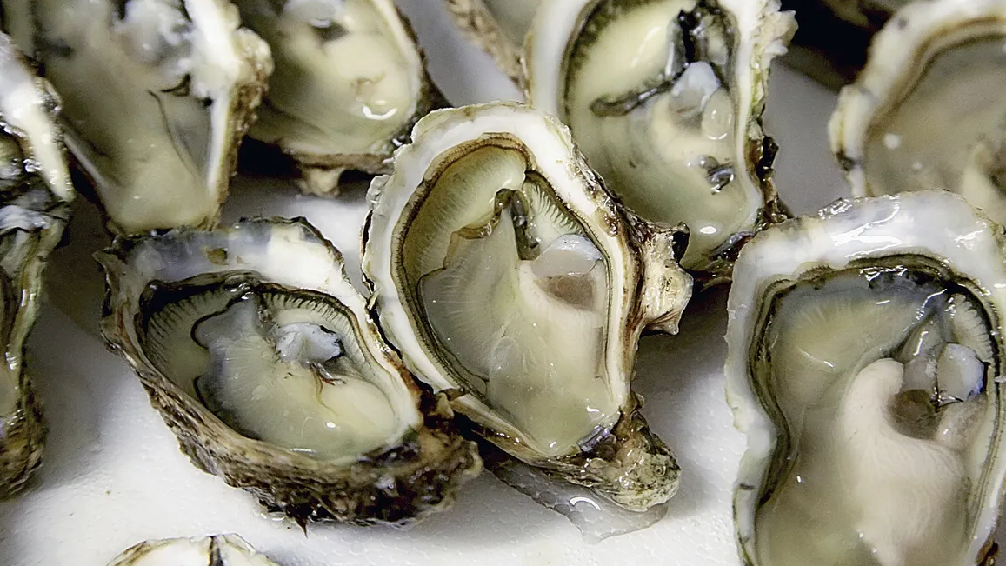
Temporal dynamics of eastern oyster larvae in Great Bay Estuary, NH
Alyssa Stasse
Matthew L.H. Cheng, Kelsey Meyer, Nicole Bumbera, Kaitlin Van Volkom,
Alix Laferriere, Jennifer A. Dijkstra, Bonnie L. Brown
Department of Biological Sciences
University of New Hampshire

Slide 2

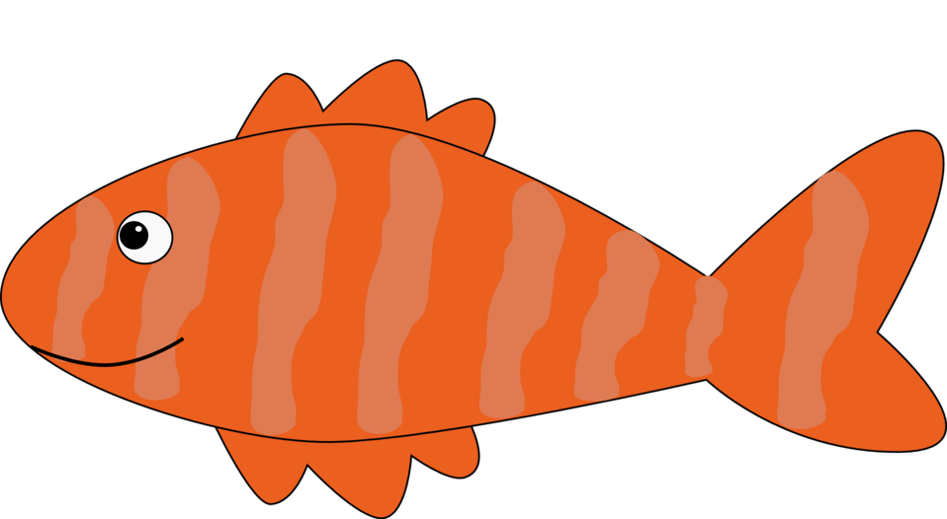

Eastern oyster ecosystem services
Background
Methods
Results
Discussion
Bivalve water filters
Habitat for juvenile fish
Shore protection

Slide 3
Research objectives
Background
Methods
Results
Discussion
Reveal the dynamics of abundance of C. virginica larvae in GBE by examining changes in larval abundance.
Ascertain whether there are differences in settlement across representative sites where oysters previously were abundant.

Slide 4
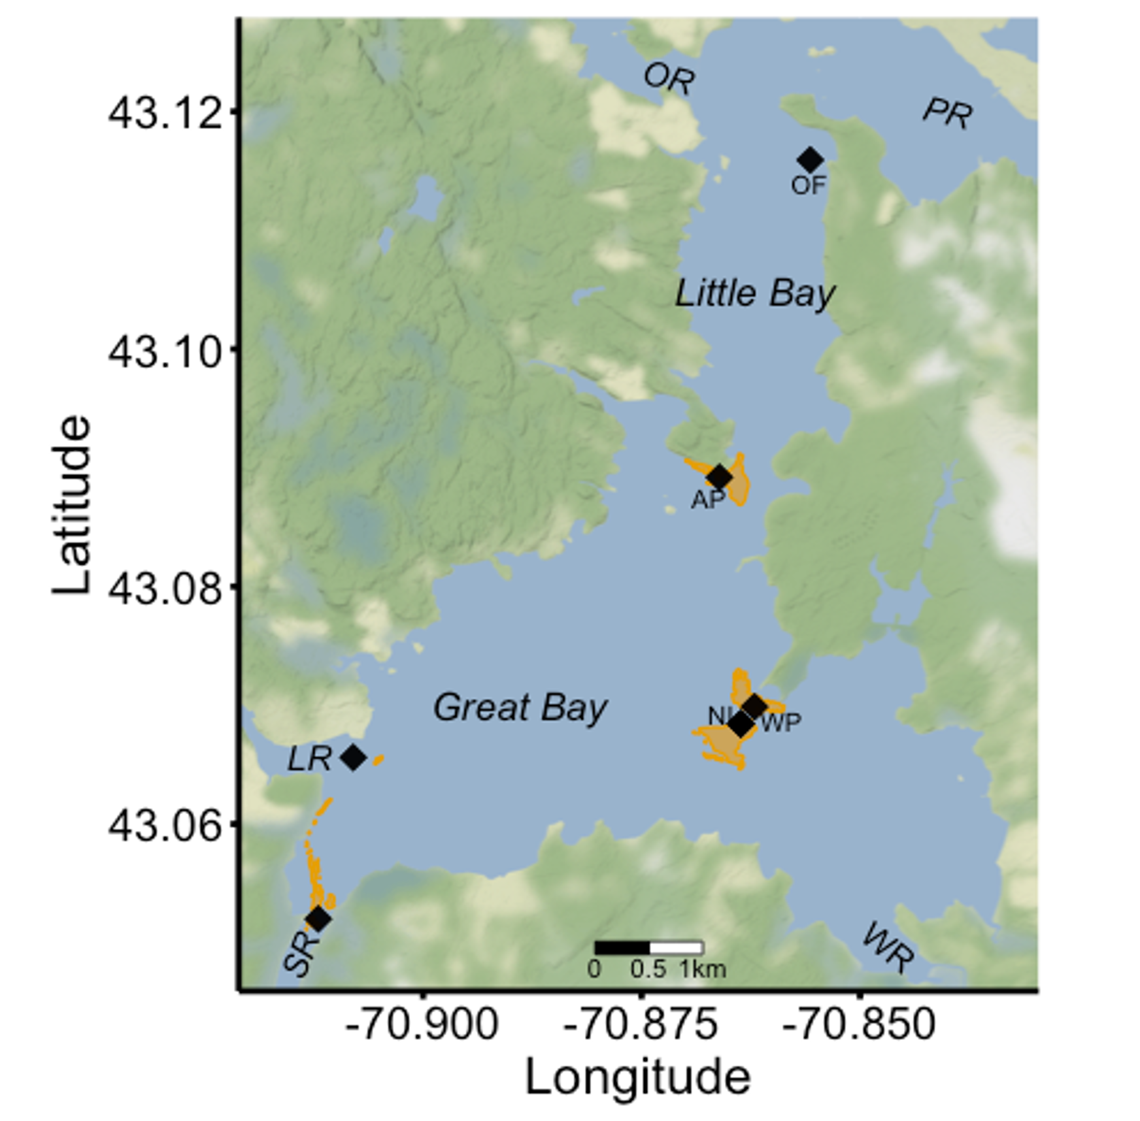
Study sites in GBE
Background
Methods
Results
Discussion
OF: Oyster farm in Little Bay
AP: Adams Point
WP: Woodman Point
NI: Nannie Island

Slide 5
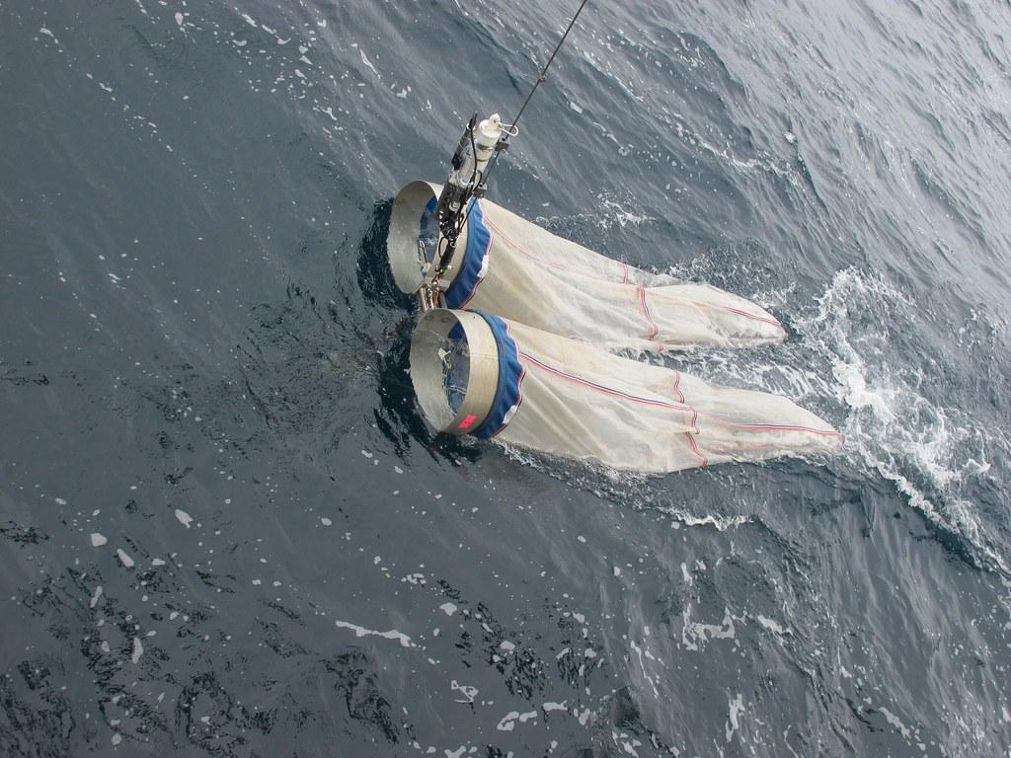
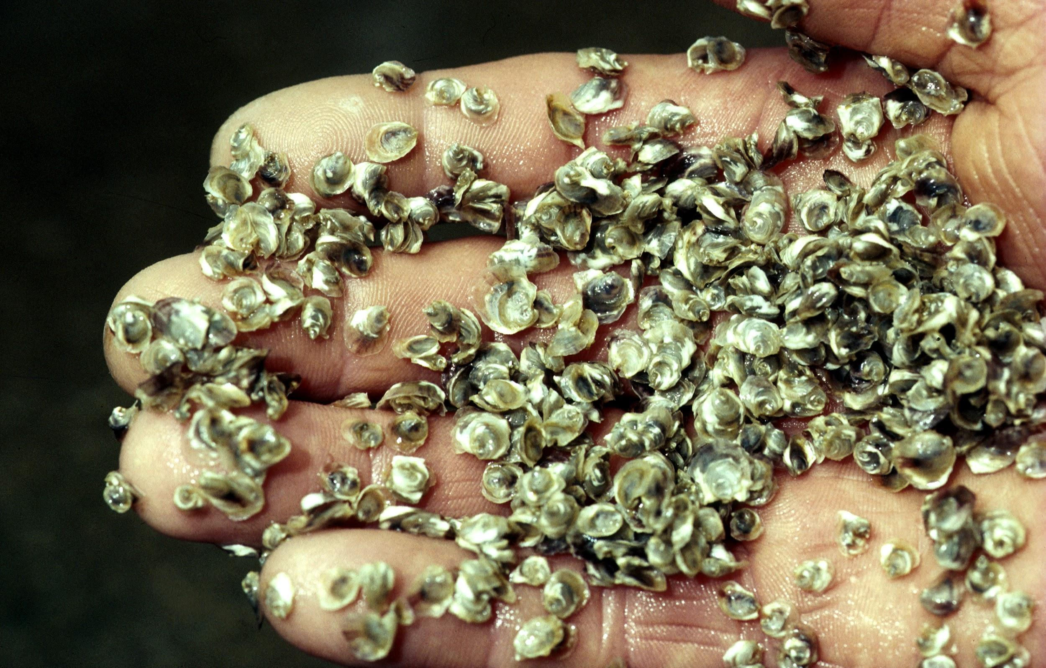
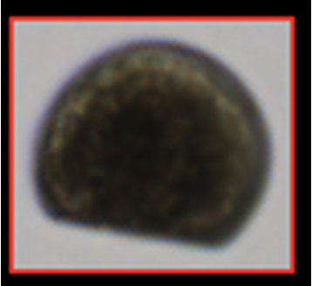
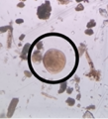
Field sampling
Background
Methods
Results
Discussion
Larval tows
Spat collection
Enumeration of larvae

Slide 6
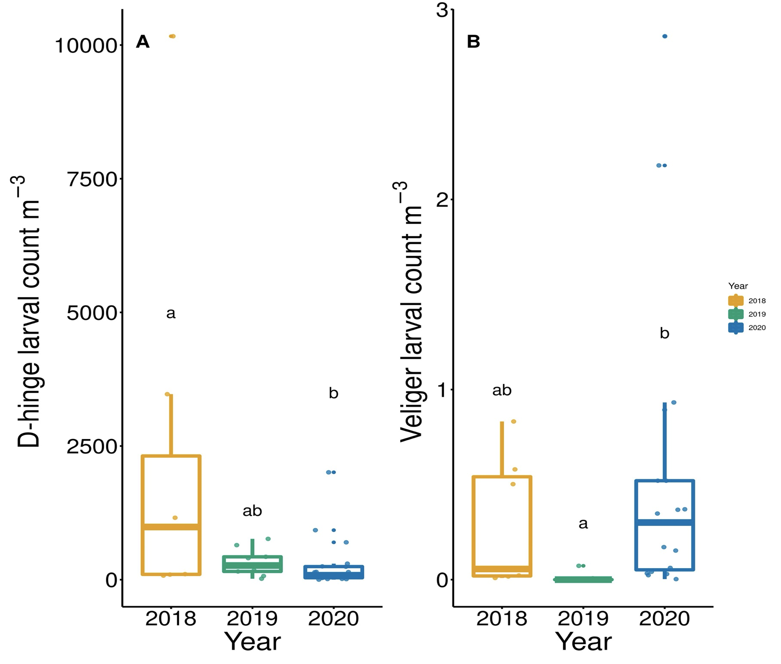

Background
Methods
Results
Discussion
D-hinge larvae differed significantly between 2018 and 2020.
Veliger larvae differed significantly between 2019 and 2020.

Slide 7
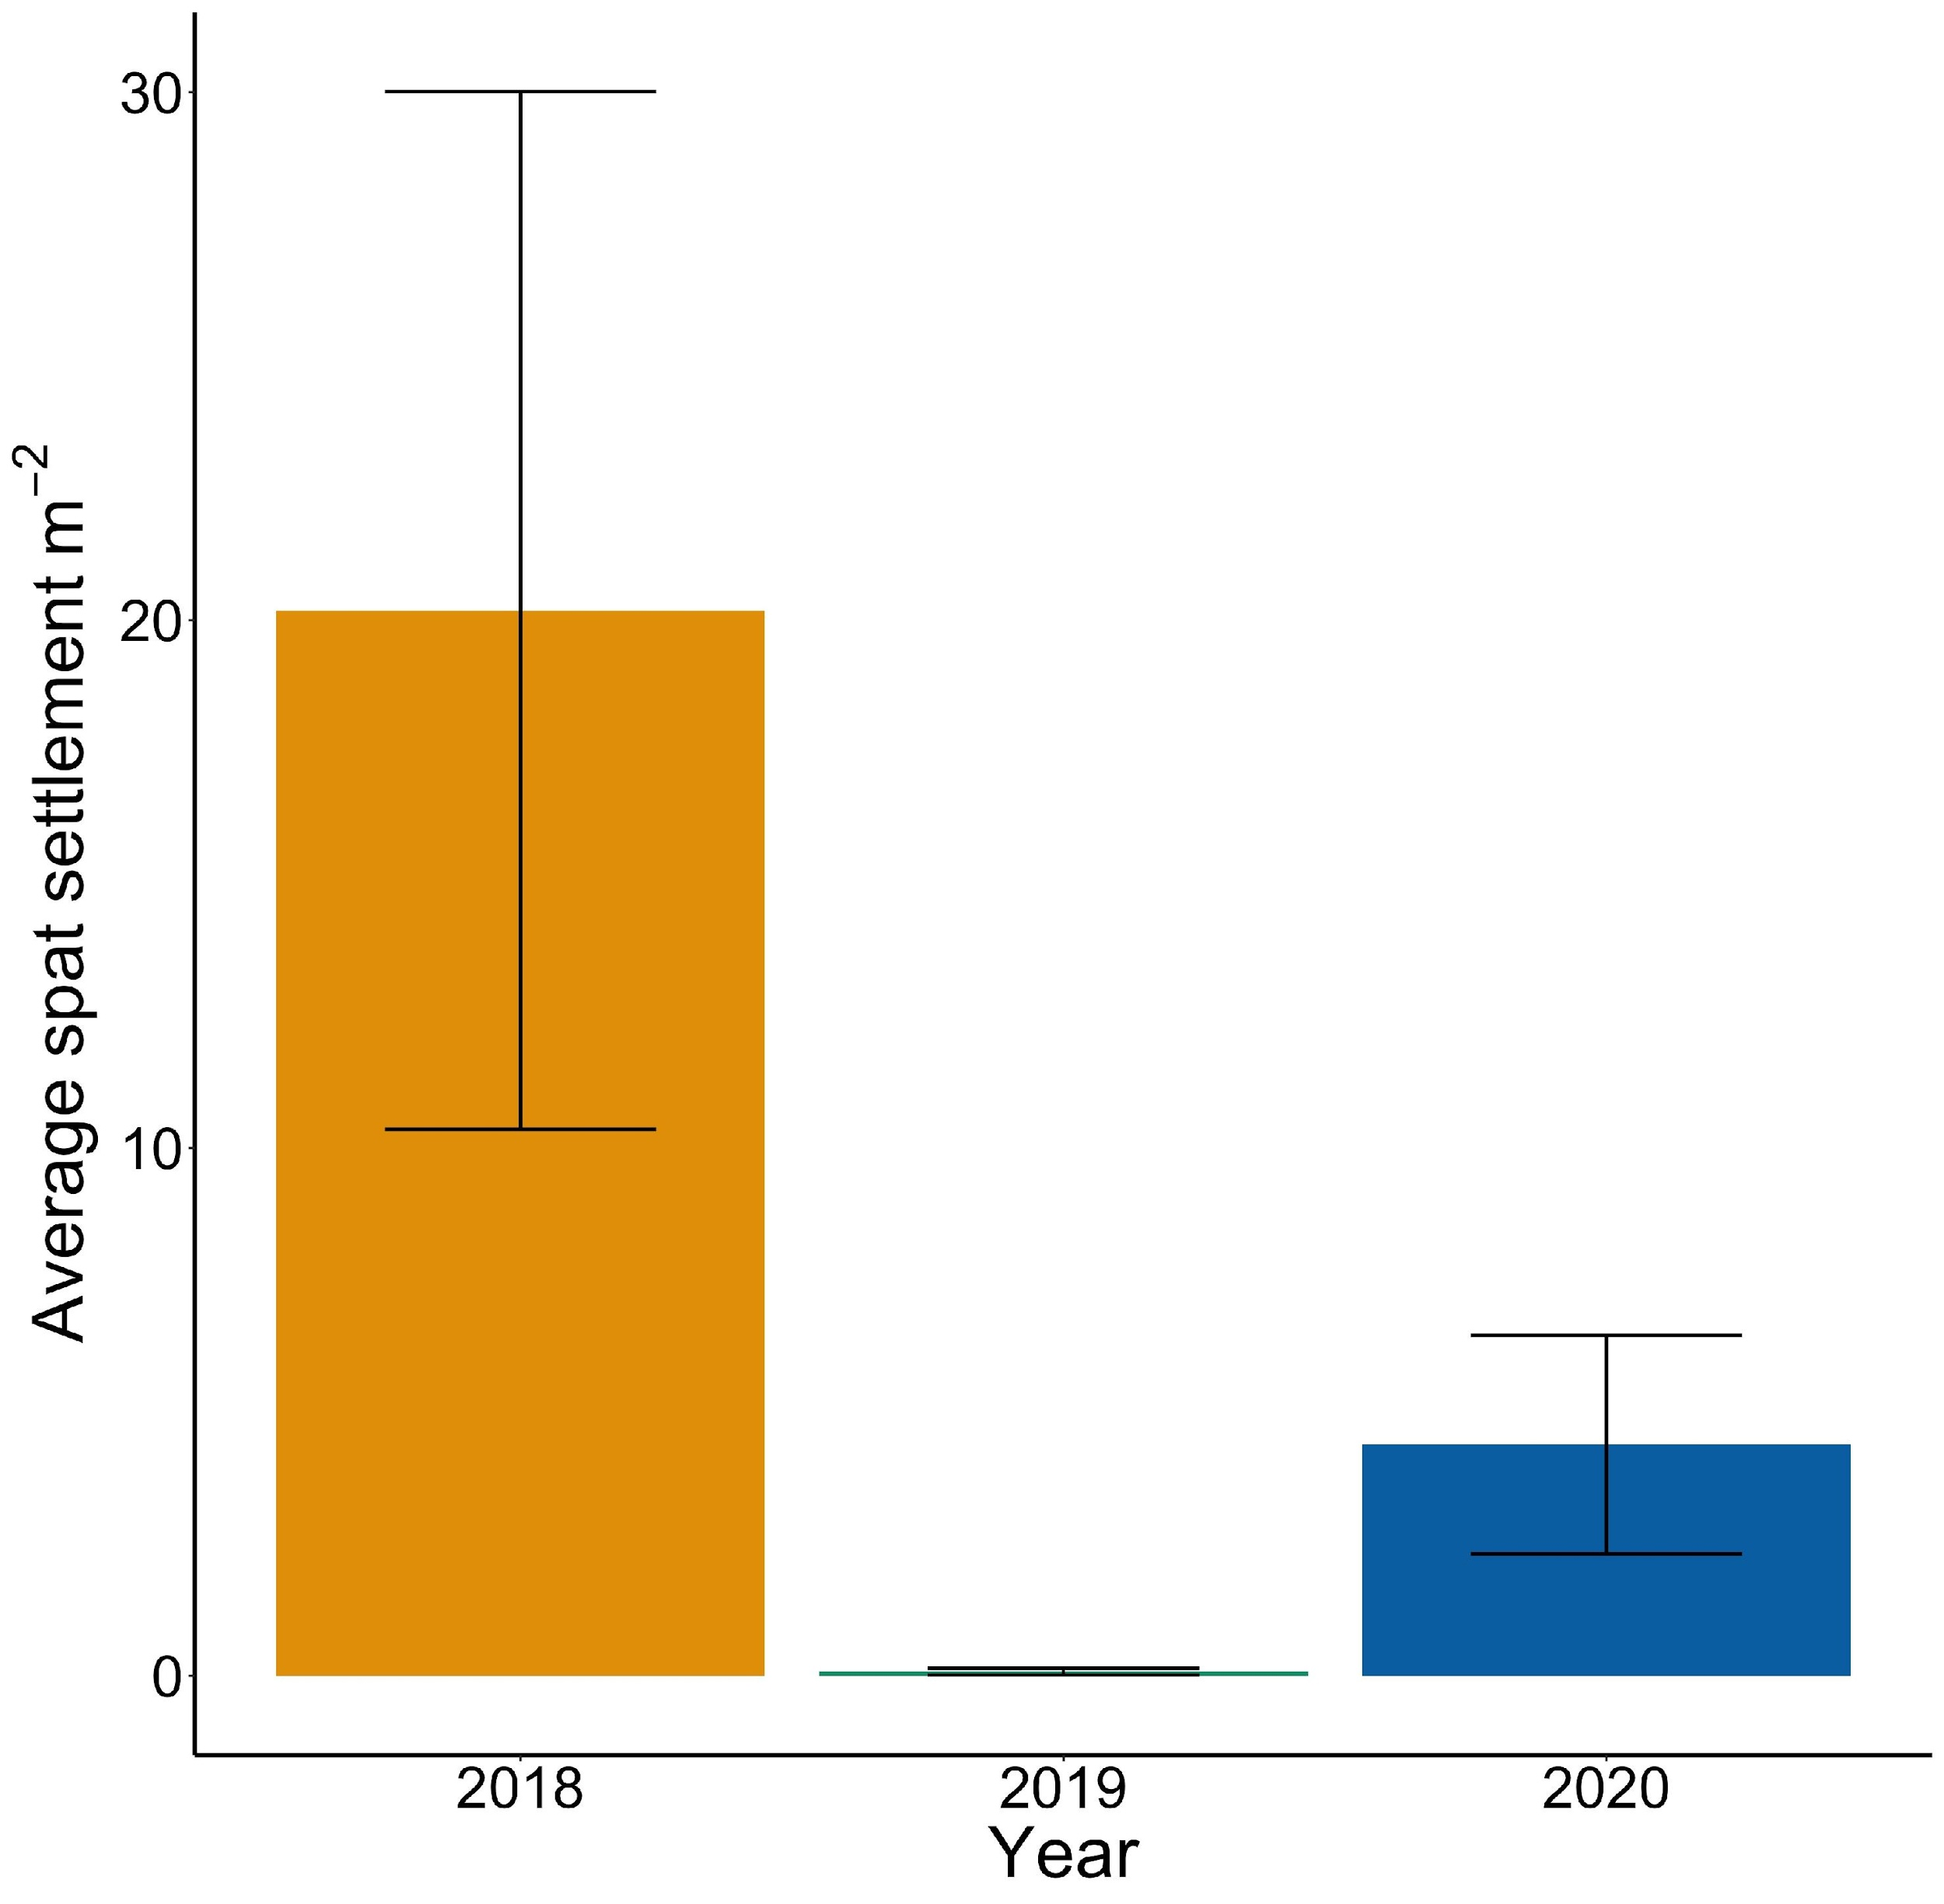
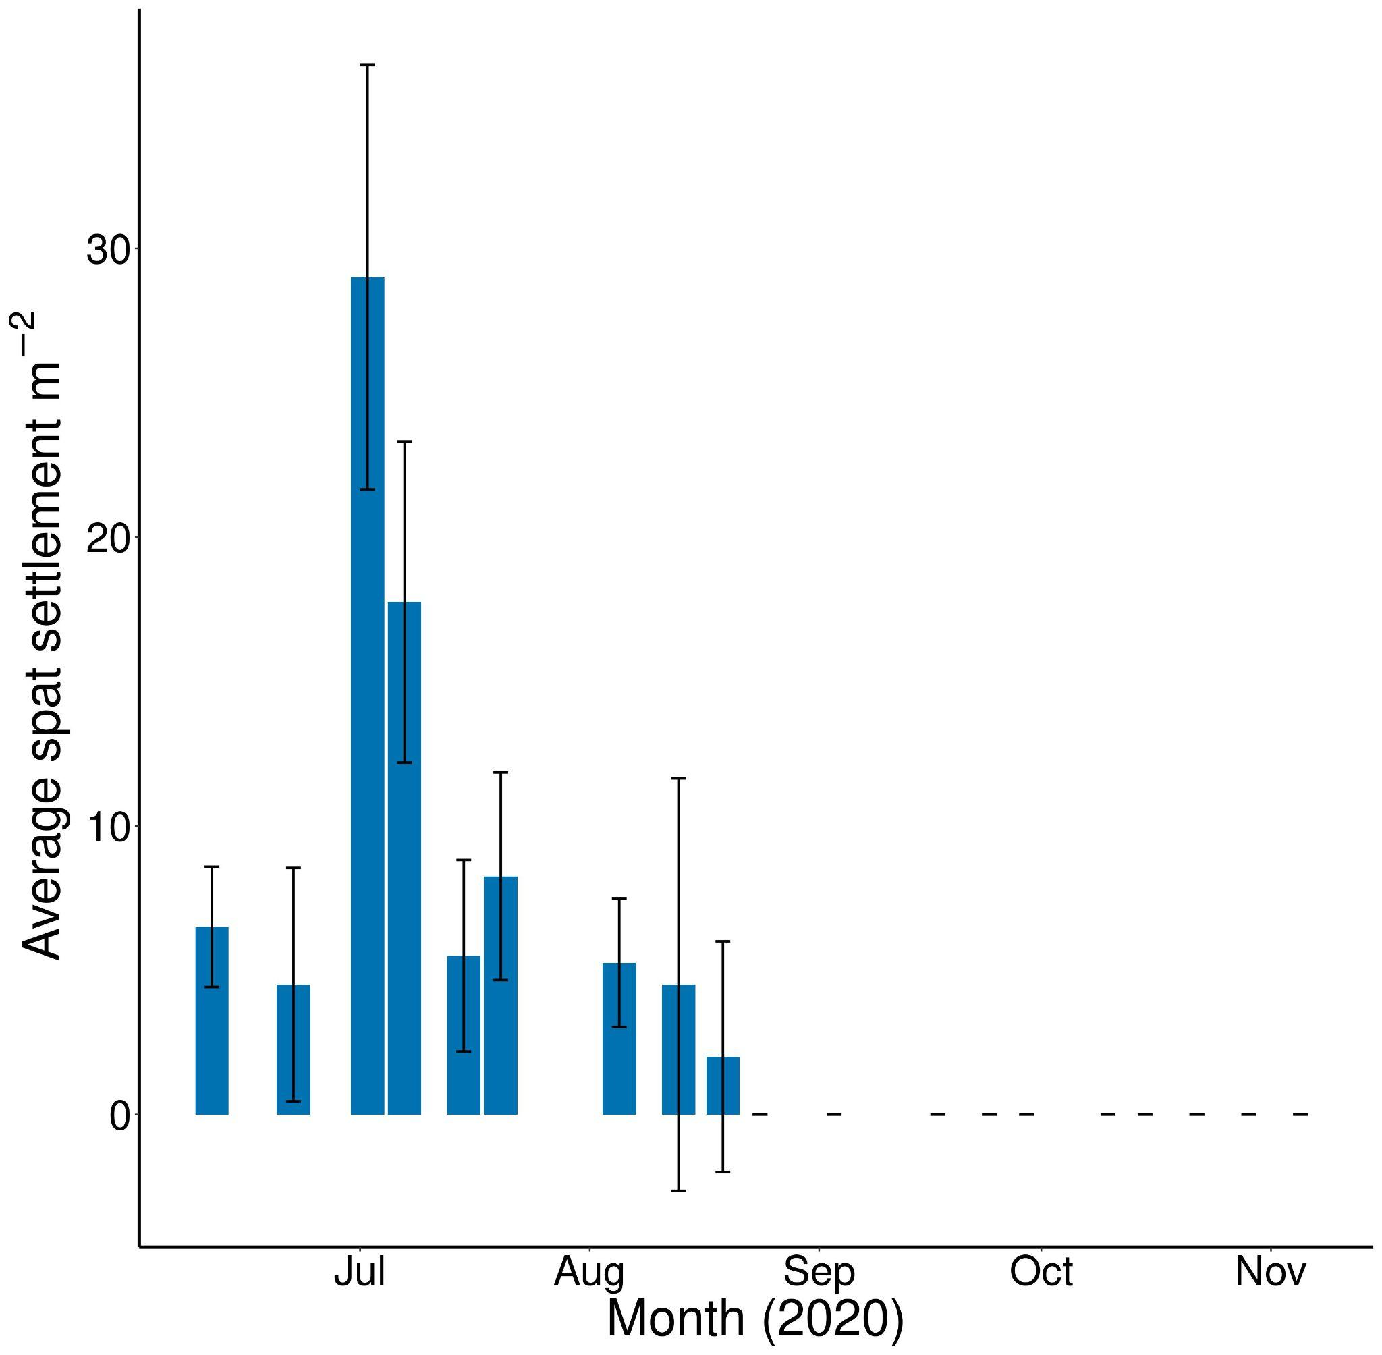
Background
Methods
Results
Discussion

Slide 8
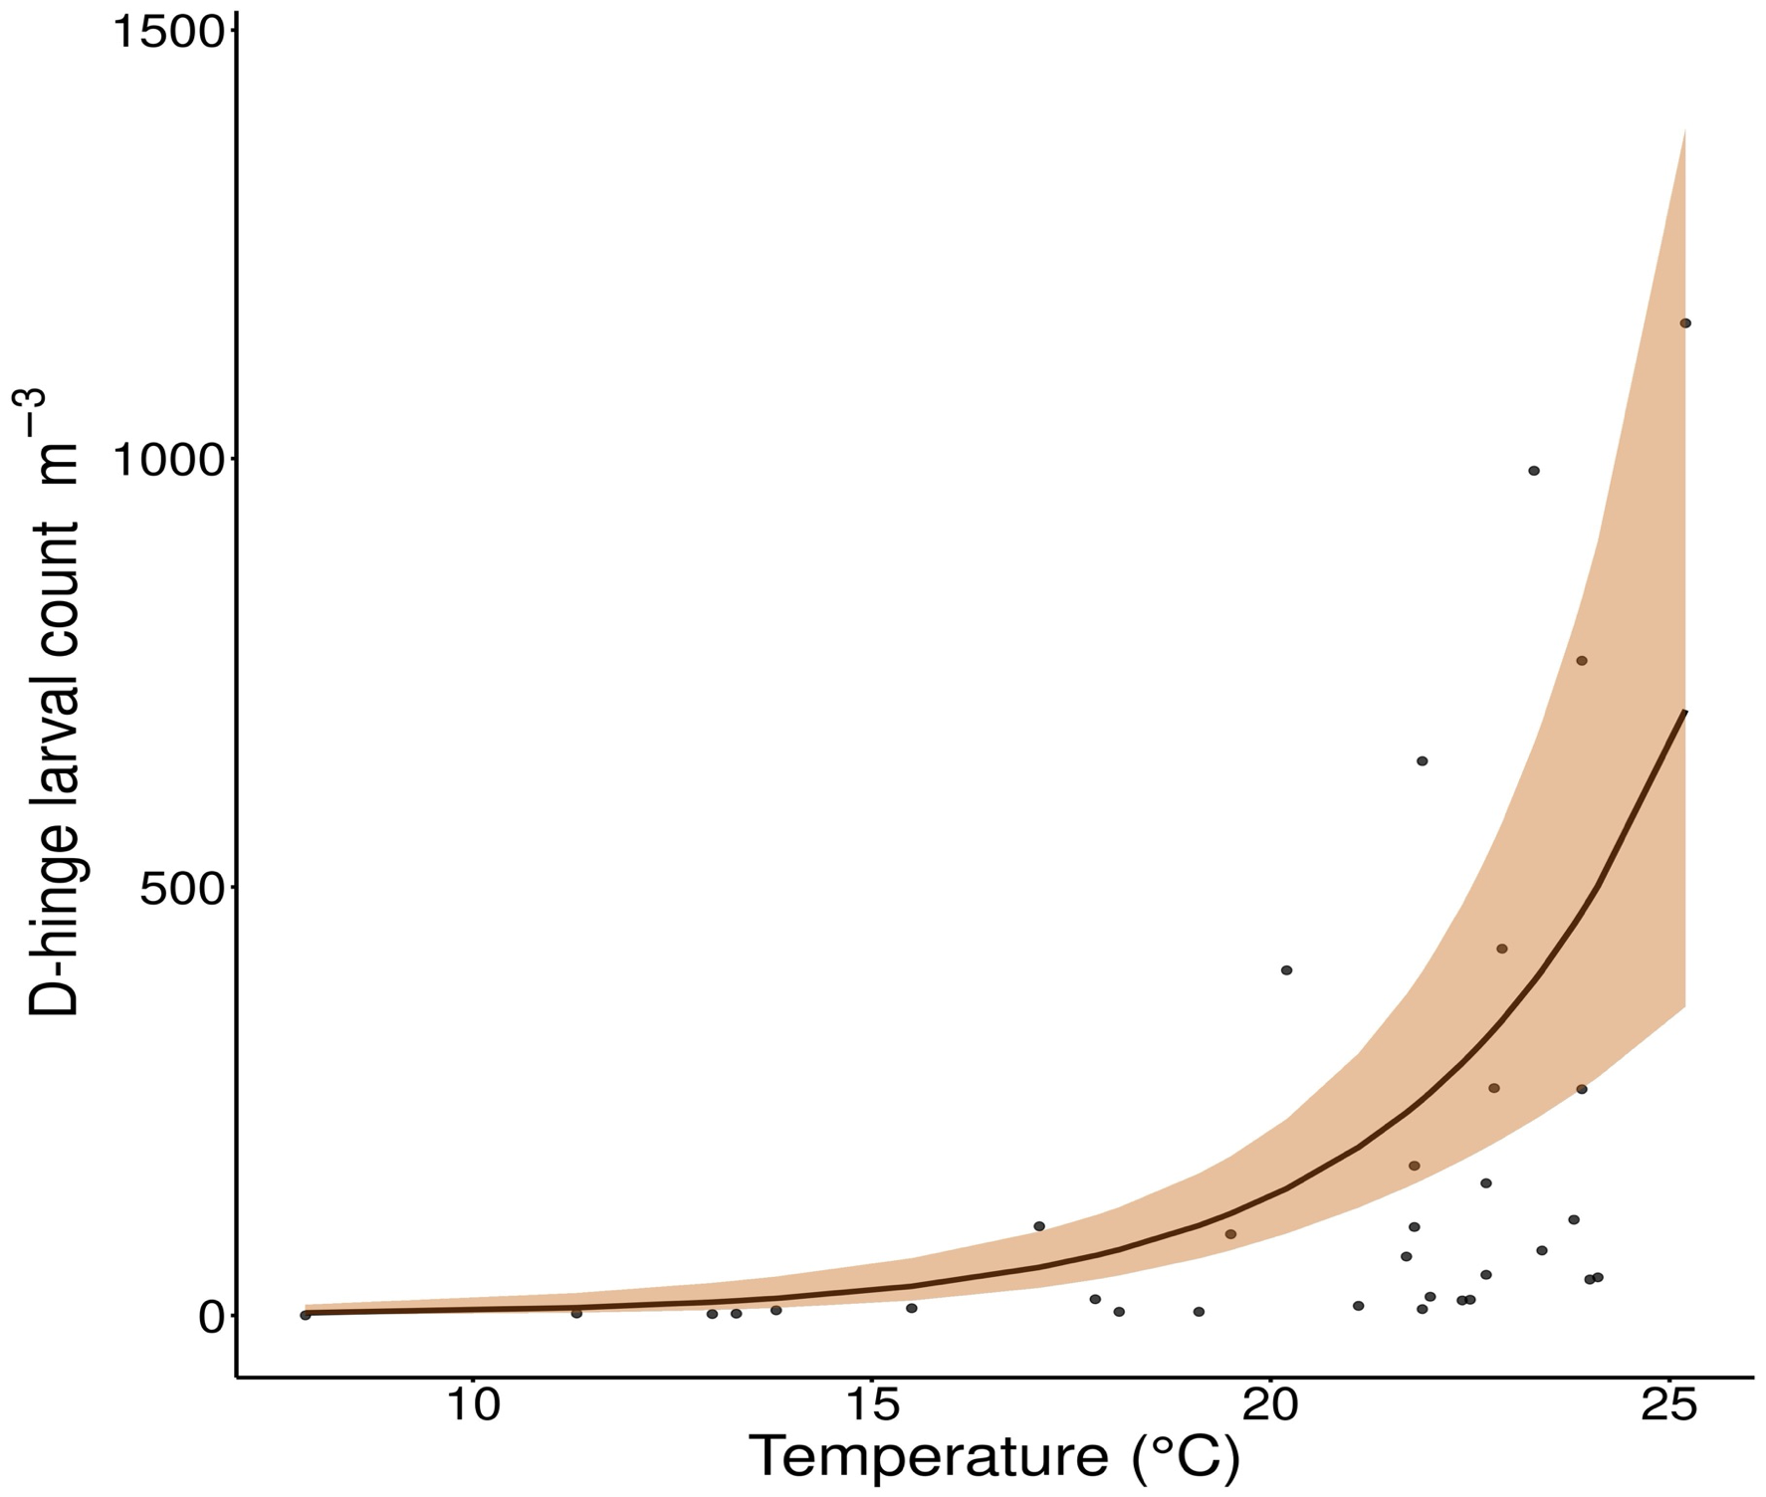
Background
Methods
Results
Discussion
Temperature was the only physicochemical factor associated with D-hinge larvae.
(P < 0.001,
Adj. R² = 0.5086)

Slide 9
Significant findings
Background
Methods
Results
Discussion
Research and restoration efforts should occur earlier in the season than they currently are and should focus on variables other than larvae and spat.
Other studies show that temporal dynamics of eastern oysters are much more complicated than regression can show.
Spat numbers are decreasing in GBE.

Slide 10
Future work
Background
Methods
Results
Discussion
Future studies should incorporate modeling of larval distribution, phytoplankton composition, and setting substrate/availability into larval abundance.
Genetic analyses could provide a means of identifying heritage of larvae/spat = new insight into oyster dynamics.
Are there new predators?

Slide 11

Acknowledgements
Committee members:
Bonnie Brown
Liz Harvey
Ray Grizzle
Robert Atwood
Dave Bushek
Brianna Group
Data analysis:
Patty Jarema, Rich Smith, Chris Neefus, Matt Cheng, Carl Strickland, Andy Ackerman
Logistics & writing:
Jessica Bolker, Lisa Buchalski
Lab work:​
Lauren Welch, Tallie Anne Algiere, Shimaa Ghazal, Bo-Young Lee, Kelsey Meyer, Grant Milne, Matt Cheng, Taja Sims-Harper
Funding:
NHAES Hatch
UNH Marine Biology
NH Sea Grant
Field & site:
Kelsey Meyer, Grant Milne, Krystin Ward, Laura Brown, Matt Cheng, Taja Sims-Harper, Alix Laferriere, Jerry Stasse, Chloe Pearson, Aliya Caldwell

Slide 12
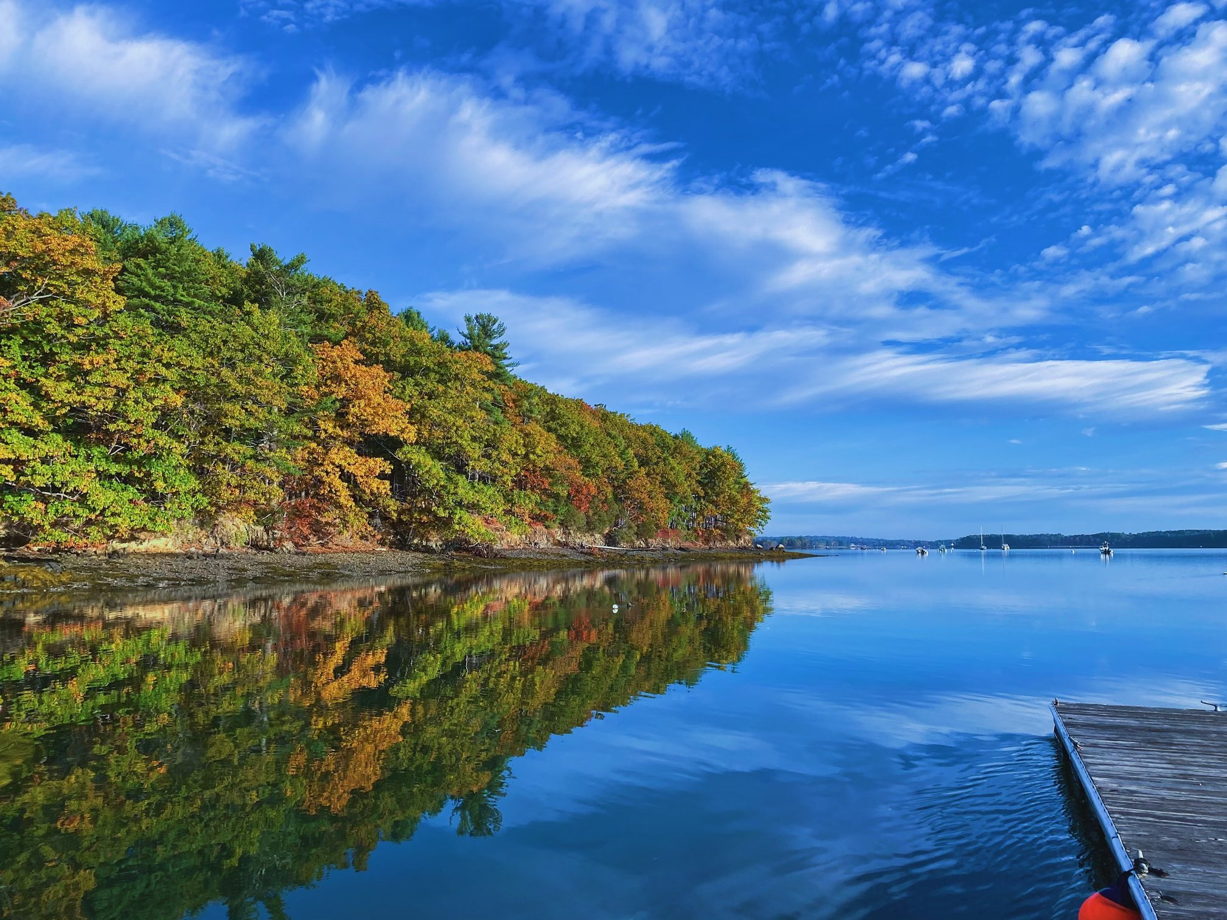
Questions?
Email: alyssa.stasse@unh.edu
Twitter: @alyssastasse
Paper featured in Journal of Shellfish Research

