Slide 1
Relationship Between Dietary Quality and Cardiometabolic Risk in a College Population
Chris Guarino BS, Sherman J. Bigornia, PhD, Jesse Stabile Morrell, PhD
Department of Agriculture, Nutrition, and Food Systems

Slide 2
Purpose
To investigate whether diet quality is related to Metabolic Syndrome risk in students at the University of New Hampshire

Slide 3
Introduction
Metabolic Syndrome (MetS) is an umbrella term for certain factors that increase the risk of heart disease, diabetes and stroke
MetS is characterized by having ≥ three of the following five risk factors
Waist Circumference (iliac crest) >40 in. for men, > 35 in. for women
High Density Lipoprotein (HDL) > 40 mg/dL for men, <35 mg/dL for women
Fasting Plasma Glucose (FPG) > 100 mg/dL
High Density Lipoprotein (HDL) > 40 mg/dL for men, <35 mg/dL for women
High Density Lipoprotein (HDL) > 40 mg/dL for men, <35 mg/dL for women

Slide 4
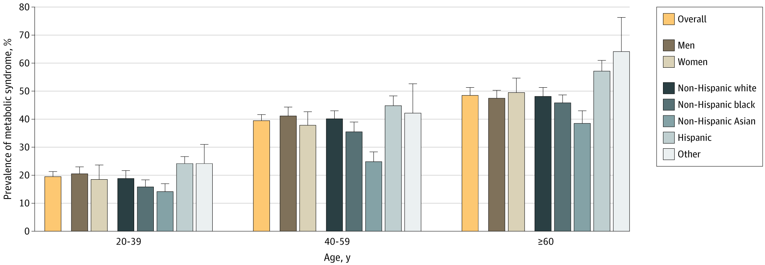
Background
Trends in the Prevalence of Metabolic Syndrome in the United States, 2011-2016²
To investigate whether diet quality is related to Metabolic Syndrome risk in students at the University of New Hampshire
Error bars indicate 95% CIs. Hispanic race/ethnicity includes Mexican American or other Hispanic race. Other race/ethnicity includes other non-Hispanic races, including non-Hispanic multiracial. Comparisons of prevalence estimates between age groups among the specified demographic subgroups were performed using χ² tests. All comparisons yielded P <.001
2. Hirode G, Wong RJ. Trends in the Prevalence of Metabolic Syndrome in the United States, 2011-2016. JAMA. 2020;323(24):2526-2528. doi:10.1001/jama.2020.4501

Slide 5
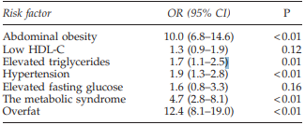
Background-UNH
Sixty percent of University of New Hampshire (UNH) adults age 18-24y had ≥ 1 risk factor for MetS (2012)³
Twenty-one percent had ≥ 2, and 5% had MetS
HDL-C & Blood Pressure were the most common risk factors met by students with average and above average measures of fitness³
Adjusted Odds Ratios (95% CI) of Having Cardiovascular Disease Risk Factors Among College Adults, 18–24 Years, with Below-Average Fitness (vs. Average or Above-Average Fitness)³
Odds ratios (OR) calculated with logistic regression; gender served as a covariate. CI, confidence interval; HDL-C, high-density lipoprotein cholesterol
Research Question: What about students’ diets?
3. Morrell JS, Cook SB, Carey GB. Cardiovascular Fitness, Activity, and Metabolic Syndrome Among College Men and Women. Metab Syndr Relat Disord. 2013;11(5):370-376. doi:10.1089/met.2013.0011

Slide 6
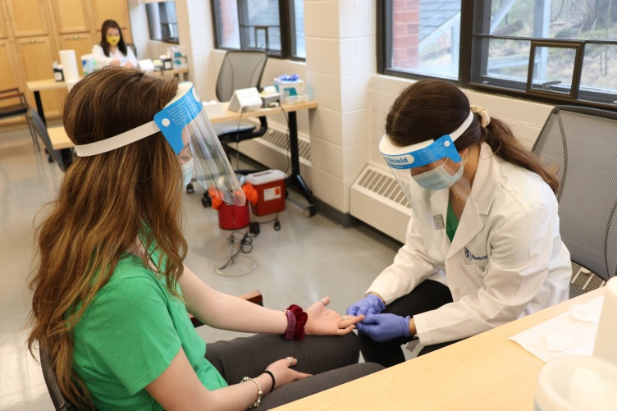
Methods
College Health and Nutrition Assessment Survey (CHANAS)⁴
Ongoing, cross-sectional screening project at UNH
Students were recruited from an introductory Nutrition course
Participants provided informed consent (UNH IRB #5524)
Metabolic Syndrome Risk Criteria
Anthropometric measurements (waist circumference, minimal and iliac crest)
Biochemical Measures using Cholestech-LDX
HDL-C, FPG, TAG, BP
Anthropometric, biochemical, & clinical measures were performed after an overnight fast (10-12hrs)
Diet
Collected 3-day dietary recall average using Diet and Wellness+
Survey Says. UNH Today. Published July 22, 2021. Accessed April 6, 2022. https://www.unh.edu/unhtoday/2021/07/survey-says
4. Burke JD, Reilly RA, Morrell JS, Lofgren IE. The University of New Hampshire’s Young Adult Health Risk Screening Initiative. J Am Diet Assoc. 2009;109(10):1751-1758. doi: 10.1016/j.jada.2009.07.005

Slide 7
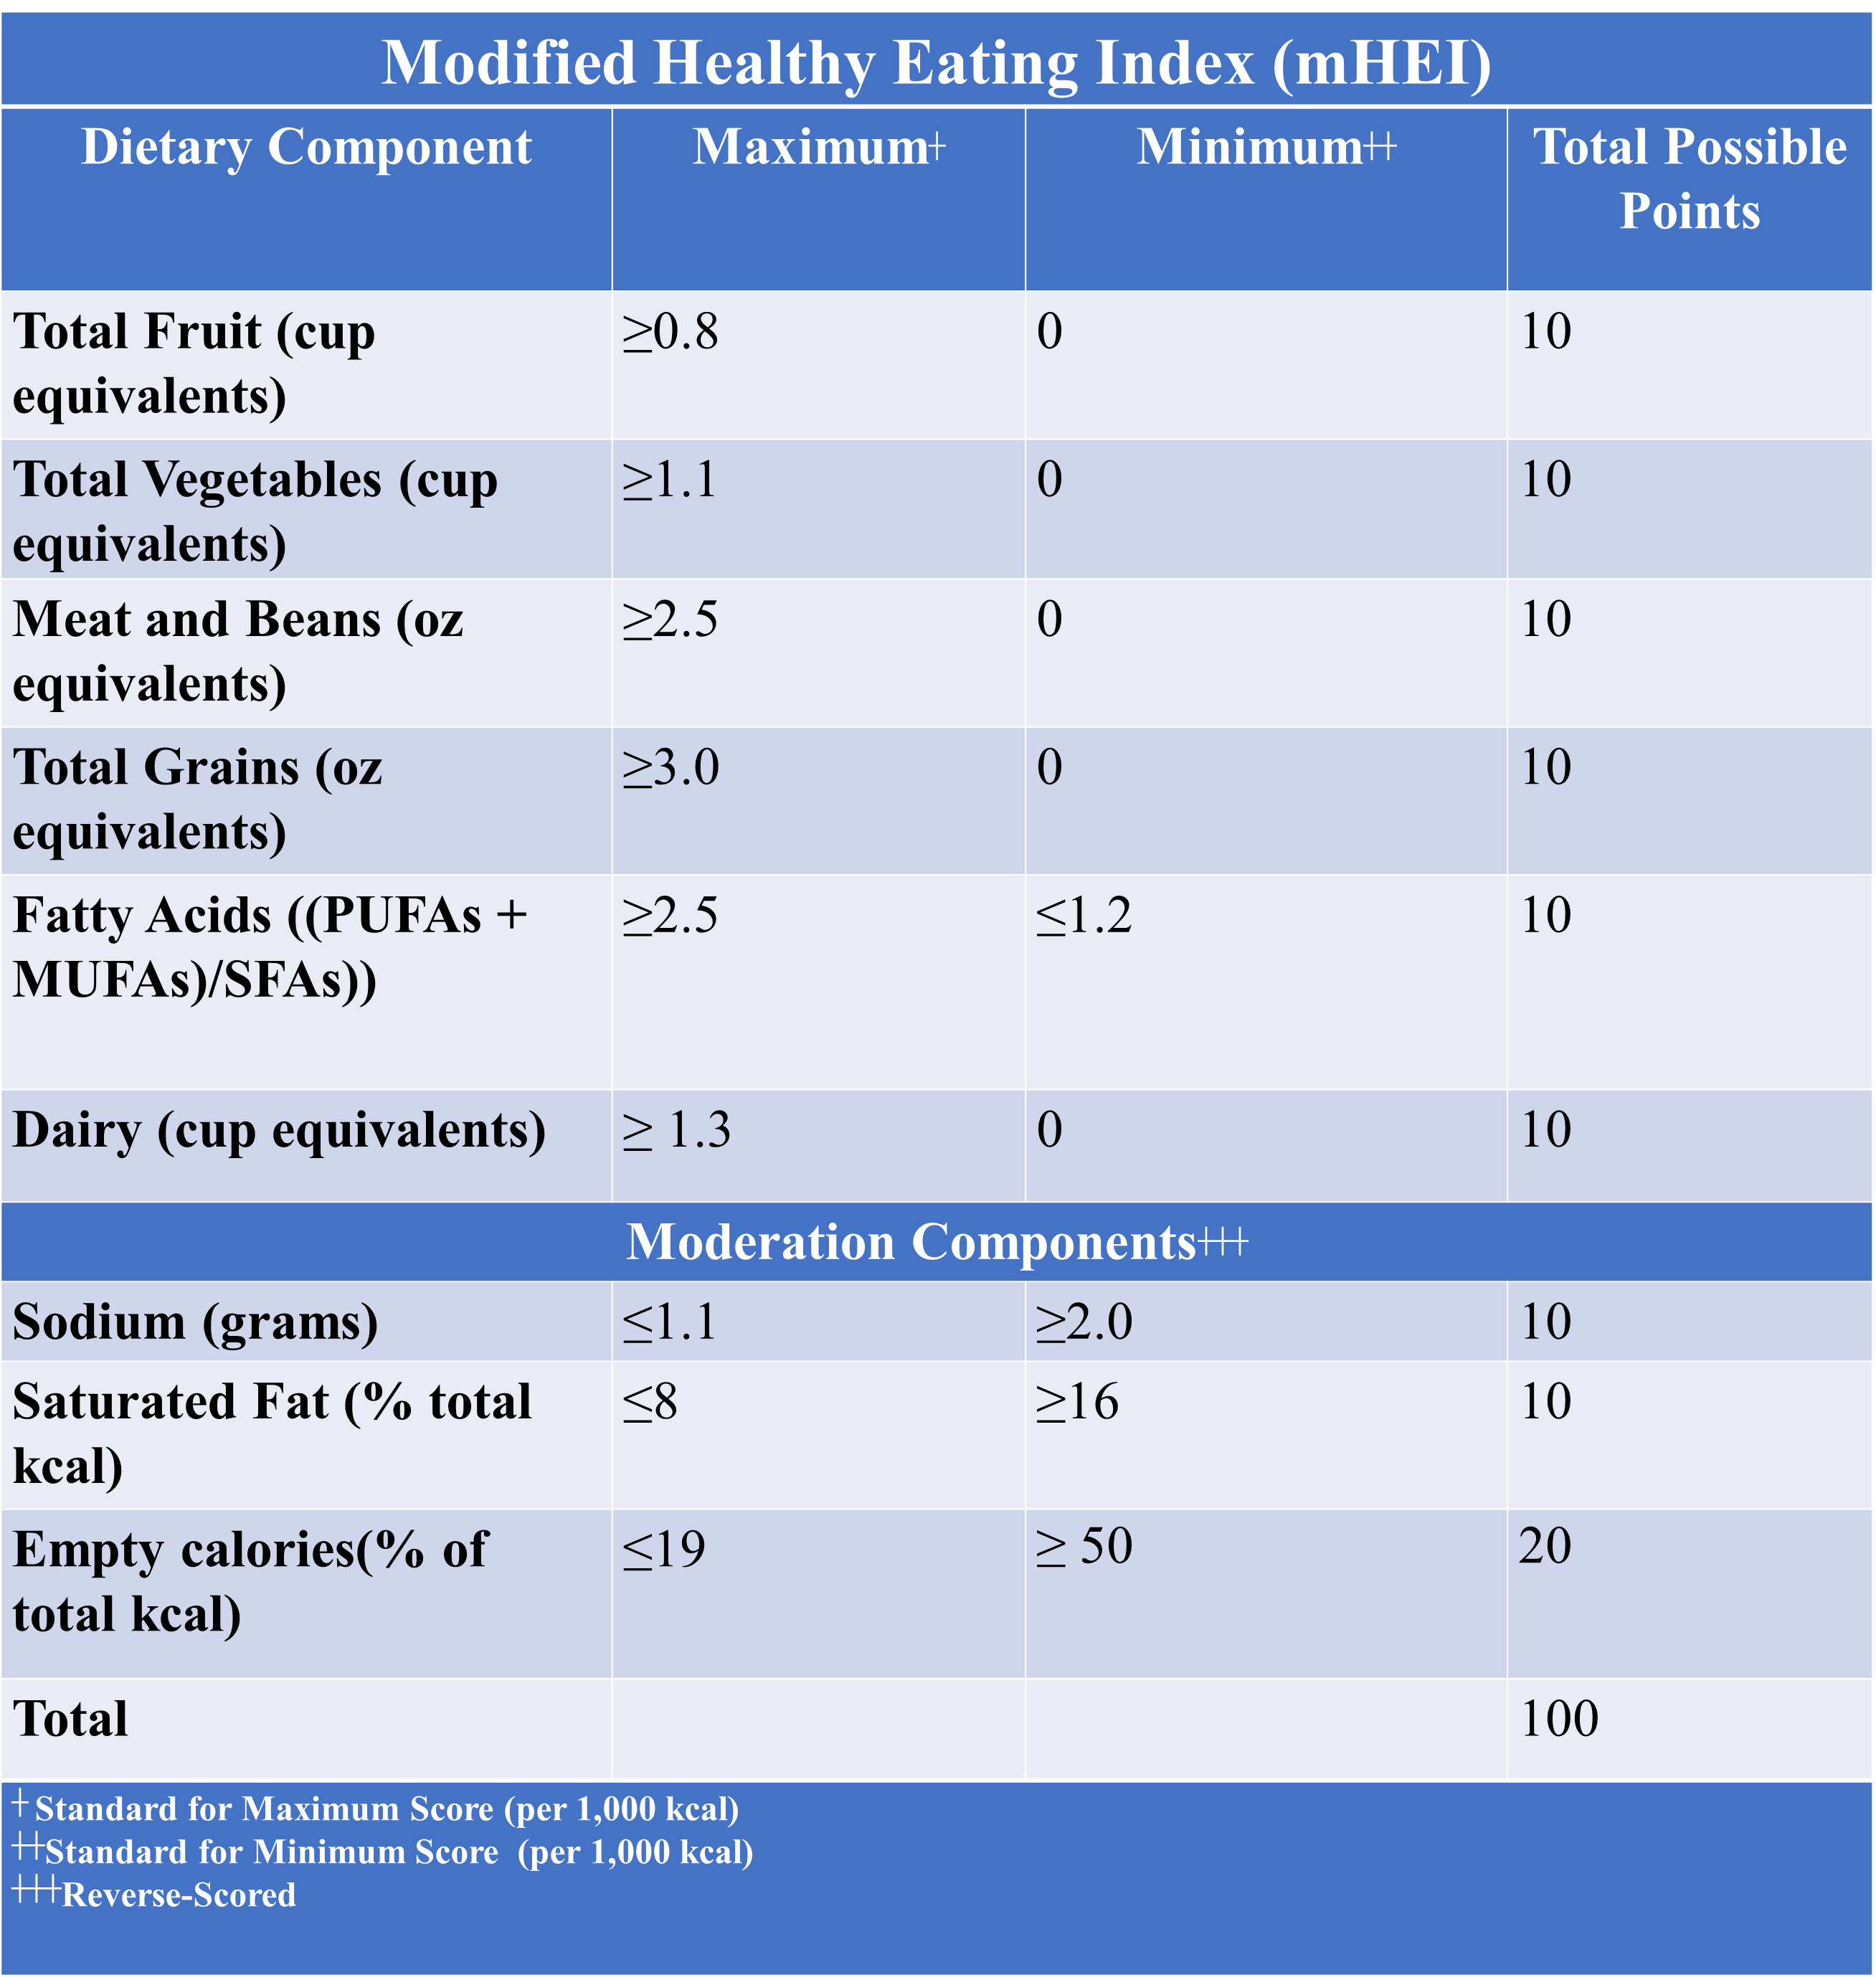
The Modified Healthy Eating Index (mHEI)
A modified Healthy Eating Index (mHEI) score was assigned (0-100) based on HEI-2005, -2010, and -2015 categories to assess the diet quality of college students based on the Dietary Guidelines for Americans
Modified Healthy Eating Index (mHEI)
Criteria | HEI Model | Standard for Maximum Score (per 1,000 kcal) | Standard for Minimum Score | Total Possible Points
Total Fruit | HEI-2015 | ≥0.8 cup equivalents | No fruit | 10
Total Vegetables | HEI-2015 | ≥1.1 cup equivalents | No vegetables | 10
Meat and Beans | HEI-2005 | ≥2.5 oz equivalents | No meat/beans | 10
Total Grains | HEI-2005 | ≥ 3.0 oz equivalents | No grains | 10
Fatty Acids | HEI-2010 | (PUFAs + MUFAs)/SFAs ≥2.5 (10 points) | (PUFAs + MUFAs)/SFAs ≤1.2 | 10
Dairy | HEI-2015 | ≥ 1.3 cup equivalents | No dairy | 10
Moderation Components
Sodium | HEI-2015 | ≤1.1 gram | ≥2.0 grams | 10
Saturated Fat | HEI-2015 | ≤8% of energy | ≥16% of energy | 10
Empty calories | HEI-2010 | ≤19% of energy | ≥ 50% of energy | 20
Total |  |  |  | 100

Slide 8
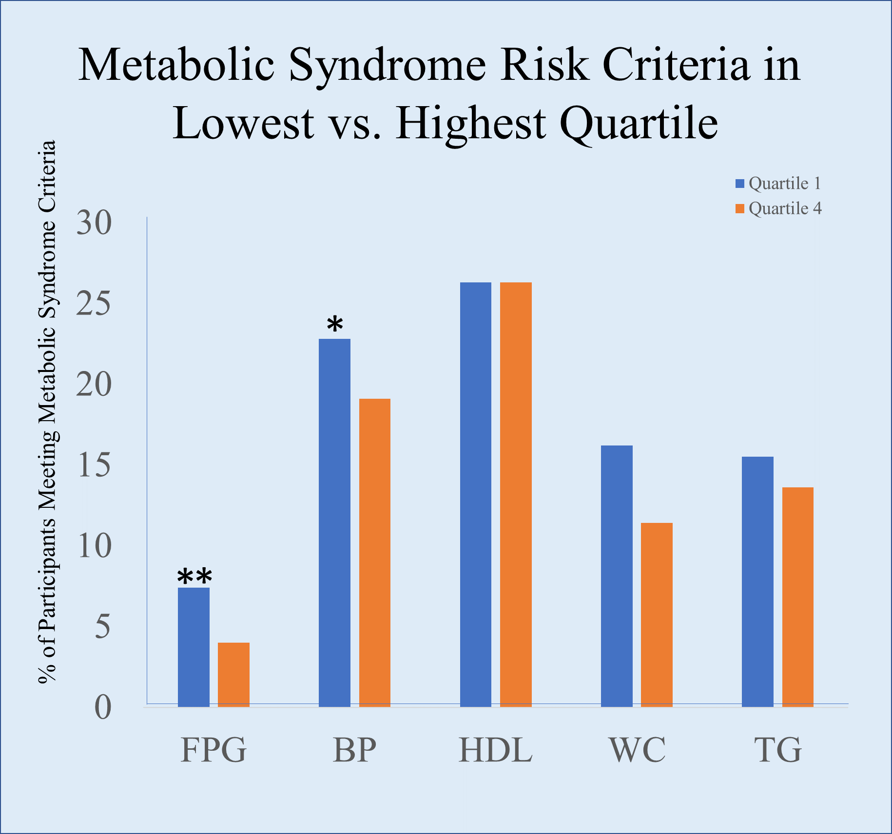
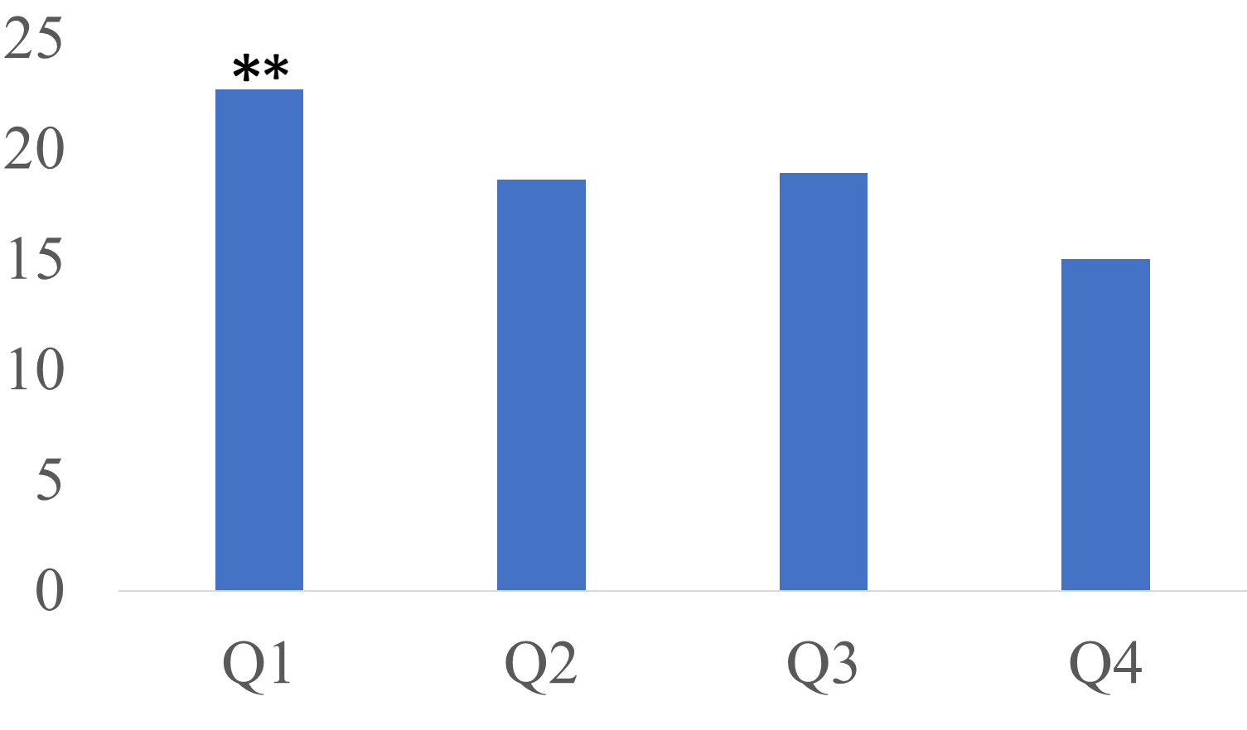
Results-Chi Square Analysis
FPG = Fasting Plasma Glucose, BP = Blood Pressure (systolic and diastolic). HDL = High-Density Lipoprotein, WC = Waist circumference , TG = Triglycerides, *p<0.04, **p<0.0001
Participants in mHEI Q1 vs. Q4 were more likely to meet ≥2 MetS criteria (22.7% vs. 15.0%, X²=30.0, p< 0.0001)
A greater proportion of mHEI Q1 v. Q4 met the criteria for fasting plasma glucose (7.4% v. 4.0%, X²=29.0, p< 0.001) and blood pressure (22.8% v. 19.1%, X²=8.8, p=0.04).

Slide 9
Conclusion
Students with the healthiest diets met less risk factors for metabolic syndrome
Students with the least healthy diet more frequently met the MetS criteria for fasting plasma glucose and blood pressure
Our findings support a relationship between diet quality and metabolic syndrome among a representative sample from UNH
Next Step: Logistic Regression to control for association of possible confounders (age, sex, physical activity, smoking status)

Slide 10
Acknowledgements
New Hampshire Agriculture Experiment Station and USDA National Institute of Food and Agriculture Hatch Project 1010738, UNH Graduate School, Department of Agriculture, Nutrition and Food Systems, Brandy Moser, BS, BA

Slide 11
Thank You!
Questions?

