Slide 1
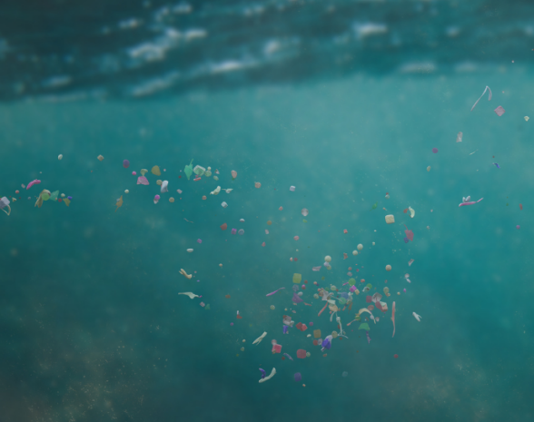
Developing a Protocol to Assess Microplastics in Estuarine Environments
Hanna Mogensen
Master’s Candidate
Department of Biological Sciences
University of New Hampshire
Moore Lab

Slide 2
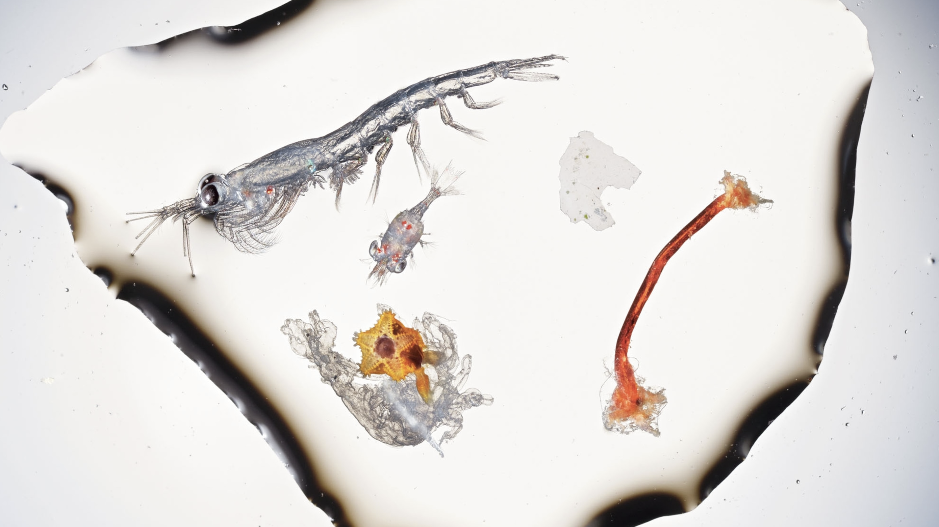
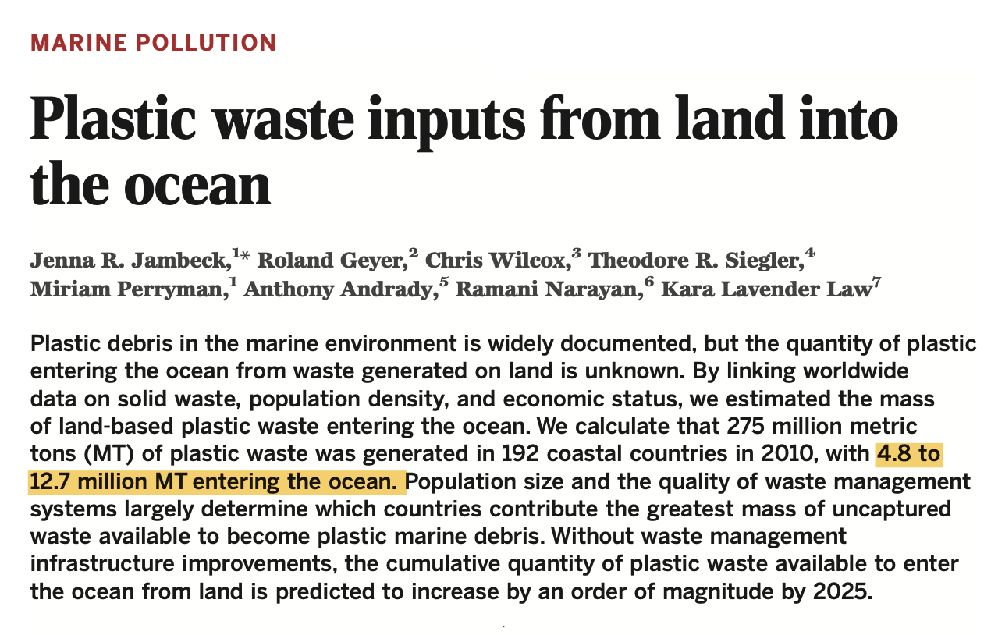
Microplastics
Background
Study Design
Methodology
Take Aways
Scale
Over 400 million Mt of plastic produced annually
Low rate of plastic recycling
Where is all the plastic going?
Small plastic particles less than 5 mm in size
Physically pervasive & persistent
Associated with persistent, bioaccumulative and toxic (PBT) chemicals
(National Geographic, 2019)
Notes:
There are number of concerns with regard to microplastics in the environment, the largest two being:
Physical impacts: plastics are pervasive and persistent. Once ingested in marine organisms, they can remain within the species and accumulation has been tied to reduced physiological functioning (reduced growth rate, energy reserves and reproductive success).
Chemical impacts: Plastics have been found to contain persistent, bioaccumulative, and toxic (PBT) chemicals. These contaminants can originate from two sources, additive-derived chemicals during the manufacturing process, or chemicals absorbed from the aquatic environment
These toxins can leach out of plastics during the digestive process, transferring to the organism.
This has negative impacts on ocean health at large, marine species, as well as potential impacts on higher trophic species (including humans) who eat these marine organisms.
Another reason plastic in our oceans is a significant concern is due to the scale at which it is happening
Over the last 50 years, plastic production has climbed from 50 million metric tons per year to over 400 million. (Law et al. 2020)
Despite how simple resin recycling is, only about 20% is estimated to be recycled worldwide, and that rate drops to 8.4 % is in the US.
With the large majority of plastic waste incorrectly disposed of each ear it leads us to ask “WHERE DOES ALL THE PLASTIC GO?”
In 2010 it was estimated that 4.8-12.7 million metric tons of plastic entered the oceans in a single year (Jambeck et al., 2015).
This illustrates the role that oceans are playing as a sink for plastic marine litter.
A dollop of surface water from the English Channel contains a shrimplike krill, about a third of an inch long; a smaller decapod crustacean; and an orange sea star just emerging from its filmy floating larval stage. The white chip and the fraying red fiber on the right are polyethylene

Slide 3
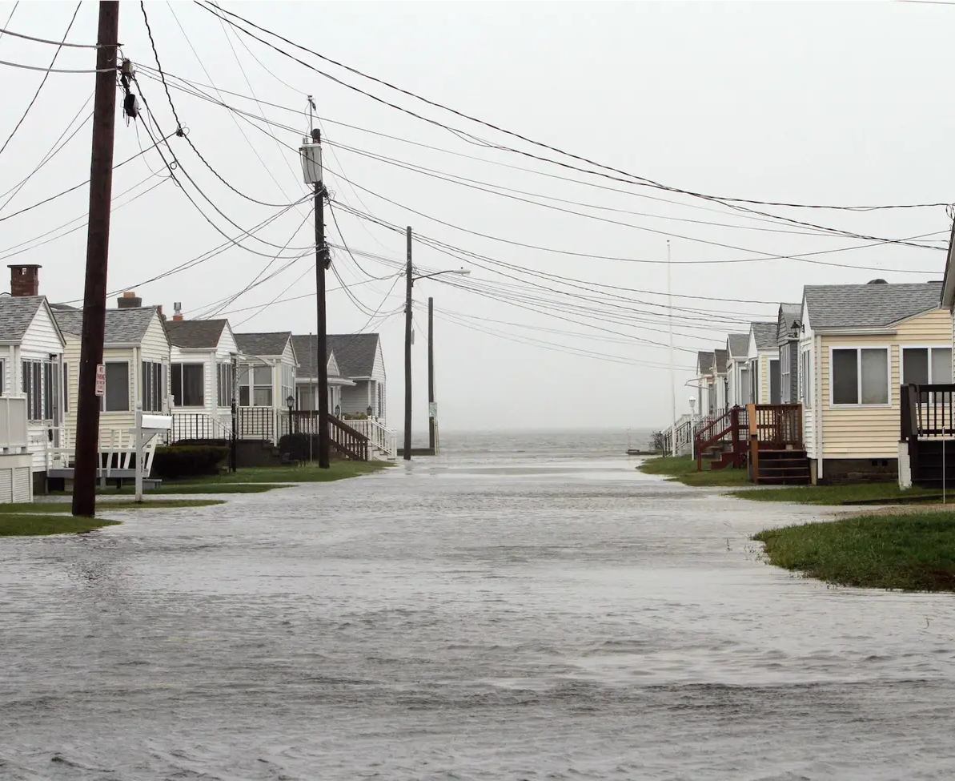
Microplastic Movement
Background
Study Design
Methodology
Conclusions
Hampton-Seabrook Estuary
80% of marine plastic litter originates from land-based sources (Andrady, 2011)
Estuaries are critical ecosystems of concern
AP Photo: Jim Cole
Figure: Alimi et al., 2018
Notes:
But interestingly, the majority of that litter is not coming from marine-based sources (fishing lines, shipping, etc.) Instead, an estimated 80% of marine plastic litter is believed to originate from land-based sources. Because of this, estuaries that are situated at the intersection of terrestrial and aquatic environments, are critical ecosystems of concern. Despite the fact that these environments are key parts of the story, very few studies have been done to understand localized pathways of MP entry and movement within estuaries.
My research aims to explore this topic, by focusing in on one defining aspect of estuary systems- their tides and specifically assessing the role of tidal flooding on MP. Tidal flooding has garnered significant attention in coastal communities and is expected to become more common as climate change continues to increase sea levels, and cause more frequent and intensive precipitation and storm events.
Understanding the role that tides have in microplastic entry and transport is critical to long-term management of this problem.

Slide 4
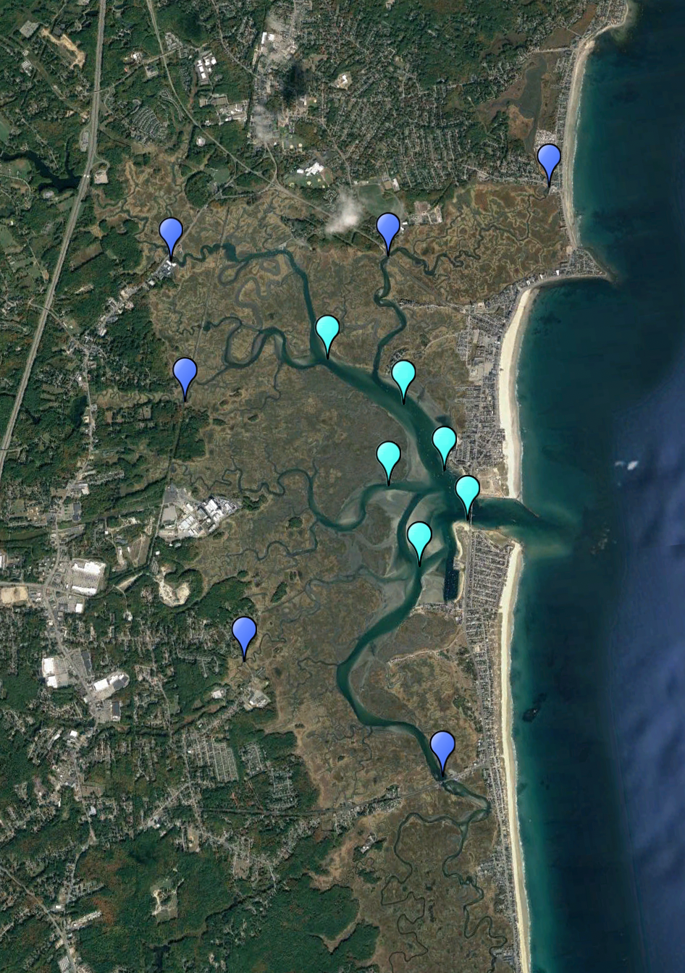
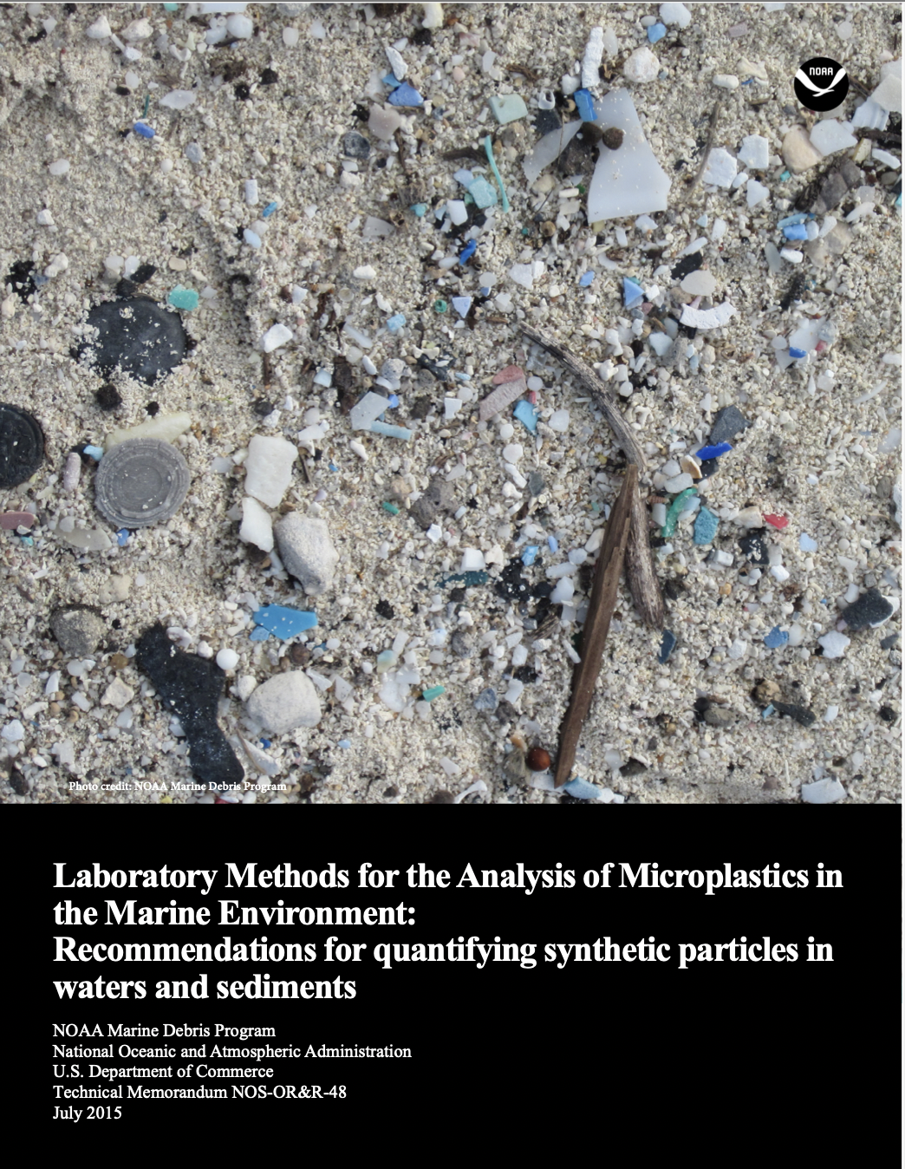
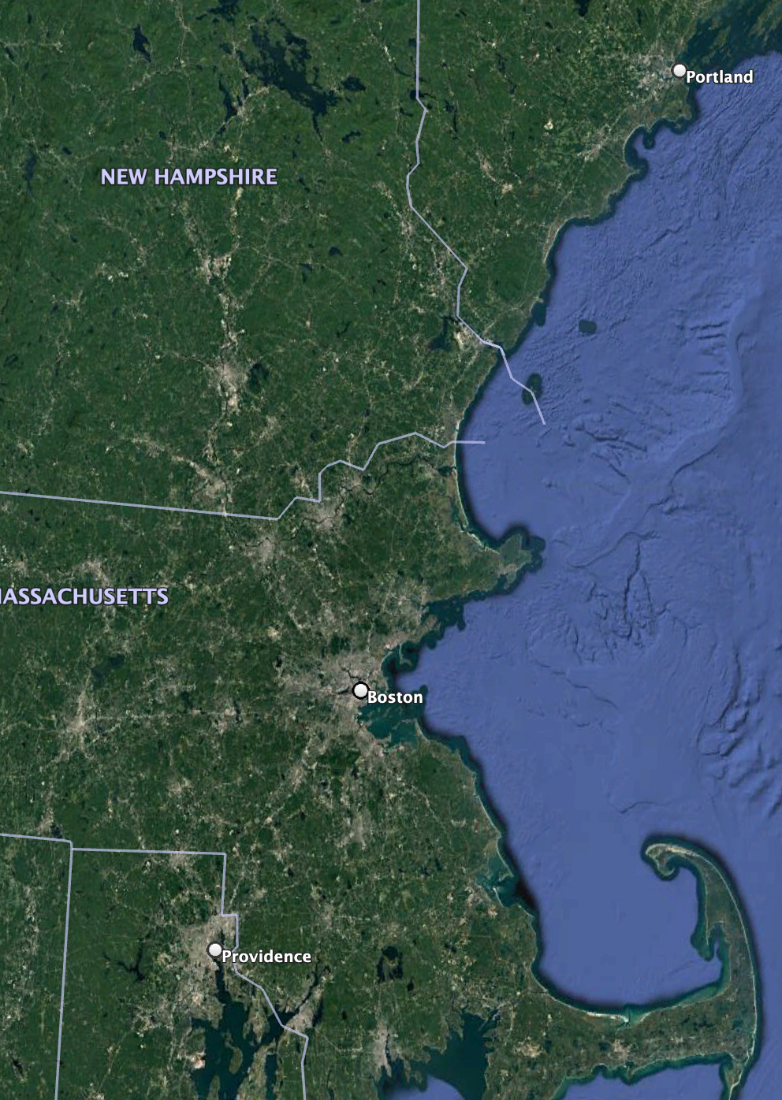
Study Design
Background
Study design
Methodology
Conclusion
Study Location: Hampton Seabrook Estuary (NH)
Sampling period: July-September 2021, twice monthly (neap + spring tide)
Established Protocol: NOAA Marine Debris Program
Started to collect and process samples!
Notes:
So last summer, I geared up to answer my research question.
I selected a dynamic Estuary, the Hampton Seabrook Estuary in Southern New Hampshire: range of population densities, a diversity of commercial and recreational activities, and experiencing more intense and frequent flooding and tidal surges
I Selected my sampling period to test the effects of tidal flooding (using tidal phase as a proxy)- June to September
And I found an established protocol- the NOAA Marine Debris Program MP sampling and isolation protocol
After collecting some test samples and running through the laboratory protocol using our estuary samples, I quickly realized that the NOAA sampling protocol, which was developed for open ocean sampling, was not going to work for our estuary samples. Mainly due to 2 differences:

Slide 5
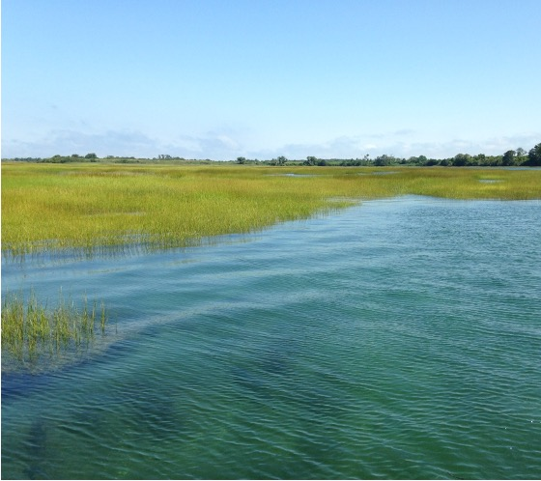
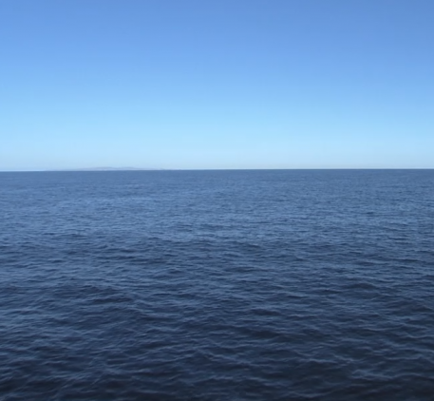
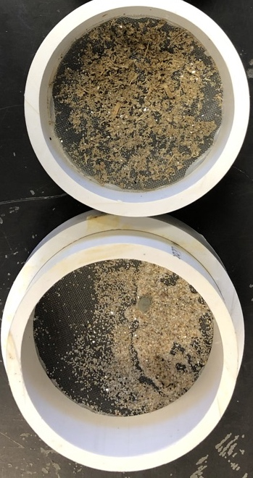
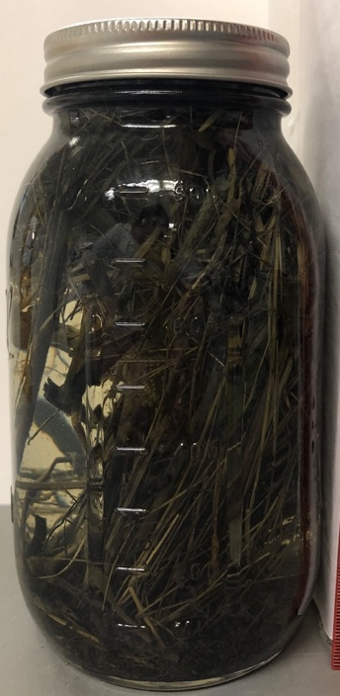
Estuary
Background
Study design
Methodology
Conclusion
Open Ocean
Open Ocean
High amount of organic matter
High amount of silt/sediment
Notes:
After collecting some test samples and running through the laboratory protocol using our estuary samples, I quickly realized that the NOAA sampling protocol, which was developed for open ocean sampling, was not going to work for our estuary samples. Mainly due to 2 differences:
High amounts of organic matter (reeds, wrack, eelgrass, seaweed, etc.)
High amount of sediment in certain locations
So, before I could actually answer my research question, I needed to first develop a modified protocol to sample in this estuary environments.

Slide 6
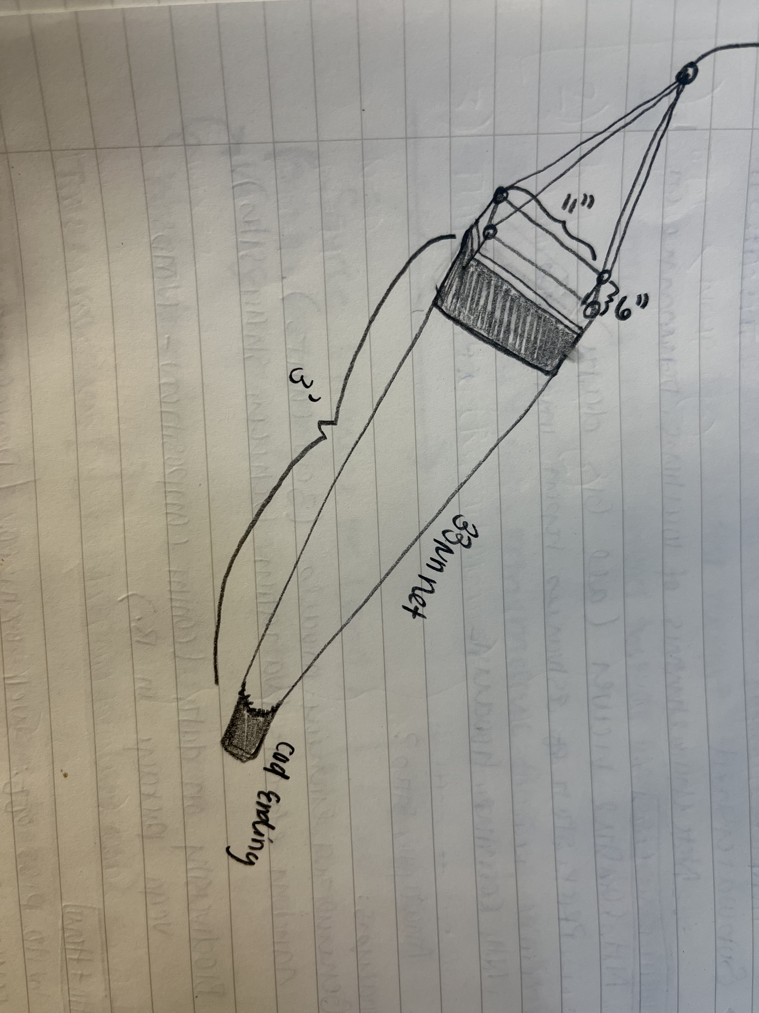
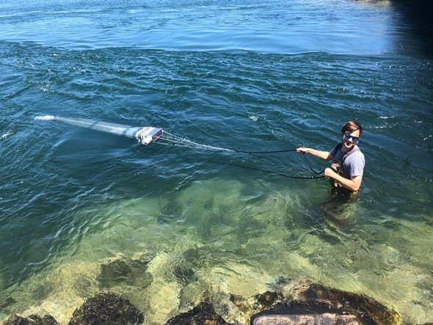
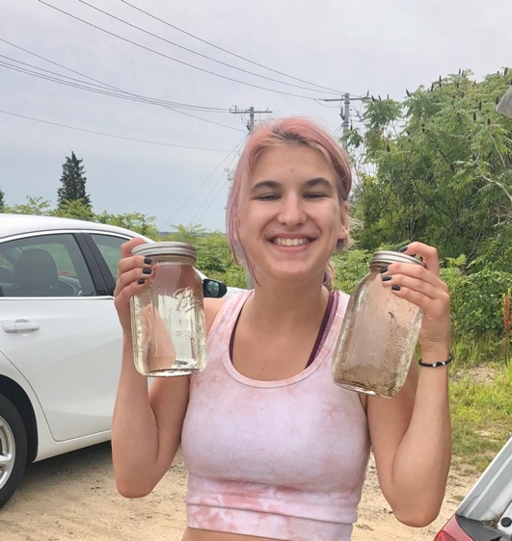
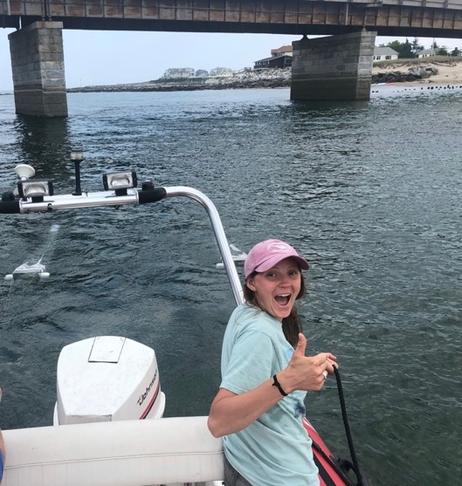
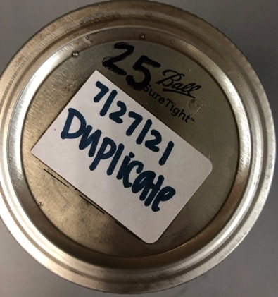
Background
Study design
Methodology
Conclusion
Field Sampling Methodology
NOAA Field Protocol
Modifications for Estuary
Designed smaller Manta Trawl net
Modified collection method
Added blanks and duplicates
Integrated secondary collection method (1 L grabs)
Chesapeake Bay Program
Large Manta Trawl net (3m)
Towed using a large vessel (1-1.5 knots)
Follows a transect for set time or distance (15 mins/ 0.5 miles)
Notes:
The first thing I did was to modify the field sampling methodology
Explain NOAA protocol
Modifications:
Built our own smaller manta trawl net (economical, able to make 2 and also more versatile for sampling)
Modified collection (anchored boat-using tide and waders in areas too shallow to bring the boat)
Integrated blanks and duplicates to assess sample variation and ensure quality control
Added a secondary (more accessible) sampling methodology to explore future options

Slide 7
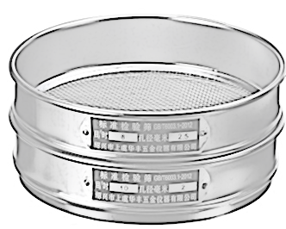
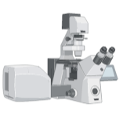
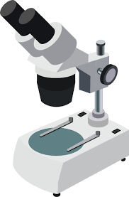
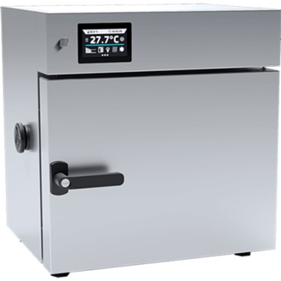
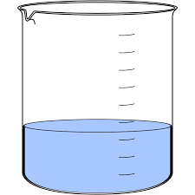
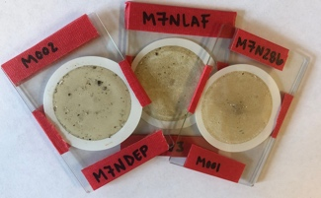
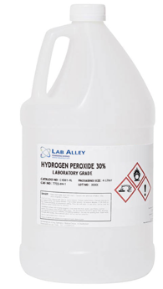
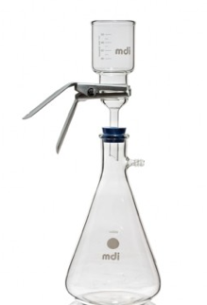
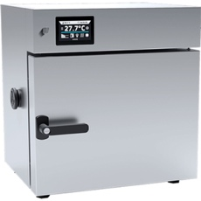
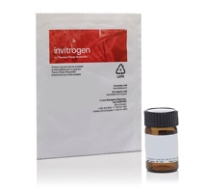
Background
Study design
Methodology
Conclusion
Lab Processing Methodology
NOAA Lab Protocol
Modifications for Estuary
Sieve
Sieve
At 90 C
Nikon Confocal
Outcomes
Prevent plastic degradation
Minimize residual OM
Improve recovery rate
Eliminate visual bias
At 60 C
Concerns
Plastic degradation
High OM
Low plastic recovery
Visual bias
Density Separation
(ZnCL₂)
At 60 C
Density Separation
(NaCl)
WPO
Fe + H₂O₂
H₂O₂
Notes:
Them we modified the Lab methodology
Modified filtration step (finer)
Reduced temp of drying step (keep below 60C)
Switched digestion (more successful)
Added more efficient *optional density separation step using zinc chloride
Improved final filtration
Employed less bias and low-cost detection step by using fluorescent staining technique (Nile Red and DAPI)

Slide 8
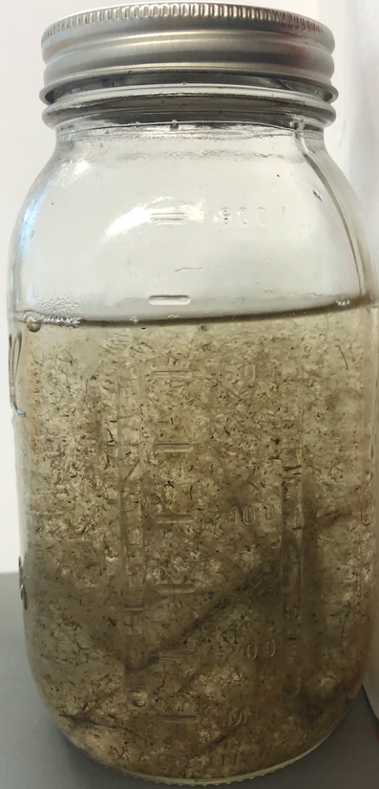
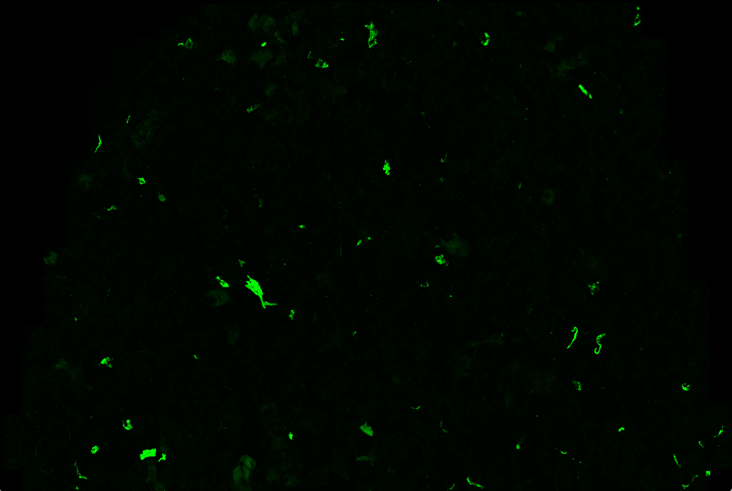
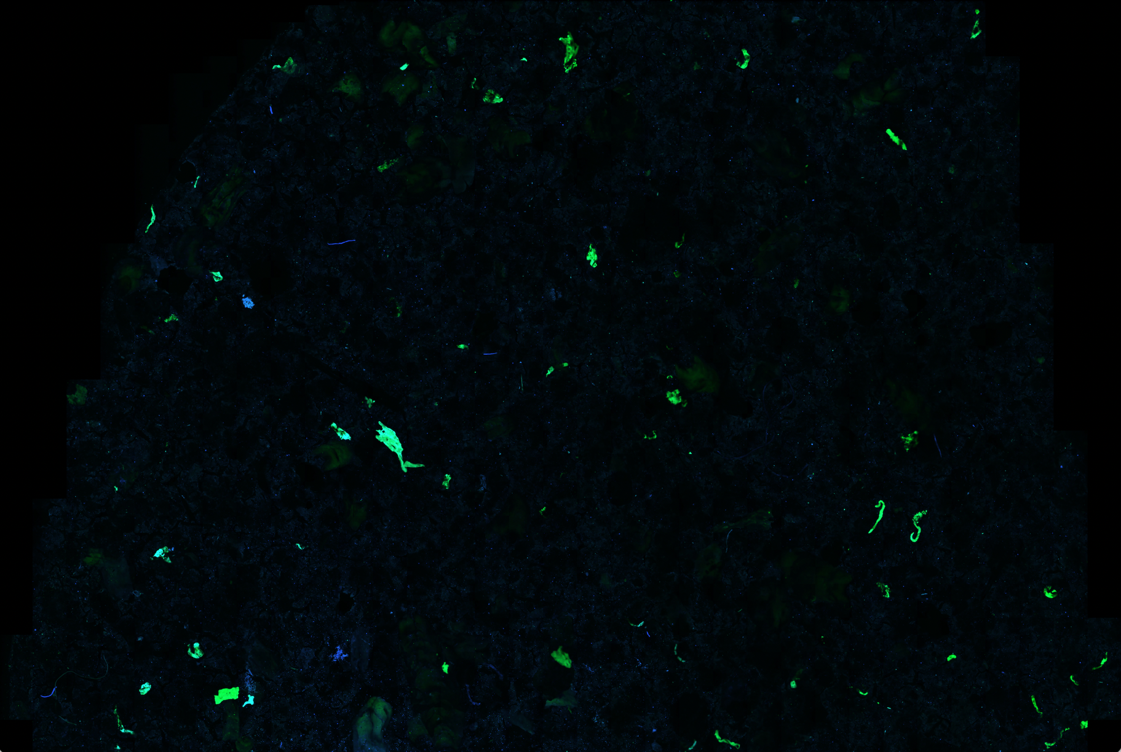
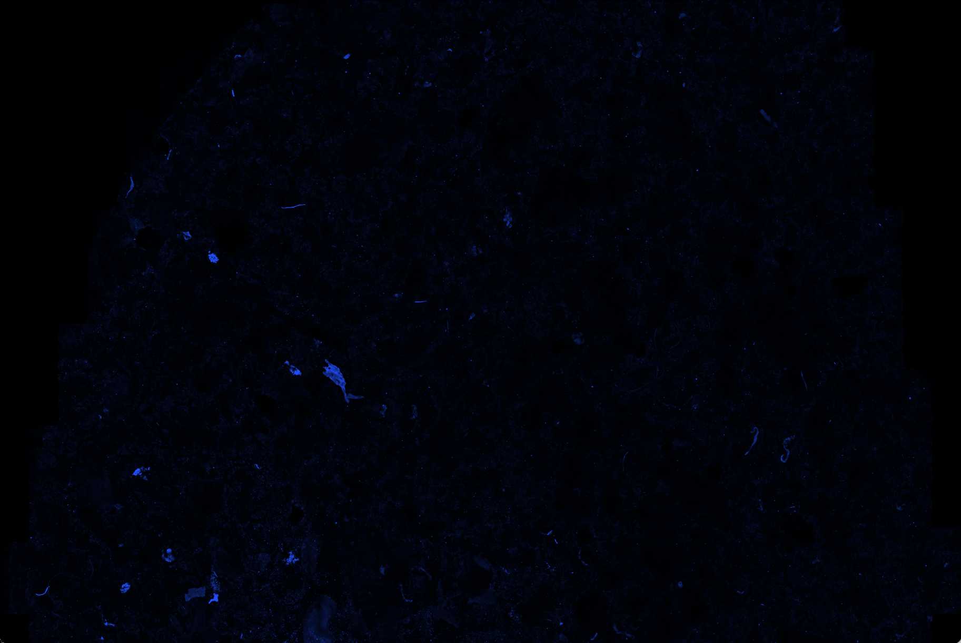
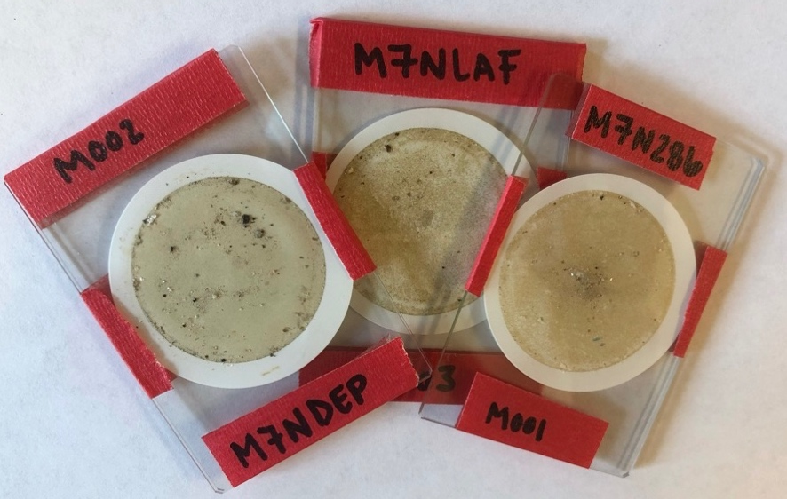
Results
Background
Study design
Methodology
Conclusion
Notes:
These outcomes allowed us to take samples like this,
And pair down to samples like this
That could be scaned using a confocal microscope to detect plastic pieces like this!

Slide 9
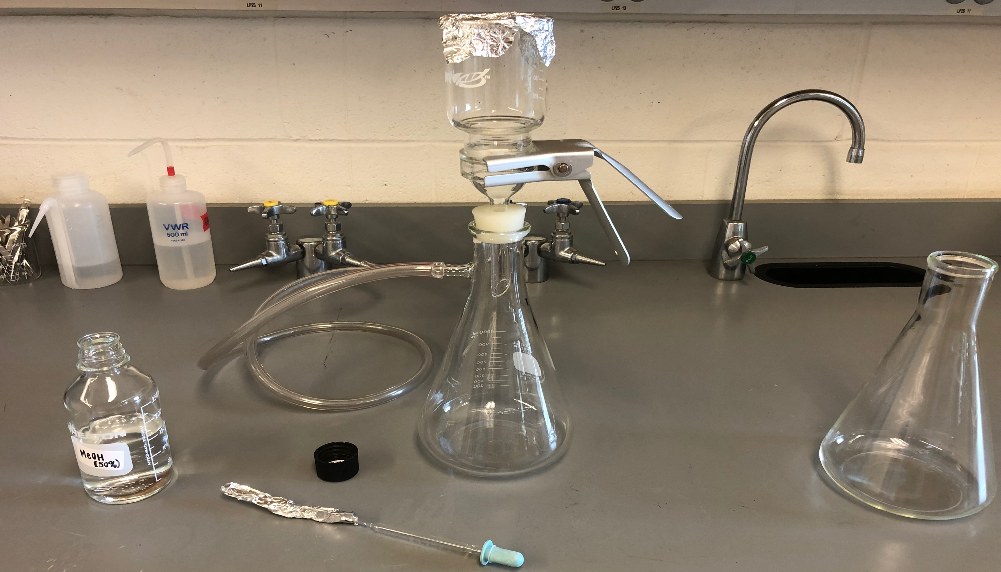
Take-Aways & Conclusions
Background
Study design
Methodology
Conclusion
Developed a successful protocol
Adaptable and scalable
More accessible methodology
Notes:
Opportunities may present themselves in ways you don’t expect!
Developed a protocol to answer my research question
Can be used on broader scale for analysis in other NE estuaries
Results from study will test additional methodology to make microplastic research more accessible

Slide 10
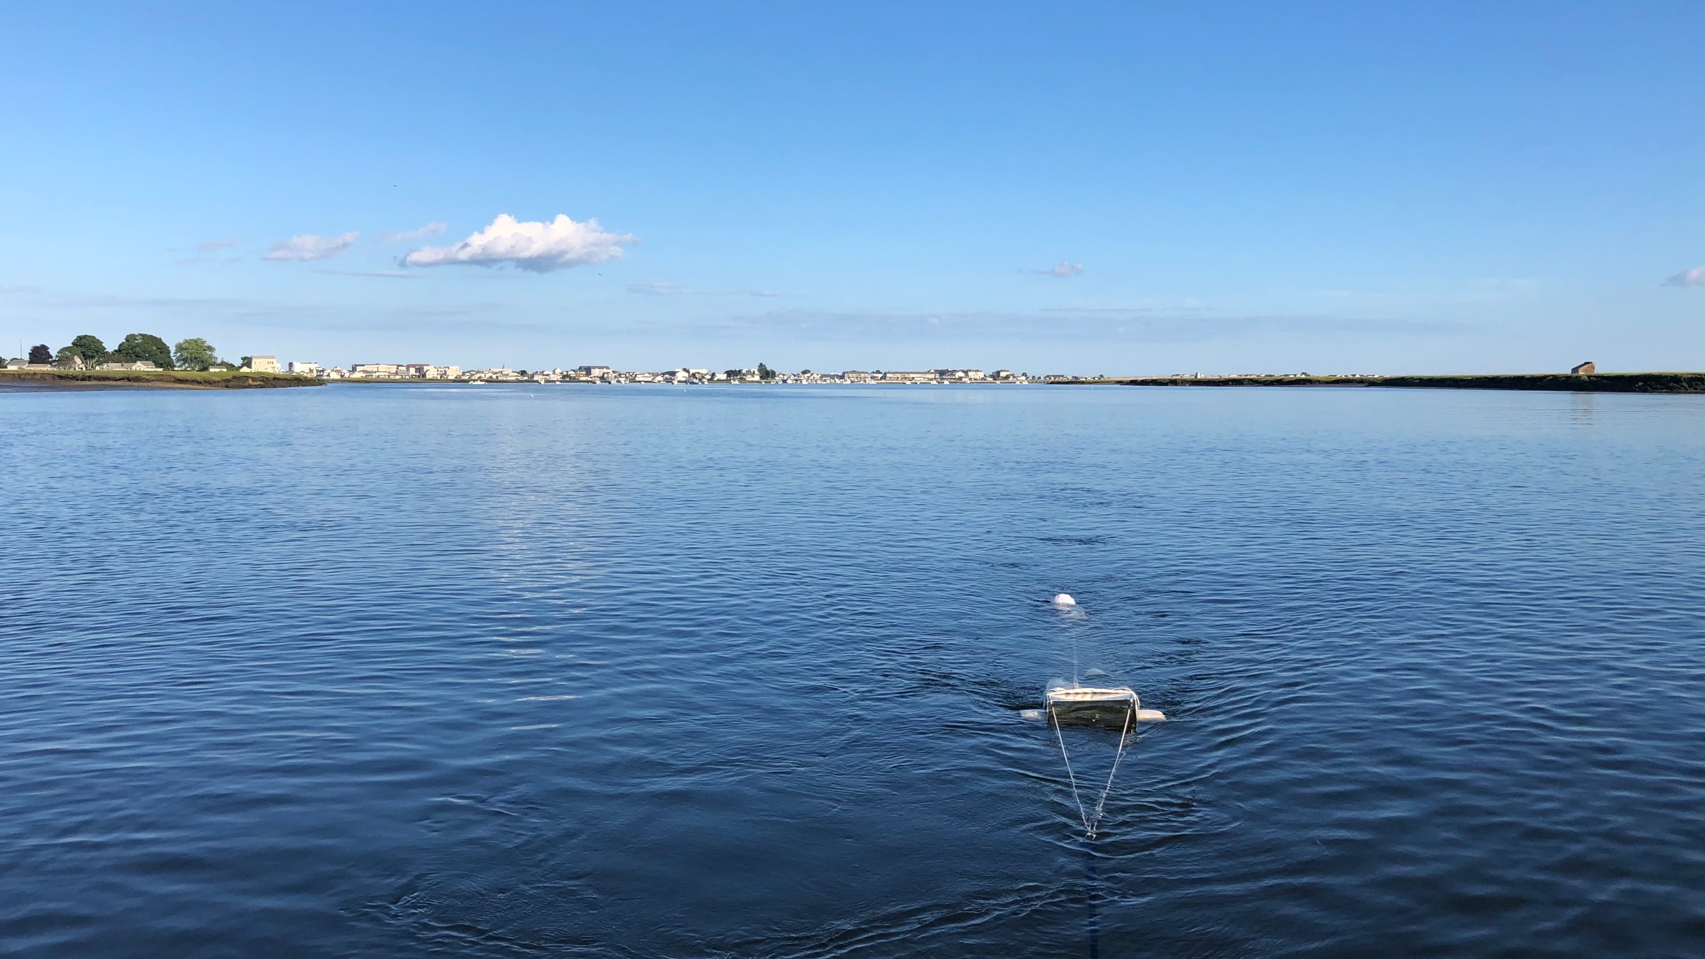
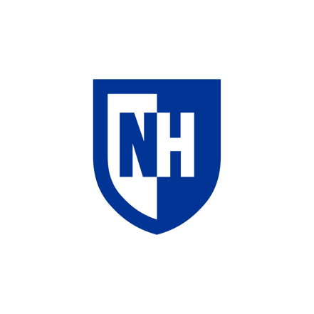
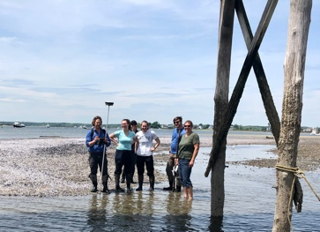
Questions?
A Big Thanks!
School of Marine Science and Ocean Engineering
UNH Graduate School
UNH Marine Biology Graduate Program
And everyone in the Moore Lab!
E-mail: hmm1031@wildcats.unh.edu

Slide 11
Sources
Andrady, A.L. 2011. Microplastics in the marine environment. Marine Pollution Bulletin 62: 1596-1605.
EPA, United States Environmental Protection Agency. 2019. Facts and Figures about Materials, Waste, and Recycling. Plastics: Material-Specific Data. https://www.epa.gov/facts-and-figures-about-materials-waste-and-recycling/plastics-material-specific-data. Accessed on 7 November 2020.
Erikson, M., Lebreton, L.C.M., Carson, H.S., Thiel, M., Moore, C.J., Borerro, J.C., Galgani, F., Ryan, P.G. and J. Reisser. 2014. Plastic Pollution in the World’s Oceans: More than 5 Trillion Plastic Pieces Weighing over 250,000 Tons Afloat at Sea. PLOS One, 9(12) e111913.
Jambeck, J.R., Geyer, R., Wilcox, C., Siegler, T.R., Perryman, M., Andrady, A., Narayan, R. & K.L. Law. 2015. Plastic waste inputs from land into the ocean. Science. 347(6223): 768-771
Law, K.L. 2017. Plastics in the Marine Environment. Annual Review Marine Science. 9:205-29.
Law, K.L., N. Starr, T.R. Siegler, J.R. Jambeck, N.J. Mallos and G.H. Leonard. 20202. The United States Contribution of Plastic Waste to Land and Ocean. Sciences Advances 6: eabd0288.
New Hampshire Employment Security (NHES). 2020. Community Profiles: Hampton, NH. < https://www.nhes.nh.gov/elmi/products/cp/profiles-htm/hampton.htm>
Masura, J., J. Baker, G. Foster and C. Arthur. 2015. Laboratory Methods for the Analysis of Microplastics in the Marine Environment: Recommendations for quantifying synthetic particles in waters and sediments. NOAA Technical Memorandum NOS-OR&R-46.
PlasticsEurope, Association of Plastic Manufacturers. 2015. Plastics—the Facts 2015. https://committee.iso.org/files/live/sites/tc61/files/The%20Plastic%20Industry%20Berlin%20Aug%202016%20-%20Copy.pdf. Accessed on 4 November 2020.
PlasticsEurope, Association of Plastic Manufacturers.2019. Plastics-the Facts 2019. https://www.plasticseurope.org/application/files/9715/7129/9584/FINAL_web_version_Plastics_the_facts2019_14102019.pdf. Accessed on 4 November 2020.
Rochman C.M., Browne, M.A., Halpern, B.S., Hentschel, B.T., Hoh. E., Karapanagioti, H.K., Rios-Mendoza, L.M., Takada, H., The, S. & R.C. Thompson. 2013. Classify plastic waste as hazardous. Nature 494:169–71.
Seabrook-Hamptons Estuary Alliance (SHEA). 2019. Flooding in Hampton, NH Situation Assessment. Hampton, NH.
Teuton, E.L., J.M, Saquing, D.R.U, Knappe, M.A. Barlaz, S. Jonsson, A. Bjorn, S.J., Rowland, R.C. Thompson, T.S., Galloway, R.Yamashita, D.Ochi, Y. Watanuki, C. Moore, P.H. Viet, T.S. Tana, M. Prudente, R. Boonyatumanond, M.P. Zakaria, K. Akkhavong, Y. Ogata, H. Hirai, S. Iwasa, K. Mizukawa, Y. Hagino, A. Imamura, M. Saha, H. Takada. 2009. Transport and release of chemicals from plastics to the environment and to wildlife. Philosophical
Notes:
Need to update!

