Slide 1
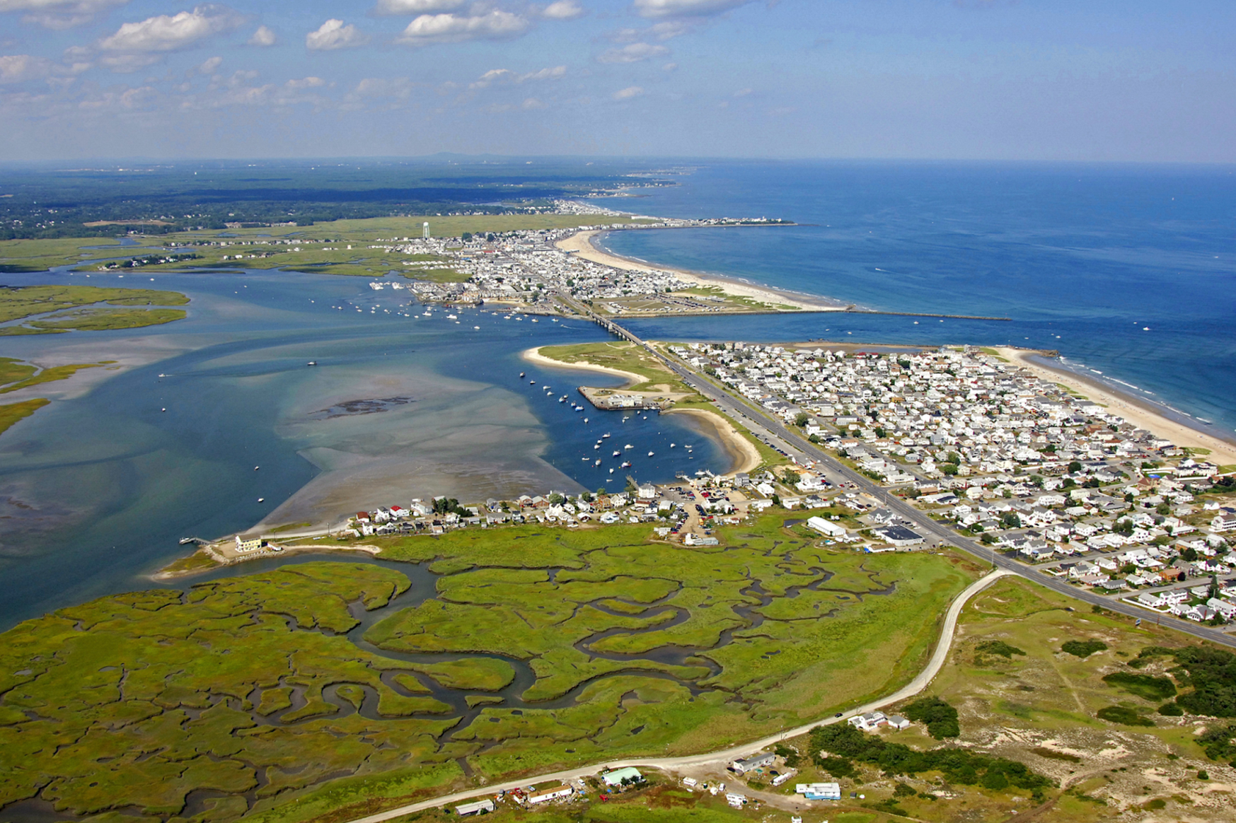


Observations of Shear Instabilities in Hampton Inlet
Katie Kirk^{1,2}, Dr. Thomas Lippmann¹
1. UNH, Department of Earth Sciences
2. NOAA Center for Operational Oceanographic Products & Services

Slide 2
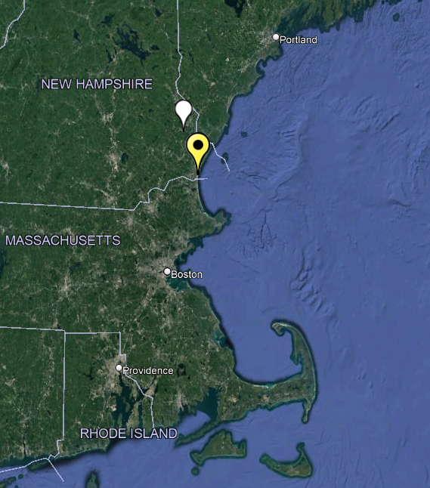
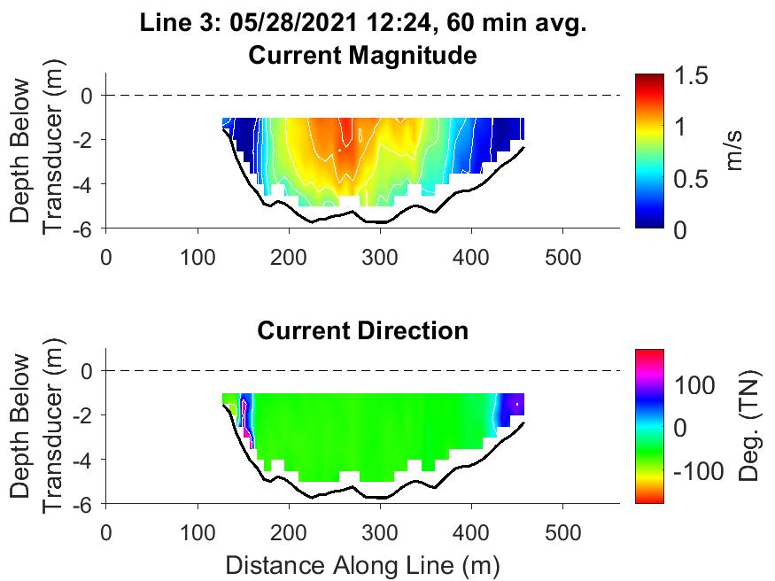
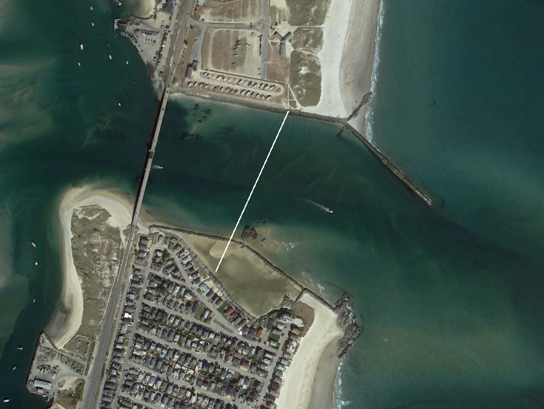


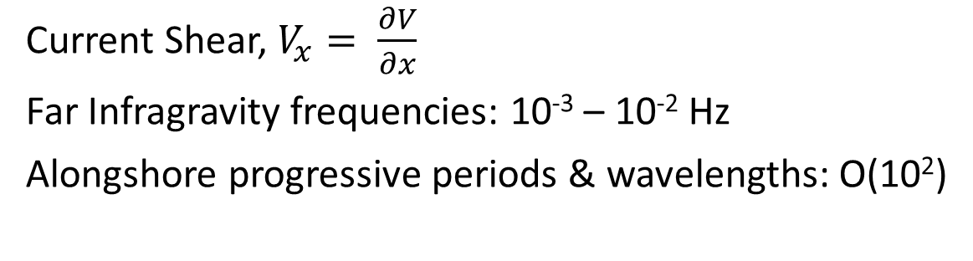
Shear Instabilities
$$V_{x}$$
UNH
Hampton Inlet
Current Shear, $V_{x}= \frac{∂V}{∂x}$
Far Infragravity frequencies: 10⁻³ – 10⁻² Hz
Alongshore progressive periods & wavelengths: O(10²)
Notes:
Our objective for this study was to observe shear instabilities of tidal currents in Hampton Inlet, which is located along the NH coastline.
We hypothesized that currents in narrow channels can have horizontal velocity gradients that produce instabilities in the flow that can lead to the spinoff of large eddies.
Here we are looking at tidally driven currents versus in the nearshore where wave breaking drives the long shore currents.

Slide 3
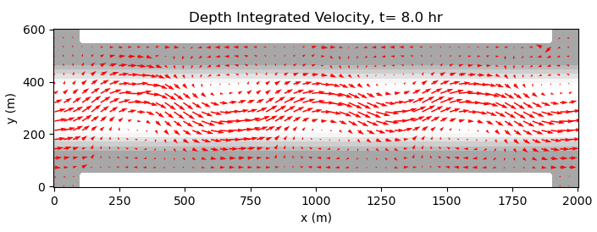
Implications of Shear Instabilities
Meandering of the tidal current
Transport in the estuary and on ecosystem dynamics
Renewable energy initiatives due to mixing of momentum

Slide 4
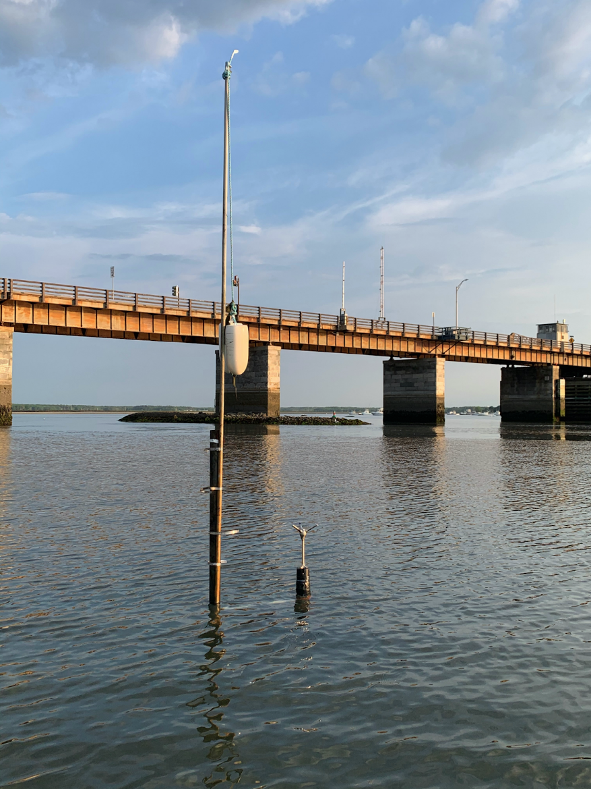
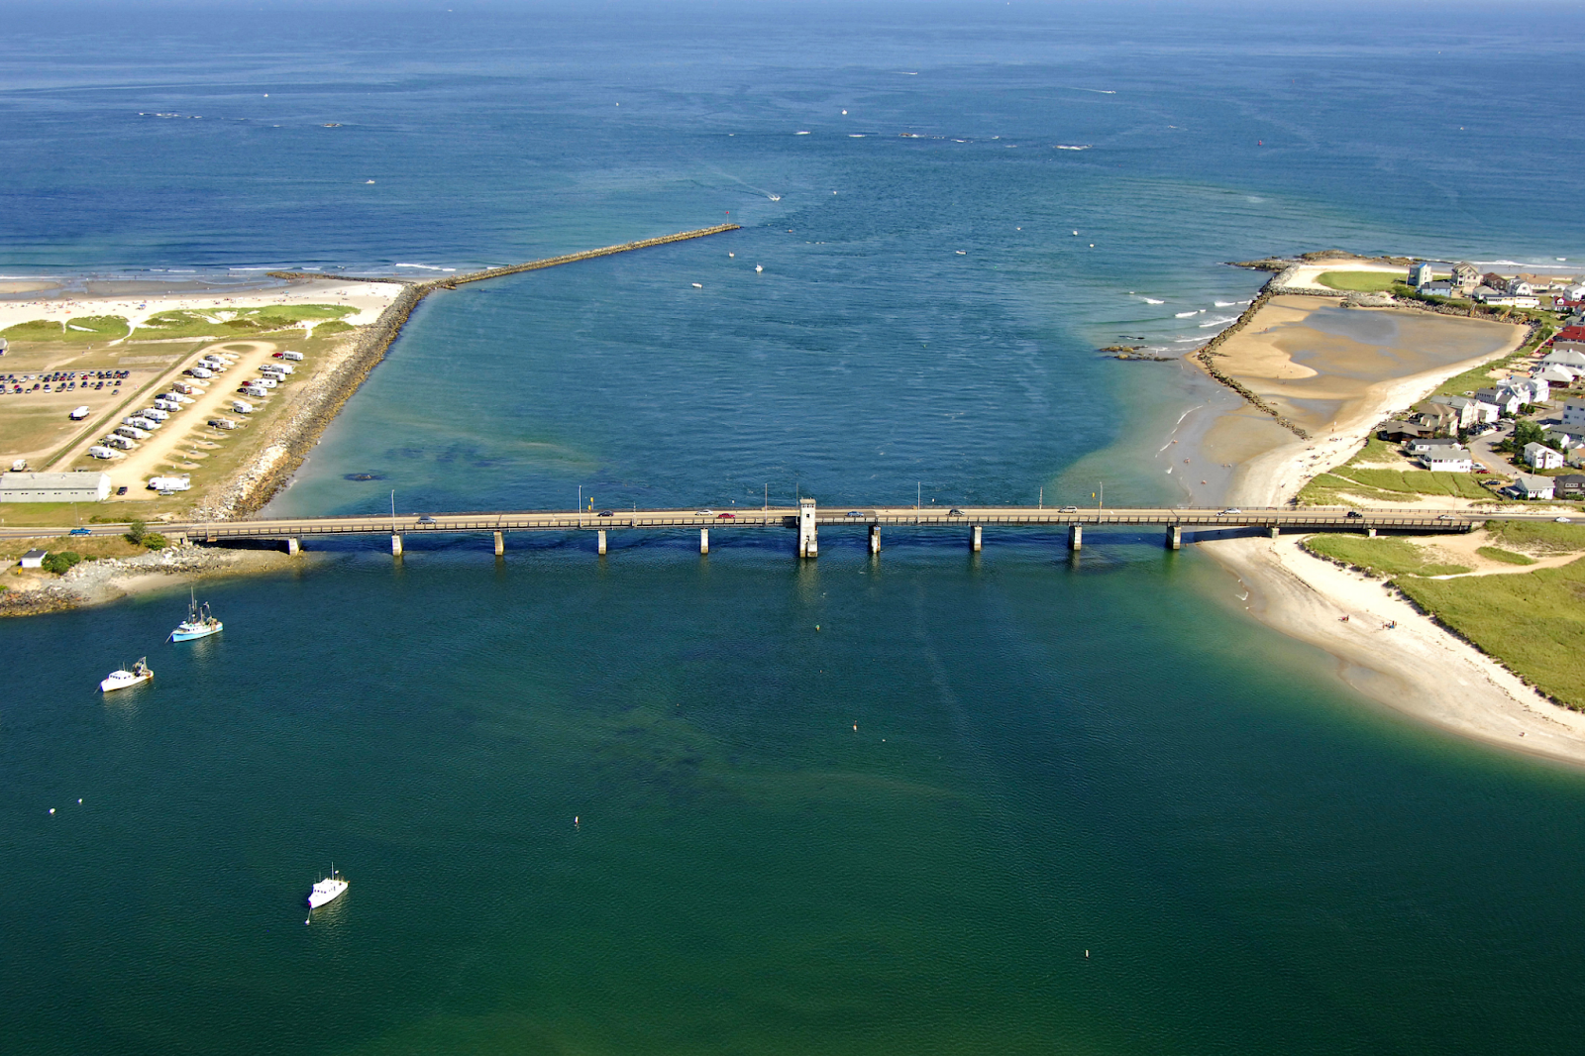
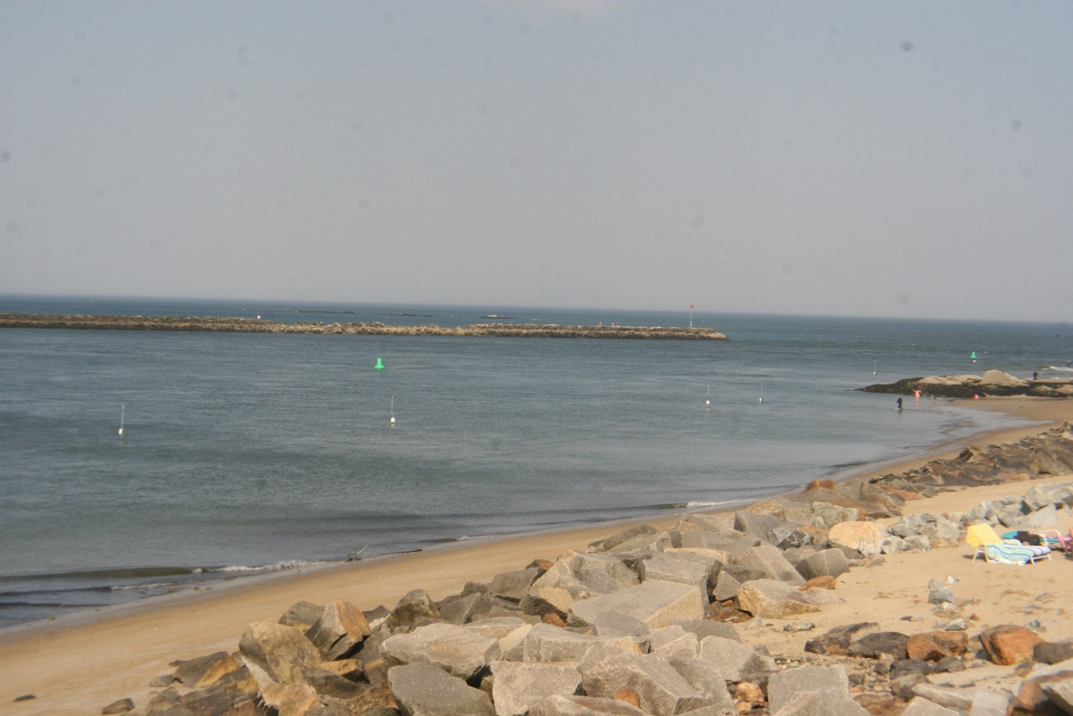
W
Hampton / Seabrook Inlet
Hampton
Seabrook
W
marinas.com

Slide 5
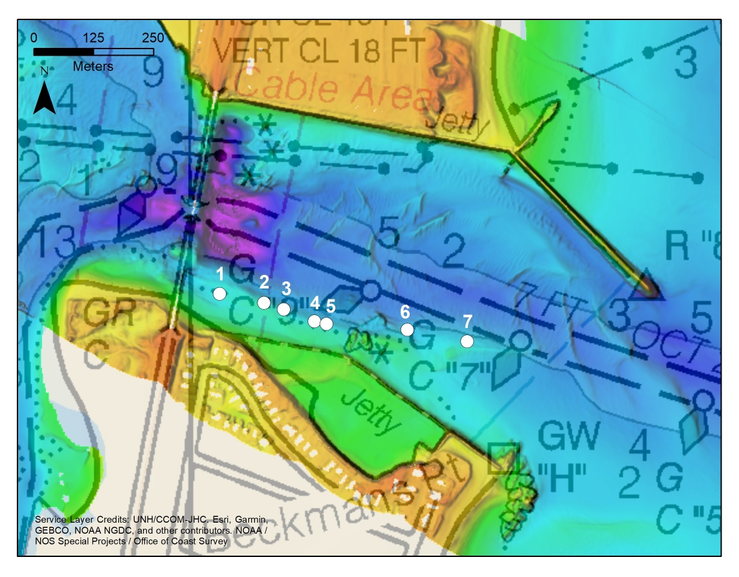
Hampton Inlet Observations
Along-channel Array:
Following Oltman-Shay et al. 1989
7 current meters (ADCPs & ADVs)
Deployed at ~ 3 m below NAVD88
Length of array: 389.3 m
Min lag spacing: 18.5 m
Deployment duration: 6 days = 12 tidal cycles
1 Hz sampling
Bathymetry:
Sonar & GPS surveys pre- & post- deployments
Cross-channel Transects:
4 lines
ADCP tows
Notes:
Deployment: 5/25/2021 – 06/1/2021

Slide 6
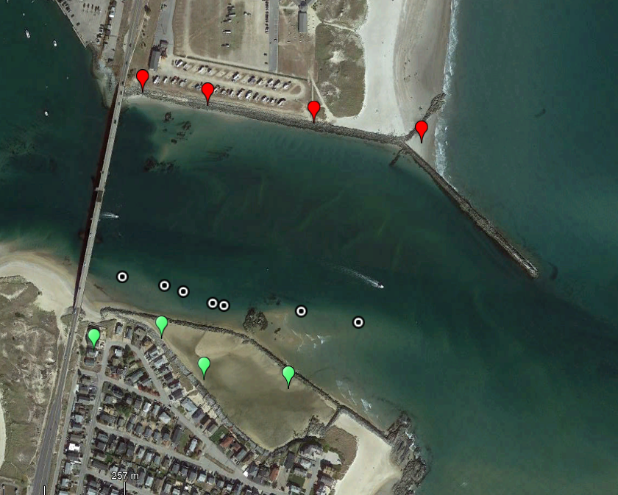
Hampton Inlet Observations
Along-channel Array:
Following Oltman-Shay et al. 1989
7 current meters (ADCPs & ADVs)
Deployed at ~ 3 m below NAVD88
Length of array: 389.3 m
Min lag spacing: 18.5 m
Deployment duration: 6 days = 12 tidal cycles
1 Hz sampling
Bathymetry:
Sonar & GPS surveys pre- & post- deployments
Cross-channel Transects:
4 lines
ADCP tows
Line 1
Line 2
Line 3
Line 4
1
2
3
4
5
6
7
Notes:
Deployment: 5/25/2021 – 06/1/2021

Slide 7
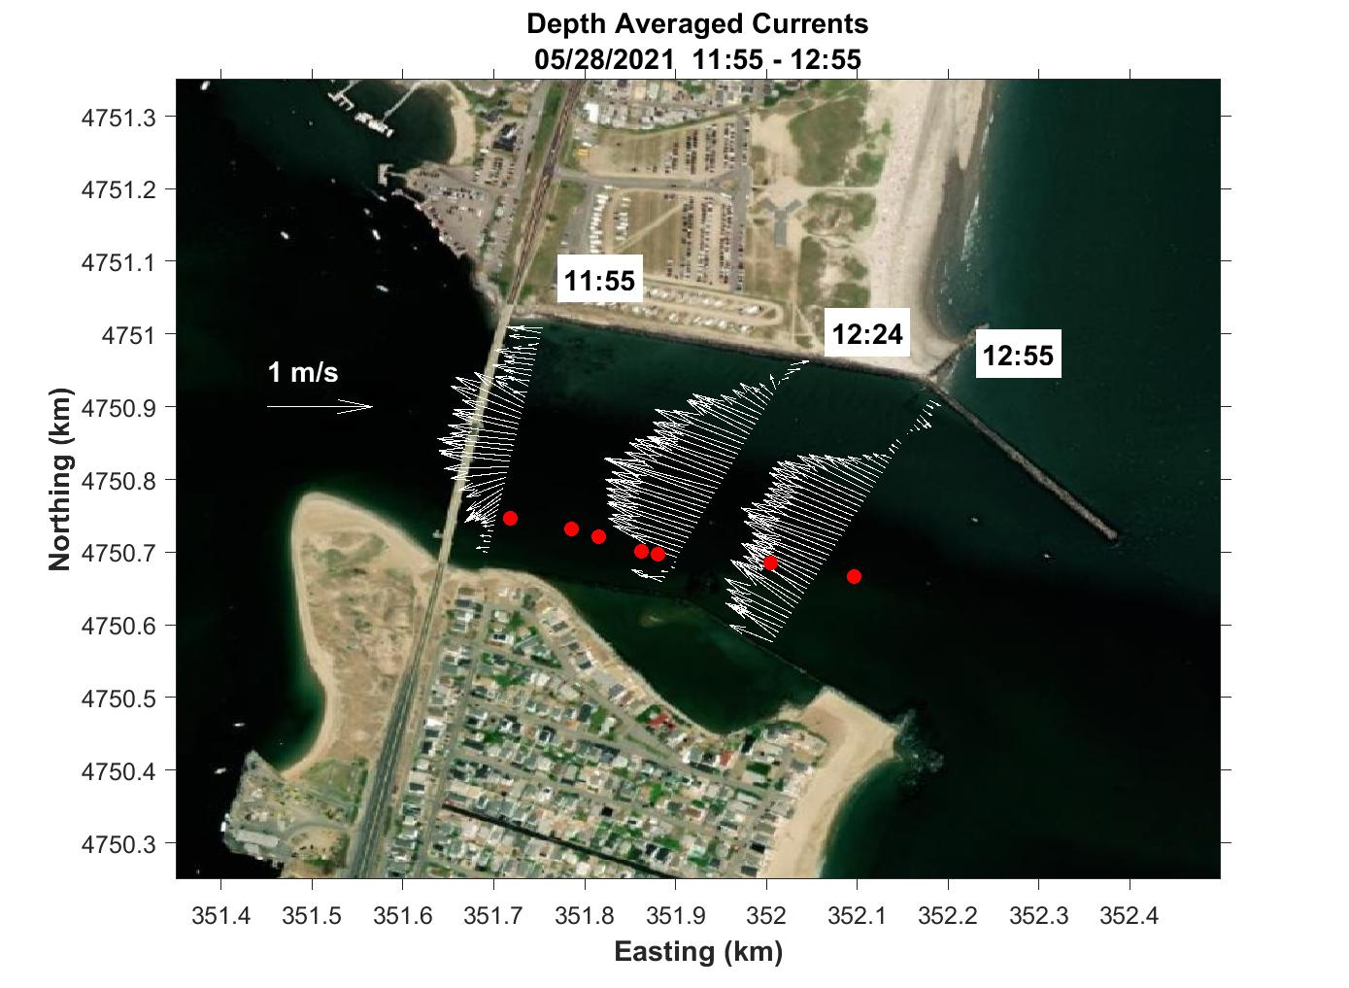
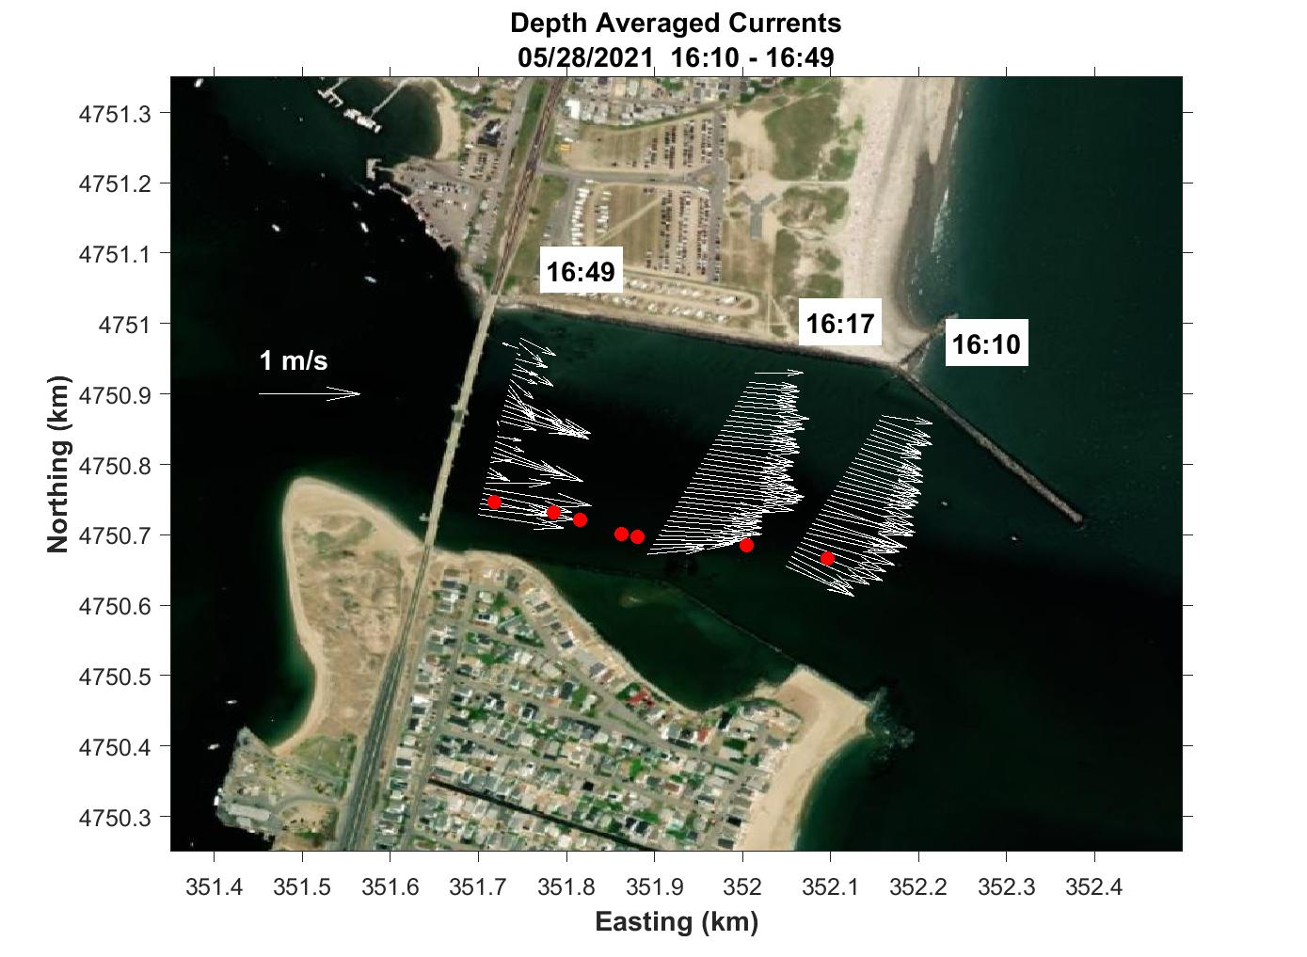
Cross-Inlet ADCP Transects
Flood Tide
Ebb Tide

Slide 8
Cross-Inlet ADCP Transects
Flood Tide
Seabrook, S
Hampton, N

Slide 9
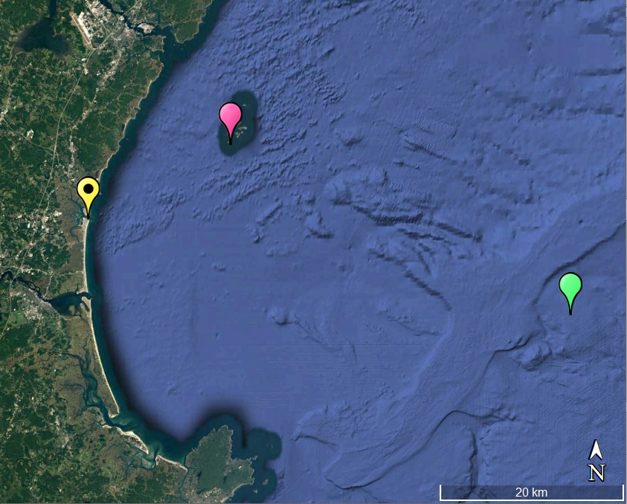
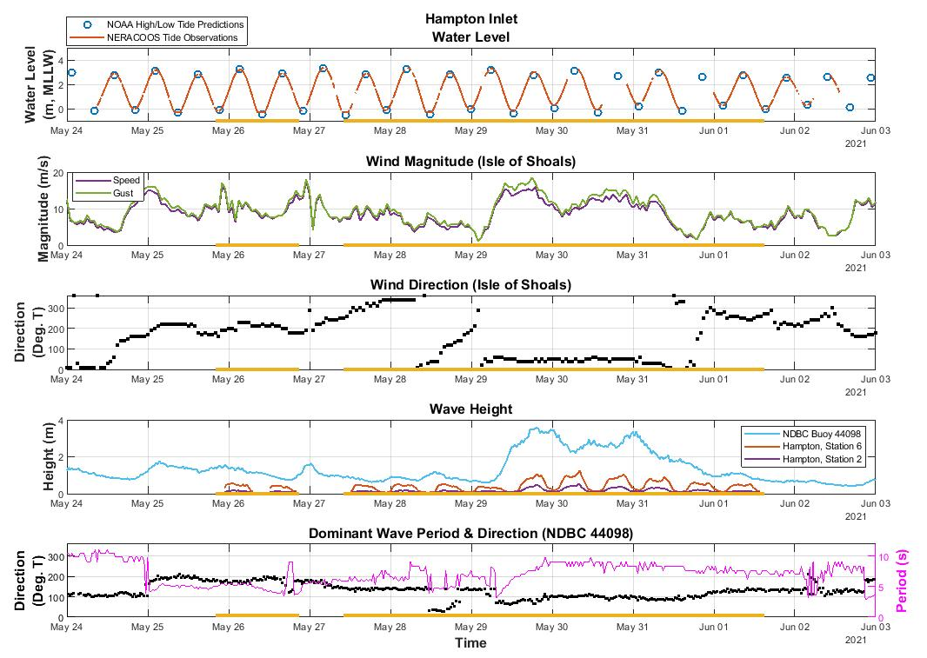
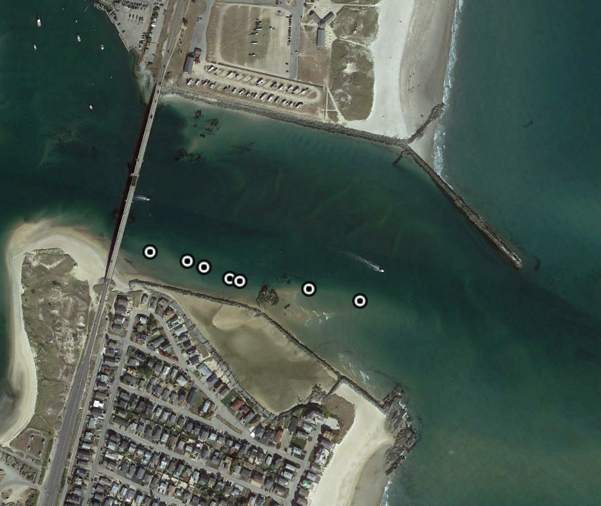
Ancillary Data
Array Deployment
Isle of Shoals
Hampton Inlet
Jeffrey’s Ledge
(NDBC 44098)
Hampton Inlet
2
6
Notes:
Spring tide
Nearly 4 m tidal range
Station 6 waves reach ~ 1.3 m. Station 2 waves reach up to about 50 cm but are primarily less than 20 cm → 2 orders of magnitude difference than the offshore waves (~ 3.5 m vs 30 cm)
Wave dir @ 90 deg → coming straight into inlet

Slide 10
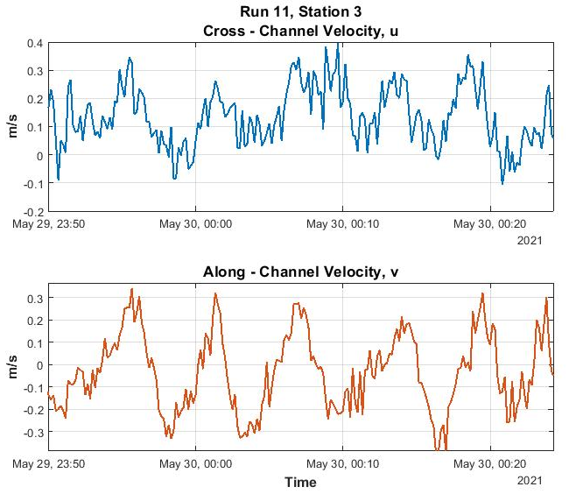
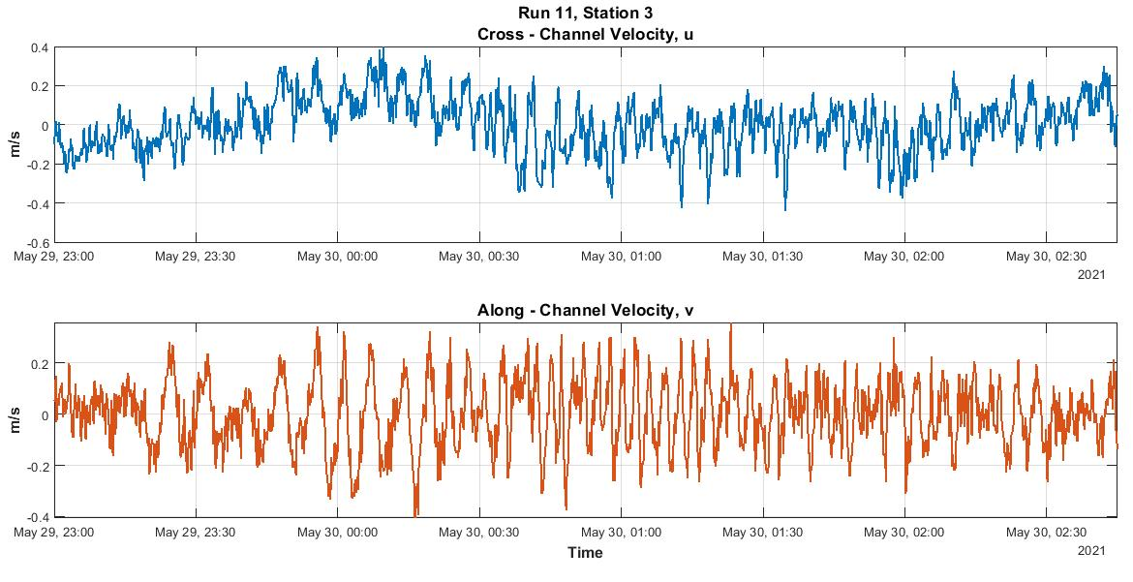
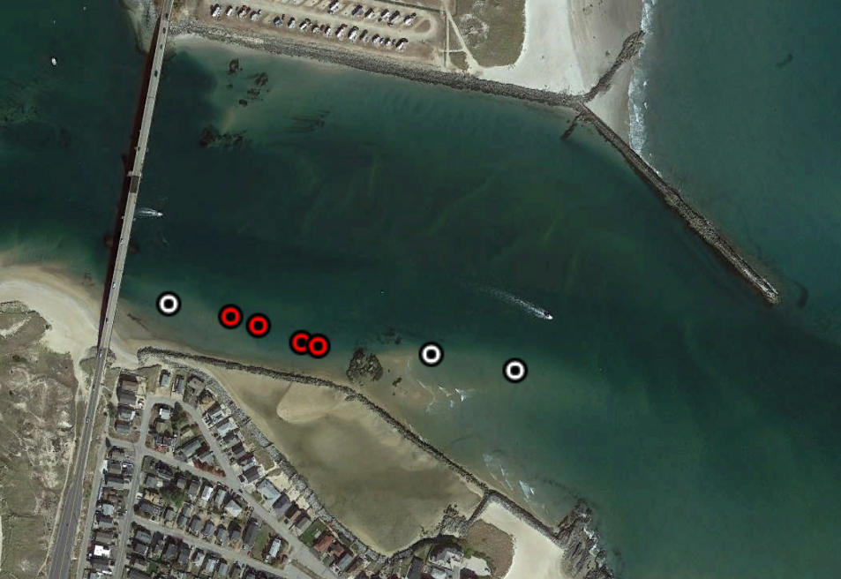
Current Meter Array Observations
Flood tide, Stations 2 - 5
101 m
1
2
3
4
5
6
7
Notes:
Sampled at 1 Hz. Time avg 10 sec. Bin avg. for ADCPs.
QCd & quadratic detrended
Run 11: 5/29/2021 23:00:00 – 05/30/2021 02:45:00, duration: 03:45:00
Length of array (2 – 5 stations): ~101 m
Min lag spacing remains at 18.5 m
Mean u = -0.2375, -0.1954, -0.0611, -0.0246
Mean v = 0.1118 0.0761 0.0774 0.0409

Slide 11
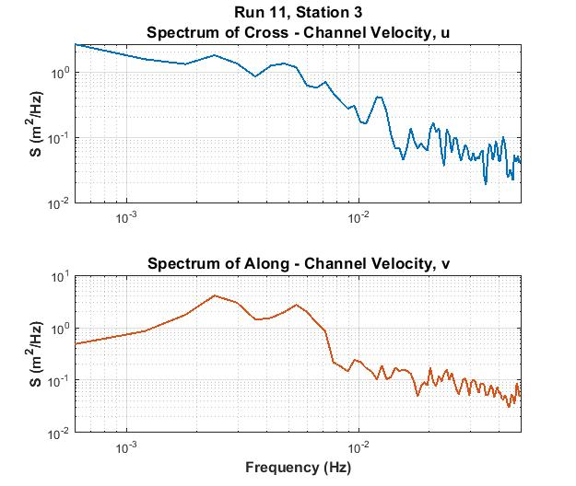
Velocity Spectrum
Flood tide, Stations 2 - 5
101 m
1
2
3
4
5
6
7
Notes:
Spectra: 8 ensembles, 1 band, and Hanning window

Slide 12
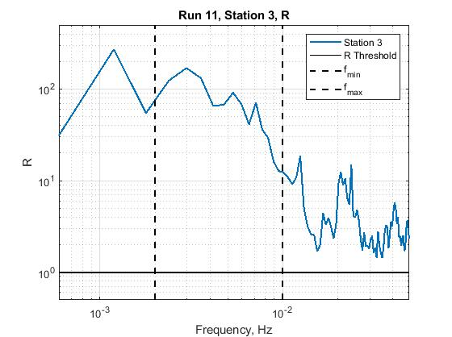
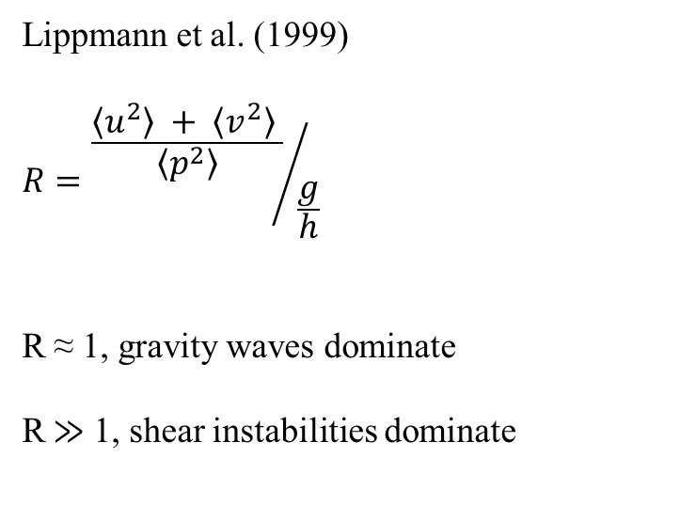
Velocity to Pressure Variance Ratio, R
Flood Tide, Stations 2 - 5
Lippmann et al. (1999)
$$R={\frac{〈u^{2}〉 + 〈v^{2}〉 }{〈p^{2}〉}}/{\frac{g}{h}}$$
R ≈ 1, gravity waves dominate
R$≫$ 1, shear instabilities dominate

Slide 13
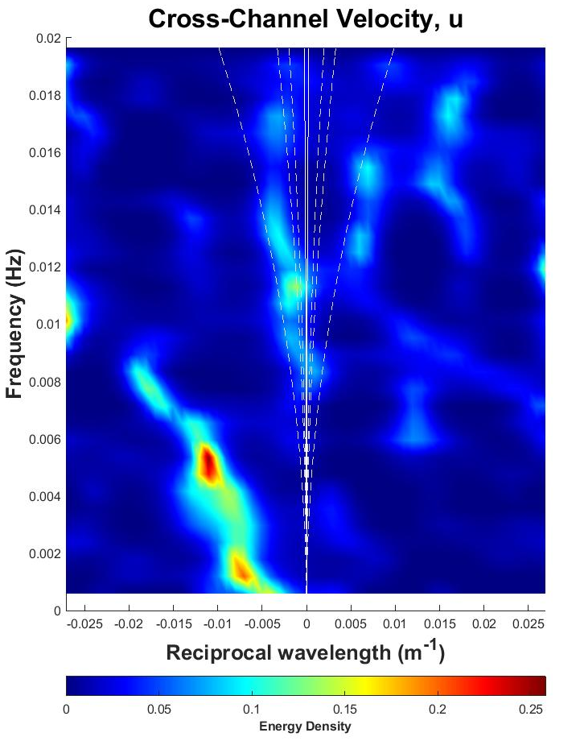
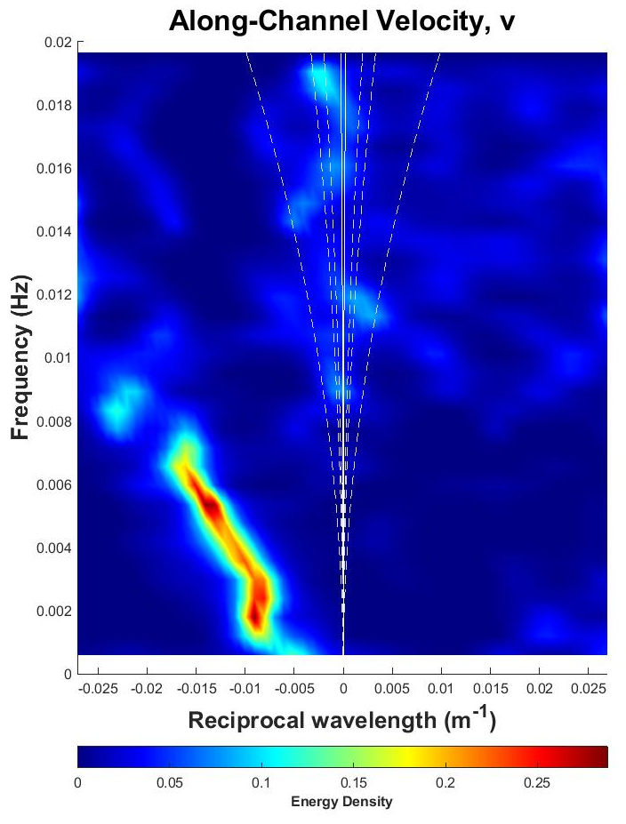
Wavenumber-Frequency Spectra
Flood Tide, Stations 2 - 5
N
Westward
Eastward
Westward
Eastward
Notes:
Cross-Spectral Matrix: 8 ensembles, 1 band, Kaiser window
Use IMLEs to calculate k-f

Slide 14
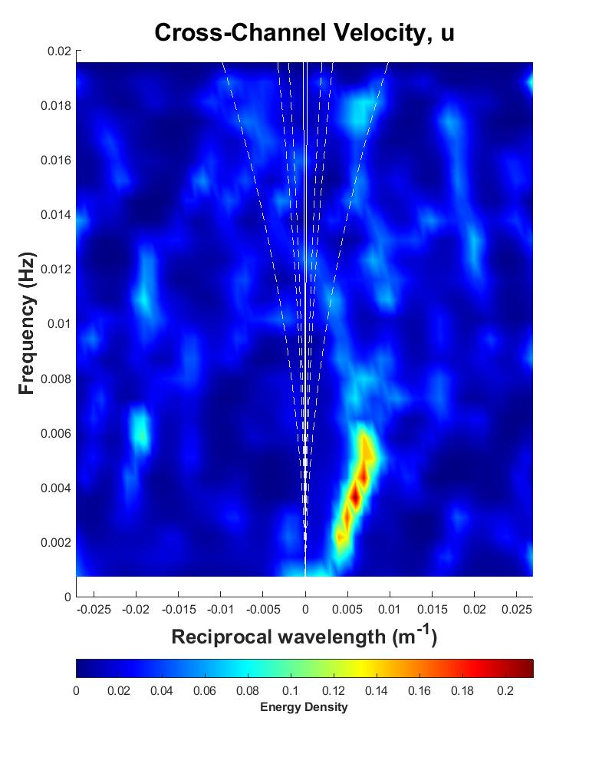
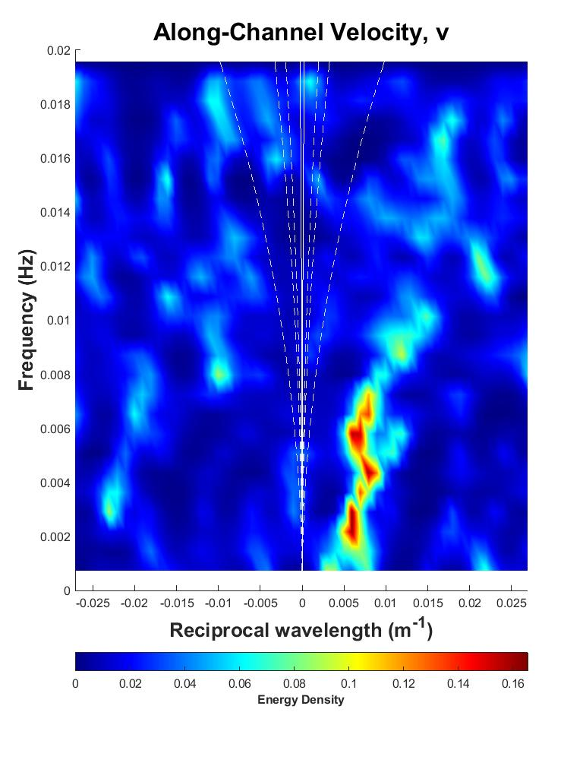
Wavenumber-Frequency Spectra
Ebb Tide, Stations 1 - 5
N
Westward
Eastward
Westward
Eastward
Notes:
- V: not linear → possibly due to voriticies shedding off bridge pilings and/or complications due to topography

Slide 15
Conclusions
kkirk@ccom.unh.edu
The presence of shear instabilities of tidal currents were observed in a bounded inlet using an array of current meters.
  Clearly distinctive motions from low mode gravity waves
Instabilities show progressive characteristics & propagate in the direction of the tidal current.
Velocity to pressure variance ratios (R) show the infragravity band is dominated with rigid-lid-like motions, consistent with instabilities.
The shear instability range of wavenumbers & frequencies observed is consistent with analytical solutions.

