Slide 1


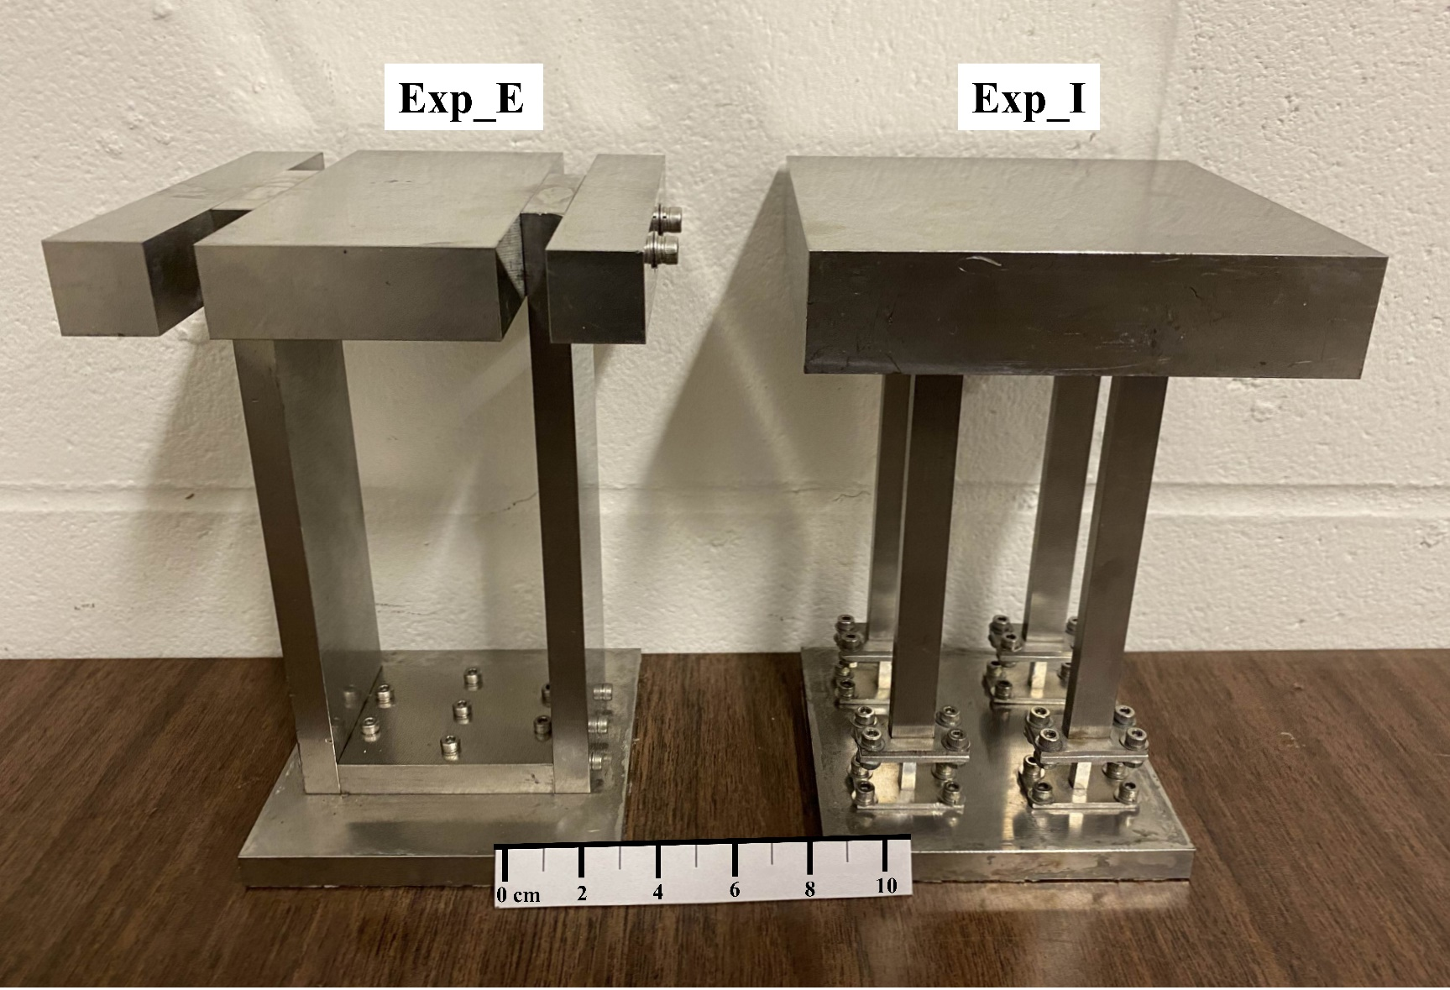
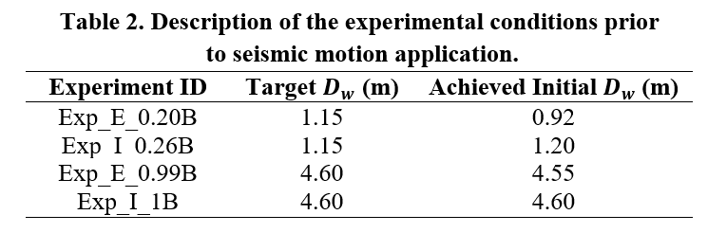
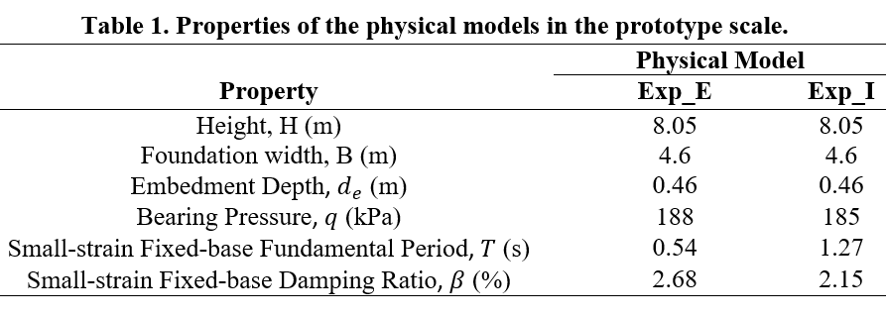
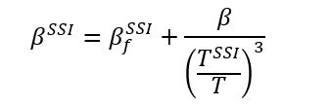
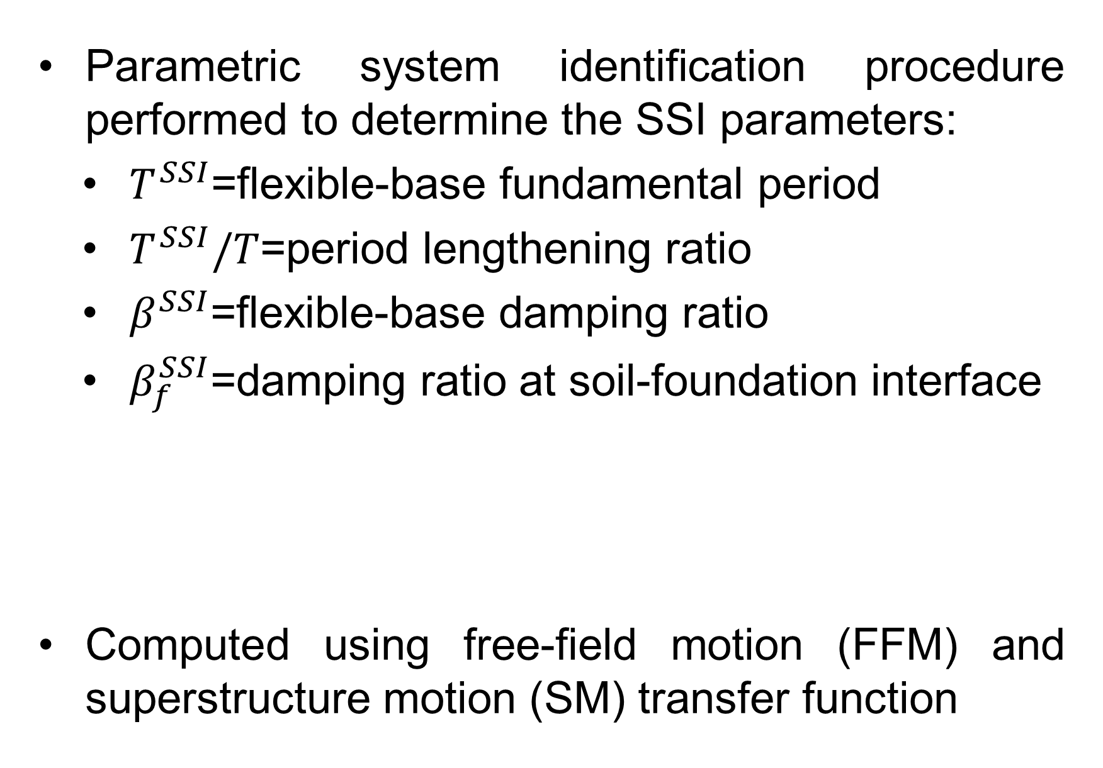
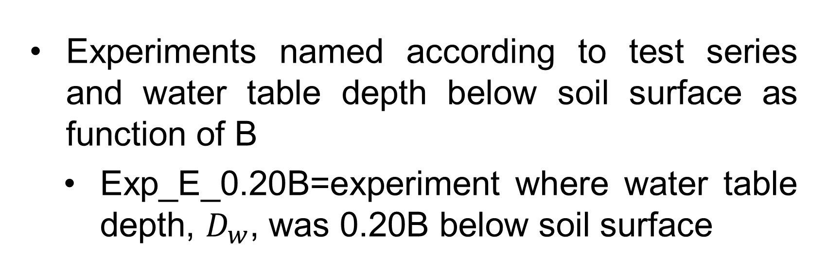
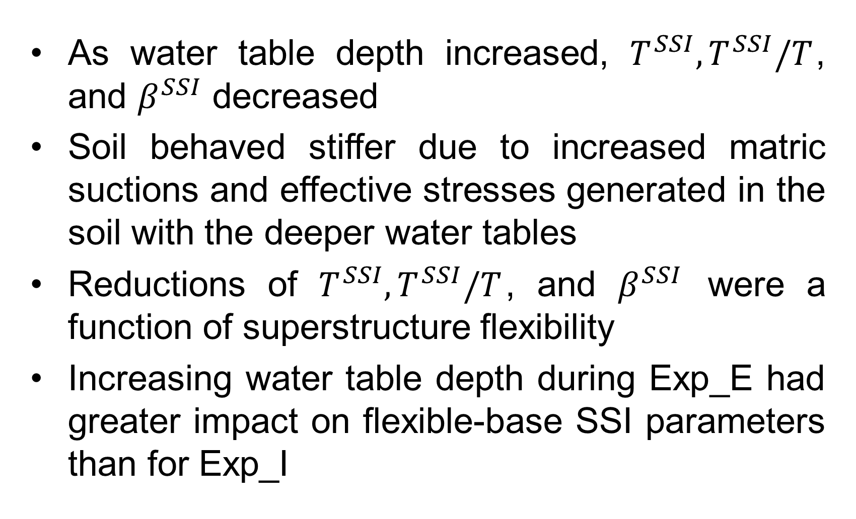

Centrifuge Modeling to Evaluate the Seismic Response of Elastic and Inelastic Structures Embedded in Unsaturated Soil
Matthew M. Turner¹, Majid Ghayoomi¹, Kyohei Ueda², Ryosuke Uzuoka²
¹University of New Hampshire Department of Civil and Environmental Engineering
²Kyoto University, Disaster Prevention and Research Institute
Abstract
Design of Model Structures
Cross-Experimental Results and Discussion
Soil-structure interaction has been increasingly considered in the design of structures located in areas of high seismicity. Design codes typically assume the soil to be in either the dry or fully saturated states; however, dynamic soil properties such as stiffness and damping are influenced by the degree of saturation in the underlying soil. This poster presents some findings from two series of centrifuge tests to evaluate the performance of a mid-rise structure, shallowly embedded in sandy silt with varying water table depths. In one test series the physical model was designed to remain within its elastic range, in another, the physical model was designed to behave inelastically during seismic loading. Results indicate that as the water table elevation decreased, the soil behaved stiffer, leading to reduced period lengthening and system damping. Reductions in period lengthening and system damping that were correlated with the depth of the water table, were also related to the behavior of the superstructure, with greater reductions observed during the experiments performed on the elastic structure.
Each structure exhibits unique response
  Exp_E=completely elastic superstructure response
  Exp_N=inelastic superstructure response
Parameters held constant=total height, foundation width, foundation length, embedment depth, bearing pressure, fixed-base fundamental period and damping ratio
Fig. 4. Soil-water-retention curve of soil material.
Experiments named according to test series and water table depth below soil surface as function of B
  Exp_E_0.20B=experiment where water table depth, $D_{w}$, was 0.20B below soil surface
Fig. 6. Variation of flexible-base SSI parameters across Exp_E and Exp_I.
Fig. 2. Photograph of physical models.
Seismic Input Motions
As water table depth increased, $T^{SSI}, T^{SSI}/T$, and $β^{SSI}$ decreased
Soil behaved stiffer due to increased matric suctions and effective stresses generated in the soil with the deeper water tables
Reductions of $T^{SSI}, T^{SSI}/T$, and $β^{SSI}$ were a function of superstructure flexibility
Increasing water table depth during Exp_E had greater impact on flexible-base SSI parameters than for Exp_I
Series of unidirectional seismic motions applied to base of laminar container
Response of structural systems during representative input motion investigated
Scaled horizontal component of 1994 Northridge, CA earthquake
Figure shows input motions were similar across experimental conditions and allows for comparison of system responses
Introduction
Two types of seismic designs in practice:
  Conventional Capacity Design-strength mobilization restricted to superstructure
  Rocking Foundation-mobilization of plastic deformation at soil-foundation interface
Goal=model one completely elastic and one inelastic structural system to determine influence of water table elevation on Soil-Structure interaction (SSI) behavior
Four centrifuge tests were performed
  Two on elastic structure with water table at soil surface and about 0.25B below soil surface
  Two on inelastic structure with same water table conditions as above
Soil Material and Test Setup
Silica No. 9 Sand used
  Fines content=64%
  Prepared through dry pluviation into centrifuge laminar box
  Dry density=$1463 kg/m^{3}$
Saturated at 1-g, then spun up to 46-g in geotechnical centrifuge
Water table drained in-flight
Conclusions
Two series of dynamic centrifuge tests performed
Evaluated influence of water table depth on dynamic response of buildings
One building with superstructure to remain completely elastic
One building with superstructure to experience inelastic deformations
Variations in experimental conditions were minor
Depth of water table had clear influence on SSI induced parameters
Greater changes to SSI parameters with water table depth observed for Exp_E than for Exp_I
Study highlights influence of the water table elevation on the nonlinear response of soil-structure systems, which may help to identify shortcomings of current seismic design codes in the context of damage potential and building performance.
Fig. 5. Comparison of recorded BM acceleration response spectra.
Data Analysis Methods
Parametric system identification procedure performed to determine the SSI parameters:
  $T^{SSI}$=flexible-base fundamental period
  $T^{SSI}/T$=period lengthening ratio
  $β^{SSI}$=flexible-base damping ratio
  $β_{f}^{SSI}$=damping ratio at soil-foundation interface
Computed using free-field motion (FFM) and superstructure motion (SM) transfer function
Fig. 1. Conventional vs. rocking foundation.
Fig. 3. Schematic centrifuge test layout.

