Slide 1
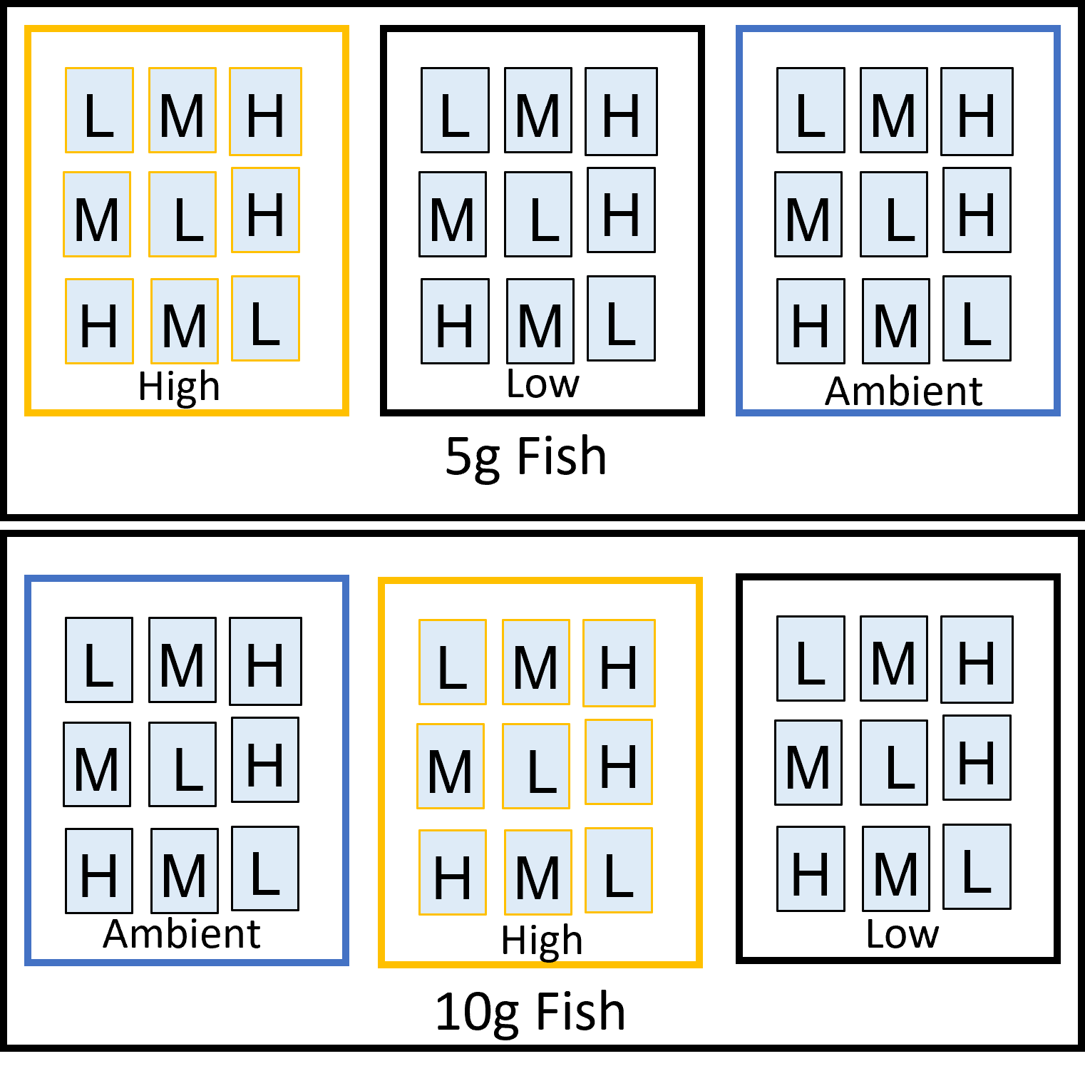
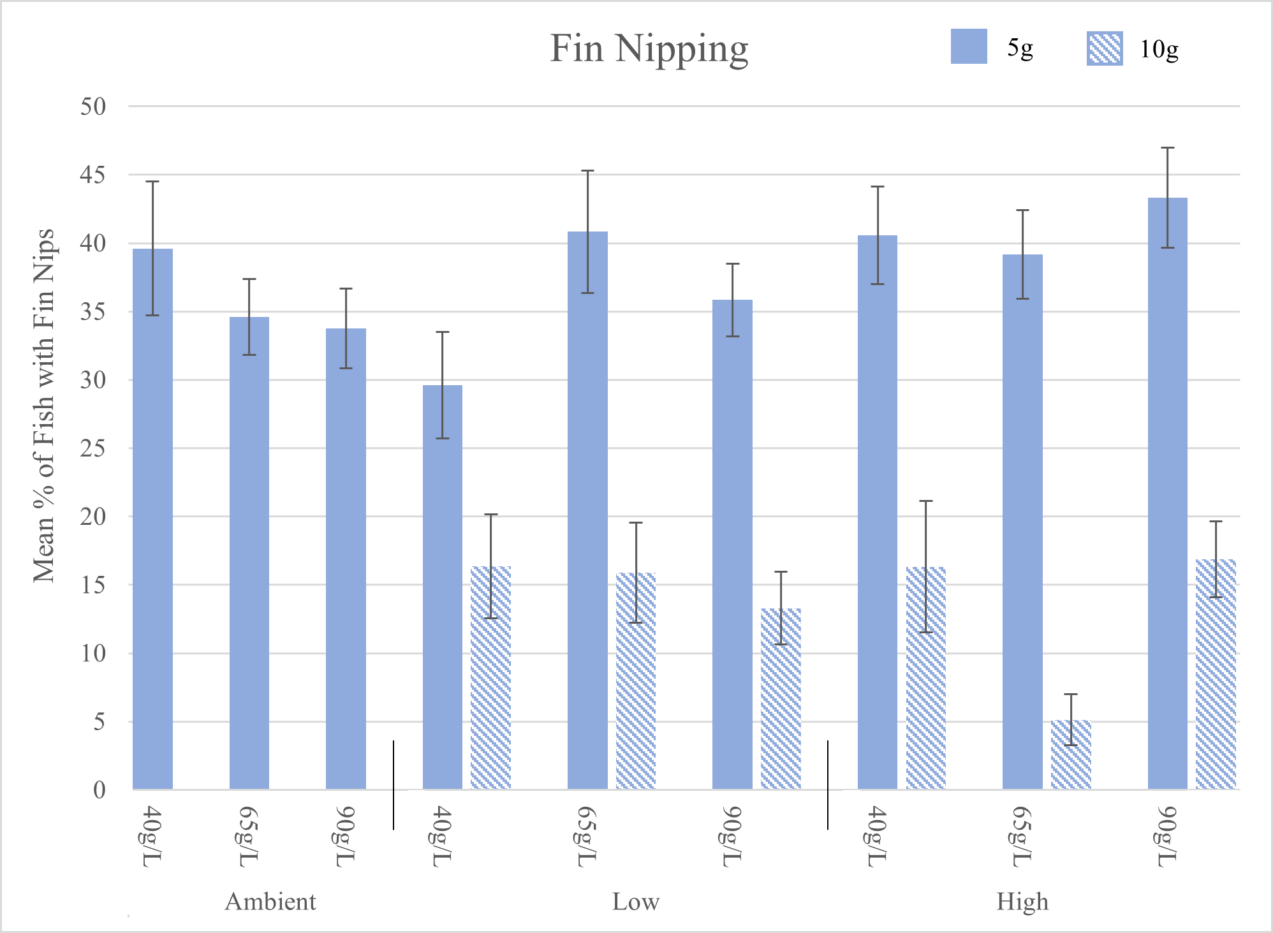
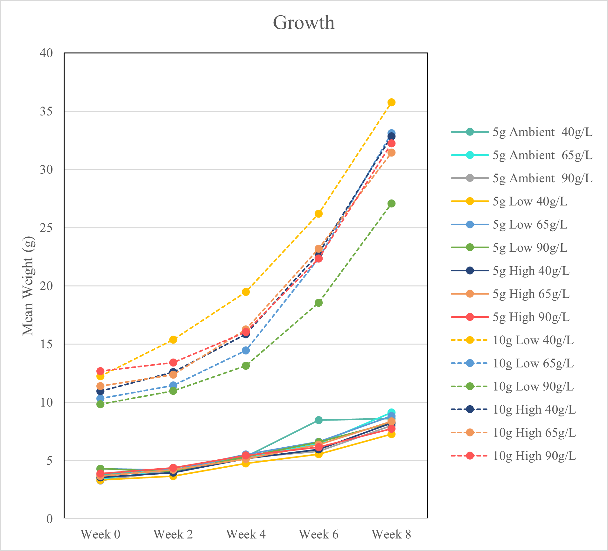
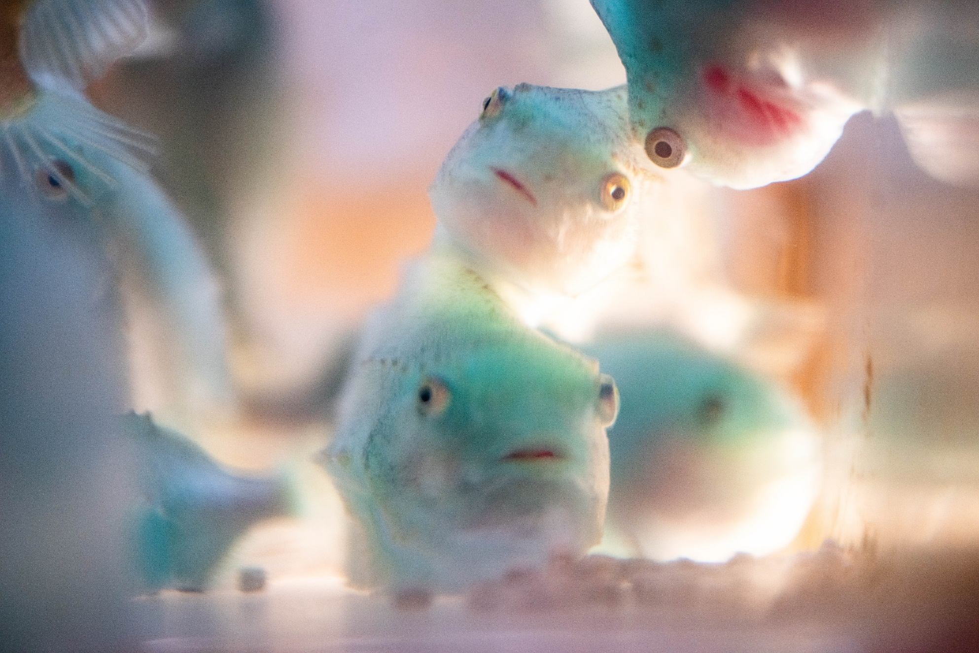
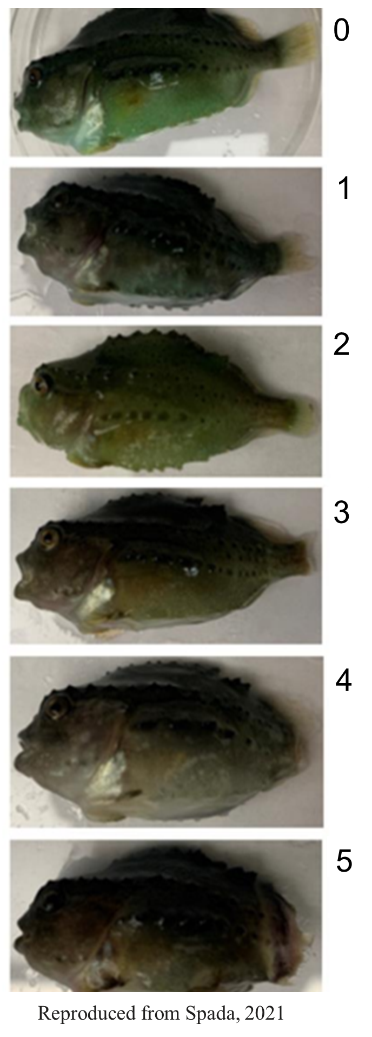
THE EFFECTS OF FISH SIZE, STOCKING DENSITY,
AND PHOTOPERIOD ON JUVENILE LUMPFISH AGGRESSION
Shelby A. Perry and Elizabeth A. Fairchild
shelby.perry@unh.edu
University of New Hampshire, Department of Biological Sciences
Introduction
Materials and Methods
Results and Conclusions
Today in the salmonid aquaculture industry, lumpfish (Cyclopterus lumpus) currently are the most commonly used cleanerfish [1]. Since the emergence of promising data showcasing the lumpfish’s ability to effectively delouse salmon in sea pens [2-7], the demand for lumpfish has risen exponentially [1]. Lumpfish are reared untill they reach roughly 25 grams, upon which, they are implemented into salmonid pens. It is during this young juvenile period that cannibalism occurs. From observations during the 2019 and 2020 lumpfish rearing seasons at the University of New Hampshire Coastal Marine Laboratory (CML), this seemed to be a finite phase occurring when the fish were roughly 5g. Size grading the fish regularly is a standard protocol that hatcheries use to minimize cannibalism in lumpfish; however, despite this frequent and labor-intensive process, cannibalism persists and poses one of the largest causes of mortality in the hatchery. We question whether there are confounding stressors that contribute to cannibalism [8] and, if understood better, could be controlled to minimize fish loss.
Experimental Design:
Treatments include fish size (5g and 10g), stocking density (L=40g/L, M=65g/L, and H=90g/L), and photoperiod (ambient, low constant light, and high intensity constant light). A total of three replicates were used. The number of fish used for 5g treatments were as follows: 518 ambient 5g fish, 437 low constant 5g fish, and 472 high intensity 5g fish. For 10g fish, 161 fish were used in the low constant treatment and 140 fish for the high intensity treatment.
Fin nipping is greater in 5g fish than 10g fish in both low and high lighting regimes.
Growing 5g fish in low constant light at 40g/L may reduce fin nipping, but data have not been analyzed yet.
There appears to be little effect of photoperiod and stocking density on growth of 5g fish.
Photoperiod and stocking density may affect growth of 10g fish, with lower stocking densities allowing for greater growth especially when subjected to low light.
Fin Nipping Index
Sampling:
All fish were sampled biweekly for growth (wet weight, nearest 0.1 g) and aggression. In tanks that housed 5g fish, a subsample of the population (20 fish) was taken to approximate tank growth, whereas, in 10g fish tanks, all fish in each tank were sampled individually.
Fish Aggression:
Fish aggression was tabulated using a scale from 0 to 5, with 0 representing a fish with an undamaged caudal fin, and 5, a fish with severe damage to the caudal peduncle [9].
Tim Briggs/NH Sea Grant
Objectives
Tim Briggs/NH Sea Grant
Acknowledgements
Thank you to everyone at the Coastal Marine Laboratory, especially Nathan Rennels, Lily Wong, Danielle Danis, and Samantha Brady. This research is funded by the New Hampshire Agricultural Experiment Station.
We aim to assess stressors that could impact aggression, and in turn cannibalism, in lumpfish reared intensively under varying size classes, stocking densities, and photoperiods.
Hypothesis: Cannibalism occurs only during a specific ontogenetic period during intensive lumpfish rearing and can be exacerbated by additional stressors including fish density and photoperiod/light intensity.
.
References
Powell, A., J. W. Treasurer, C. L. Pooley, A. J. Keay, R. Lloyd, A. K. Imsland, and C. Garcia de Leaniz. (2017). Use of lumpfish for sea-lice control in salmon farming: challenges and opportunities. Reviews in Aquaculture 0: 1–20. doi: 10.1111/raq.12194
Imsland, A. K., P. Reynolds, G. Eliassen, T. A. Hangstad, A. Foss, E. Vikingstad, and T. A. Elvegård. (2014a). The use of lumpfish (Cyclopterus lumpus L.) to control sea lice (Lepeophtheirus salmonis Krøyer) infestations in intensively farmed Atlantic salmon (Salmo salar L.). Aquaculture 424–425: 18–23.
Imsland, A. K., P. Reynolds, G. Eliassen, T. A. Hangstad, A. V. Nytrø, A. Foss, E. Vikingstad, and T. A. Elvegård. (2014b). Assessment of growth and sea lice infection levels in Atlantic salmon stocked in small-scale cages with lumpfish. Aquaculture 433: 137-142.
Imsland, A. K., P. Reynolds, G. Eliassen, T. A. Hangstad, A. V. Nytrø, A. Foss, E. Vikingstad, and T. A. Elvegård. (2014c). Notes on the behaviour of lumpfish in sea pens with and without Atlantic salmon present. Journal of Ethology 32(2): 117–122.
Imsland, A. K., P. Reynolds, G. Eliassen, T. A. Hangstad, A. V. Nytrø, A. Foss, E. Vikingstad, and T. A. Elvegård. (2015a). Assessment of suitable substrates for lumpfish in sea pens. Aquaculture International 23: 639–645.
Imsland, A. K., P. Reynolds, G. Eliassen, T. A. Hangstad, A. V. Nytrø, A. Foss, E. Vikingstad, and T. A. Elvegård. (2015b). Feeding preferences of lumpfish (Cyclopterus lumpus L.) maintained in open net-pens with Atlantic salmon (Salmo salar L.). Aquaculture 436: 47-51.
Imsland, A.K.D., A. Hanssen, A. V. Nytrø, P. Reynolds, T. M. Jonassen, T. A. Hangstad, T. A. Elvegård, T. C. Urskog, and B. Mikalsen. (2018). It works! Lumpfish can significantly lower sea lice infestation in large-scale salmon farming. Biology open, 7(9), p.bio036301.
Pereira, L. S., A. A. Agostinho, and K. O. Winemiller. (2017). Revisting cannibalism in fishes. Rev Fish Bio Fisheries 27(3): 1-15. doi:10.1007/s11160-017-9469-y
Spada, N. N. (2021). Improving larval and juvenile lumpfish, Cyclopterus lumpus, aquaculture: nutrition and growing conditions. Master’s Thesis, Dept. of Biological Sciences, University of New Hampshire, Durham, NH, 133 p.

