Slide 1

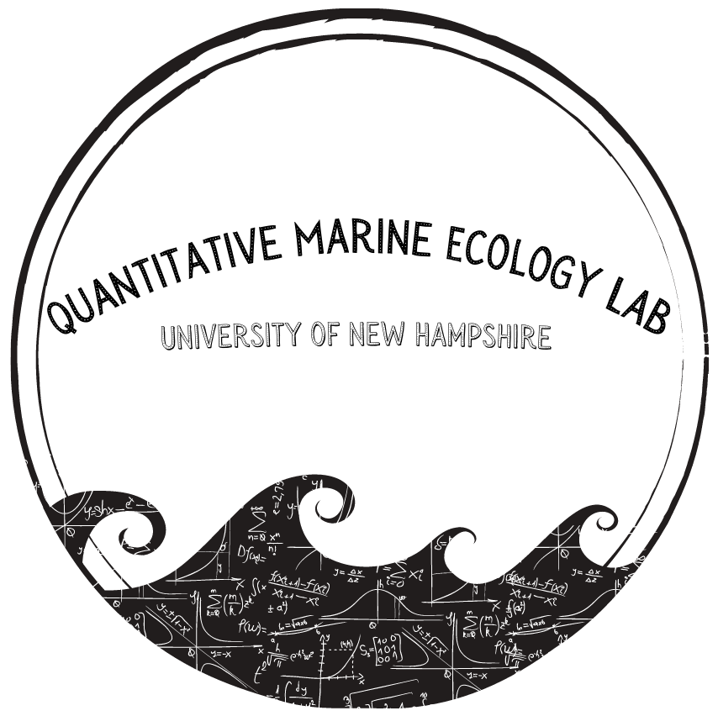
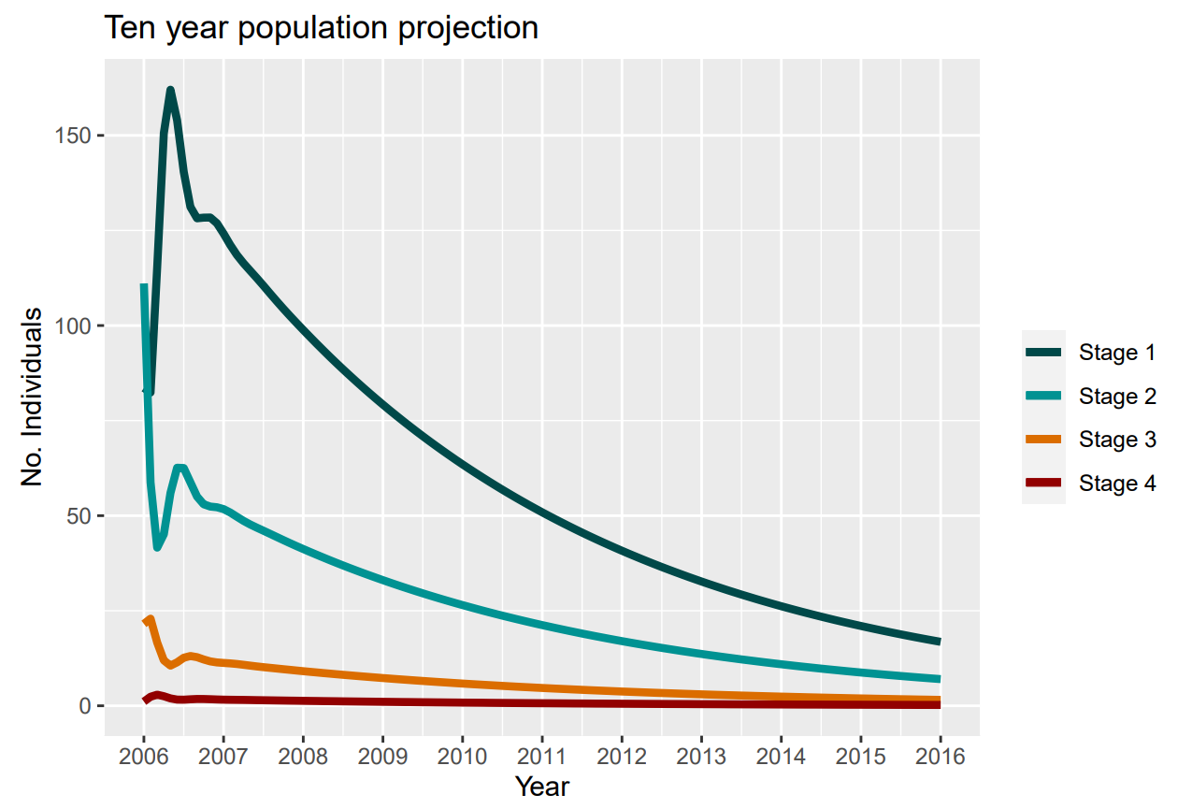
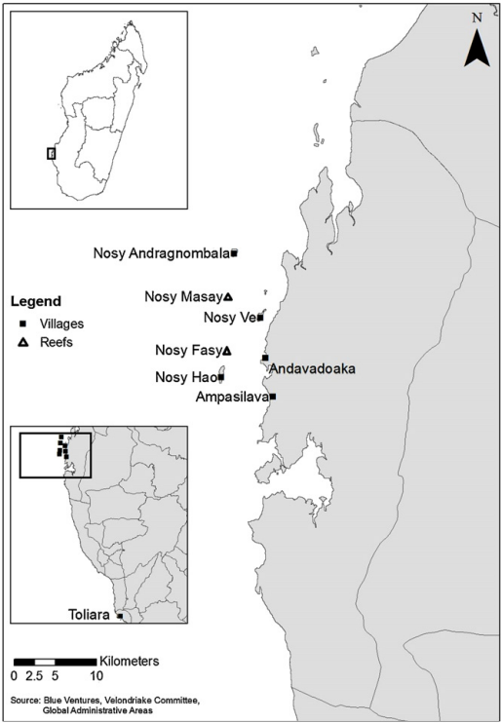

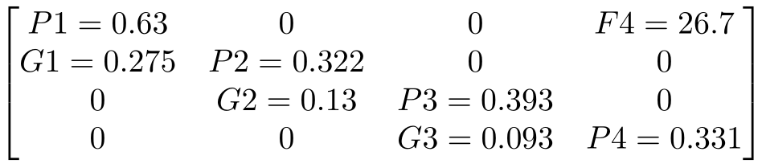

The effects of urbanization and industry on cephalopod population dynamics
Sophie Wulfing, Easton R. White
sophiewulfing@unh.edu
Quantitative Marine Ecology Lab
University of New Hampshire, Department of Biological Sciences
Introduction
Methods
Increased urbanization in Madagascar has led to higher fishing pressure which has in turn resulted in a decline in fish catch and biomass.
In the early 2000’s, international export markets began to transform the fishery from subsistence to industrial harvest., Cephalopods have become the largest class of exports (Benbow et al., 2014; Humber et al., 2006)., leading to decreased catch.
Very few population modeling studies have been conducted on the cephalopod population of Madagascar. This project aims to understand how the region’s blue octopus community dynamics act under different levels of harvest and protection.
We used Wood’s Quadratic Programming Method (Caswell 2001) to estimate our parameters for a stage-based Lefkovitch matrix population model from data collected in Raberinary and Benbow 2012.
F₄
Stage 1
G₁
Stage 2
G₂
Stage 3
G₃
Stage 4
P₁
P₂
P₃
P₄
Figure 2: Visualization of matrix model. Here, the population of grey octopus is split into four distinct life stages: Stage 1 immature, Stage 2 incipient maturity, Stage 3 mature, and Stage 4 fully mature (Raberinary and Benbow, 2012). Only fully mature individuals reproduce, resulting in only one fecundity parameter (F)
Figure 4: Octopus cyanea population projection calculated by multiplying our population matrix by a population vector. Each multiplication represents a month-long timestep
Results
Conclusions and Further Directions
Figure 1: Map of the data collection region in Southwestern Madagascar from Raberinary and Benbow 2012
The dominant and population projection (Figure 4) indicate a gradual decline of the blue octopus's population in Southern Madagascar
The result of sensitivity analysis will indicate how heavily the growth rate will respond to changes to each parameter of the matrix. This will allow us to identify the groups within this population whose protection will most benefit population growth, essentially creating focus points of conservation.
We will use this model to analyze how different amounts of fishing pressure will affect cephalopod population dynamics.
We hope to use this research to better inform what the best management scenarios are for this population and to implement fishing practices that both maintains healthy cephalopod population stocks and supports the local fishing community.
Figure 3: Stage-based population matrix model with parameters calculated from Raberinary and Benbow, 2012
From our matrix (Figure 3), we calculated a dominant eigenvalue of 0.982 and an average reproductive output of 1.756
Stage Class | Stable Stage Distribution (Dominant eigenvector) | Reproductive Value (Left eigenvector)
1 Immature | 0.657 | 1
2 Incipient Maturity | 0.274 | 1.279
3 Mature | 0.061 | 6.491
4 Fully Mature | 0.009 | 41.029
Objectives
Investigate annual spawning patterns of these communities
Determine the optimal time and duration of fishing limits
Explore how Madagascar’s cephalopod populations will react to various environmental conditions, with potential to add a spatial component to our model
Acknowledgements
Thank you to Easton White for his support on this project, as well as the University of New Hampshire’s Department of Biological Sciences for this research opportunity . A big thank you to the members of our Quantitative Marine Ecology Lab for their continued support and help on this project.
Table 1: Stable stage distribution and reproductive value of each stage of our blue octopus population

