Slide 1
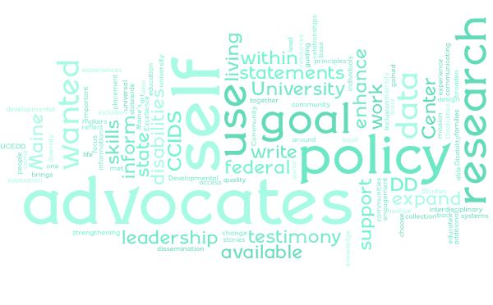
Eliminating Planned Adult Restraints: Providing Alternatives
Monique Stairs, Bachelor of Liberal Studies, Management Minor
Background- Leadership Placement Partner
The University of Maine Center for Community Inclusion and Disability Studies (CCIDS) is Maine’s University Center for Excellence in Developmental Disabilities (UCEDD). CCIDS brings together the resources of the university and Maine communities to enhance the quality of life for individuals with developmental disabilities and their families. Their statewide mission is met through interdisciplinary education, research and evaluation, community engagement, and dissemination of state-of-the-art information that reflect the guiding principles of inclusion, diversity, universal design and access, and social justice.
Goals of Leadership Project
Goal # 1 I came into my leadership placement with the goal of strengthening my skills around systems change through policy work. I wanted to be able to use data and research to back up the experiences and stories of people living with disabilities. I also wanted to expand my experience of communicating with federal level policy makers and diversify and expand relationships to broaden my policy base through local, state and federal policy.
Goal #2 I had the additional goal to use the knowledge and skills I gained from data and research collection to educate and enhance the testimony of self-advocates. I wanted to choose one issue that is important to self-advocates to focus my leadership learnings on and support self-advocates to write their own testimony/position statements with data points.
Project Activities
Extensive search of available research regarding the use of restraints in adults living with I/DD and the alternative options available to use rather than restraint.
Meetings with the Coalition Against Adult Restraint to coordinate.
Educating self-advocates about the Behavior Management Regulations.
Working collaboratively across the disability network to strategize, inform, support, and prepare self-advocates.
Assisting self-advocates and family members to write their statements.
Shared Research articles I found within the DD Network and within stakeholder groups to inform policy work.
Wrote a statement to share on the OADS listening session.
Milestones of Project Timeline
Educated Self-Advocates on Restraint in October
Researched Restraint & Trauma Link
Behavior Regulations OADS Listening Sessions
Organized & Educated Self-Advocates
Supported Self-Advocates on position statements
Outcomes
Self-advocates participated in the OADS listening sessions and advocated for the elimination of restraints.
Research articles I collected were shared within the disability network and shared with policy makers at DHHS, OADS during listening sessions. These articles are now being cited and used to make changes within Maine’s system of care, especially in looking at adopting a Trauma Informed Care Model.
Self-advocates learned how systems change works and how powerful their voices are collectively.
OADS has agreed to hire and expert to assist in the phase out and elimination of the use of restraints in Maine.
OADS Listening Sessions
The Department of Health and Human Services, Office of Aging and Disability Services announced they would be hosting three virtual listening sessions on 14-197 C.M.R. Chapter 5, Regulations Governing Behavioral Support, Modification and Management for People with Intellectual Disabilities or Autism in Maine. The goal of the virtual listening sessions is to gather input on the current rule which can be found here.
These listening sessions presented an opportunity to advocate for the elimination of planned restraints for adults receiving services.

